Slide 1
Nursery Landsacpe CDE
Study PowerPoint
Central Region
Area – Junior
2015

Slide 2
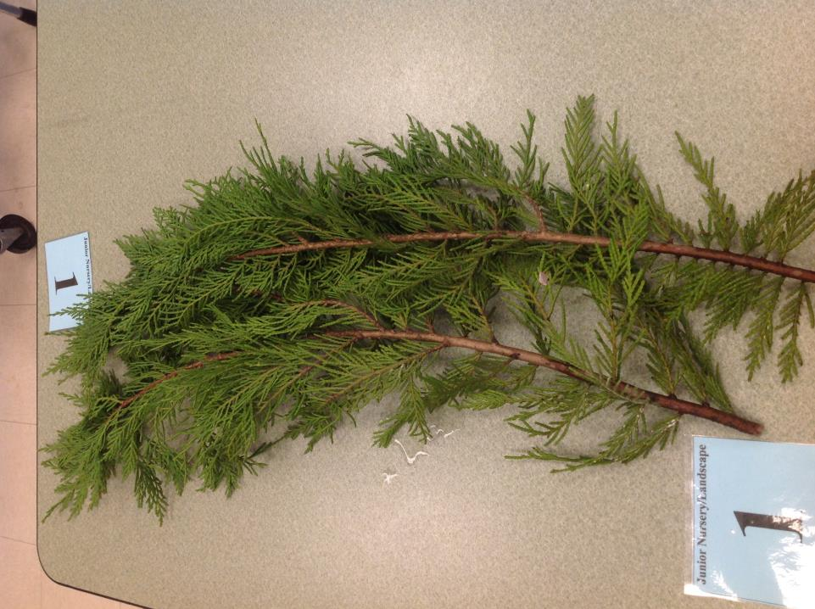
Leyland Cypress

Slide 3
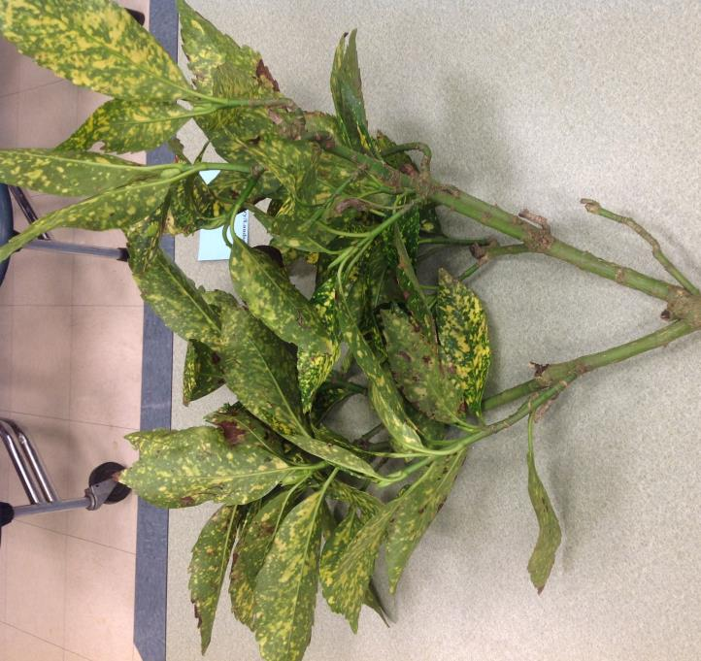
Japanese Aucuba

Slide 4
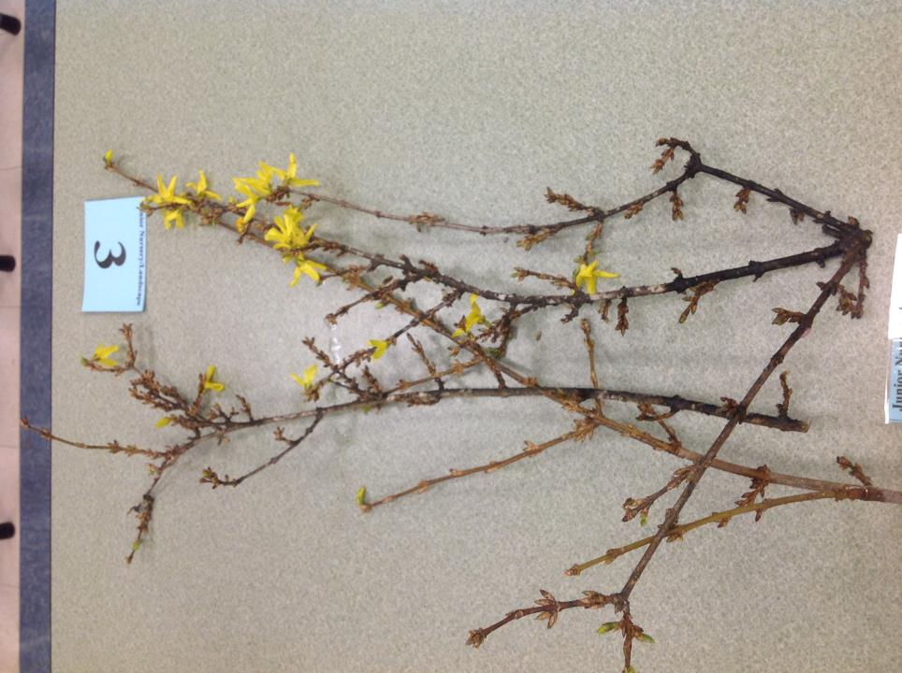
Border Forsythia

Slide 5
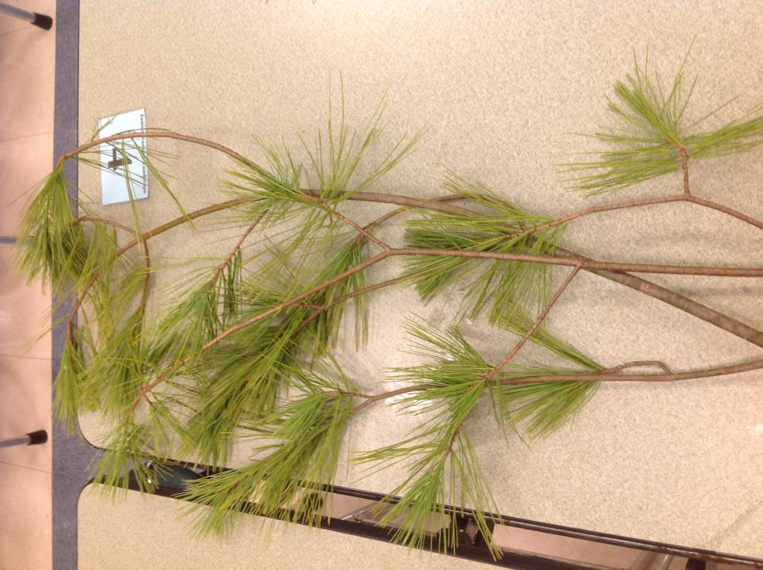
White Pine

Slide 6
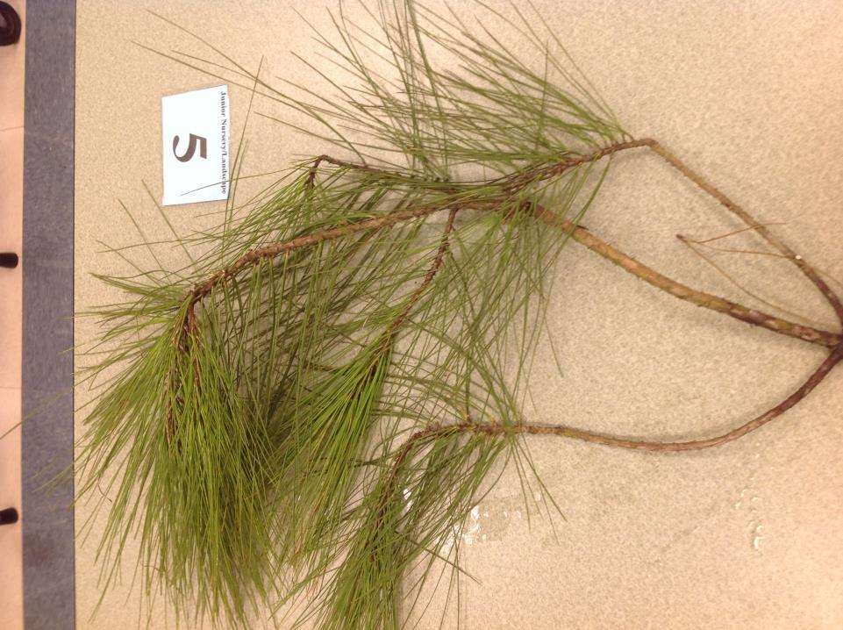
Loblolly Pine

Slide 7
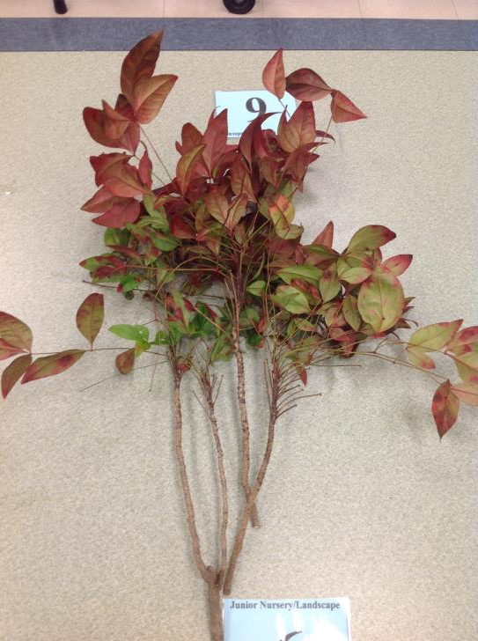
Dwarf Nandina

Slide 8
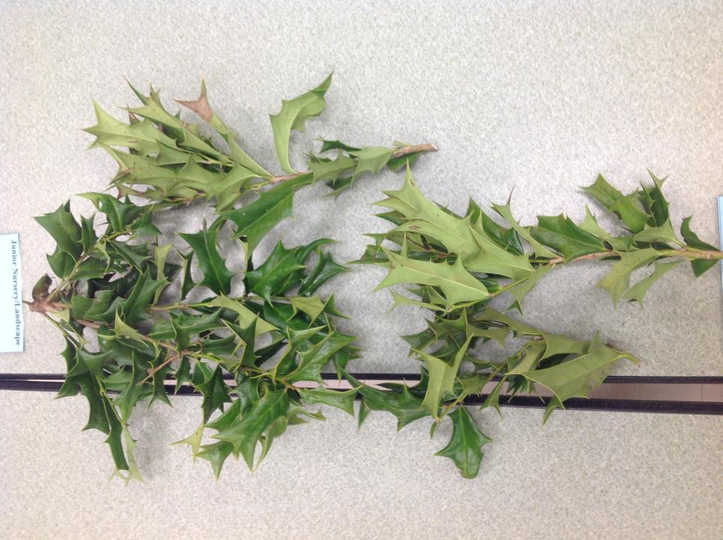
Chinese Holly

Slide 9
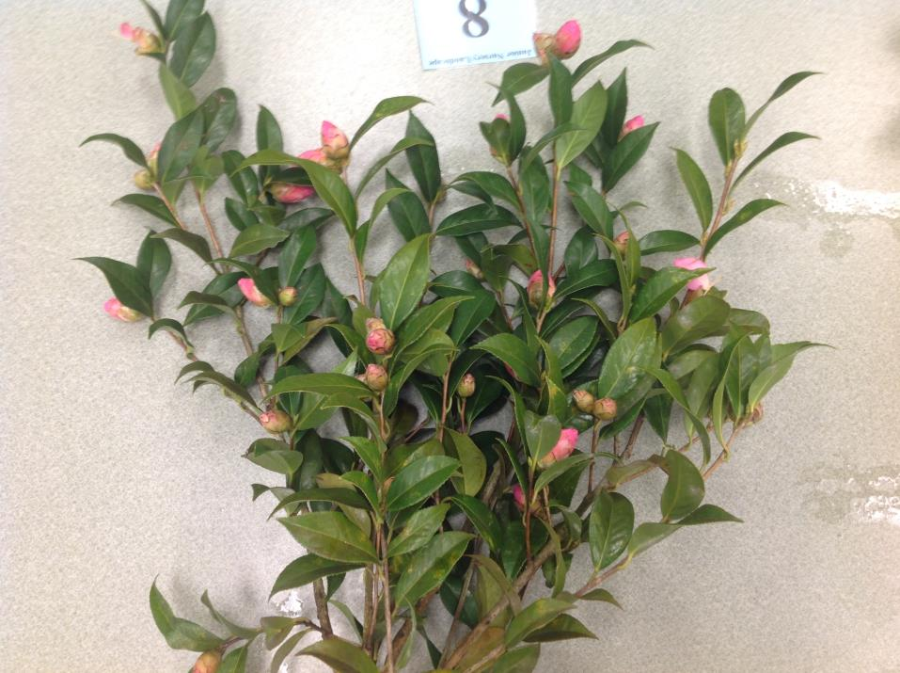
Camellia

Slide 10
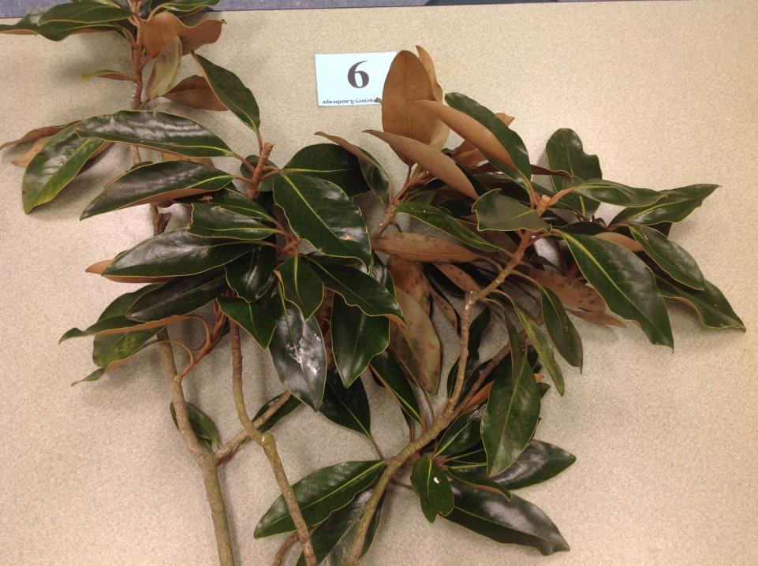
Southern Magnolia

Slide 11
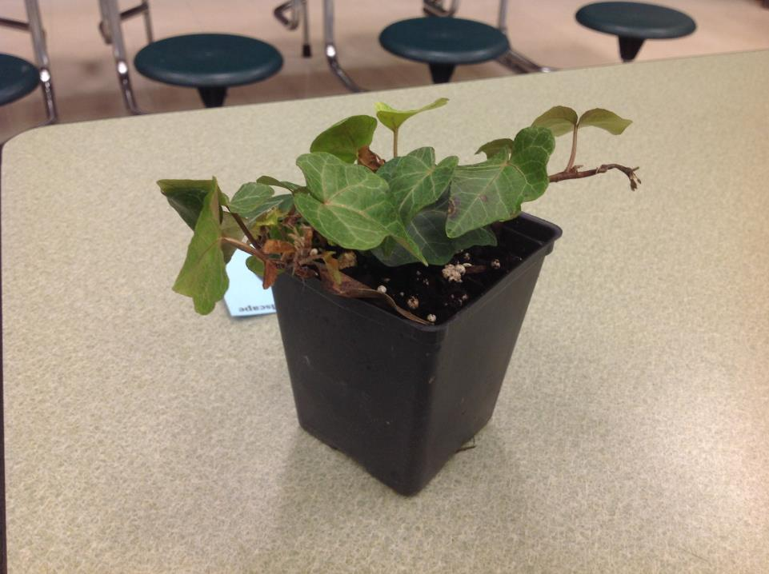
English Ivy

Slide 12
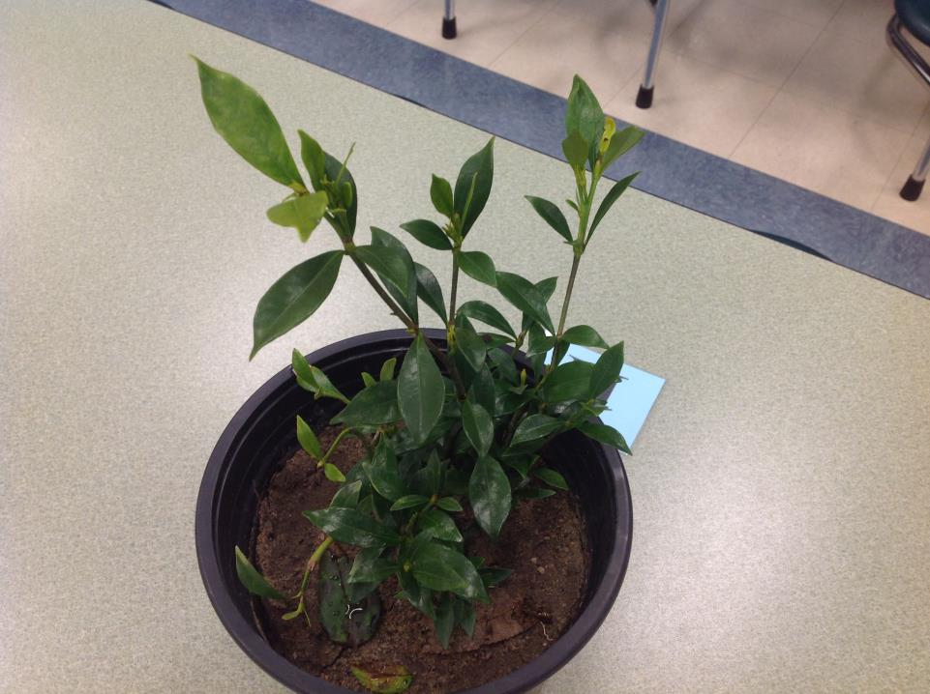
Gardenia

Slide 13
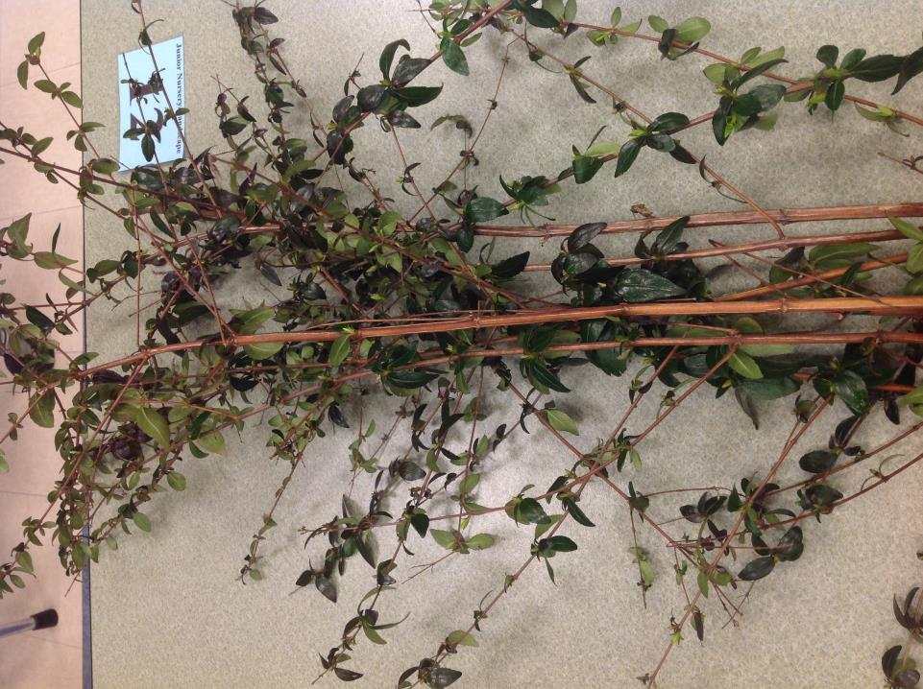
Glossy Abelia

Slide 14
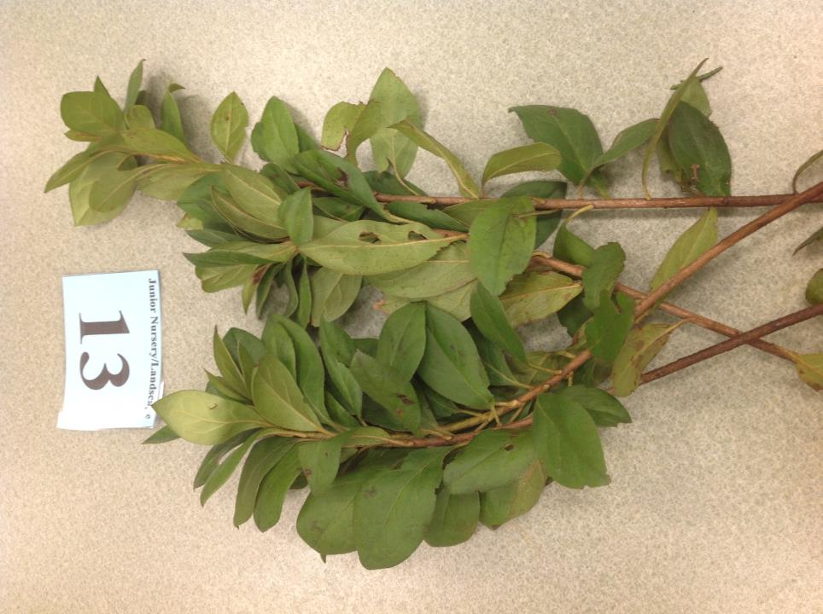
Indica Azalea

Slide 15
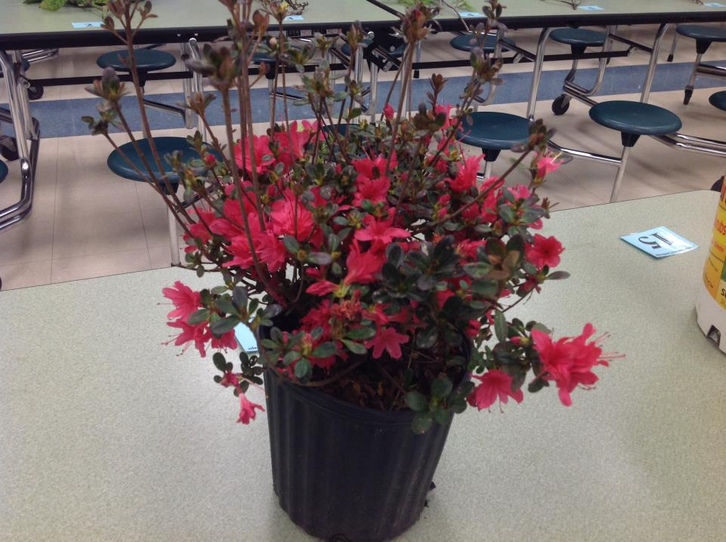
Kurume Azalea

Slide 16
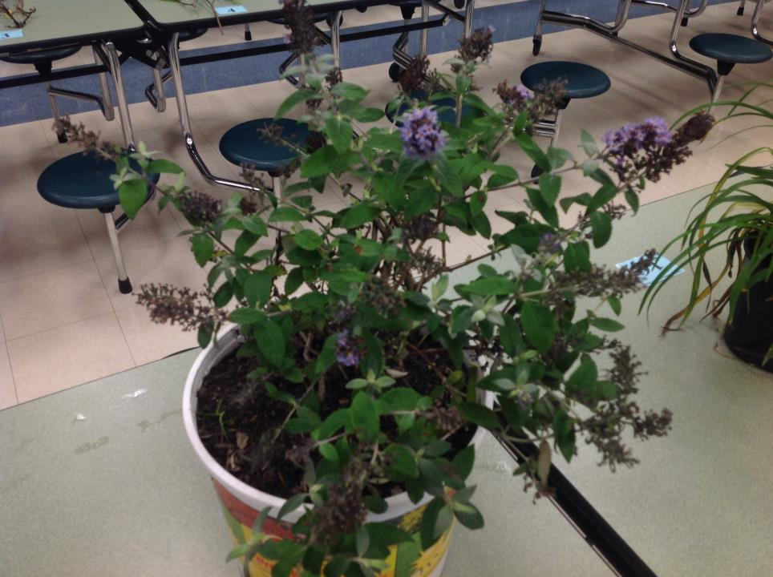
Butterfly Bush

Slide 17
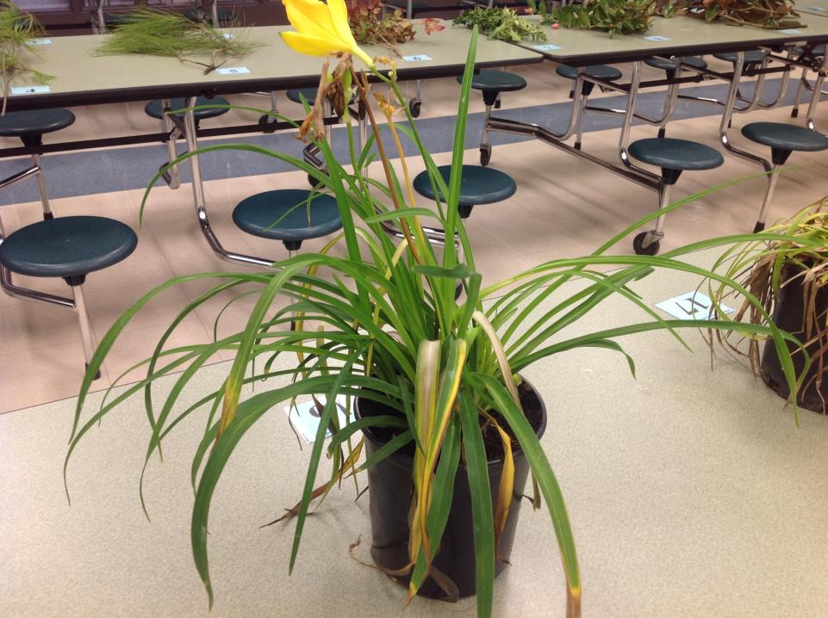
Daylily

Slide 18
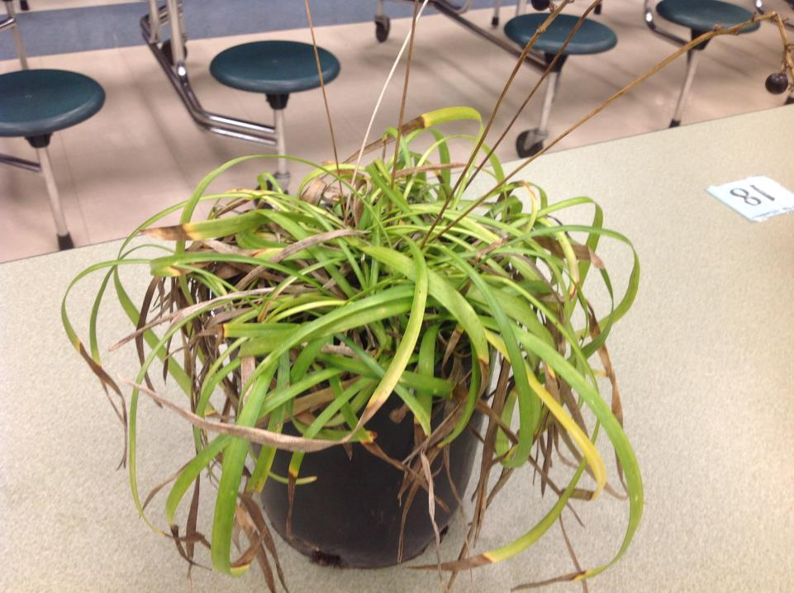
Liriope

Slide 19
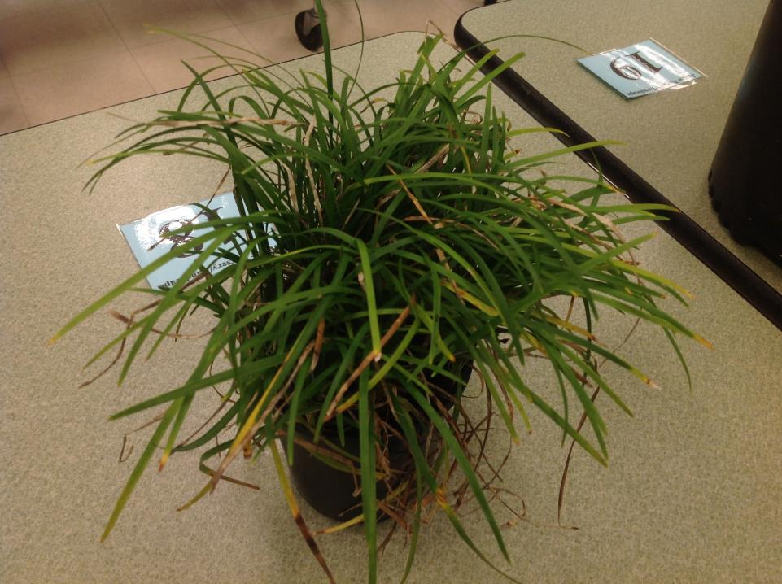
Mondo Grass

Slide 20
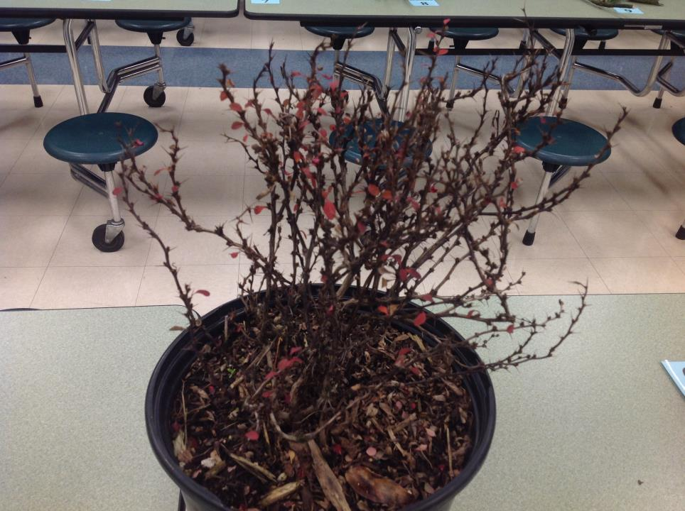
Japanese Barberry

Slide 21
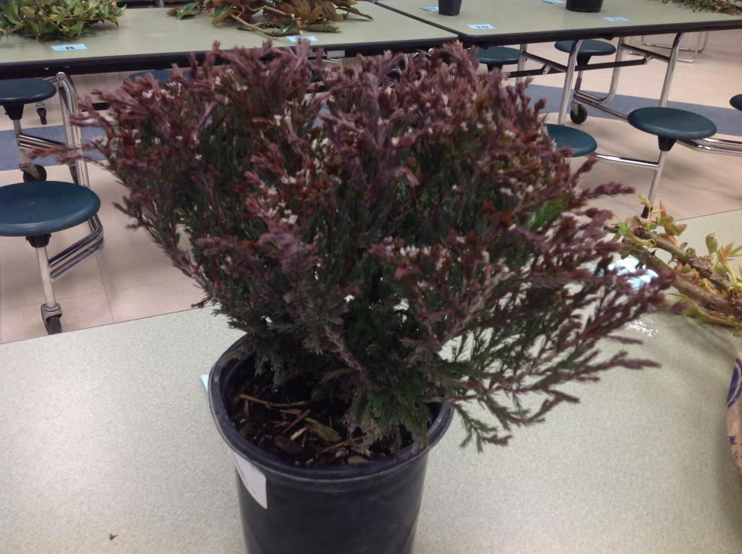
Andorra Juniper

Slide 22
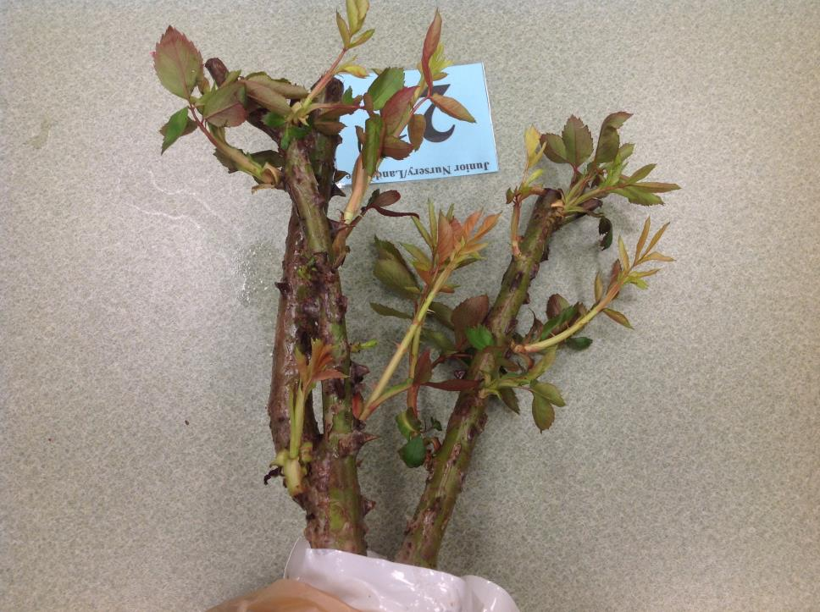
Hybrid Tea Rose

Slide 23
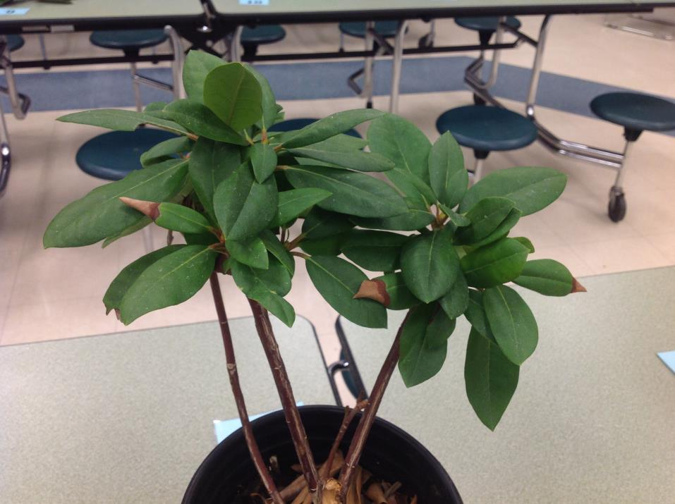
Rhododendron

Slide 24
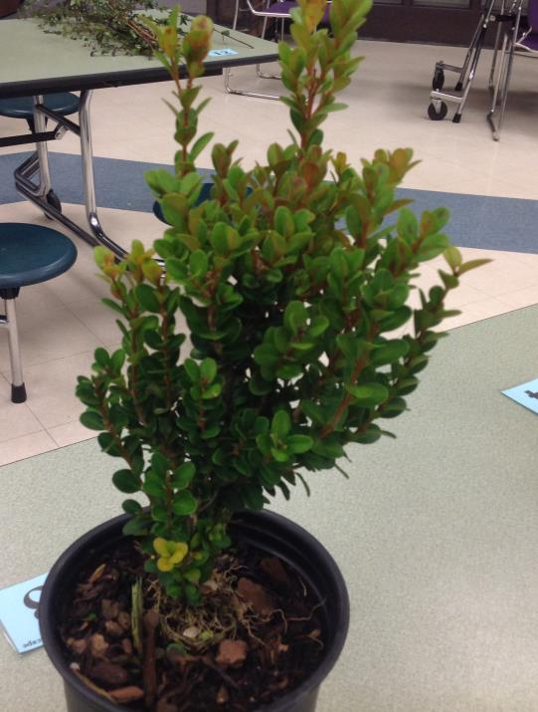
Boxwood

Slide 25
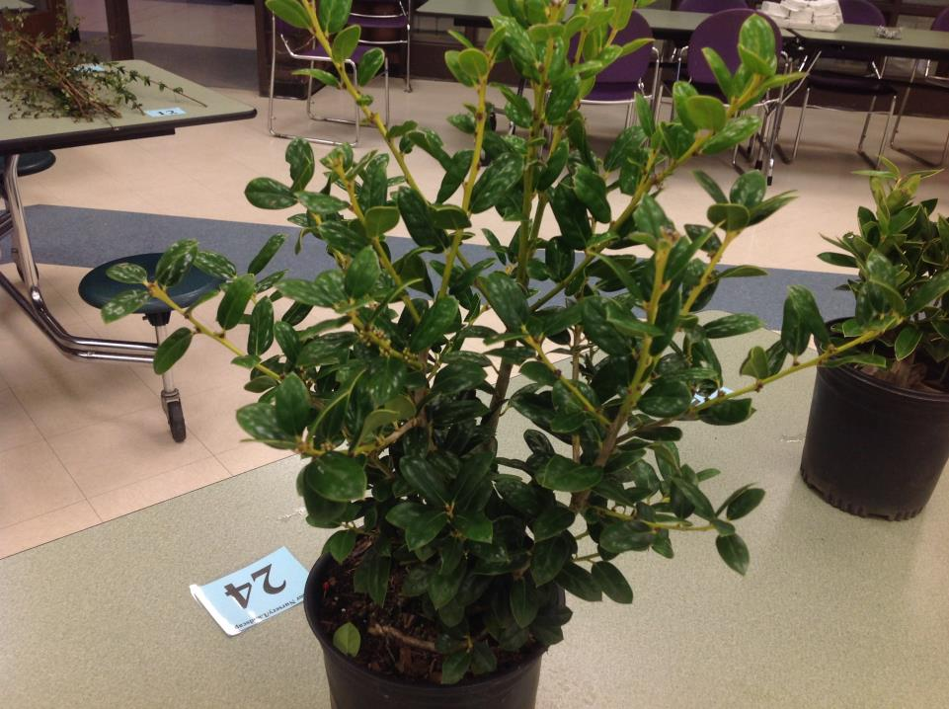
Dwarf Burford Holly

Slide 26
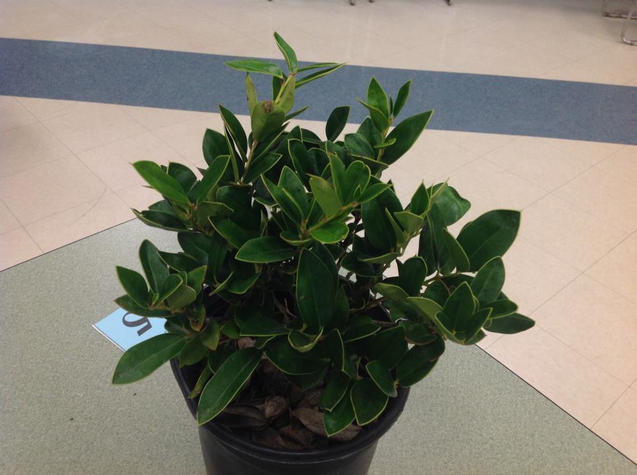
Carissa Holly

