Slide 1
Ohm’s Law
Determining Watts, Amperes and Power Factors using Ohm’s Law
S. Bell
Georgia Agricultural Education

Slide 2
The first step in developing an understanding of Ohm’s Law and how to use it for making electrical calculations is to develop a basic understanding of electrical terms and symbols used in Ohm’s Law.

Slide 3
Voltage – the difference in electrical potential energy between two points per unit electric charge. Simply, it is a pressure that pushes charged electrons through an electrical circuit. Almost all voltage in residential construction in the United States will be 120/240 volts. Often represented by the letter E for electromotive force.
Voltage is “Nominal”; it may be more or less than 120 V depending upon a variety of factors but mainly ambient temperature and length or distance to the outlet or access point from the source.

Slide 4
Amperage – This is the strength of an electrical current, often referred as an amp. Over current devices such as breakers or fuses and wire sizing are all based on the amperage of a circuit. 100 to 200-amp main electrical service panels are common sizes in residential construction and 15 or 20-amp branch circuits are common for lighting and plug loads. Current is represented by the letter I for Intensity. 1 Amp = 6.28 Quintillion electrons passing a given point/second

Slide 5
Resistance – a measure of the difficulty to pass an electrical current through a conductor. The concept is similar to friction and is measured in ohms. Resistance isn’t a very common measurement use when determining energy use but is used when sizing electrical conductors or service equipment. These are calculations that we do not usually do, but it does help one to understand why larger conductors are better capable of handling larger loads and carrying current longer distances. Resistance is represented by the letter R.

Slide 6
Wattage – Wattage is defined as the rate of doing work and is represented by the letter P. Wattage is the measurement of how electricity is billed and is the most useful electrical information to an energy auditor. Electricity is billed at a kilowatt hour, or 1000 watts used in an hour.
Also referred to as Volt-Amps –VA
(Assuming the Power Factor is 1)
NEC requires a minimum of 180 VA/receptacle

Slide 7
Ohm’s law states that the current through a conductor between two points is directly proportional to the voltage across the two points. Where I is the current through the conductors in units of amperes, E is the voltage measured across the conductors in units of volts, and R is the resistance of the conductors in units of ohms. P symbolizes power, measured in watts. The formulas below represent the equations that are Ohm’s law:
E/I=R E/R=I IxR=E P/I=E P/E=I IxE=P

Slide 8
Ohm’s Law
BIG PICTURE
UNITS OF MEASURE
P
POWER
(WATTS)
W
WATTS
(POWER)
I
CURRENT
(AMPS)
E
VOLTAGE
(VOLTS)
A
AMPS
(CURRENT)
V
VOLTS
(VOLTAGE)

Slide 9
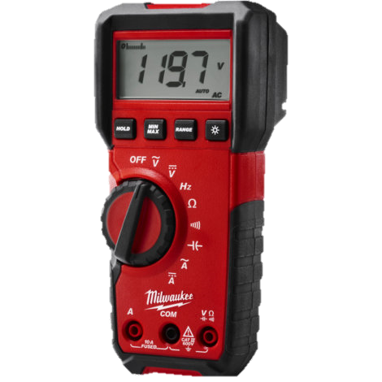
Nominal Voltage
Grounded or “Neutral” conductor side
Ungrounded or “Hot” conductor side

Slide 10
Single Phase, 240 V Nominal
120V phase “A”
240
120V phase “B”

Slide 11
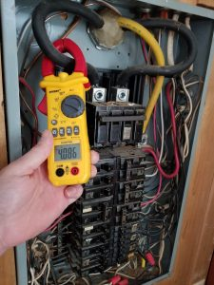
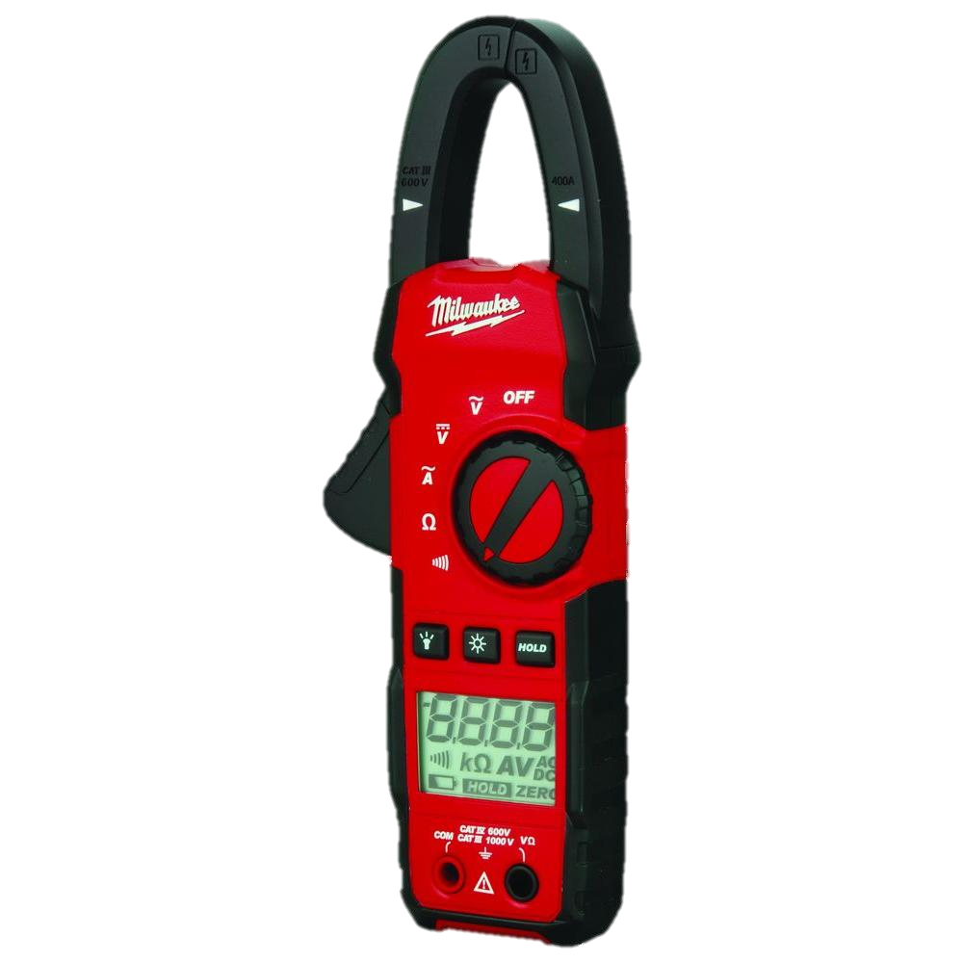

Slide 12
All electrical devices and appliances are required to have electrical information printed somewhere on the product. The photo below shows one of these tags.

Slide 13
This appliance nameplate happens to be a toaster oven. The tag states the oven operates at 120 volts at 60 Hertz (Hertz is the frequency of power, or how many times per second alternating power completes one cycle, all power in the United States operates at 60 Hertz). The power consumption of the toaster oven is 1,300 watts. Knowing the appliance operates at 120 volts and uses 1,300 watts, we can use ohms law to calculate how many amps it draws, useful for determining correct circuit breaker and wire sizing, or the resistance of the product.

Slide 14
Watts = 1,300
Volts = 120
Amperes = ?
W = V x A
W
WATTS
(POWER)
A
AMPS
(CURRENT)
V
VOLTS
(VOLTAGE)
1,300 W = 120V x A
120V 120V
1,300 ÷ 120V = 10.83 Amperes

Slide 15
What happens to the load on the toaster oven circuit if, due to voltage drop, I have only 110 volts at my receptacle?
Watts = 1,300
Volts = 110
Amperes = ?
W = V x A
1,300 W = 110V x A
110V 110V
1,300 ÷ 110V = 11.81 Amperes

Slide 16
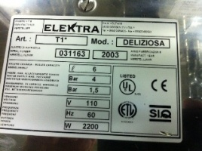
Let’s calculate the load in Amperes for a coffee maker.
Watts = 2,200
Volts = 110 (Rated)
Amperes = ?
W = V x A
2,200 W = 110V x A
110V 110V
2,200 ÷ 110V = 20 Amperes

Slide 17
Great! Let’s make breakfast using our toaster oven and coffee maker!
Lets say we have used our multimeter to measure the voltage on our kitchen circuit and we have 117 V

Slide 18
Toaster Oven
Watts = 1,300
Volts = 117
Amperes = ?
W = V x A
1,300 W = 117 V x A
117V 117 V
Coffee Maker
Watts = 2,200
Volts = 117
Amperes = ?
W = V x A
2,200 W = 117 V x A
117V 117 V
1,300 ÷ 117V = 11.11 Amperes
2,200 ÷ 117 V = 18.8 Amperes

Slide 19
What is the total Load on our circuit?
11.11 amp toaster + 18.8 amp coffee maker =
Too much for a single 20 amp small appliance circuit!
This is why the National Electrical Code requires that all kitchens be served by a minimum of 2 – small appliance circuits! NEC 210.11(C)
29.9 amps!

Slide 20
Let’s determine the Ohm’s of resistance.
P
POWER
(WATTS)
From our toaster oven nameplate
P = Watts = 1,300 W
I = Intensity of Current = Amperes or Amps = ?
E = Electromotive force = Volts = 120 V
I
CURRENT
(AMPS)
E
VOLTAGE
(VOLTS)

Slide 21
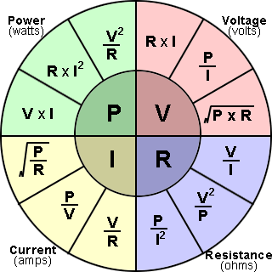
From our name plate we know…..
Watts = 1,300
Volts = 120
Resistance = ?
Therefore,
Looks like we have some work to do!
V²
P
R =

Slide 22
From our name plate we know…..
Watts (P) = 1,300
Volts = 120
V²
P
R =
R = 120² ÷ 1,300 Watts
R = 14,400 ÷ 1,300 Watts = 11.076923 Ohm’s

Slide 23
What’s That Mean?

Slide 24
Resistance rating
Higher numbers indicate a higher resistance rating, which means more energy will be required to integrate the component in a circuit. Pretty typical for any type of appliance with a heating element like a toaster oven, range, coffee maker etc.
Also means an insulator would need to be capable of providing that amount of resistance to protect from electrical shock.

Slide 25
Test resistance in a circuit when it is unpowered. In other words, don't connect the circuit to a power supply when using your ohmmeter. Doing so could damage your digital ohmmeter or invalidate your resistance reading.
The lower the number, the lower the resistance and the better the conductor. Ground rod readings should be very low if not “0”

Slide 26
Get a digital multimeter and set it to measure resistance in Ohm’s, . Place one of the leads on each end of a length of copper conductor to measure resistance. Try different lengths and different AWG sizes of conductors and discuss the difference and what it means.
Ʊ

Slide 27
Review
What does the letter P represent?
W
P = Watts or Power = Work
What does the letter I represent?
A
I = Amperage or Intensity of Current
What does the letter E represent?
V
E = Volts or Electromotive Force = Pressure

Slide 28
Let’s calculate the load for a bathroom circuit based on two hair dryer’s operating at the same time.
What is the load in amperes for one,120 V hair dryer rated at 1,900 watts?
W = V x A
1,900 Watts = 120 V x A
120 V 120 V
A = 15.8

Slide 29
Can 2 hair dryers be used at the same time on a 20 amp bathroom circuit in Homemakers Cabin at the State FFA/FCCLA Center?
NO
!!!

Slide 30
Here’s a problem for all of the livestock show people out there. Get the nameplate rating of a livestock blower/dryer, and a set large animal clippers. Get the information from the name plate and determine the load in amperes for each device separately. If both of the devices are in use on the same circuit at the same time, what is the total load on the circuit?

Slide 31
Blower = 2040 Watts @ 120 V
Large animal clippers = 240 Watts @ 120 V
W = V x A
Blower - 2040 Watts = 120 V x A
120 V 120 V
Livestock Blower Load in Amperes = 17

Slide 32
Large Animal Livestock Clippers = 240 Watts @ 120 V
W = V x A
Clippers - 240 Watts = 120 V x A
120 V 120 V
Clippers Load in Amperes = 2

Slide 33
What is the total load on the circuit if both devices are used simultaneously at the same receptacle?
Livestock Blower Load in Amperes = 17
Clippers Load in Amperes = 2
Total Load in Amperes = 19
Will a 20 amp, circuit handle the total load of the livestock blower and the clippers at the same time?

Slide 34
For how long????????
What is your experience with running blowers and clippers at the same time?
What do you think is happening in the circuit to cause breakers to trip if the blower and clippers used matched the load rating in this problem?

Slide 35
Greenhouse Fan Disconnect
Three Phase Formulas
Watts
Amperes =
_______________________
1.732 x Volts x Power Factor
Watts = 1.732 x Volts x Amperes x Power Factor
Volt-Amperes = 1.732 x Volts x Amperes

Slide 36
Alrighty, this one is a doozey so hang on!
What do we know from the nameplate rating of the disconnect and what exactly do we want to learn?
Amps = ? (30 is disconnect rating)
Volts = 240
3 Phase (Three Phase Conductors)
H.P. (Horse Power) = 3 up to 7.5
Watts = ?????
Power Factor = ???
So, it looks like we have 3 unknown factors, Fan motor Amps (max and min), Watts and Power Factor…….

Slide 37
Since we know that this is a disconnect for a fan motor in the greenhouse, what we want to know is the amperage rating of the fan motor so we can size the conductor.
This is an easy problem to solve, all we need is a copy of the National Electrical Code and the ability to use it! For our discussion, I’m going to tell you where to look in the code book. We need to look at Table 430.250, Full Load Current for Three-Phase Alternating Current Motors.

Slide 38
From our table, we can determine that the rated amperage for a 3 H.P, 240 V, 3-Phase motor is 9.6 amperes.
For a 7.5 H.P. motor, the rating is 22 amperes.

Slide 39
So, how do we determine the number of Watts?
We need to understand Horsepower.
Theoretical horsepower for an electric motor is 746 watts/H.P.
Actual horsepower for motors ½ H.P. or larger is 1,000 Watts, and 1,200 Watts for motors ½ H.P. or less.
The standard H.P. rating for our disconnect is 3 so …
3 H.P. x 1,000 Watts/H.P. = 3,000 Watts

Slide 40
Using all of the information we have…….
Watts = 1.732 x Volts x Amperes x Power Factor
3,000 watts = 1.732 x 240 V x 9.6 Amps x Power Factor
3,000 watts = 3,990.528 VA x Power Factor
3,000 watts = 3,990.528 VA x Power Factor
3,990.528 kVA 3,990.528 VA
Power Factor = 0.75 or 75% Power Factor

Slide 41
Which means….
When we use the amperage of the motor to determine the conductor size for the circuit, we must increase the ampacity by 133% which we can do by multiplying our amperage by 1.33 to allow for the inefficiency of the motor.
(100 ÷ .75 power factor = 133% ÷ 100 = 1.33)

Slide 42
So,
9.6 Amps x 1.33 = 12.769 amps
This represents the full load rated amperage for a 3 H.P., 9.6 amp, 240 v, 3-phase motor with a Power Factor of 75%

Slide 43
For a 7.5 H.P. motor…
7.5 x 1,000 watts/H.P. = 7,500 Watts
7,500 watts = 1.732 x 240 V x 22 Amps x Power Factor
7,500 watts = 9,144.96 VA x Power Factor
7,500 watts = 9,144.96 VA x Power Factor
9,144.96 VA 9,144.96 VA
Power Factor = 0.82 or 82% Power Factor

Slide 44
Which means….
When we use the amperage of the motor to determine the conductor size for the circuit, we must increase the ampacity by 122% which we can do by multiplying our amperage by 1.22 to allow for the inefficiency of the motor.
(100 ÷ .82 power factor = 122% ÷ 100 = 1.22)

Slide 45
So,
22 Amps x 1.22 = 26.84 amps
This represents the full load rated amperage for a 7.5 H.P., 22 amp, 240 v, 3-phase motor with a Power Factor of 82%, which is why our disconnect is rated at 30 amps!

Slide 46
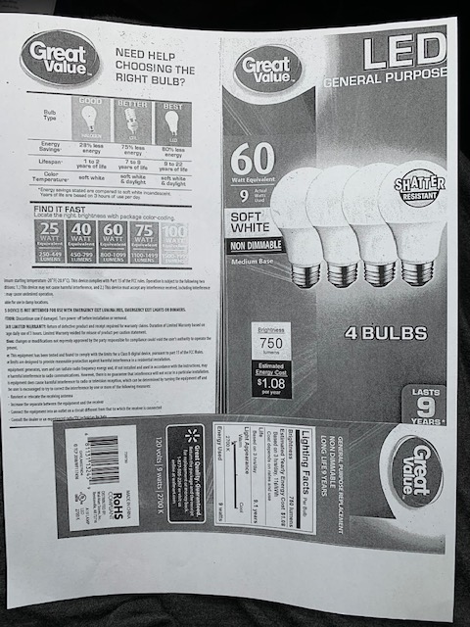
Student Activity
Compare the amperage of the compact fluorescent bulb to the current rating of the halogen bulb fixture.
What does the information tell you about the differences between the two?

Slide 47
Compact fluorescent
9 Watts = 120 V x Amps
120 V 120 V
9 Watts ÷ 120 V = .075 Amps
Halogen Fixture = 8.33 Amps and 1,000 Watts!
What’s that mean as it relates to resistance, heat emitted by the lights and cost of operation?

