Slide 1
Nursery/Landscape Plant Id tips
Central Region Ag Education/ Georgia

Slide 2
Glossy Abelia
Opposite leaves
Upside down raindrop
Flowers trumpet shaped

Slide 3
Ajuga (carpet bugle)
Leaves look like false dandelion
Tight dense growth-herbaceous
Flowers usually blue-purple
Leaves purple to bronze

Slide 4
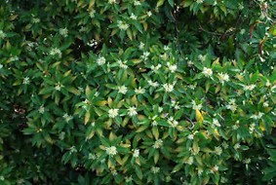
Japanese anisetree
Aromatic- alternate leaves
Evergreen tree/shrub
Arranged somewhat perpendicular to stem

Slide 5
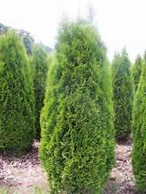
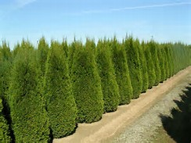
arborvitae
Grows 12-14 feet tall
deep and rich green color year-round,
foliage grows in flat sprays and, close up, the needles appear covered in fine green scales.

Slide 6
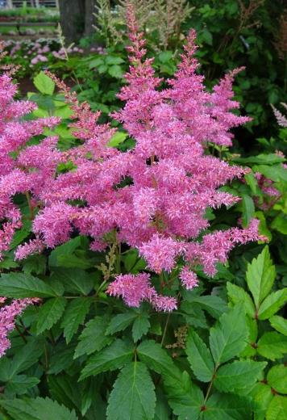
astible
Herbaceous perennial
Fern-like foliage
Flowers spike often remain

Slide 7
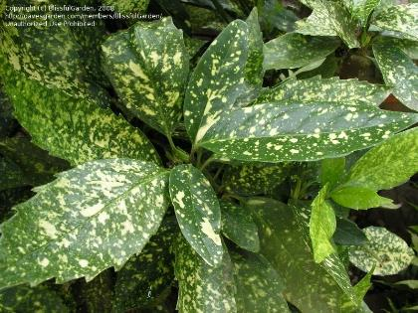
Japanese aucuba
Opposite evergreen leave-plastic texture
Can be green or variegated
Coarsely dentate

Slide 8
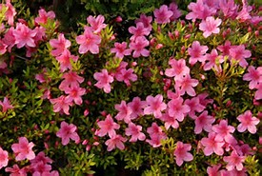
Indica azalea
Evergreen with dull green leaves
India large country-larger leaves
Pubescent

Slide 9
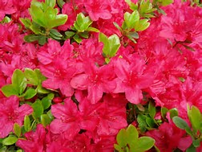
Kurume azalea
Evergreen with shinier leaves
Korea small country-smaller leaves
Pubescent

Slide 10
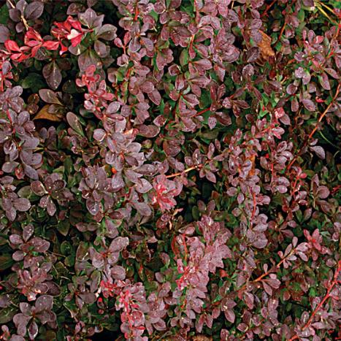
Japanese barberry
Alternate deciduous
Spine-tipped often with bud as base
Maroon sometimes yellow

Slide 11
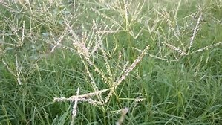
Bermudagrass hybrid
Warm season grass with runners
45 degree angle

Slide 12
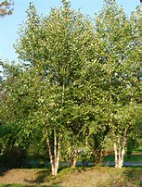
River birch
Alternate deciduous
Peeling bark
Arrowhead shaped leaf – arrowheads at river

Slide 13
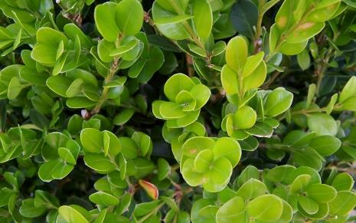
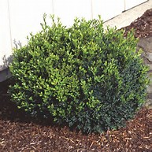
boxwood
Opposite leaves
Smells like cat pee
Often square with stem groove
Diff. shape diff. variety

Slide 14
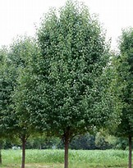
Bradford pear
Callyerana-deciduous
Fuzzy buds with smelly flowers
Poor branching system

Slide 15
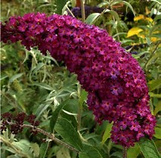
Butterfly bush
Opposite leaves-deciduous
Light white color on bottom
Stem 4-8 sided
Several colors

Slide 16
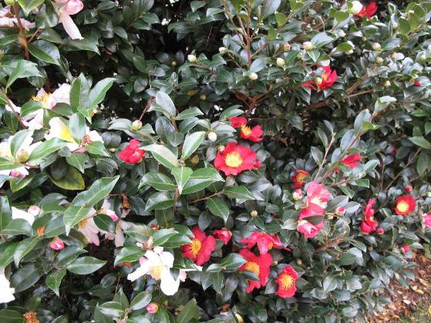
Sasanqua camellia
Smaller than Japonica
Serrated leaves-plastic
Curved petiole around bud

Slide 17
Camellia
Evergreen shrub
Leaves alternate-serrated-plastic
Black glands on tips of serrations

Slide 18
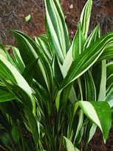
Cast iron plant
Evergreen shrub or clump
Parallel venation

Slide 19
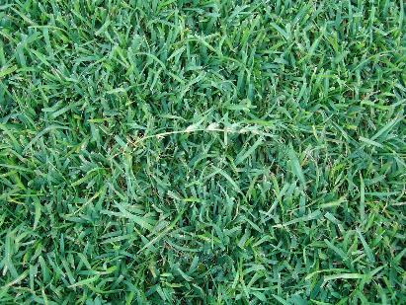
centipedegrass
Warm season grass
Wide flat blades alternate- white midrib/runners

Slide 20
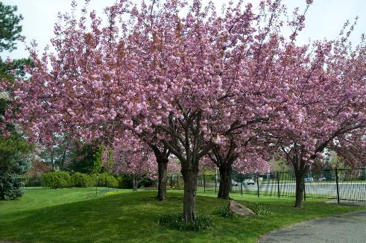
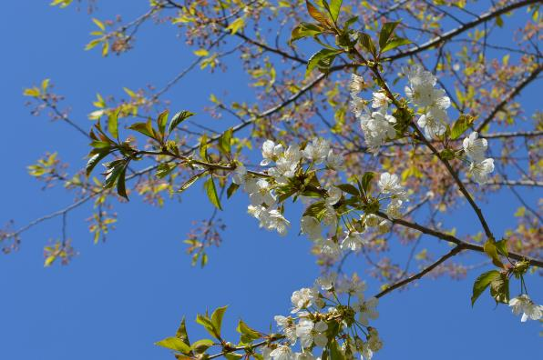
Japanese flowering cherry
Deciduous serrated leaves
Glands on petiole
Usually dark pointed buds

Slide 21
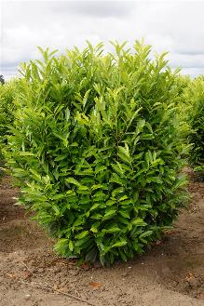
Cherry laurel
Alternate evergreen leaves slender
White flowers
2-4 glands on petiole

Slide 22
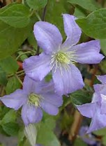
Clematis
Evergreen or deciduous vine
Terminal leaflets in 3’s

Slide 23
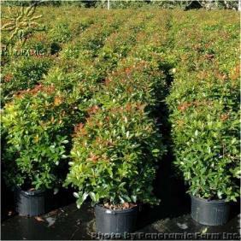
Japanese cleyera
Alternate evergreen
Red petiole-whorled often
Glossy

Slide 24
columbine
Shade perennial
Granny bonnet flowers
Leaf miner prone
3 part serrated leaf

Slide 25
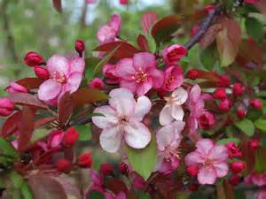
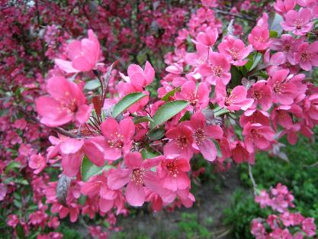
Flowering crabapple
Small deciduous tree
Spring flowering
Stubby stems

Slide 26
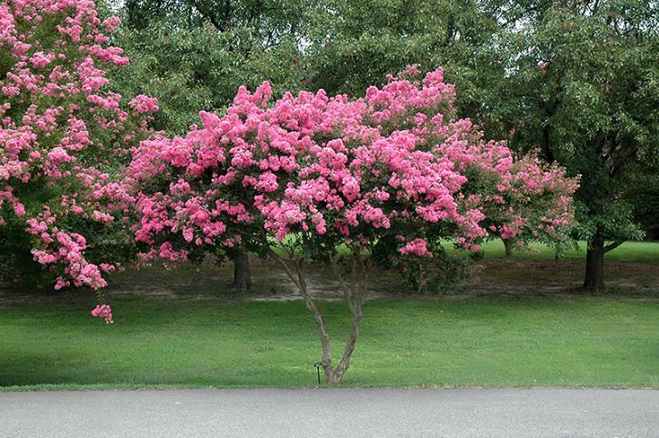
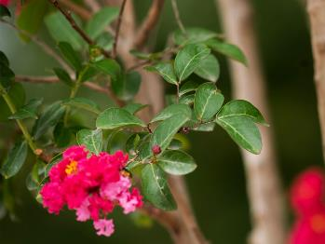
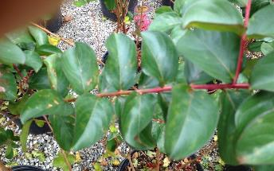
Crape myrtle
Opposite, alternate, or whorled leaves
Square stem on new growth
Smooth bark often exfoliating
Seed pods dark round

Slide 27
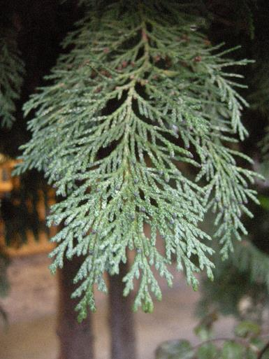
Leyland Cypress
Evergreen tree/shrub
Flat leaves
Quadrangular-square

Slide 28
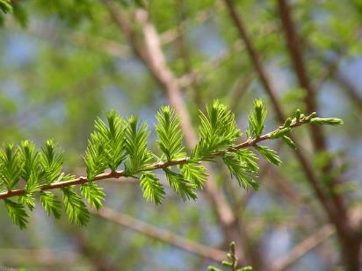
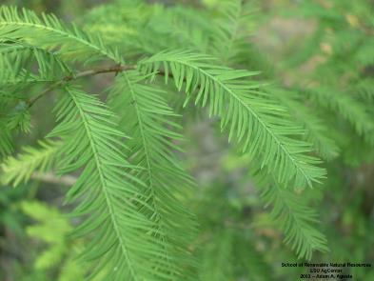
Bald cypress
Deciduous conifer
Lateral pronounced buds
Soft leaves-two rows fan out
Fibrous bark

Slide 29
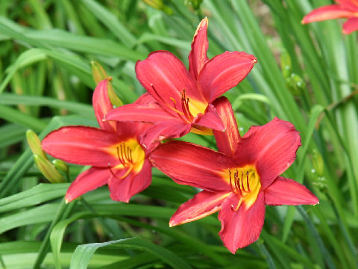
daylily
Herbaceous perennial
Leaves cupped
Sometimes dead flower spike remains

Slide 30
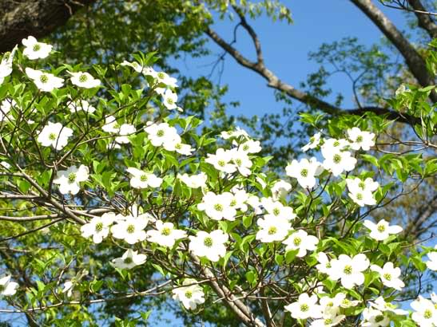
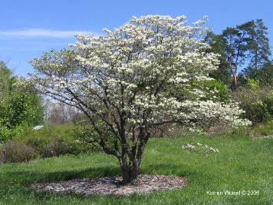
Flowering dogwood
Tree can reach up to 40 feet with upturned branches.
Leaves opposite, simple, oval and up to 5 or 6 inches long.
They are pointed at the tip and have smooth slightly wavy margins.
They are typically shiny green and smooth on the upper surface and paler on the lower surface

Slide 31
elaeagnus
Alternate simple evergreen
Silver sheen on back of leaf
Spines sometimes develop
Can be variegated

Slide 32
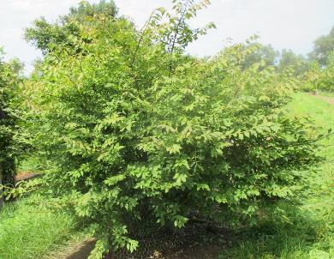
Winged euonymus
Burning Bush-red fall color
Corky wings
Opposite leaves

Slide 33
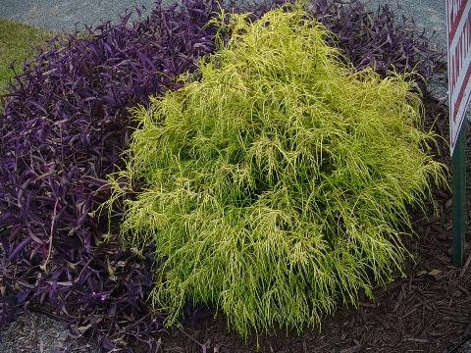
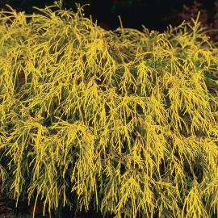
golden mop threadleaf False cypress
Evergreen
Flat not sharp like juniper
White X on back unlike arborvitae

Slide 34
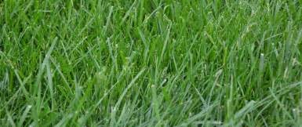
fescue
Cool season grass
Clumps no runners
Serrated backward
Collars around stem

Slide 35
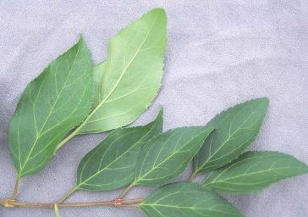
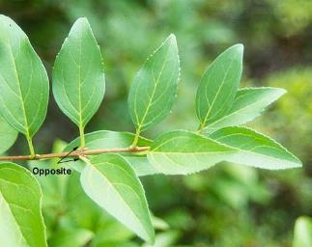
Border forsythia
Opposite buds
Square stems
Hollow stem
Leaf often half serrated

Slide 36
Fountain grass
Tender perennial ornamental
Clumps with plume flowers
Long linear leaves

Slide 37
Cape jasmine gardenia
Opposite evergreen
Ribbed leaves- garden in rows
Radicans not as ribbed

Slide 38
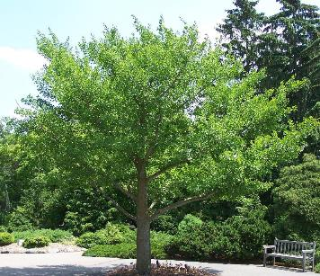
ginkgo
Alternate deciduous
Accordion buds
Parallel veins with split leaf

Slide 39
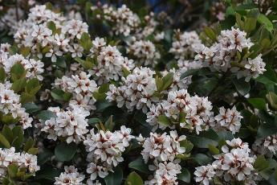
Indian hawthorn
Alternate serrated evergreen
Sometimes purple margin
Often looks whorled at ends

Slide 40
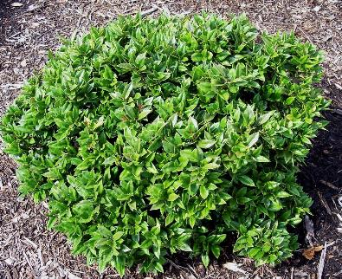
Carissa holly
Alternate leaves
I spine leaf curved up
Sun caresses the leaf
Cornuta

Slide 41
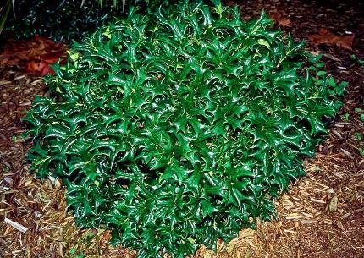
Chinese holly
Alternate leaves
7 spines C-H-I-N-E-S-E
Cornuta really rotunda species

Slide 42
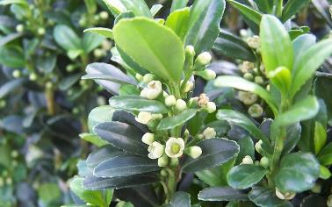
Compacta holly
Alternate leaves
Darks glands on underside
Candleabra shaped appearance
Crenata

Slide 43
Dwarf burford holly
Alternate leaves
1 spine bent over
Cornuta

Slide 44
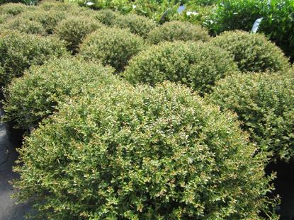
Dwarf yaupon holly
Evergreen
Football shaped leaves
Purple to gray stems

Slide 45
Helleri holly
Horizontal type growth
Dark glands on back of leaf
Crenata

Slide 46
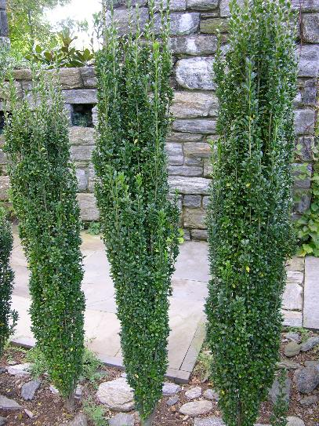
Sky pencil holly
Slender-vertical type growth
Dark glands on back of leaf
Crenata

Slide 47
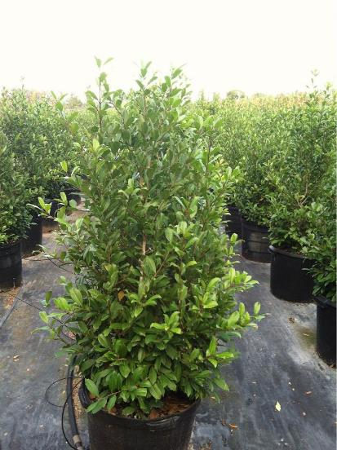
Savannah holly
Type of foster holly
Large red fruit/tree
Spiny leaves

Slide 48
Weeping yaupon holly
Evergreen-pendula-weeping
Football shaped leaves
Purple to gray stems

Slide 49
hosta
Perennial-shade
Parallel veins
Many varieties
Knots in spring as emerges

Slide 50
Oakleaf hydrangea
Deciduous-opposite
Oak leaf similarity
Orangey stem in winter

Slide 51
Bigleaf hydrangea
Deciduous opposite leaves
Leaf similar to cabbage in texture

Slide 52
English ivy
Evergreen vine
Three-five lobed
Can be variegated

Slide 53
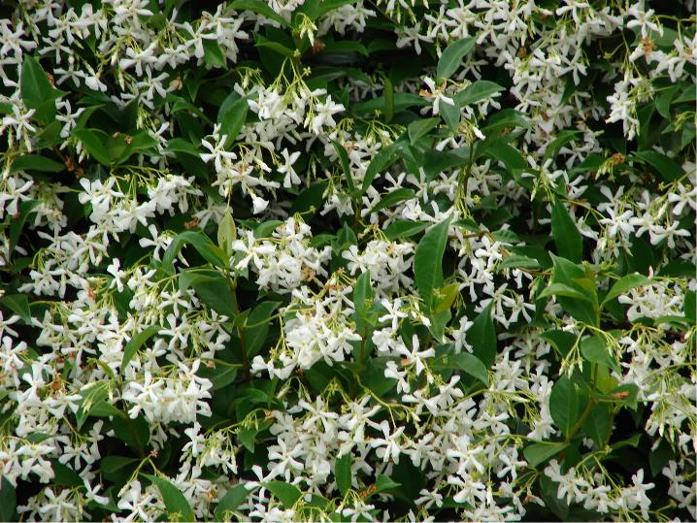
Confederate jasmine
Vine/shrub/evergreen
Not true jasmine
Star flowers/leaves opposite

Slide 54
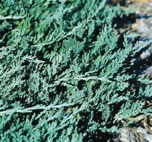
Blue rug juniper
Evergreen groundcover
Soft textured/horizontalis
Bluish tint trailing over pot

Slide 55
Shore juniper
Evergreen groundcover
Awl shaped leaves
Stripe/sharp/shore

Slide 56
Andorra juniper
Evergreen groundcover
Soft textured/horizontalis
Winter brown tint
Plumosa compacta in Dirrs book
Out and up about 18”

Slide 57
Lenten rose
Shade perennial
Flower like rose
Leaves 5-6 lobes

Slide 58
lantana
Summer sun perennial
Fragrant shrub or groundcover
Verbena family

Slide 59
liriope
Herbaceous
Clump/grass like
Muscari like grape hyacinth spike
Parallel veins

Slide 60
loropetalum
Alternate evergreen
Leaves veins pronounced
Rough pubescent texture

Slide 61
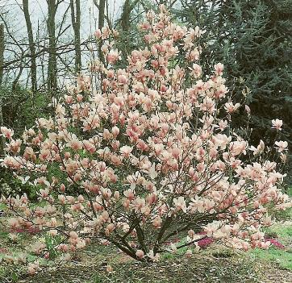
Saucer magnolia
Alternate leaves
Large pubescent flower bud
Deciduous/distinct lenticels

Slide 62
Southern magnolia
Alternate/evergreen
Large pubescent buds
Shiny leaf with pubescent underneath

Slide 63
Leatherleaf mahonia
Alternate compound
Spikey leaves
Yellow flowers/blue fruit

Slide 64
Sugar maple
Opposite simple leaf
S-U-G-A-R
Pencil point bud

Slide 65
Red maple
Opposite simple leaf
R-E-D
Cluster buds

Slide 66
Japanese maple
Opposite simple leaf
Double terminal buds

Slide 67
Mondo grass
Usually narrower than liriope
Shorter stems that liriope
Parallel veins/blue fruit vs black

Slide 68
Dwarf nandina
Alternate bipinnate to tri-pinnate
Usually less than 30”
Shorter internode than nandina

Slide 69
nandina
Alternate bipinnate to tri-pinnate
Grows usually taller than 30”
Longer internodes than dwarf
Often leggy

Slide 70
Live oak
Alternate simple evergreen
Leaf darker above, gray below
Cupped often
Brownish midrib

Slide 71
Pin oak
Alternate simple
5-7 deep U shaped lobes
2” petiole
Branches at right angles

Slide 72
White oak
Alternate simple rounded leaf
Large fruit up to an inch
Bark gray with blocky look

Slide 73
Tea olive osmanthus
Opposite simple leaf
Distinct vein below
Finely serrated
Fragrant flower

Slide 74
pachysandra
Evergreen groundcover/shade
Related to boxwood
Whorled leaflets
Serrated at the ends of leaf

Slide 75
pieris
Alternate simple
Evergreen
Serrated
New growth often reddish/whorled
Mass of bell shaped flowers

Slide 76
Mugo pine
Needles in paris
Up to 3” long
Typically shrub pine

Slide 77
Eastern white pine
W-H-I-T-E
5 needles
Often with white stripe
Smooth bark
Tends to hold branches

Slide 78
Japanese pittosporum
Alternate simple
Leaf slightly rounded
Often variegated

Slide 79
Yellow (tuliptree) poplar
Alternate simple
Cat face/tulip
Duck bill buds
Flowers

Slide 80
Varigated privet hedge
Opposite leaves/oblong shape
Variegated
Can be invasive
New sterile varieties/sunshine/golden ticket

Slide 81
Glossy privet
Opposite leaves/oblong shape
Variegated – SOMETIMES
Larger than sinense leaf and plant

Slide 82
pyracantha
Alternate simple leaf/coccinea
Slightly serrated
Thorny thus the name firethorn
Orange red fruit

Slide 83
Flowering quince
Alternate simple
Large stipules
Elbows lack of terminal bud
Fruit 2” in diameter

Slide 84
Eastern redbud
Heart shaped alternate leaf
Rick-rack stems
Reddish purple buds to pink flowers

Slide 85
rhododendron
Alternate simple leaf
Oblong leaves almost in whorls
Dark green above, paler below

Slide 86
Hybrid tea rose
Alternate compound leaf
Usually with thorns on stem

Slide 87
Rosemary
Woody perennial herb
Very fragrant
Can flower

Slide 88
Sago palm
Pseudo whorl
Unbranched trunk
Fern like leaves

Slide 89
salvia
Herbaceous perennial
Hardy
Rough textured leaf
Tall flower spike

Slide 90
sedum
Small growing perennial
Rounded succulent leaves
Opposite leaves

Slide 91
Anthony waterer spirea
Alternate simple leaf
Lance shaped serrated
Pinkish flowers

Slide 92
Vanhouttei spirea
Dark green leaves
Diamond shaped
Serrated on end
Arching stem pattern
Flowers in spring

Slide 93
Snowball viburnum
Opposite/simple
Deciduous
Large white flowers

Slide 94
Vinca (periwinkle)
Vine opposite leaves
Smooth margins
Bluish flowers

Slide 95
Bayberry wax myrtle
Alternate simple leaves
Shallow toothed
Leaves crushed fragrant
Small round drupe purplish

Slide 96
Weeping willow
Alternate simple leaf
Long narrow serrated leaf
Overall shape of planted in weeping

Slide 97
wintercreeper
Vine opposite leaves
Often feet to attach to objects
Serrated leaves
Can be deciduous

Slide 98
Chinese wisteria
Alternate pinnately compound
Vine/small tree
7-13 leaflets

Slide 99
Plum yew
Linear leaves arranged in 2 planes
Evergreen
Can be upright or prostrate
2 gray bands beneath leaf

Slide 100
Yucca (adams needle)
Leaf sword like spikey
Typically has threaded like
Filament peeling
White flower spike
Not as stiff as other yuccas

Slide 101
Emerald zoysia
Leaves typically
80-90 degree angle
Smaller than centipede
Usually smooth to touch

