Slide 1
2018 State Floral Design CDE
Senior ID

Slide 2
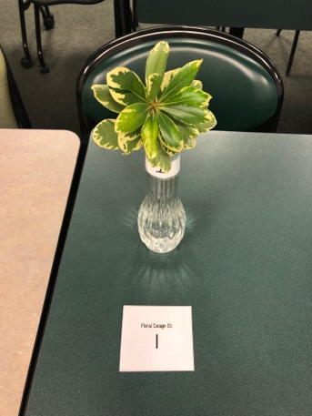
Pittosporum / Pittosporum tobira

Slide 3
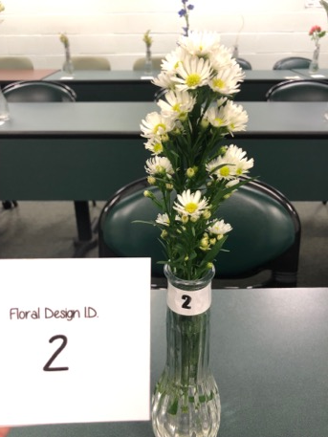
Aster Monte Casino / Aster novi-belgii

Slide 4
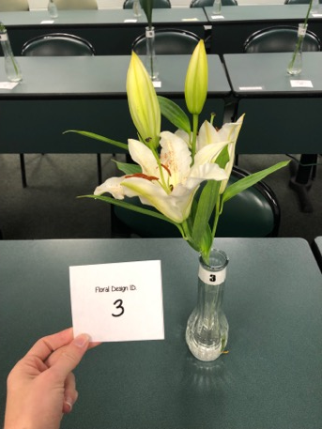
Lily / Lilium sp.

Slide 5
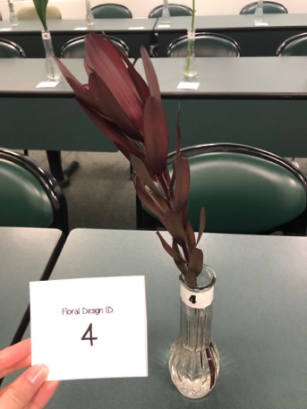
Protea/Proteaceae

Slide 6
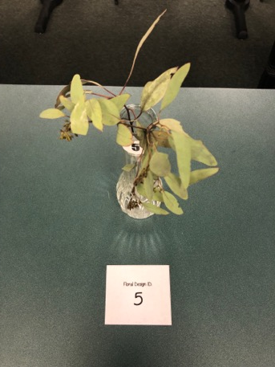
Eucalyptus / Eucalyptus sp

Slide 7
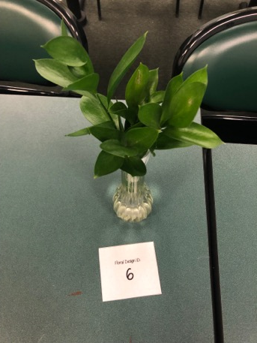
Ruscus / Ruscus sp.

Slide 8
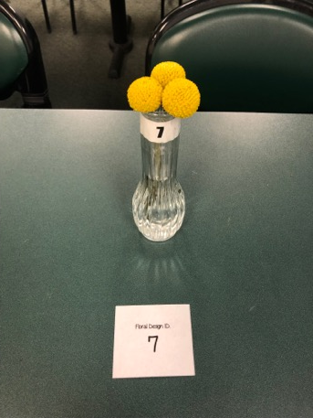
Craspedia/Craspedia globosa

Slide 9
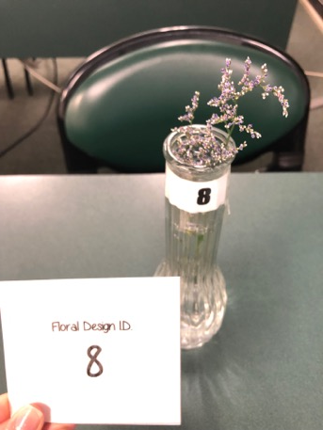
Caspia Misty Blue / Limonium ferulaceum

Slide 10
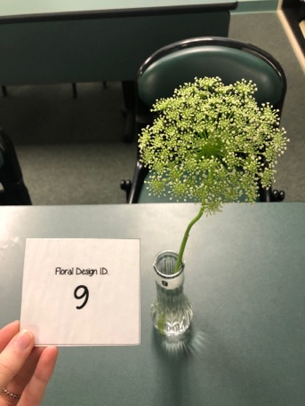
Queen Anne Lace / Ammi majus

Slide 11
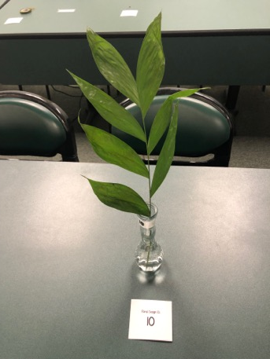
Jade / Chamaedorea sp.

Slide 12
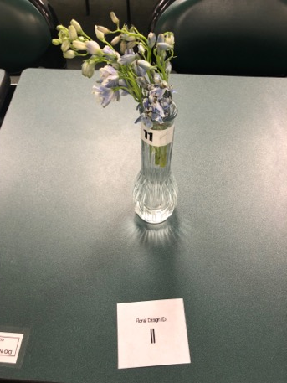
Larkspur / Consolida ambigua

Slide 13
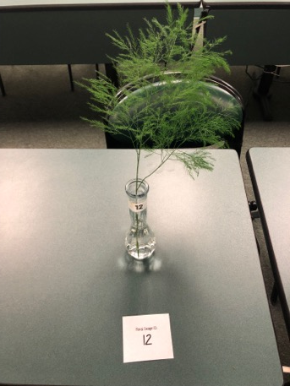
Tree Fern / Asparagus virgatus

Slide 14
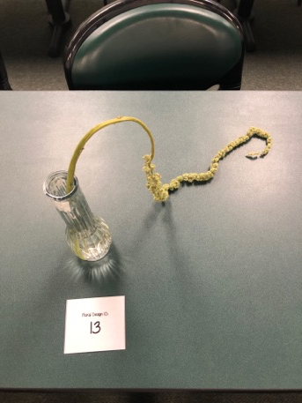
Hanging Amaranthus/Amaranthus caudatus

Slide 15
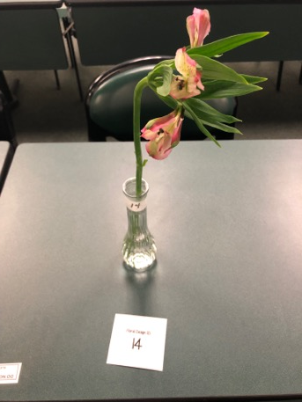
Alstroemeria / Alstroemeria sp.

Slide 16
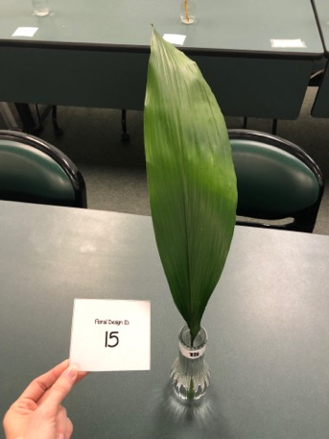
Aspidistra/ Aspidistra elatior

Slide 17
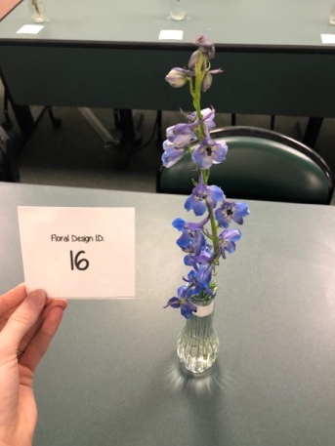
Delphinium / Delphinium elatum

Slide 18
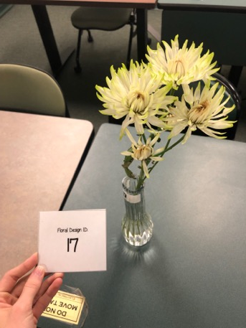
Chrysanthemum / Chrysanthemum morifolium

Slide 19
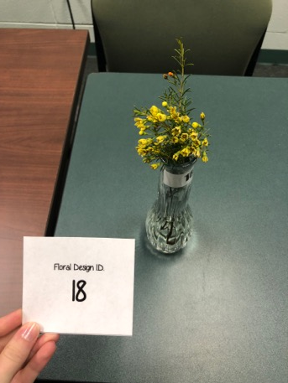
Wax Flower/Chamelaucieae

Slide 20
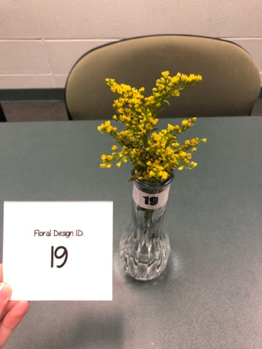
Solidago (Goldenrod) / Solidago

Slide 21
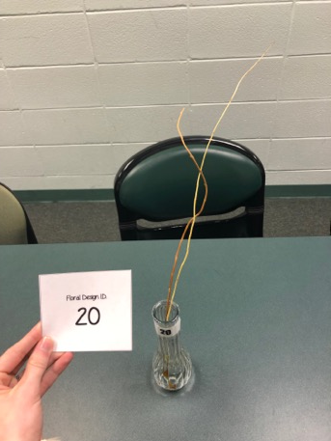
Curly Willow / Salix Sachalinensis

Slide 22
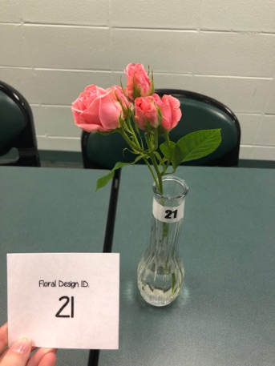
Spray Roses/Rosa sp.

Slide 23
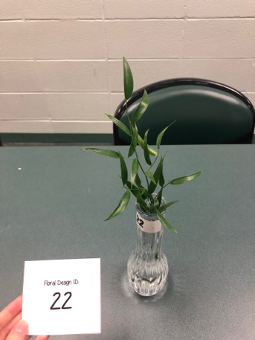
Ruscus / Ruscus sp.

Slide 24
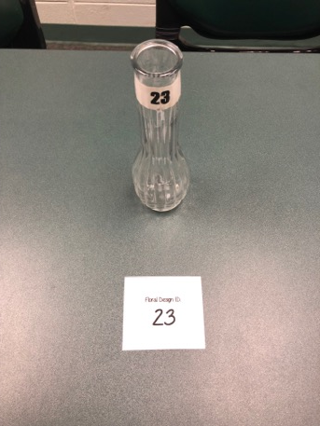
Glass vase

Slide 25
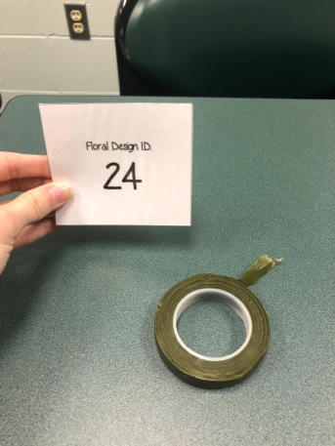
Floral tape

Slide 26
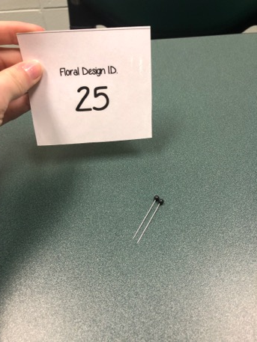
Boutonniere pin

