Slide 1
Floriculture Tools and Materials ID
Study PowerPoint

Slide 2
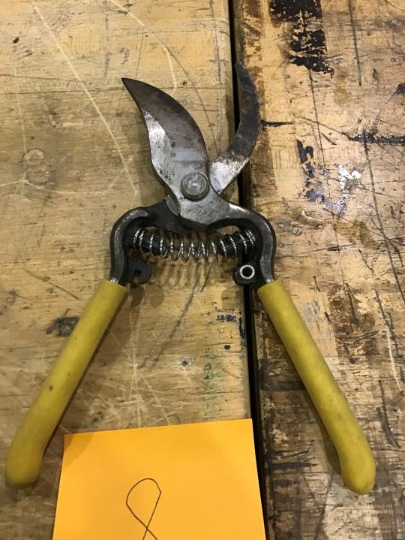
Bypass Pruner

Slide 3
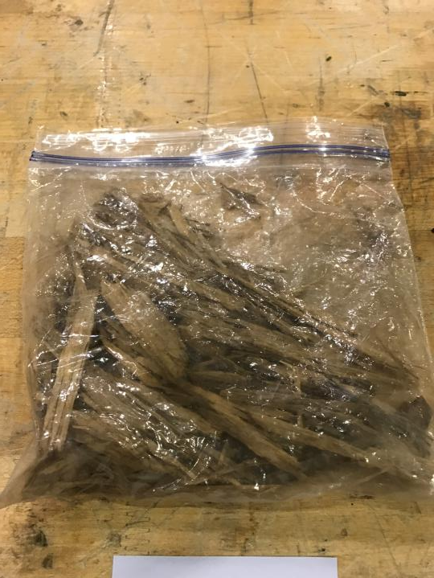
Bark Medium

Slide 4
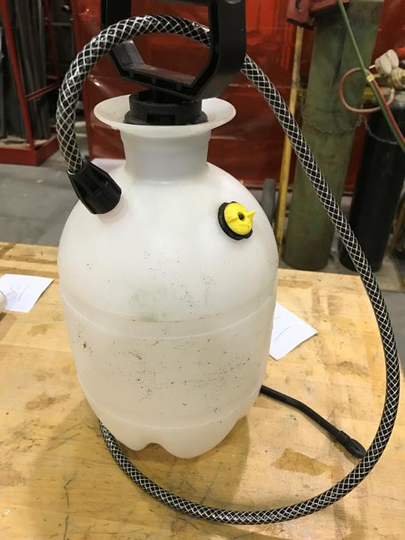
Compressed Air Sprayer

Slide 5
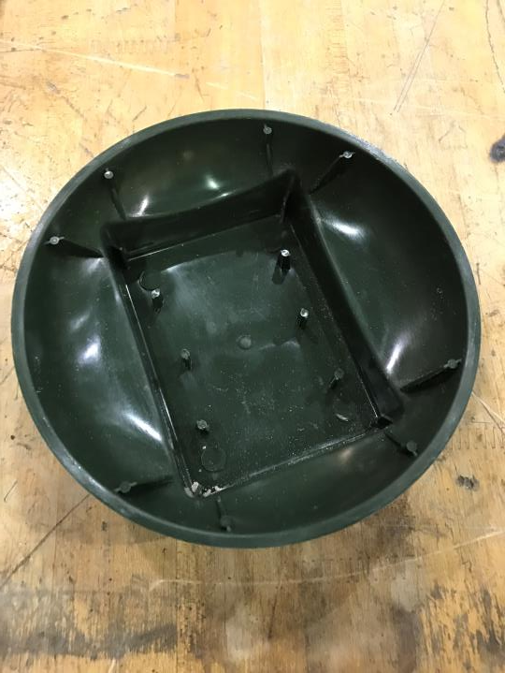
Designer Bowl

Slide 6
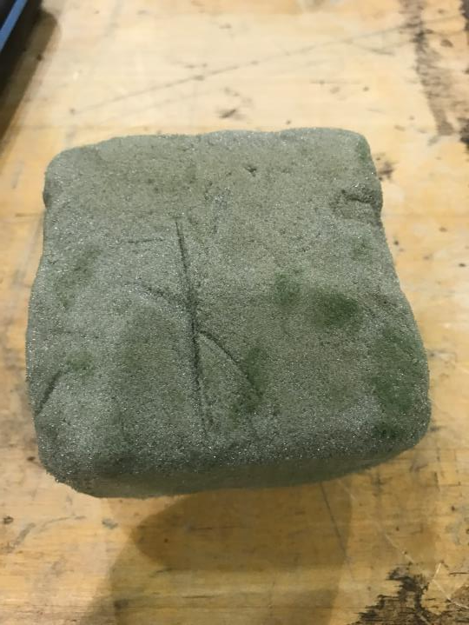
Dry Foam

Slide 7
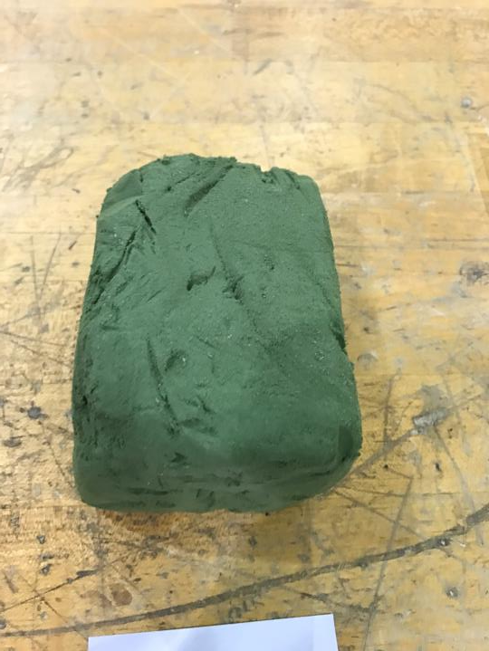
Floral Foam

Slide 8
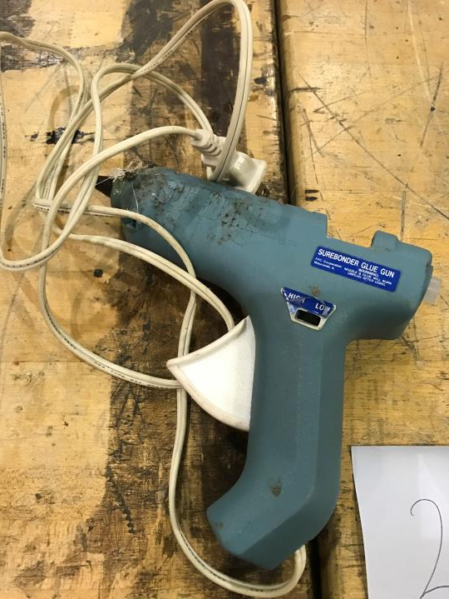
Glue Gun

Slide 9
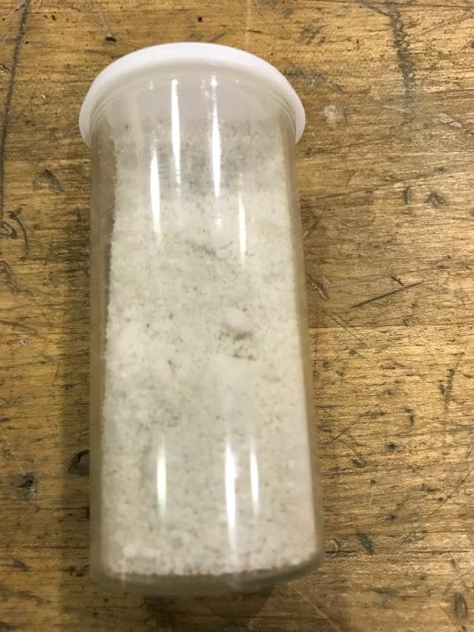
Granular Fertilizer

Slide 10
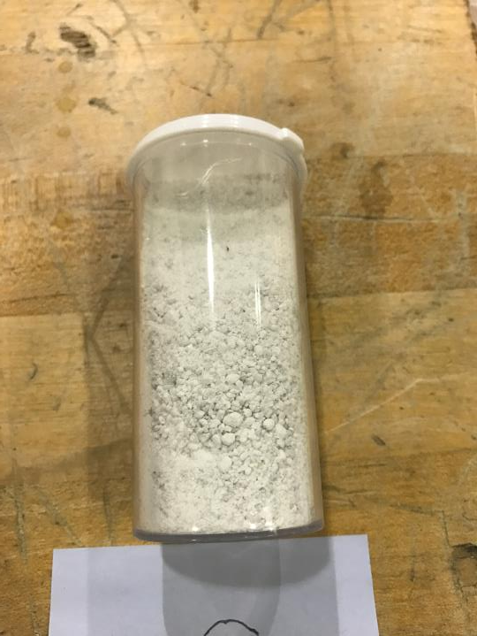
Ground Limestone

Slide 11
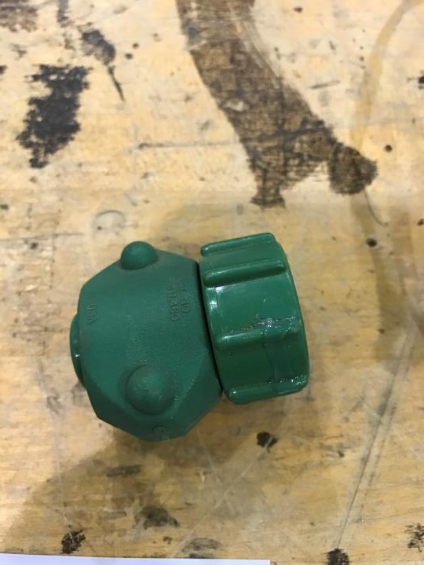
Hose-end Repair Fitting

Slide 12
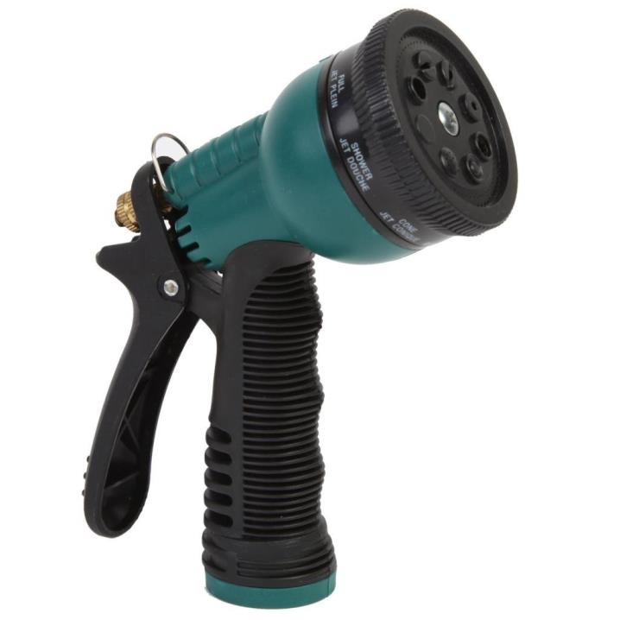
Hose-end Sprayer

Slide 13
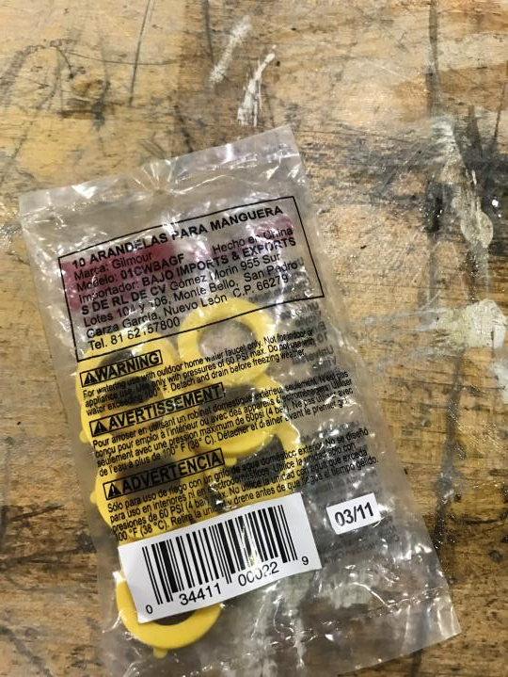
Hose-end Washer

Slide 14
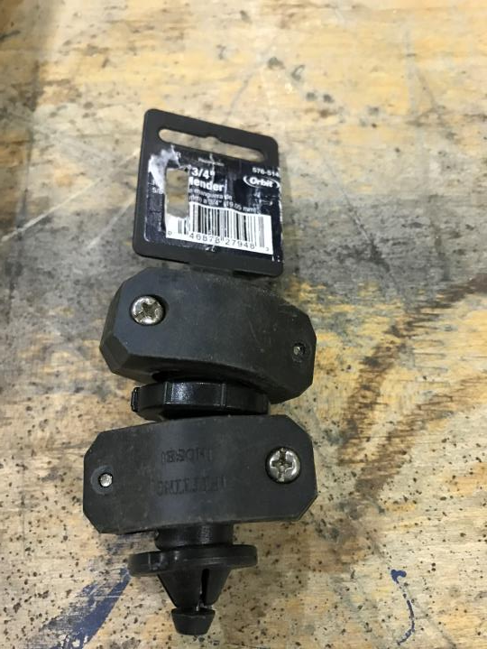
Hose Repair Coupling

Slide 15
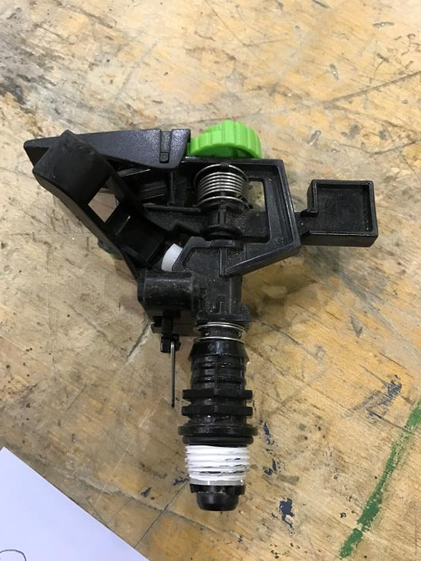
Impulse Sprinkler

Slide 16
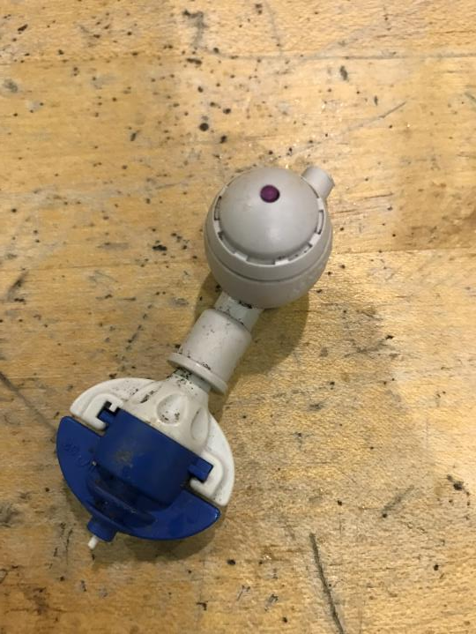
Mist Nozzle (Mist Bed)

Slide 17
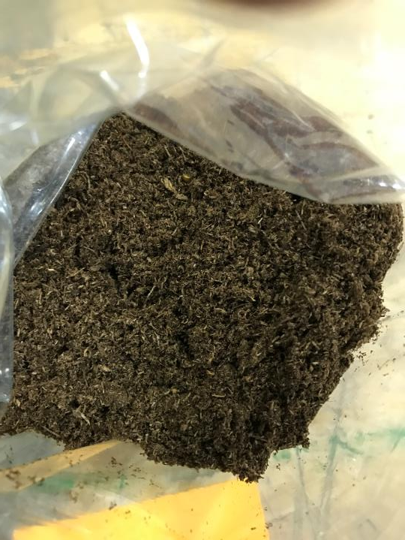
Peat Moss

Slide 18
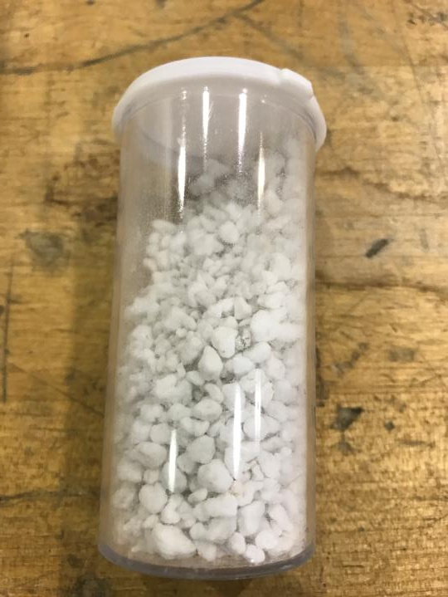
Perlite

Slide 19
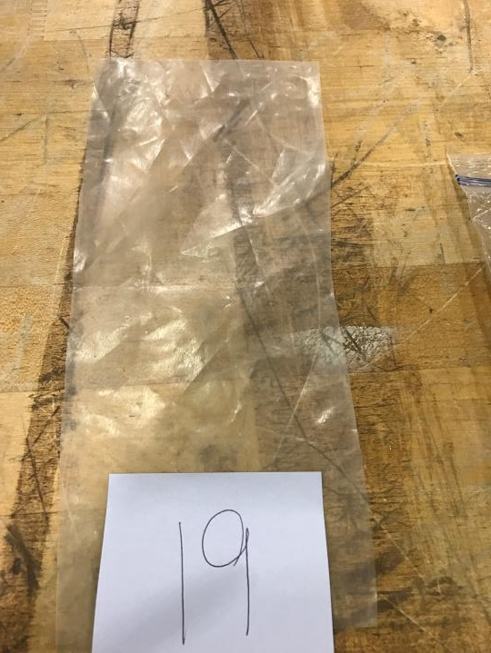
Polyethylene Film

Slide 20
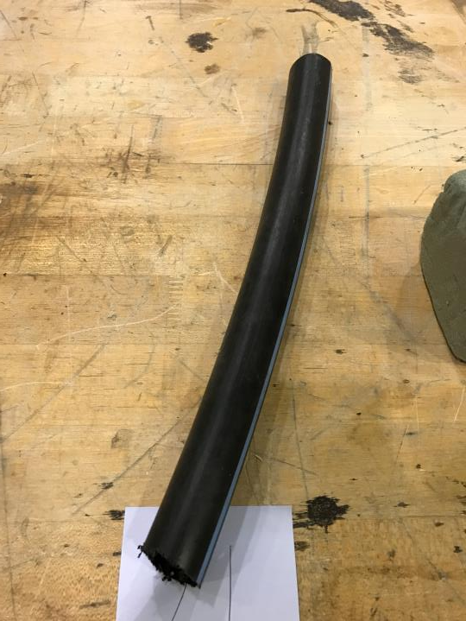
Polyethylene Pipe

Slide 21
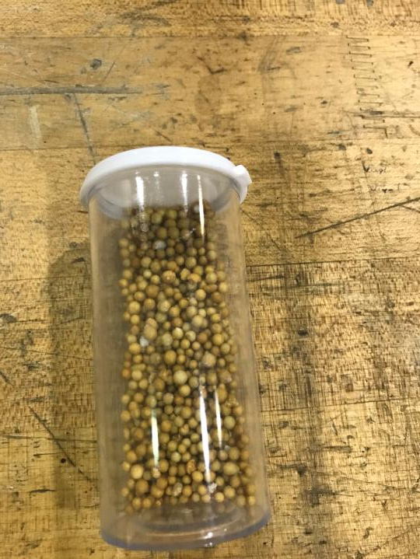
Resin-Coated Fertilizer

Slide 22
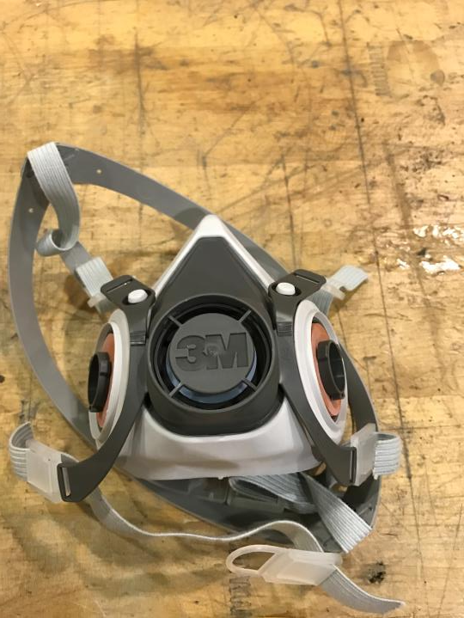
Respirator

Slide 23
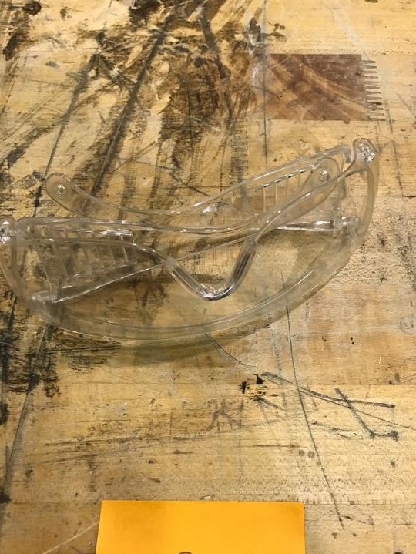
Safety Goggles

Slide 24
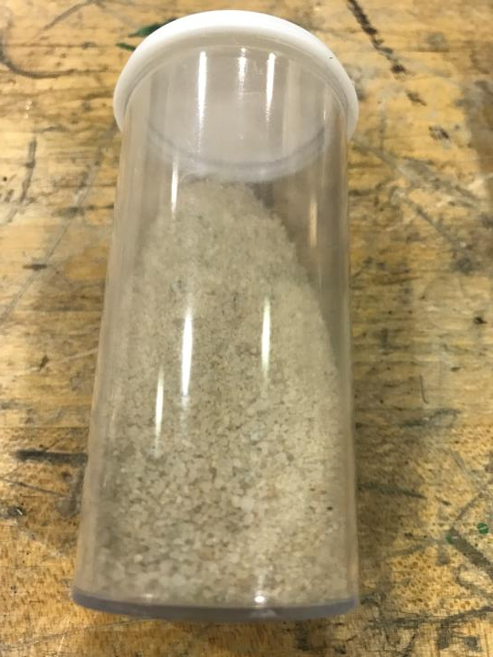
Sand

Slide 25
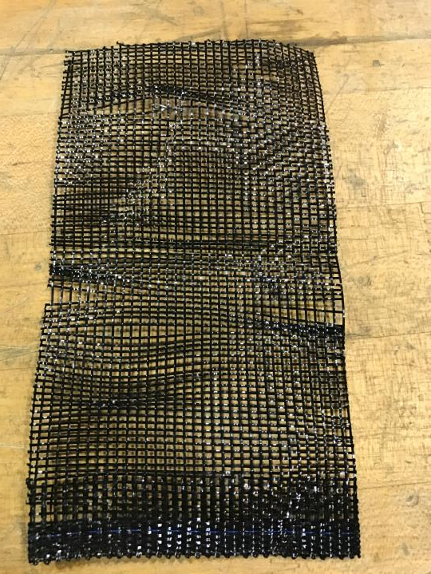
Shade Fabric

Slide 26
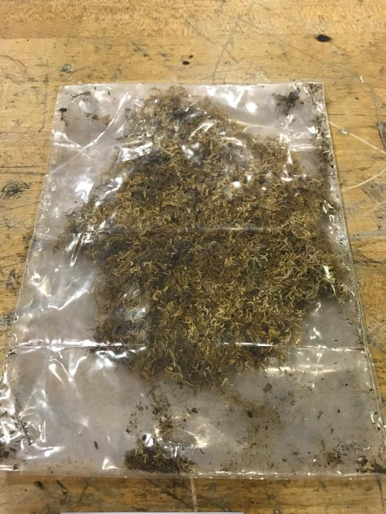
Sheet Moss

Slide 27
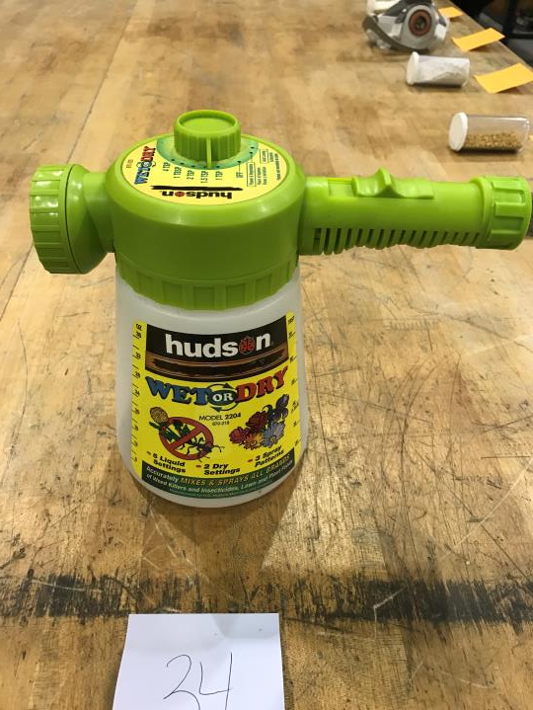
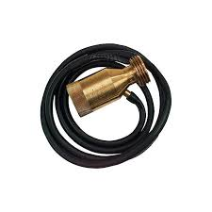
Siphon Proportioner

Slide 28
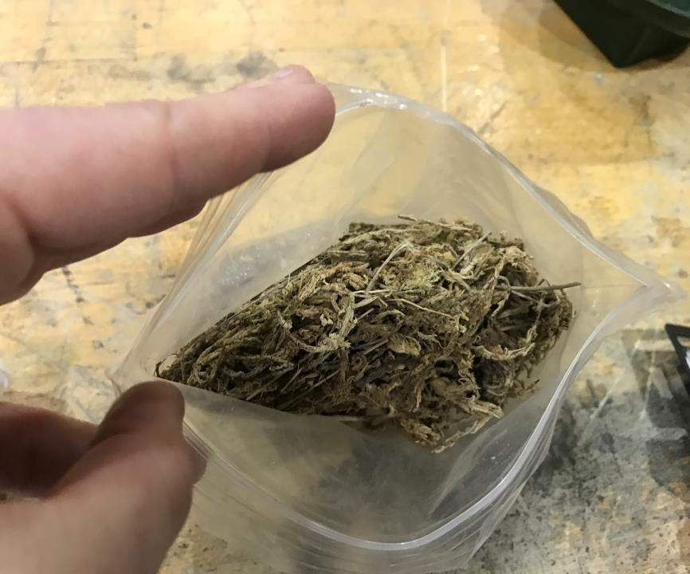
Sphagnum Moss

Slide 29
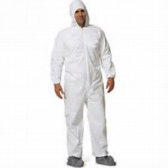
Spray Suit

Slide 30
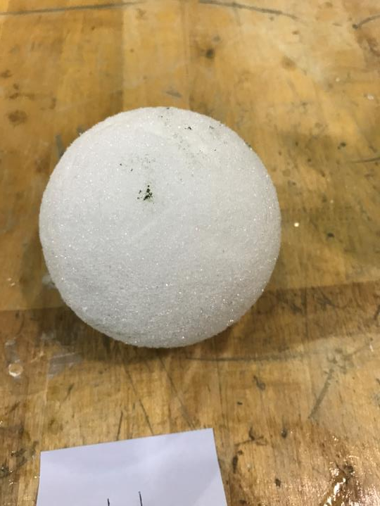
Styrofoam

Slide 31
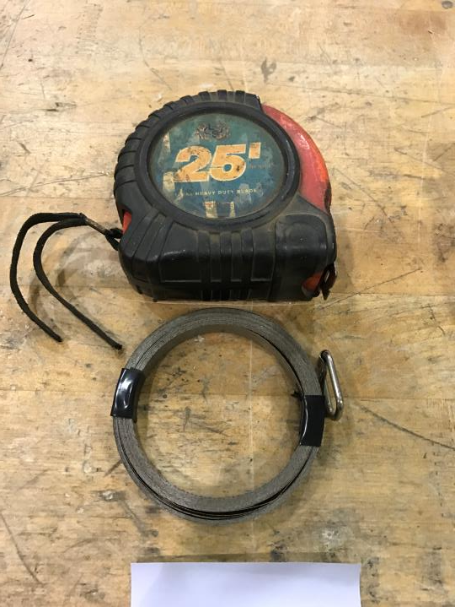
Tape Measure

Slide 32
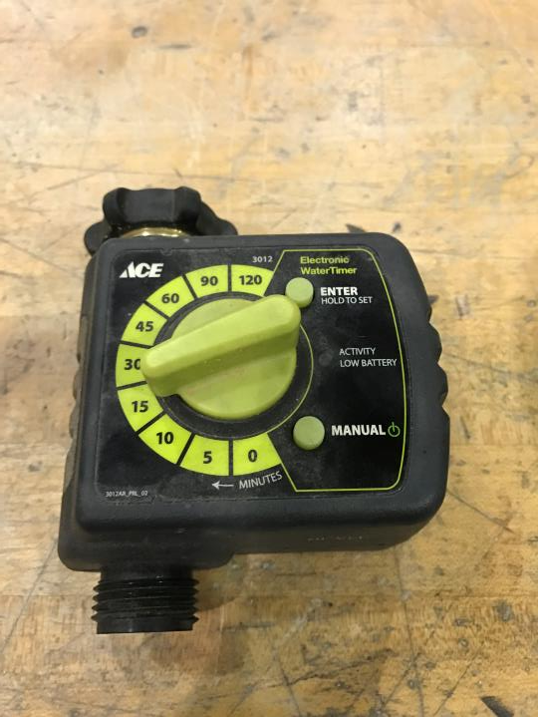
Irrigation Timer

Slide 33
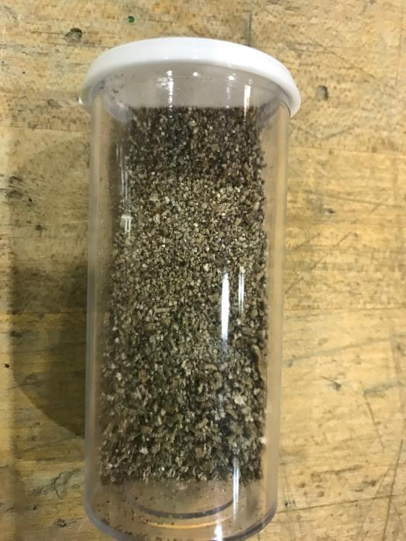
Vermiculite

Slide 34
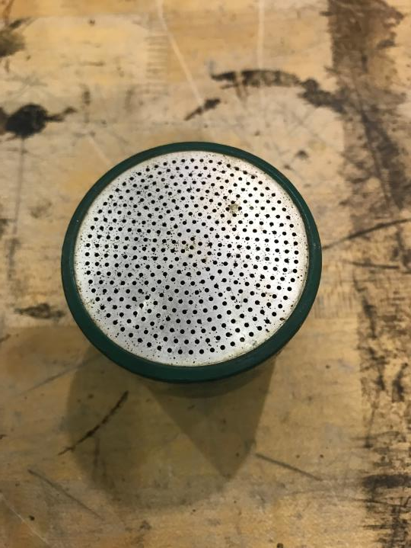
Water Breaker

Slide 35
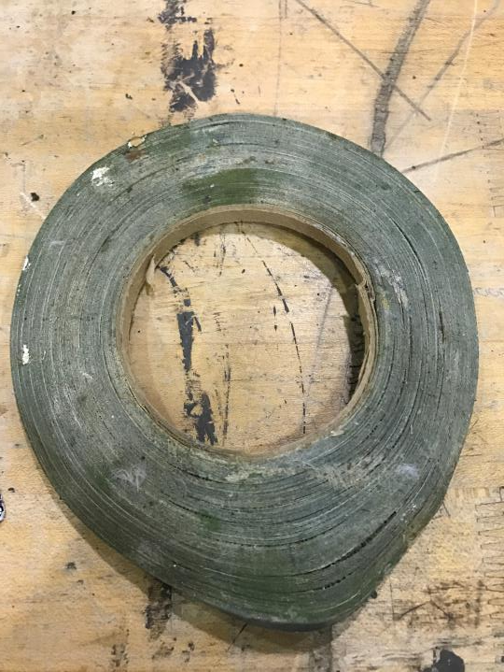
Waterproof Tape

