Slide 1
Basic Wiring Problems
With solutions

Slide 2
Electrical Supplies (Class Set of 28)
Item | Description | Quantity
Box - device | 4 x 2 1/8 x 2 1/8 | 56
Box - Octagonal | 4 x 1 1/2 | 56
Screws | #10 x 3/4 | 112
Board | 2 x 4 x 18" | 28
PVC conduit | 1/2 x 10' | 1
PVC male terminal adapter | 1/2" | 84
Rigid conduit locknut | 1/2" | 84
grounding screw (green) | 10-32 | 112
lamp holder | plastic, keyless | 56
switch | single pole | 28
Receptacle | 15 amp | 56
wire - green - solid - THHN | 14 awg - 500 ft | 1
wire - white - solid - THHN | 14 awg - 500 ft | 1
wire - black - solid - THHN | 14 awg - 500 ft | 1
Solderless connectors (wire nuts) | Red, yellow, (green optional) | 100 each color

Slide 3
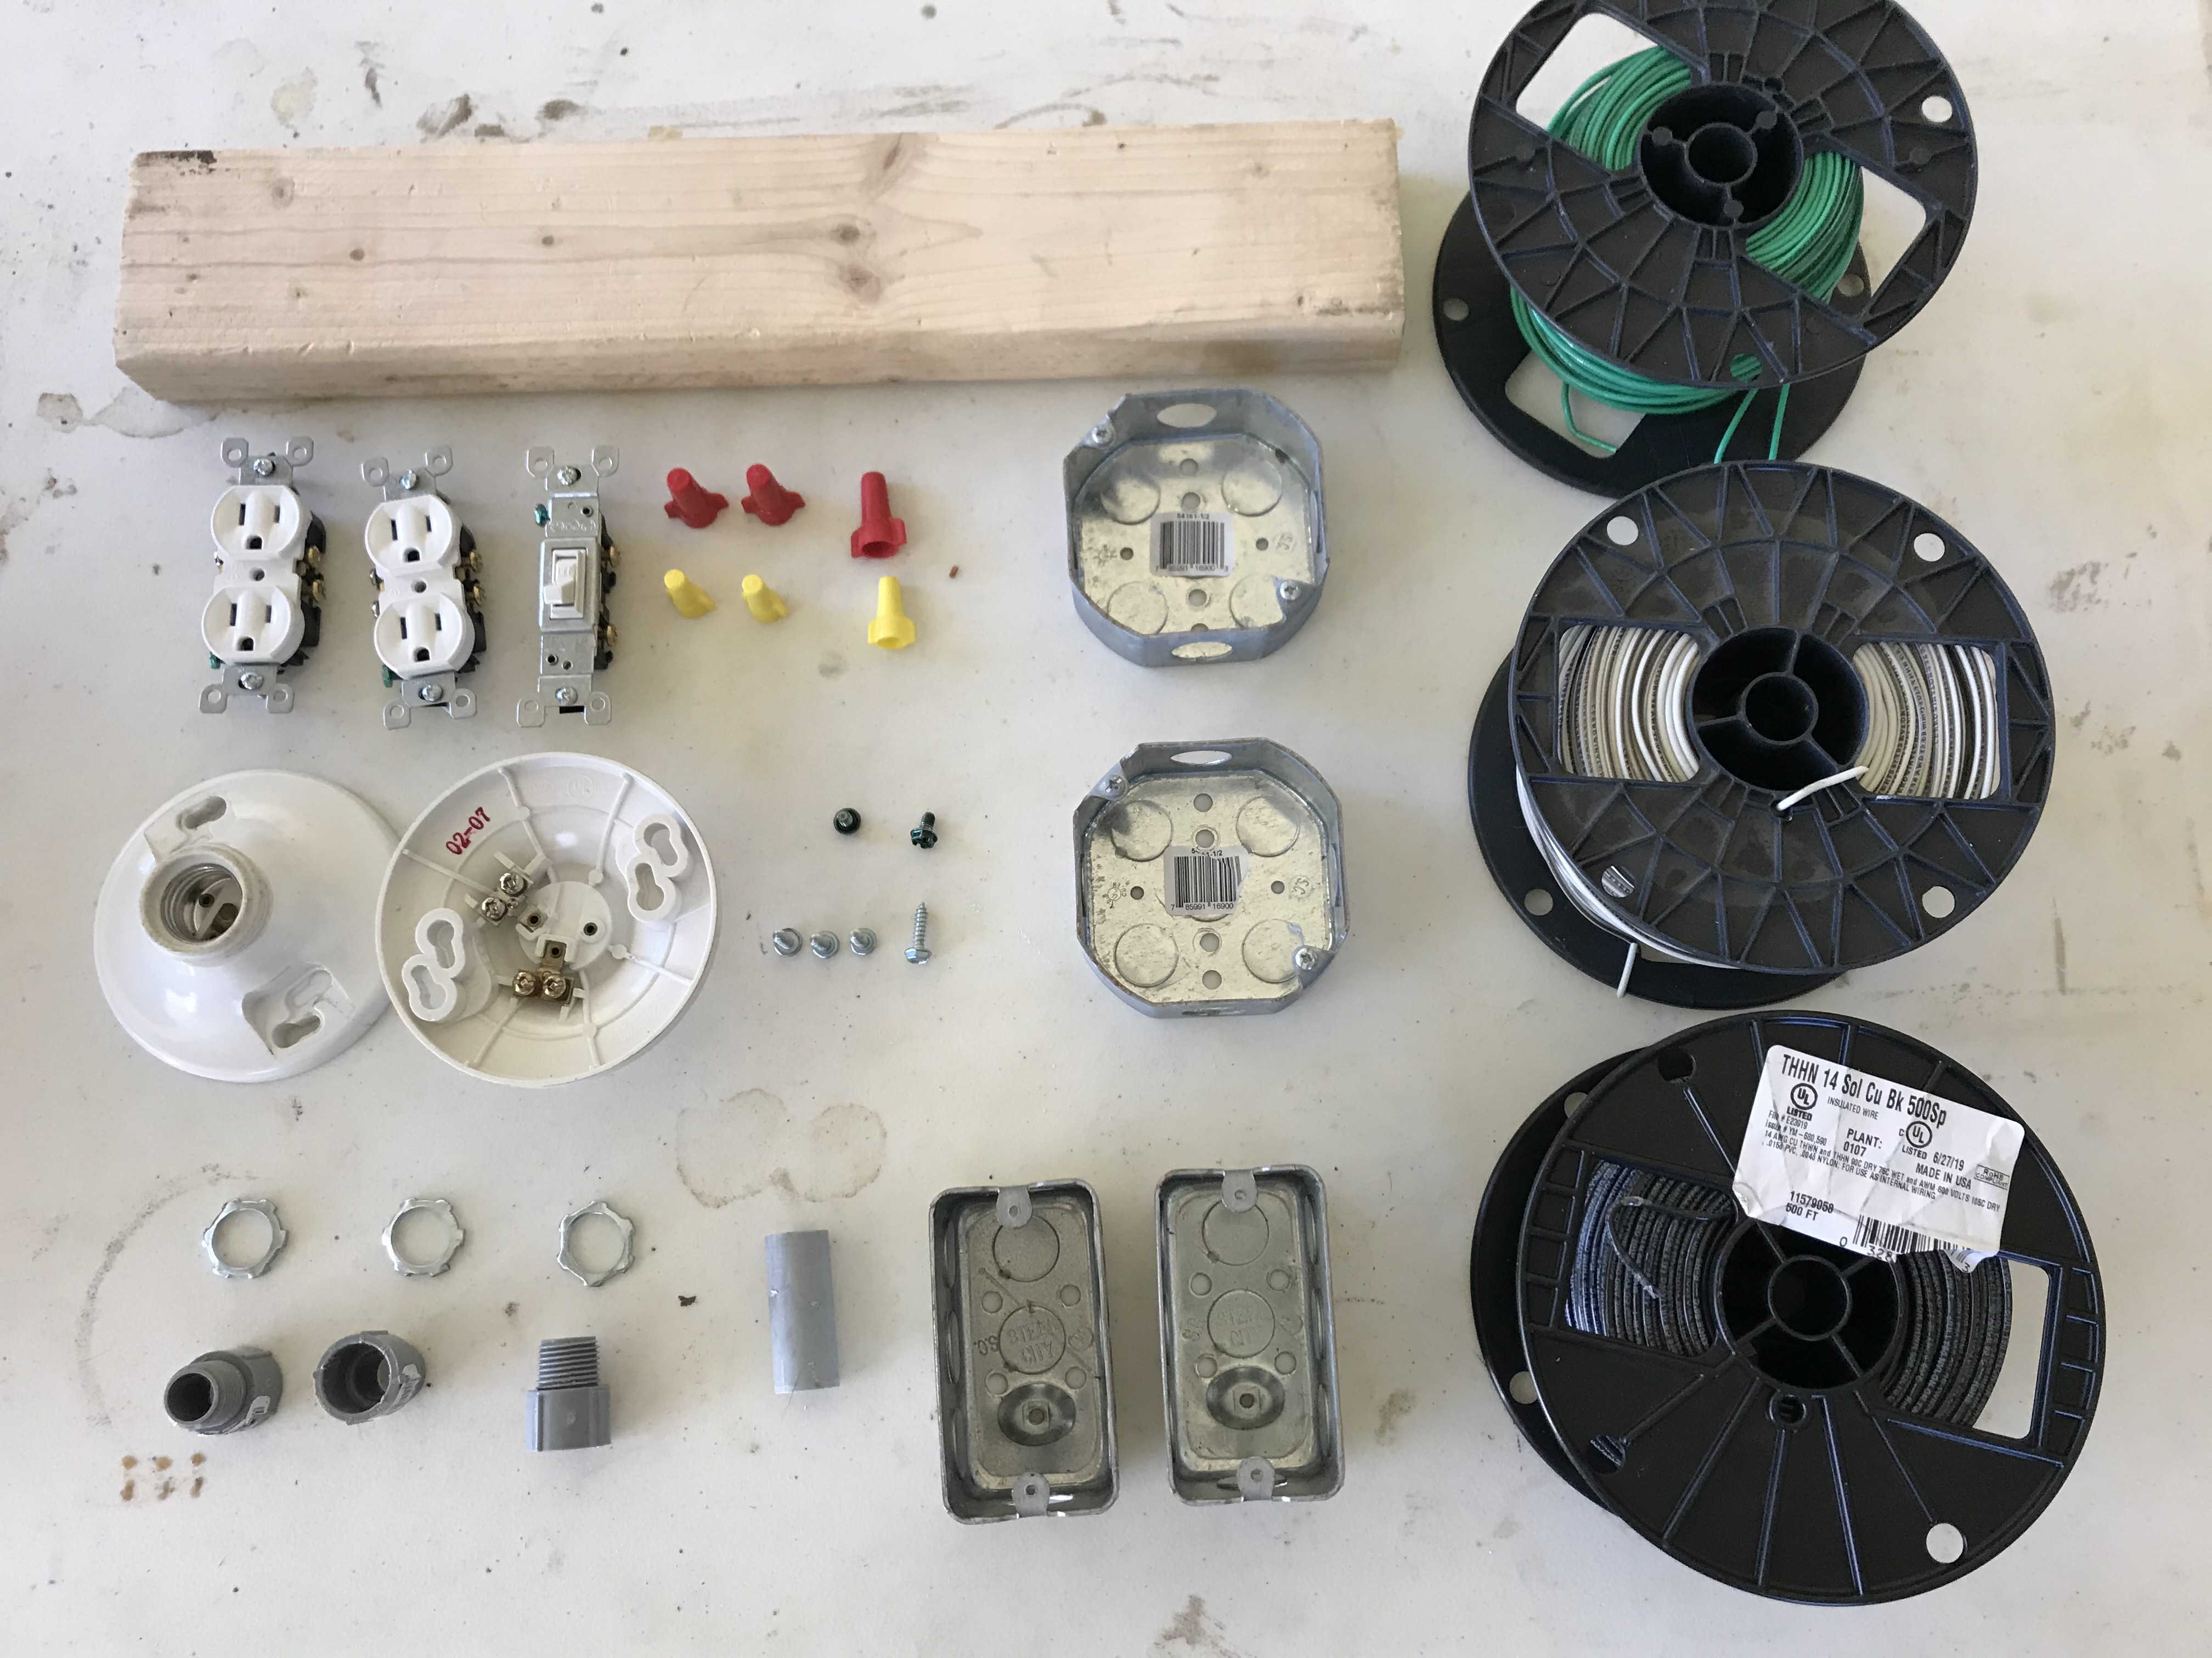
Supplies

Slide 4
Electrical Tools
Mininum
Optional
Long nose pliers
Phillips screwdriver
Flat screwdriver
Wire strippers
Hammer
Diagonal cutters
Lineman’s pliers
PVC cutters
5/16 nut driver
Cordless drill with 5/16 bit

Slide 5
Concepts to cover
PVC conduit size (1/2”)
Conductor size, type (14 awg) (solid vs stranded) (individual vs cable)
Conductor count, volume allowance
Box size, type, capacity, material, etc…
Load calculations (watts, amps, volts, ohms)
Grounding metal boxes
Length of free conductor in box
Overcurrent protection

Slide 9
Parallel

Slide 10
Series

