Slide 1


Georgia FFA
Floriculture
Disorder
Tips and Tricks
This is a free resource provided by Georgia Agricultural Education
Original creator: Melissa Riley, Central Region Horticulture Teacher

Slide 2
INSECTS
All of the following insects should be treated by an insecticide
Or “Apply Insecticide”

Slide 3
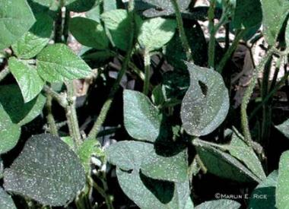
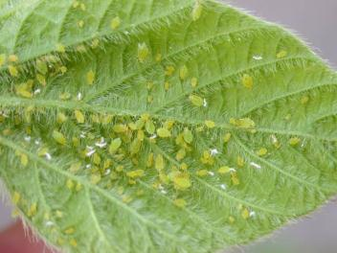
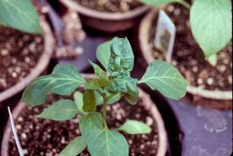
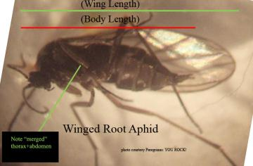
Aphids
Always appear in large groups, can be many different colors and sizes
Produces a sap (honeydew) that promote the growth of sooty mold (seen above)
Can also cause leaf curling/ distortion on new growth

Slide 4
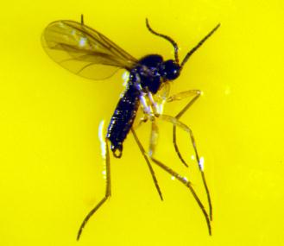
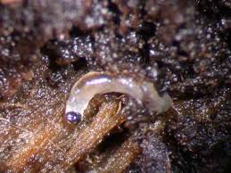
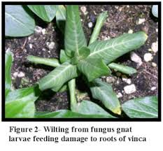
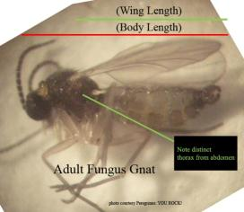
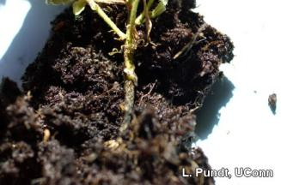
Fungus Gnat
Fungus Gnat larvae feed on the roots of the plants
Looks like a small fly – have very long antennae

Slide 5
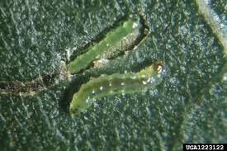
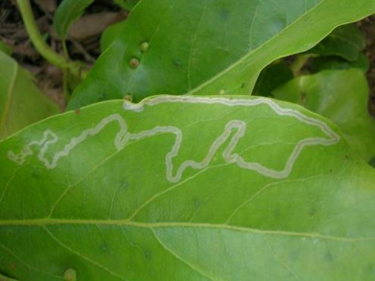
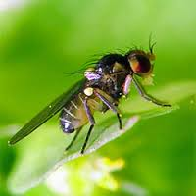
Leaf Miner
Leafminer larvae
Leafminer mining damage
Leafminer adult

Slide 6
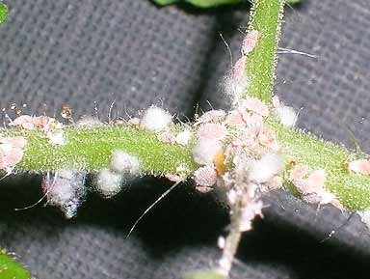
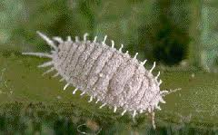
Mealy Bugs
Always white in color, start off in small groups
The webbing around some is the female laying eggs or an already formed egg mass

Slide 7
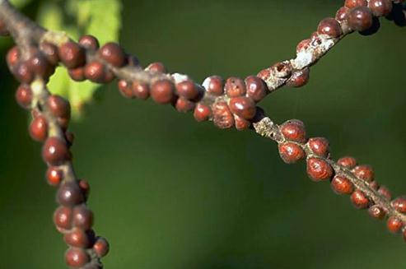
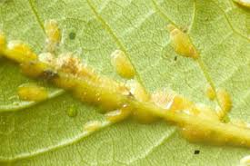
Scale
Scale can be found on the stems of the plant and the underside of the leaves. Scale can be several different colors. Scale can also be flat bodied and sit very close to the plant or sit more raised up on the surface.
Hard bodied scale
Soft bodied scale

Slide 8
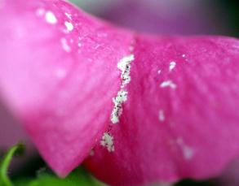
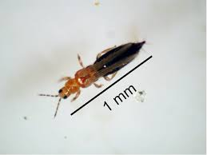
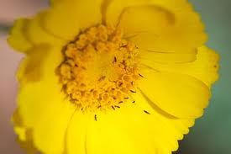
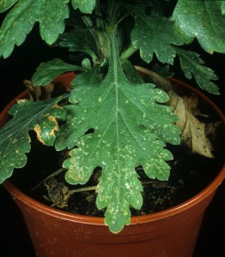
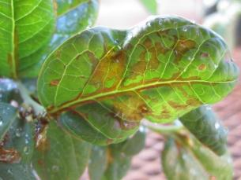
Thrips
Tiny, hard to see without a lens, dark bodies insect
Feeding damage on the petals of a flower
Often can be found inside flowers of the plant
Damage on blueberries
Damage to a florist chrysanthemum leaf

Slide 9
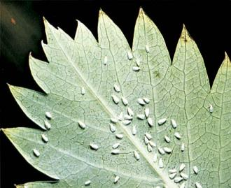
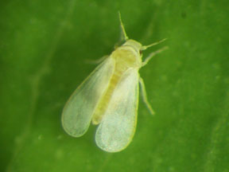
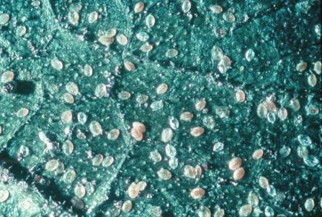
Whitefly
Whiteflies are small, white, winged insects.
Are normally found on the underside of the leaf
Lay eggs on the bottom of leaves, often egg castings( remains) are still visible even after they have hatched

Slide 10
Mites
All of the following insects should be treated by an miticide
Or “Apply Miticide/Acaricide”

Slide 11
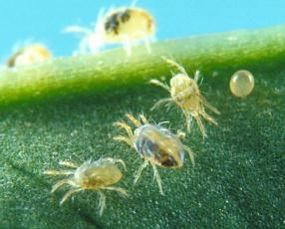
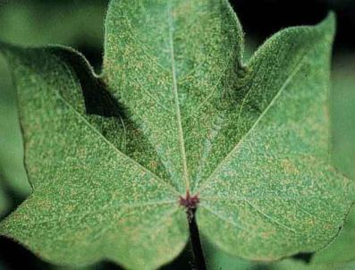
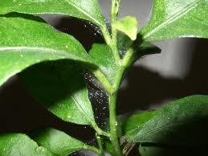
Spider Mites
appear in large groups and adults have 8 legs
Notice speckling on the leaves from spider mite damage
Also produce webbing in-between leaves of plant

Slide 12
Mollusc
All of the following pests should be treated by an molluscicide bait
Or “Apply Molluscicide Bait”

Slide 13
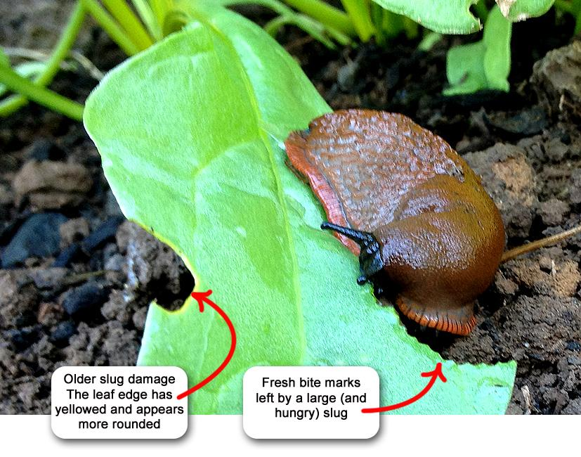
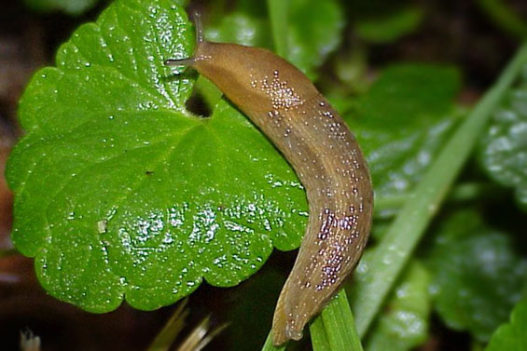
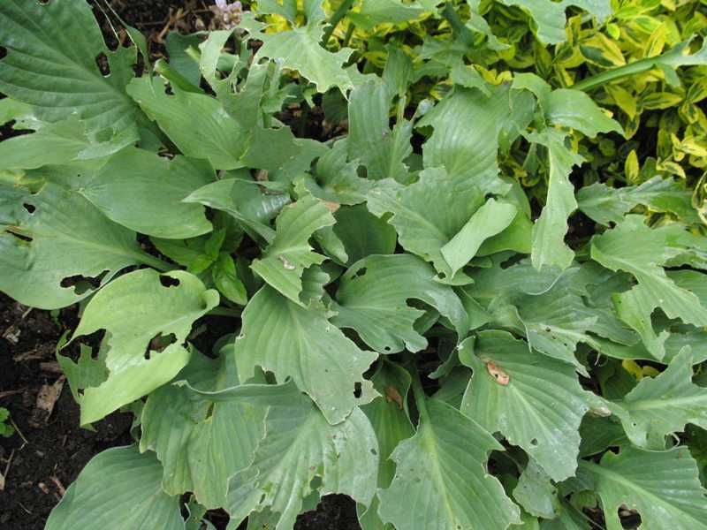
Slug
Unsegmented, soft, and slimy body – does not have a shell
Slug damage

Slide 14
Fungus/ Molds
All of the following pests should be treated by an fungicide
Or “Apply Fungicide”

Slide 15
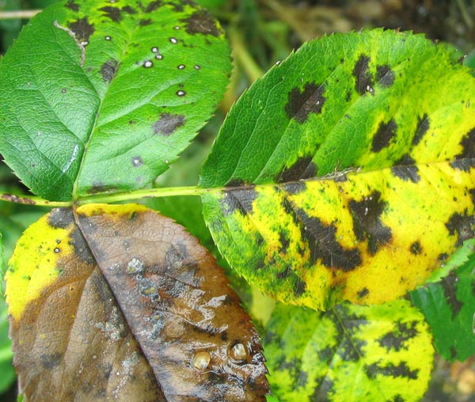
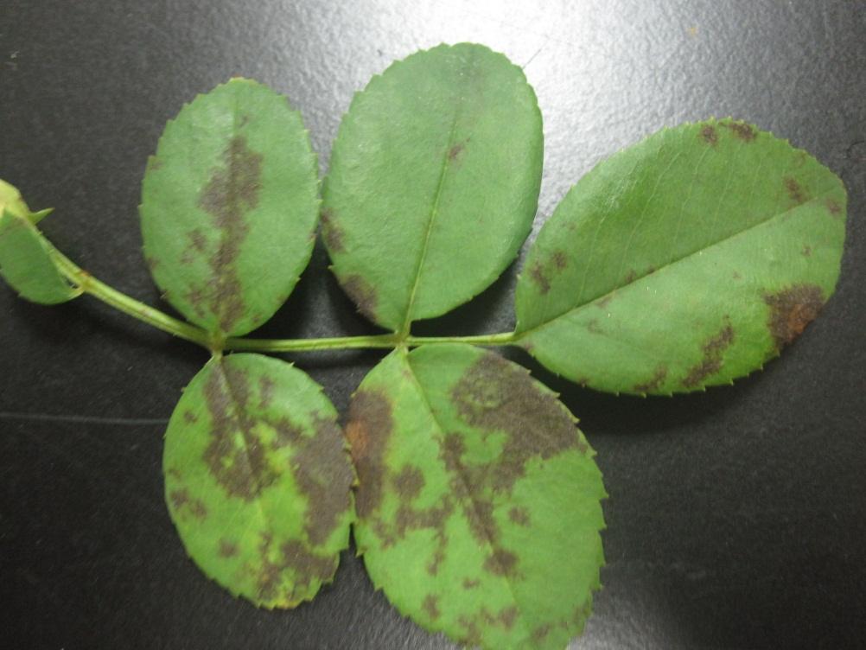
Black Spot
Brown or black circular or angular areas of dead tissue. Often dry

Slide 16
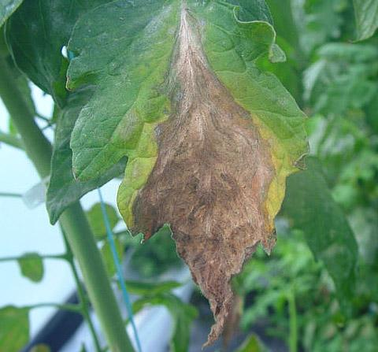
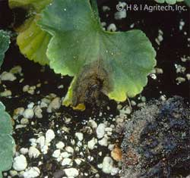
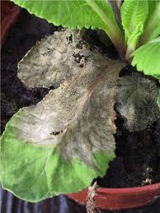
Botrytis
Symptoms of Botrytis diseases vary greatly depending on the host and plant part attacked. Generalized
symptoms include a gray to brown discoloration and a fuzzy whitish gray to tan mold growing on the surface

Slide 17
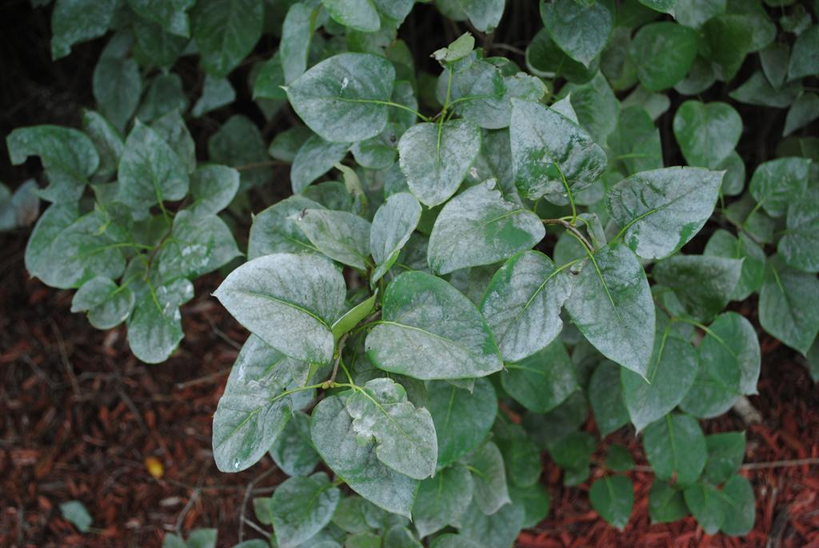
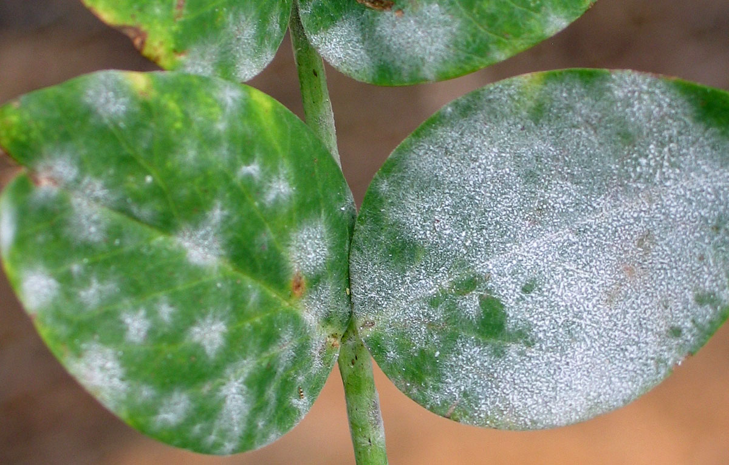
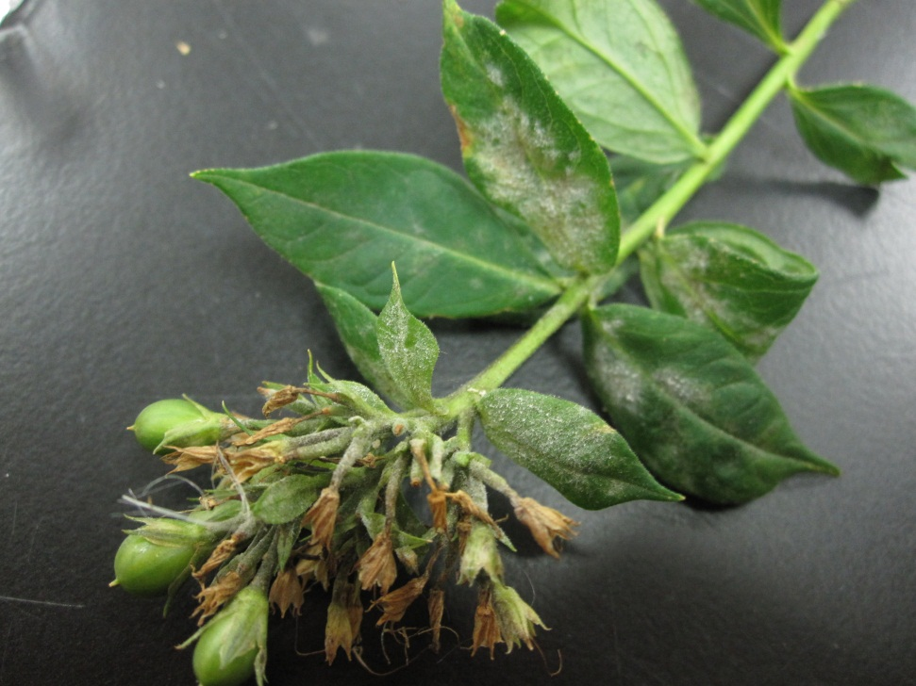
Powdery Mildew
Mold that is white/gray in color
Flat mold that grows along the top surface of the leaf

Slide 18
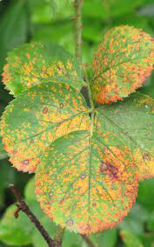
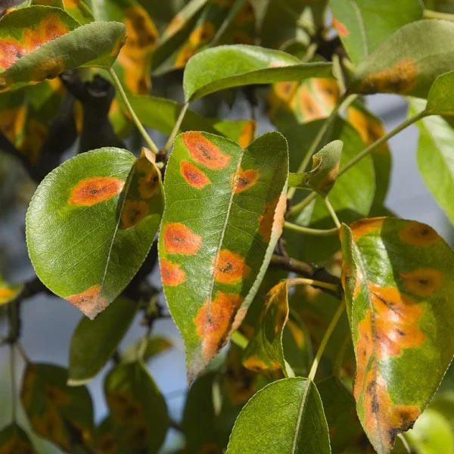
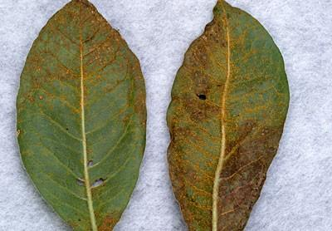
Rust
Red rings or spots on surface of the leaf
Can appear on top and underside of the leaf

Slide 19
Insufficient Plant Nutrients
The following disorders can be treated by applying a fertilizer solution
OR “Apply Complete Fertilizer”

Slide 20

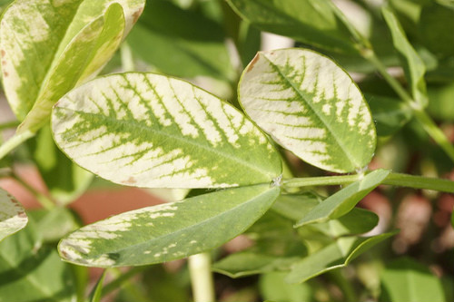
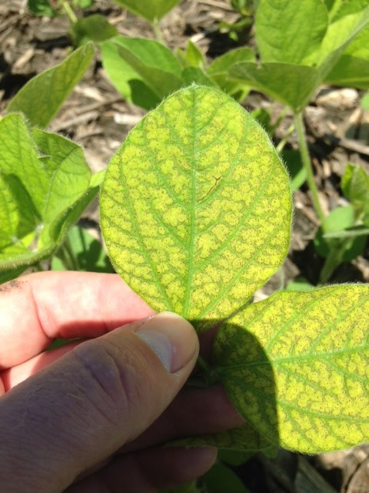
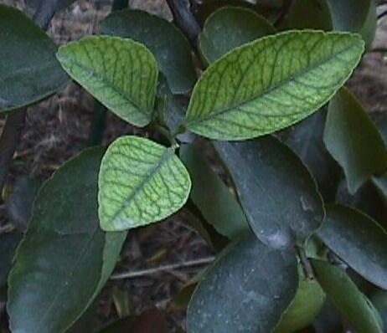
Iron Chlorosis / Deficiency
Leaf veins remain green

Slide 21
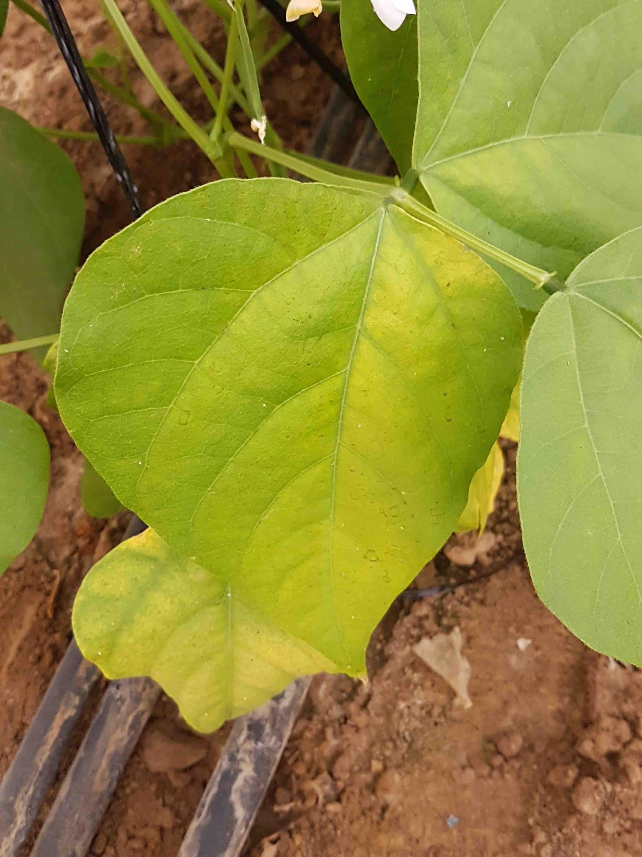
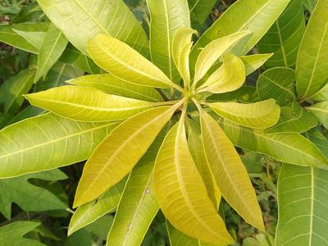
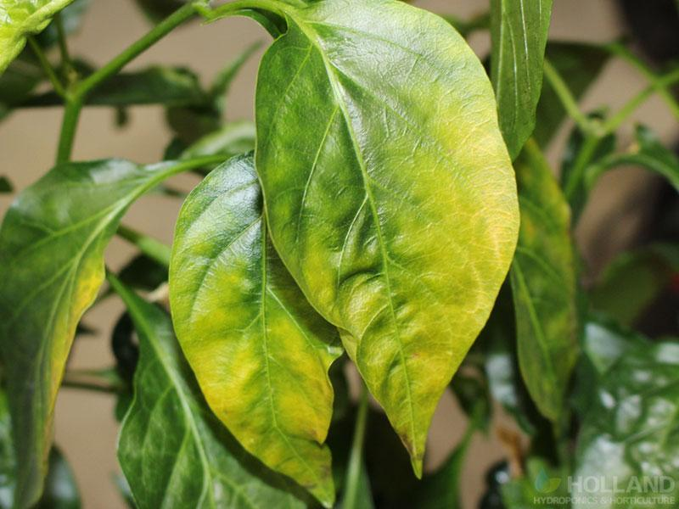
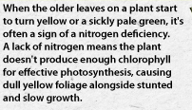
Nitrogen Deficiency

Slide 22
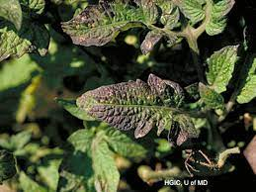

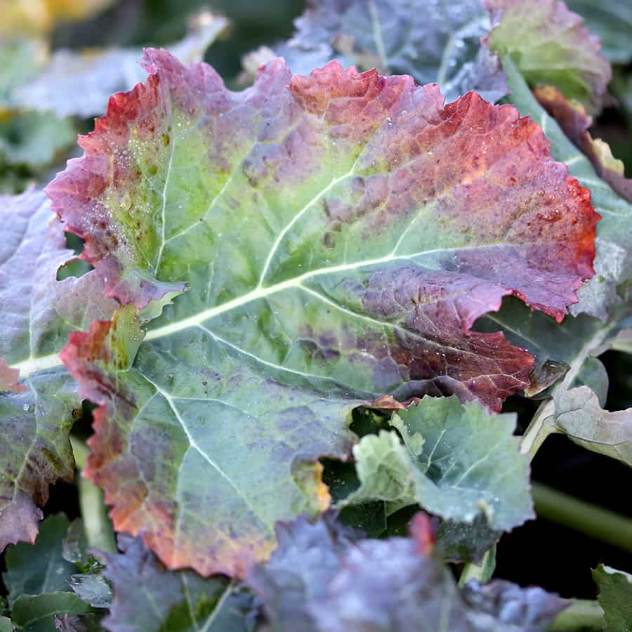

Phosphorus Deficiency
Leaf edges begin turning a purple/ brown hue

Slide 23
Other Disorders
These disorders can usually be treated by correcting watering issues and recover under favorable growing conditions
There is no treatment listed for these disorder.

Slide 24



Cold Temperature / Freeze
Typically affects new growth the most
Leaves and flowers are soft and wilted to the touch

Slide 25

Cold Water Damage
Typically occurs on plants with hairy leaf surfaces
White water spots appear on the leaf surface

Slide 26


Edema
Bumps appear on the upper or lower side of plant leaves
Can distort leaf shape

Slide 27


Insufficient Water Damage (Wilt)
Leaves and stems droop from lack of water
No discoloration appears

Slide 28
Weeds
All of the following pests should be treated by an herbicides
Or “Apply Herbicide”

Slide 29




Bermuda Grass
very fine blades and have more of a thinner, horizontal growth pattern

Slide 30


Carolina Geranium
Flowers are white to lavender with five petals, and found in two or more clusters
Stems are long, hairy, and range from green to red.
Deeply lobed, hairy on both surfaces

Slide 31


Chamber Bitter
Leaves are thin, oblong, and smooth, with rounded leaflets

Slide 32



Crab Grass
Thicker blade, clump like growth

Slide 33



False Hawksbeard
Leaves are different sizes with leaves on upper portion being smaller & hairless.
Older leaves are often crinkly and have prominent veins.
The flowers
are tiny, yellow, and dandelion-like.

Slide 34


Hairy Bittercress
Leaves are alternate
Long stems
Round, small leaf shape
Solid green with white flowers

Slide 35



Liverwort
Rubbery leaves to the touch
Solid green
Grows very flat to the ground
Likes wet areas

Slide 36


Oxalis

