Slide 1


Georgia FFA
Floriculture
Plant Identification Tips and Tricks
This is a free resource provided by Georgia Agricultural Education
Original creator: Melissa Riley, Central Region Horticulture Teacher

Slide 2
This PowerPoint was created to provide key characteristics of plants on the Plant Identification list of the Georgia Floriculture Career Development Event

Slide 3
Annuals/Bedding Plants

Slide 4
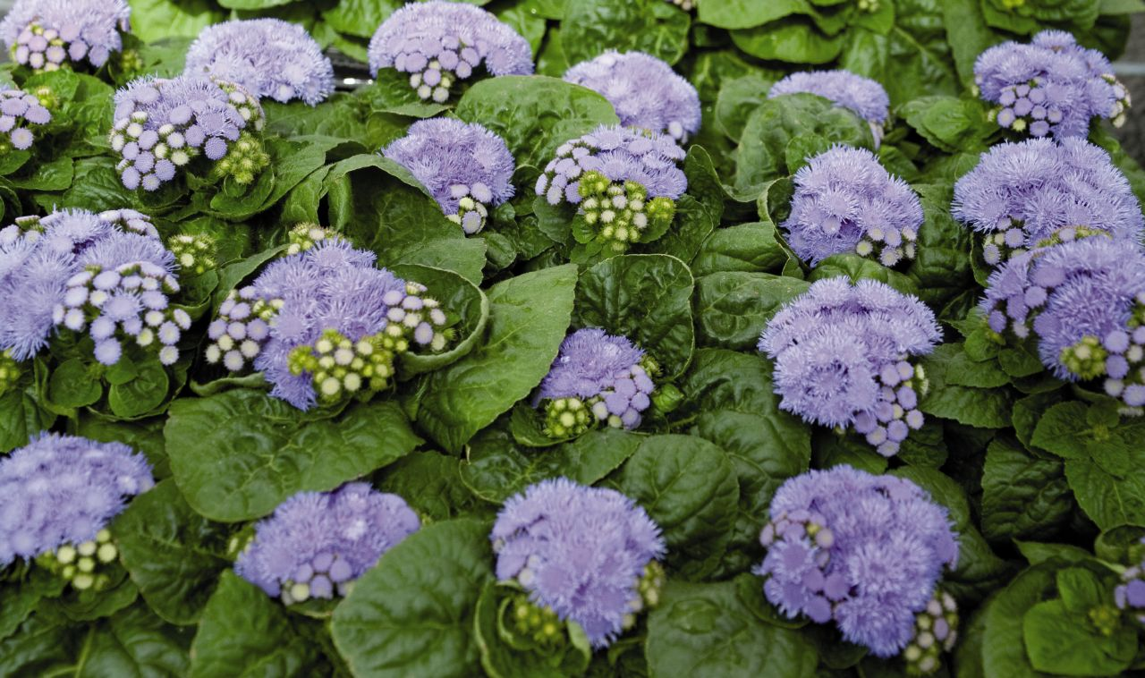
Ageratum
Bedding plant
Fluffy flowers (look like little powder puffs) in flattened to slightly rounded clusters atop compact, mounded plants
4” to 18” tall
Leaves typically rounded, cordate-at-the-base, hairy, slightly quilted, soft green
only common bedding plant with true blue flowers

Slide 5
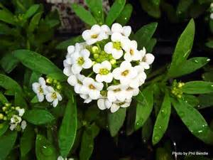
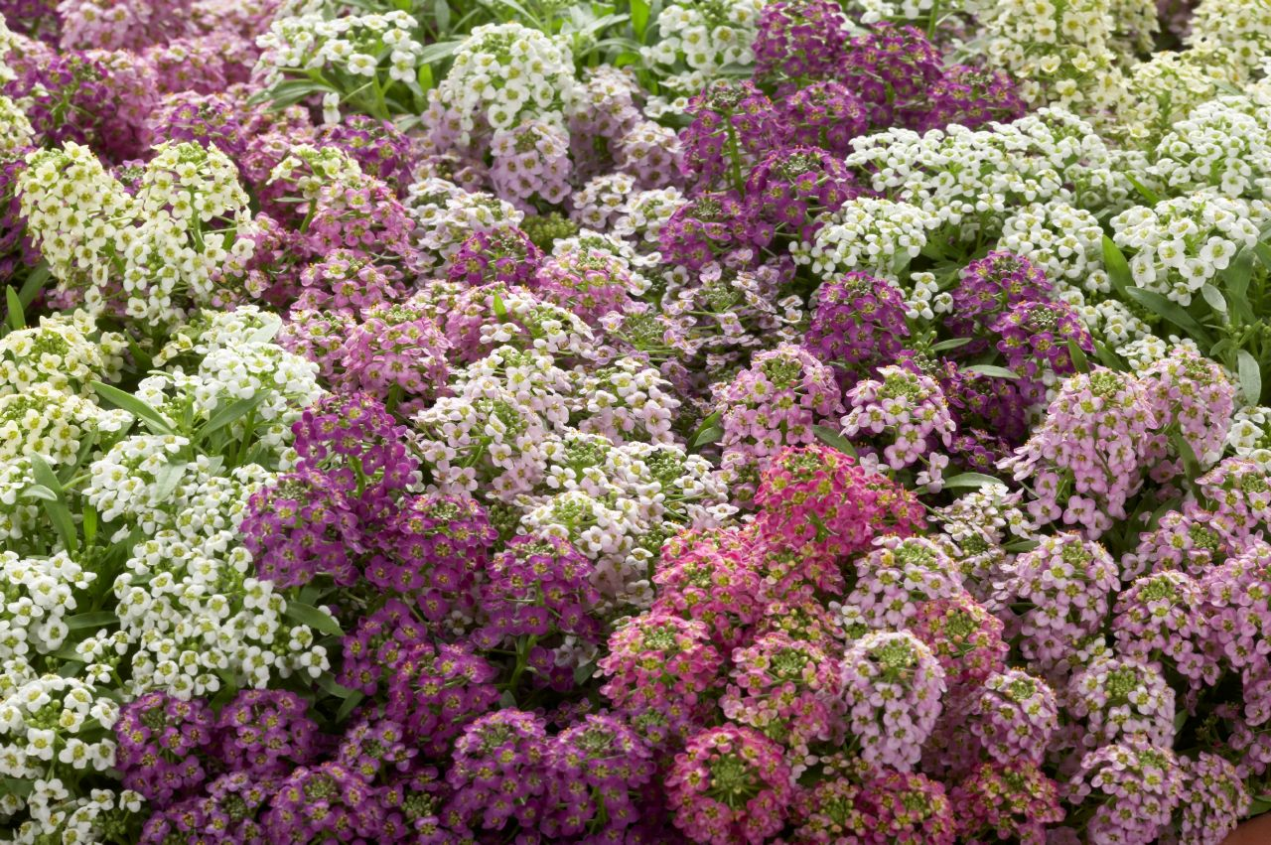
Alyssum
Very small delicate flowers – flowers can be shades of white, pink, or purple – flowers are tiny with 4 petals (Brassica)
Grows in a mounded shape
Leaves are roughly 1 inch long and only ¼ inch wide
Smells very sweet (like honey)

Slide 6
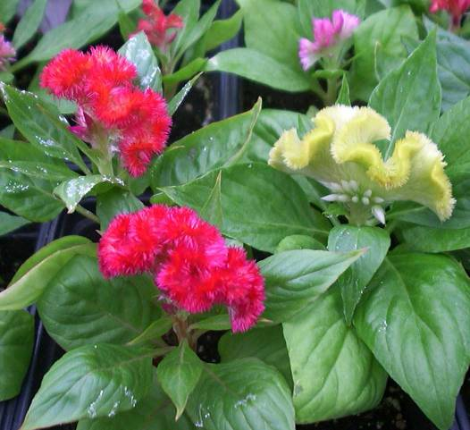
Celosia
Midrib gets progressively lighter in color towards end of leaf
Fasciated, large crested flower heads (3-12” across), with each flower head somewhat resembling the comb of a rooster.
Flower colors include bright shades of orange, red, purple, yellow and pink.
Flowers bloom throughout summer into fall (sometimes to frost) on stems clad with spear-shaped green to red purple leaves.

Slide 7
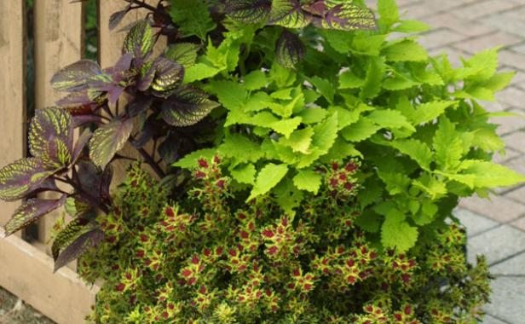
Coleus
Leaves come in multiple sizes, shapes, and colors
Square stem
Leaves are opposite

Slide 8
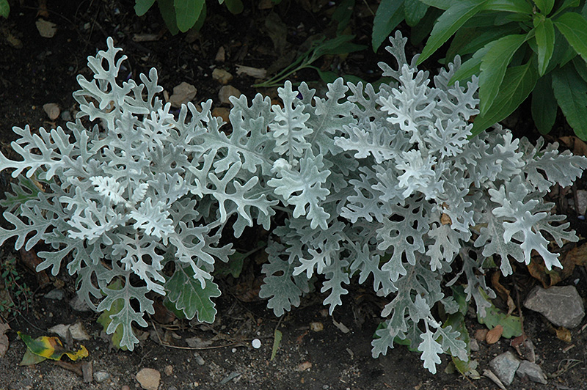
Dusty Miller
Leaves silver or gray in color
Lobed Leaf
Leaves are fuzzy and soft to the touch

Slide 9
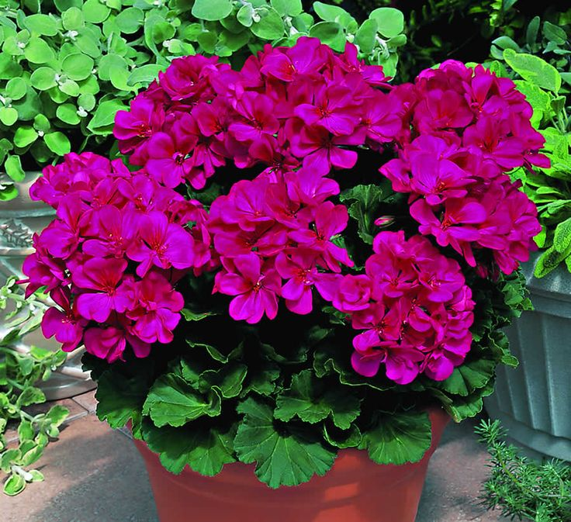
Geranium
Un-opened flower buds face down
Flower “stem” is very long and raises above foliage
Fragrant flowers bloom in clusters
Leaves are round-oval with ruffled edges
leaves have a darker "horseshoe" or zonal band running around the leaf

Slide 10
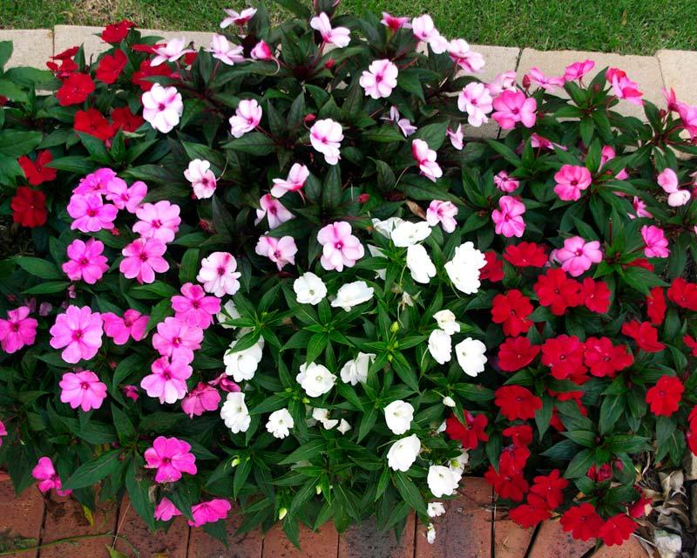
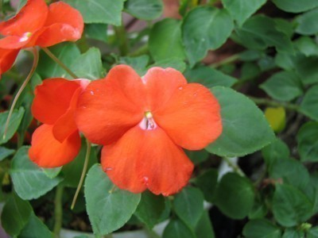
Impatiens
At the end of every vein is a small soft thorn
Stem is translucent/ succulent like – can see through the stem
It looks like the flower has two stems, but only one attaches to the plant. The other is a nectary gland, and pests like thrips can be found inside of it, lapping up nectar

Slide 11
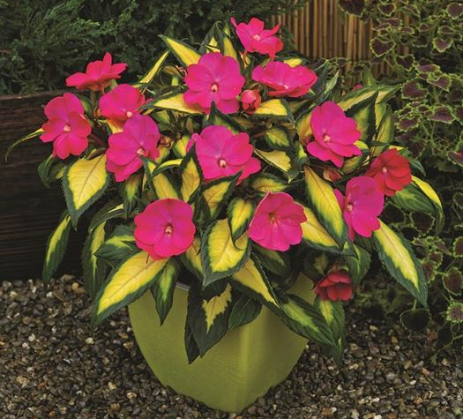
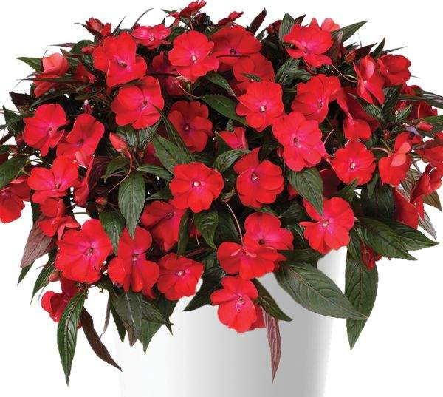
New Guinea Impatiens
Larger leaves than traditional impatiens
Similar flower but can tolerate more sun
Large, long, narrow leaves that can be variegated
Leaves are usually in whorls of 3-7 leaflets
The flowers have five slightly overlapping petals around a small, button-like center.

Slide 12
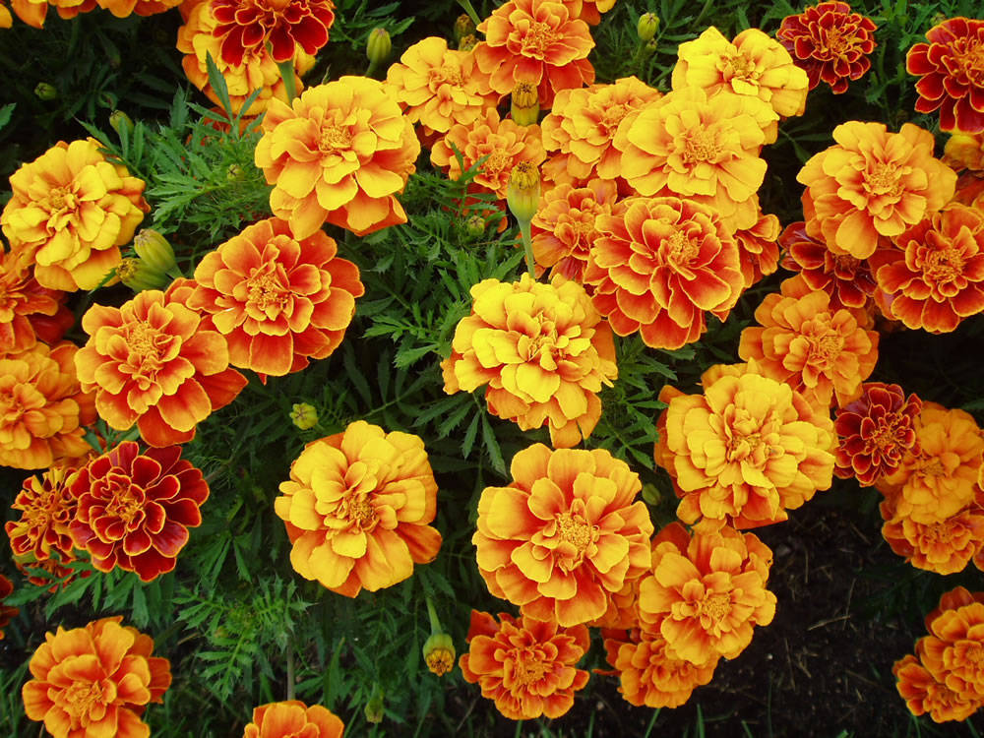
Marigold
Has a very distinct odor to ward off pests
Leaves are compound
Flowers grow in a pom/pom shape
Flower colors are typically shades of red, yellow, and orange

Slide 13
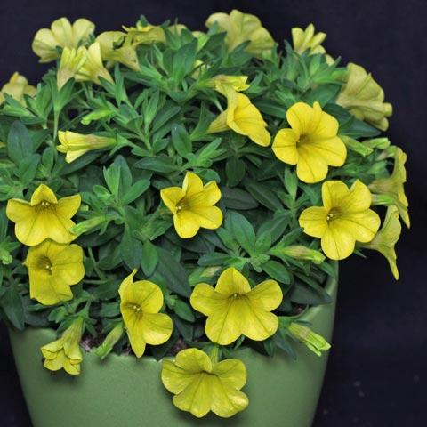
Million Bells
Flowers look like small petunias
Compact, mounded plants grow 3-9” tall on mostly trailing stems.
Prolific bloomers produce hundreds of 1” wide flowers from spring to frost
Flower colors include shades of violet, blue, pink, red, magenta, yellow, bronze, and white

Slide 14
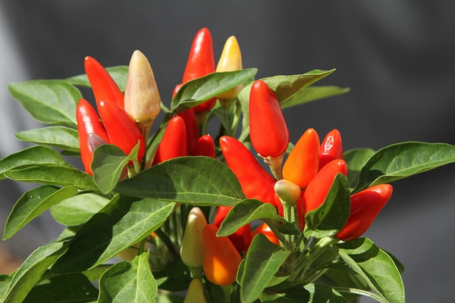
Ornamental Pepper Plant
Shrubby mounds 1-4’ tall
Lance-shaped to oval medium green leaves
Star to bell-shaped white or yellow flowers give way to edible peppers
the peppers point upward on most ornamental varieties (unlike edible peppers which hang down)
Many cultivars developed for ornamental use featuring attractive peppers in bright shades of red, yellow, purple, orange and brown.

Slide 15
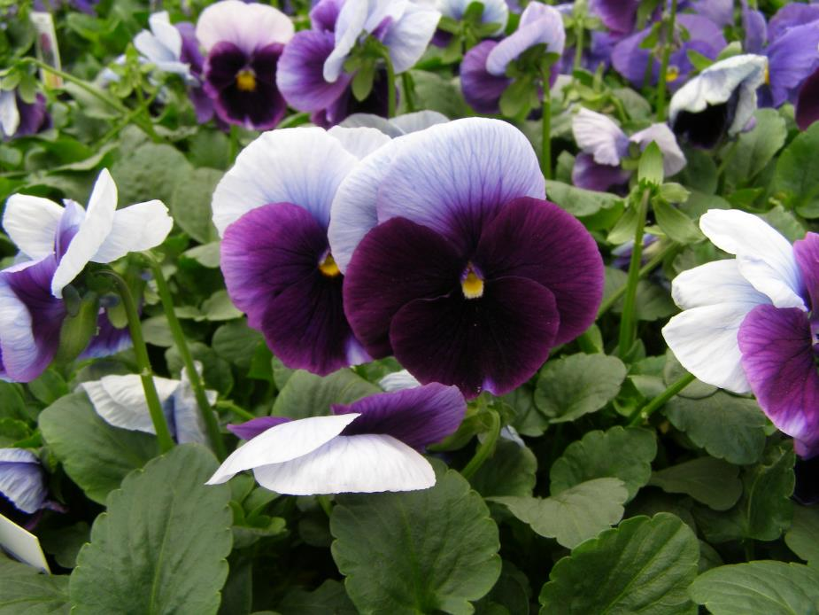
Pansy
Flowers have two layers of petals
Leaves have scalloped edges
have stipules (leaf-like structures at the base of the leaf stem) that are as large as the leaves themselves

Slide 16
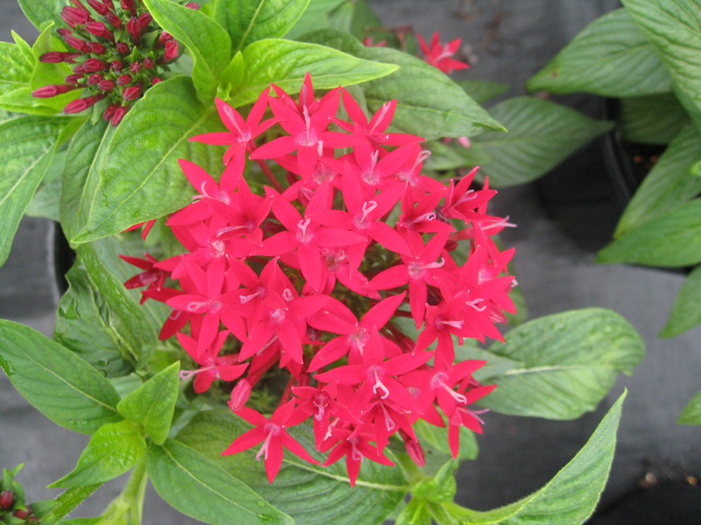
Pentas
A tropical woody-based perennial that grows to 1-2’ tall in beds or containers.
A many-branched, somewhat sprawling plant
Features 4” wide rounded clusters of star-shaped flowers.
Elliptic to lanceolate dark green leaves (to 6” long).
Flowers are pink, magenta, lilac or less commonly white.

Slide 17
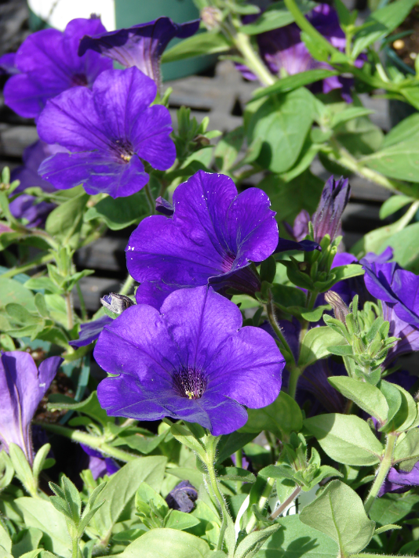
Petunia
Trumpet/ tube shaped flower – lots of colors
All the petals are attached together
Leaf is pointed and fuzzy, stem is fuzzy
Plant typically grows in a downward pattern
un your finger along a petunia stem — it's extremely sticky/glandular

Slide 18
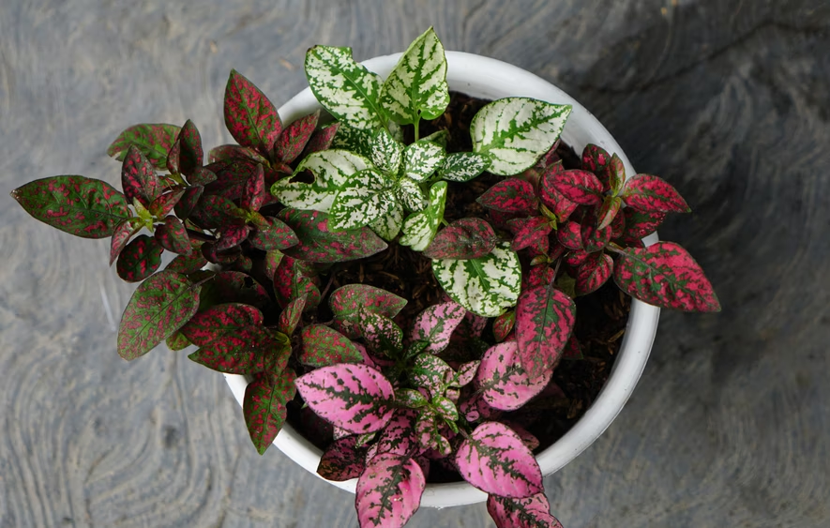
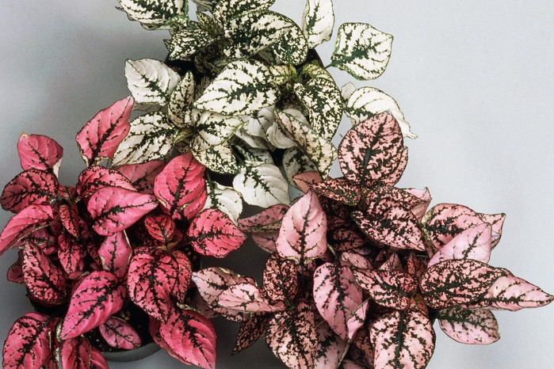
Polka-Dot Plant
brightly variegated or spotted leaves that look like polka dots
Leaves are oval shaped
The plant has a small bushy growth habit and tends to branch out as it grows.

Slide 19
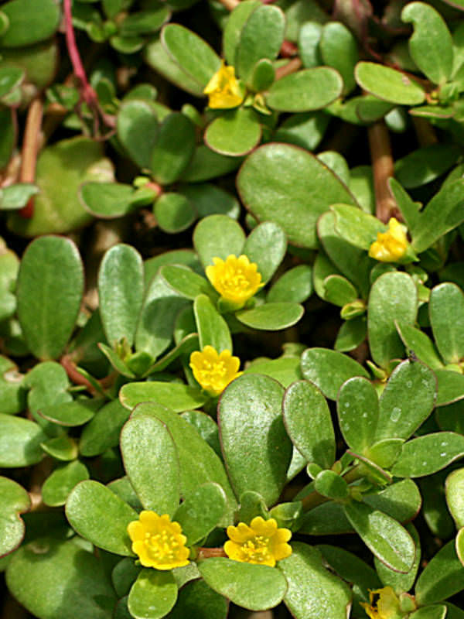
Portulaca
Features 2” diameter flowers in orange, yellow, red, pink, white and bicolors.
Plants typically grow 4-8” tall and spread to 15” wide.
Flowers bloom summer to frost.
Spatulate to ovate, flat, fleshy leaves (to 1.25” long) / like a succulent.

Slide 20
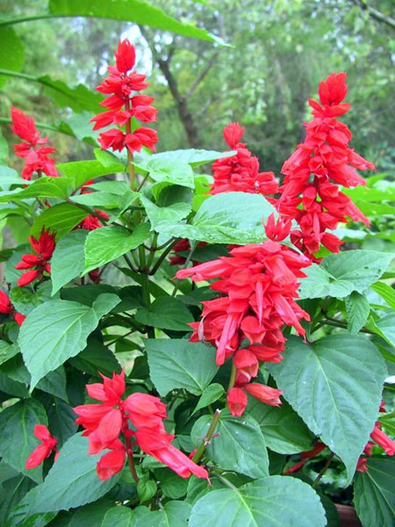
Salvia
Comes in a variety of colors, flowers is upright on a stalk with lots of blooms on one stem
Has a square stem
Leaf is triangle in shape
The leaves are rough/wrinkled

Slide 21
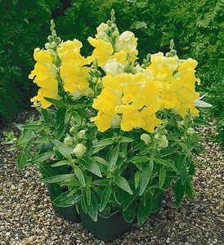
Snapdragon
Upright form
Flower well from spring to fall
Dragon-shaped, tubular, two-lipped, closed flowers
Flowers come in both pastel and bright colors such as shades of white, yellow, red, pink, orange, peach and purple (some bicolors)
Lance shaped, glossy dark green leaves (to 3” long)

Slide 22
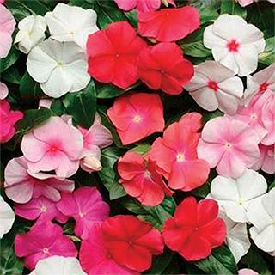
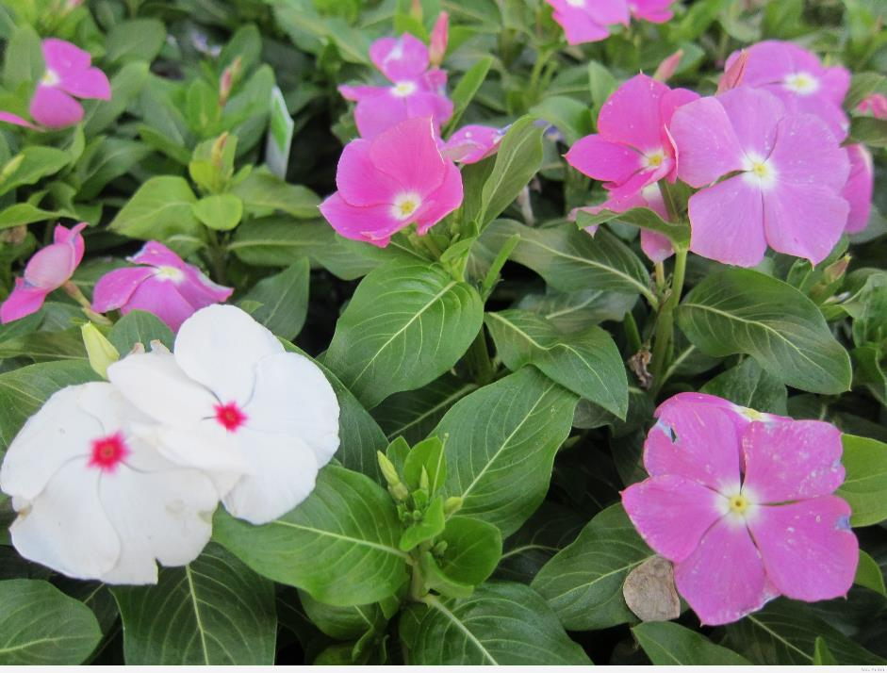
Vinca
Flower bud has pinwheel shape
Mounding 6-18” (less frequently to 24”) tall and as wide
Flowers have five flattened petal-like lobes and appear in upper leaf axils
Colors include pale pink, rose, hot pink, red, lilac, and white, often with contrasting darker throats/eyes
Oblong to ovate glossy, green leaves (2” long) with white midrib

Slide 23
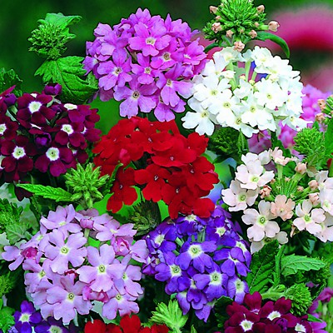
Verbena
Stems and leaves are slightly hairy
Flowers in small clusters and in a variety of colors
the flower clusters are flat-topped
Leaves are triangle shape

Slide 24
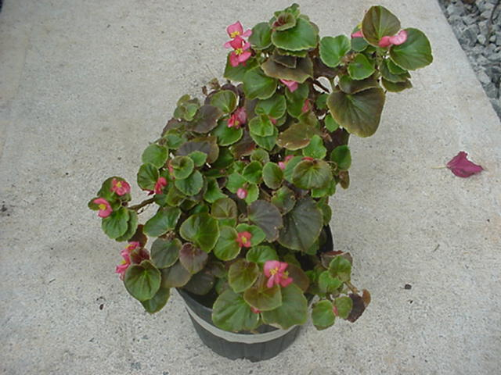
Wax Begonia
Waxy leaves gives glossy look
Leaf margins look like torn paper, rough, ragged edges
Leaves can be green or bronze
wax begonias have a very asymmetrical leaf base (one side is clearly larger than the other)

Slide 25
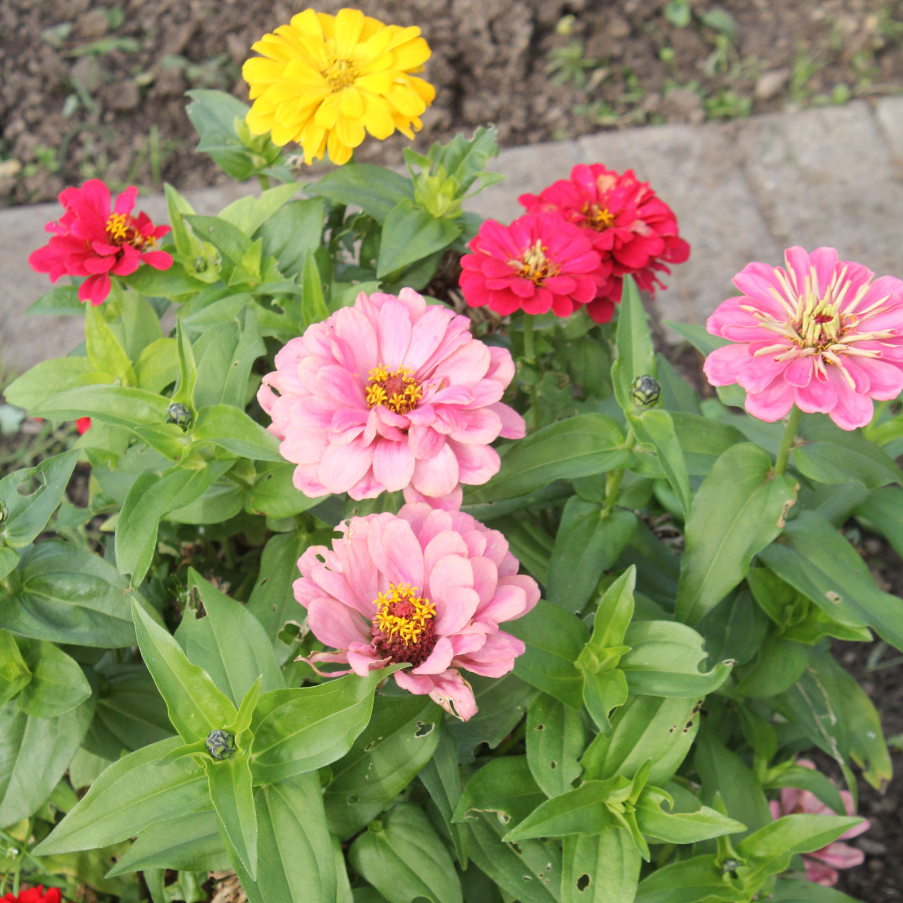
Zinnia
Composite, brightly colored flowers
No petiole – leaves go right up to stem
Growth pattern is upright
3 midribs to each leaf
Zinnia leaves are rough and sandpapery to the touch
stem is somewhat hollow

Slide 26
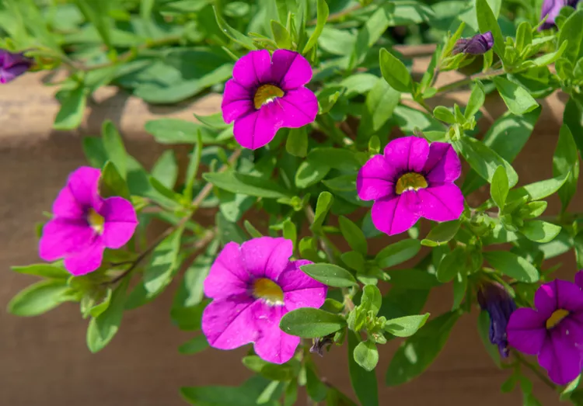
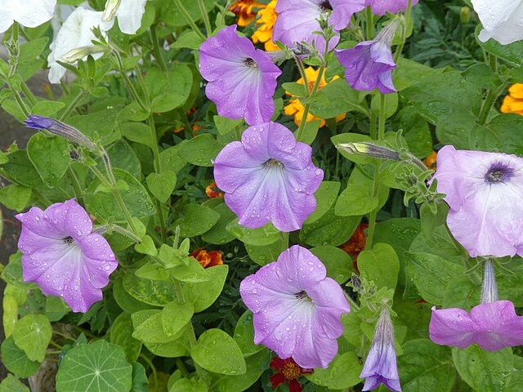
Now let's Compare
Million Bells (Calibrachoa)
Size: Tiny flowers — only about 1" wide (like a miniature petunia)
Quantity: Produces HUNDREDS of blooms at once — prolific!
Leaves: Very small, narrow leaves along trailing stems
Growth: Compact, mostly trailing stems; 3–9" tall
Everything is proportionally tiny — a 'mini' version
Petunia
Size: Large flowers — 2–4" wide (much bigger than Million Bells)
Quantity: Fewer blooms at once
Leaves: Larger fuzzy leaves; noticeably bigger than Million Bells
Texture: Sticky, hairy stem and leaves
Petals: All petals fused together into a trumpet shape

Slide 27
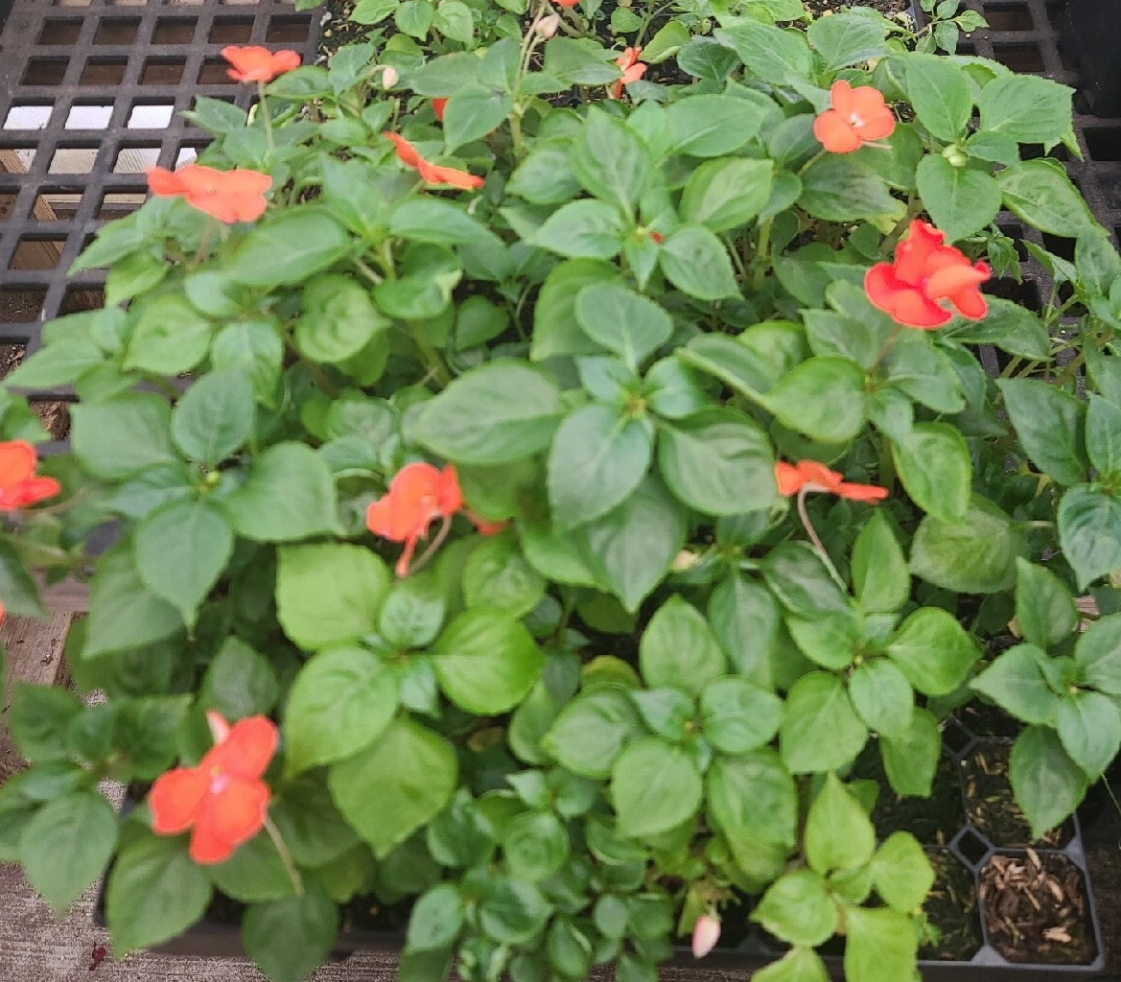
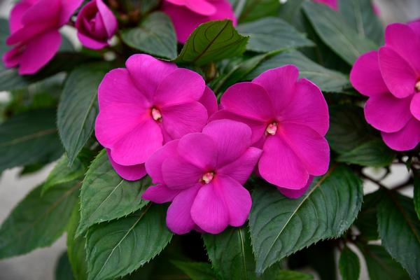
Now let's Compare
Impatiens
Leaves: Smaller, oval-shaped leaves (~2" long)
Stem: Translucent stem — you can see through it!
Thorns: Tiny soft thorn at the end of every leaf vein
Nectary: What looks like a second stem is actually a nectary gland — thrips hide inside
Flower: Smaller flowers (~1" across)
Texture: Succulent, watery stems that snap cleanly
New Guinea Impatiens
Leaves: Much larger, long, narrow leaves (3-5" long), often variegated
Arrangement: Leaves in whorls of 3–7 leaflets around the stem
Flower: Much larger flowers (up to 3" across)
Color: Leaves often have a dark, glossy sheen
Center: Five slightly overlapping petals around a small button-like center

Slide 28
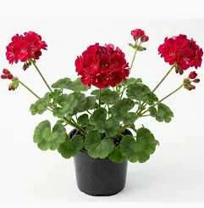
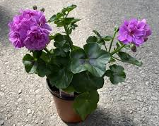
Now lets compare
Geranium
Upright bushy plant
round, hairy leaves with a distinct dark horseshoe/zone marking on the leaf surface
Strong, distinctive smell
Ivy Geranium
has showy flower clusters
Named 'ivy' because its 5-lobed leaf LOOKS like ivy — but it's a geranium
waxy, thick, semi-succulent leaves
trails from a hanging basket but cannot climb walls

Slide 29
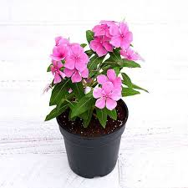
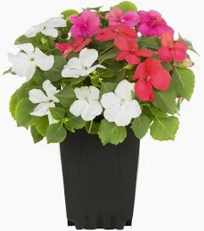
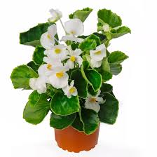
Now let's Compare
Vinca
Waxy, very glossy POINTED leaves
5 flat petals with a tube
Smooth leaf edges
WHITE center vein
Impatiens
Soft, matte leaves
Flowers are flat
Extra “stem” attached behind flower
Leaves slightly toothed
Stems very fleshy/watery
Wax Begonia
Waxy, glossy leaves
Two large + two small petals
Slightly toothed/wavy leaves

Slide 30
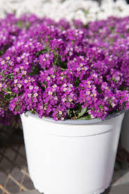
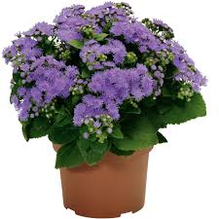
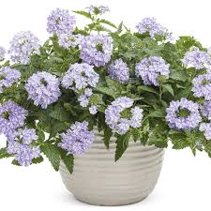
Now lets compare
Alyssum
Tiny white/purple flowers
Small, narrow leaves – Alternate
Tiny clusters of flowers - flowers are tiny with 4 petals
Ageratum
Fuzzy blue/purple flower pompoms
no visible petals
Small, oval leaves – opposite
Verbena
Spreading, trailing habit
Rough, hairy, deeply wrinkled leaves
Small 5-petaled flowers in flat-topped rounded clusters

Slide 31
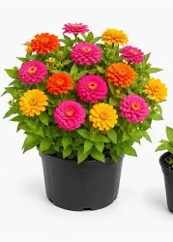
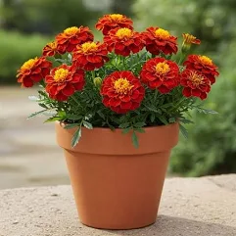
Now lets compare
Marigold
Leaves are pinnately compound — divided into many small leaflets
Smooth leaflets, delicate appearance
Flowers are yellow, orange, gold, cream, rust — warm tones only
Stems hollow, upright, branching
Zinnia
Leaves opposite and leaf base wraps around stem
Flowers in nearly every color — widest range of any annual
Flowers can be single to fully double, daisy-like to pompom
Leaves broad to oval shaped
Stems thick, upright, slightly hairy

Slide 32
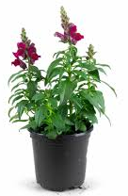
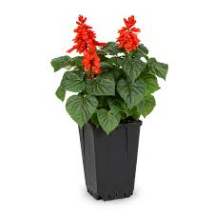
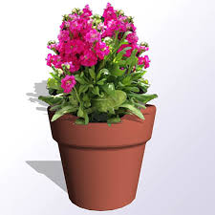
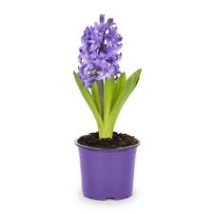
Now let's Compare
Snapdragon
Flowers - Hinged "snap" mouth — two-lipped, closes and opens
Leaves longer than it is wide, tapering to a sharp point at the tip
Smooth, slightly waxy
Alternate on stem
Hyacinth
Flowers - Tiny star-shaped florets packed densely along spike
BULB
Smooth, succulent-like, thick leaves
All from base — no leaves on flower stalk
Flowering Stock
Flowers - 4 petals in a cross arrangement, densely packed
Leaves very long, narrow, fuzzy/woolly
Alternate, clasping stem
Salvia
Flowers - Tubular, two-lipped — open tube, no snapping
Leaves oval, slightly wrinkled/rugose
Opposite on square stem

