Slide 1


Georgia FFA
Floriculture
Plant Identification Tips and Tricks
This is a free resource provided by Georgia Agricultural Education
Original creator: Melissa Riley, Central Region Horticulture Teacher

Slide 2
This PowerPoint was created to provide key characteristics of plants on the Plant Identification list of the Georgia Floriculture Career Development Event

Slide 3
Bulbs and Tuberous Plants

Slide 4
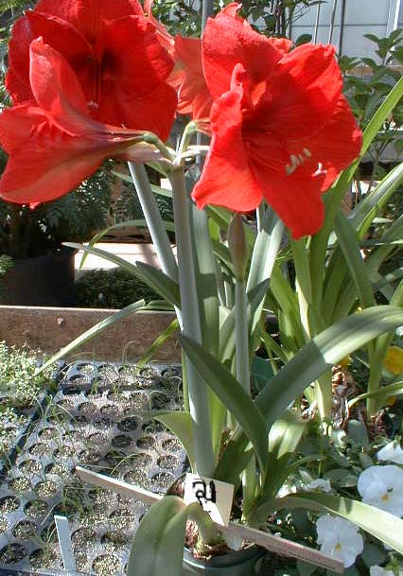
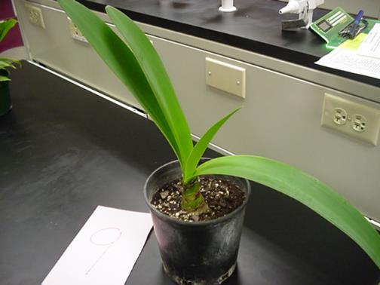
Amaryllis
Bulb, if planted correctly the bulb should show
Leaves opposite, USUALLY same # on each side
Does not have a pronounced mid-rib more of a swollen area on the back of the stem
Large flowers — multiple blooms emerge from the same point on a hollow stalk

Slide 5
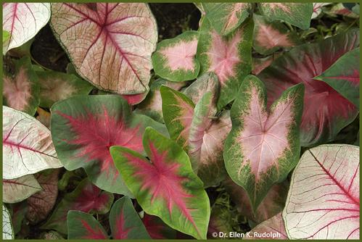
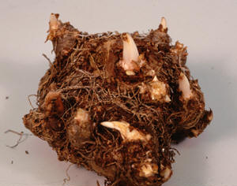
Caladium
Grows from a tuber
Plants grow in clumps 1-2.5' tall
One leaf per stem
Arrowhead-shaped leaves (~1.5' long) various shades of green mottled and blotched with pink, red, white or combinations thereof; distinctively colored veins
Stem attached under the leaf

Slide 6
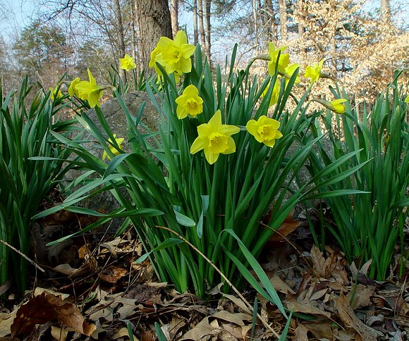
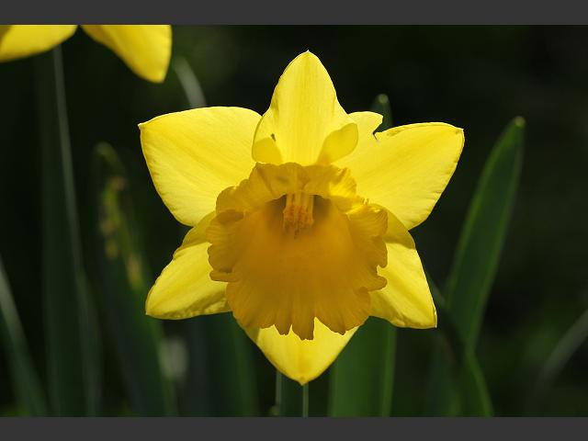
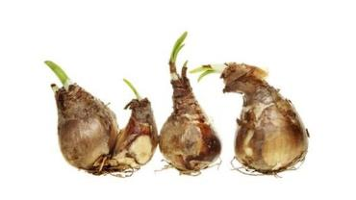
Daffodil
Flower resembles “tea cup & saucer”
Are usually yellow, white, or a mixer of the 2 colors
Leaf is flat with a very round end
Bulb is tear dropped shape

Slide 7
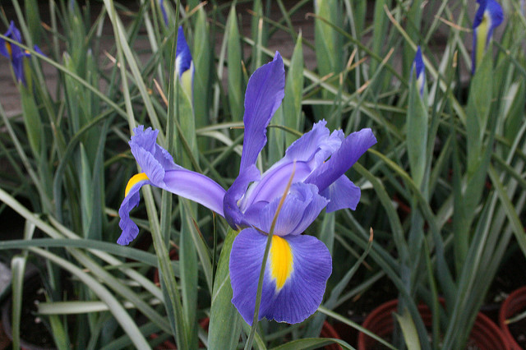
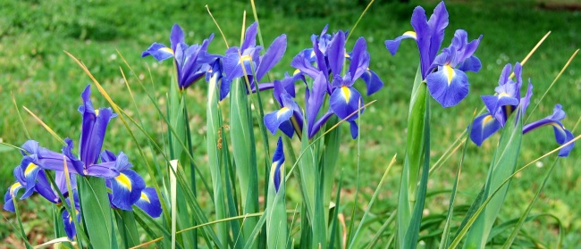
Dutch Iris
Smaller flowers compared to regular irises
Bearded can be purple/ blue or yellow and white
Leaves are very slim, grass like and silvery on the inside
Grows from a bulb (unlike most irises which grow from rhizomes)

Slide 8
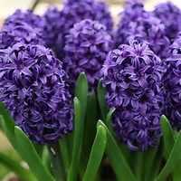
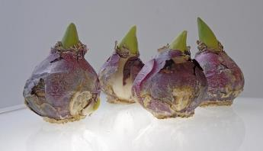
Hyacinth
Flowers come in a variety of colors
Dense spike (raceme) of tiny star-shaped florets all along one stalk
Leaf folds up into a boat shape
Bloom very early in the spring,
Very fragrant flowers
Bulb has purplish tint with very flat bottom

Slide 9
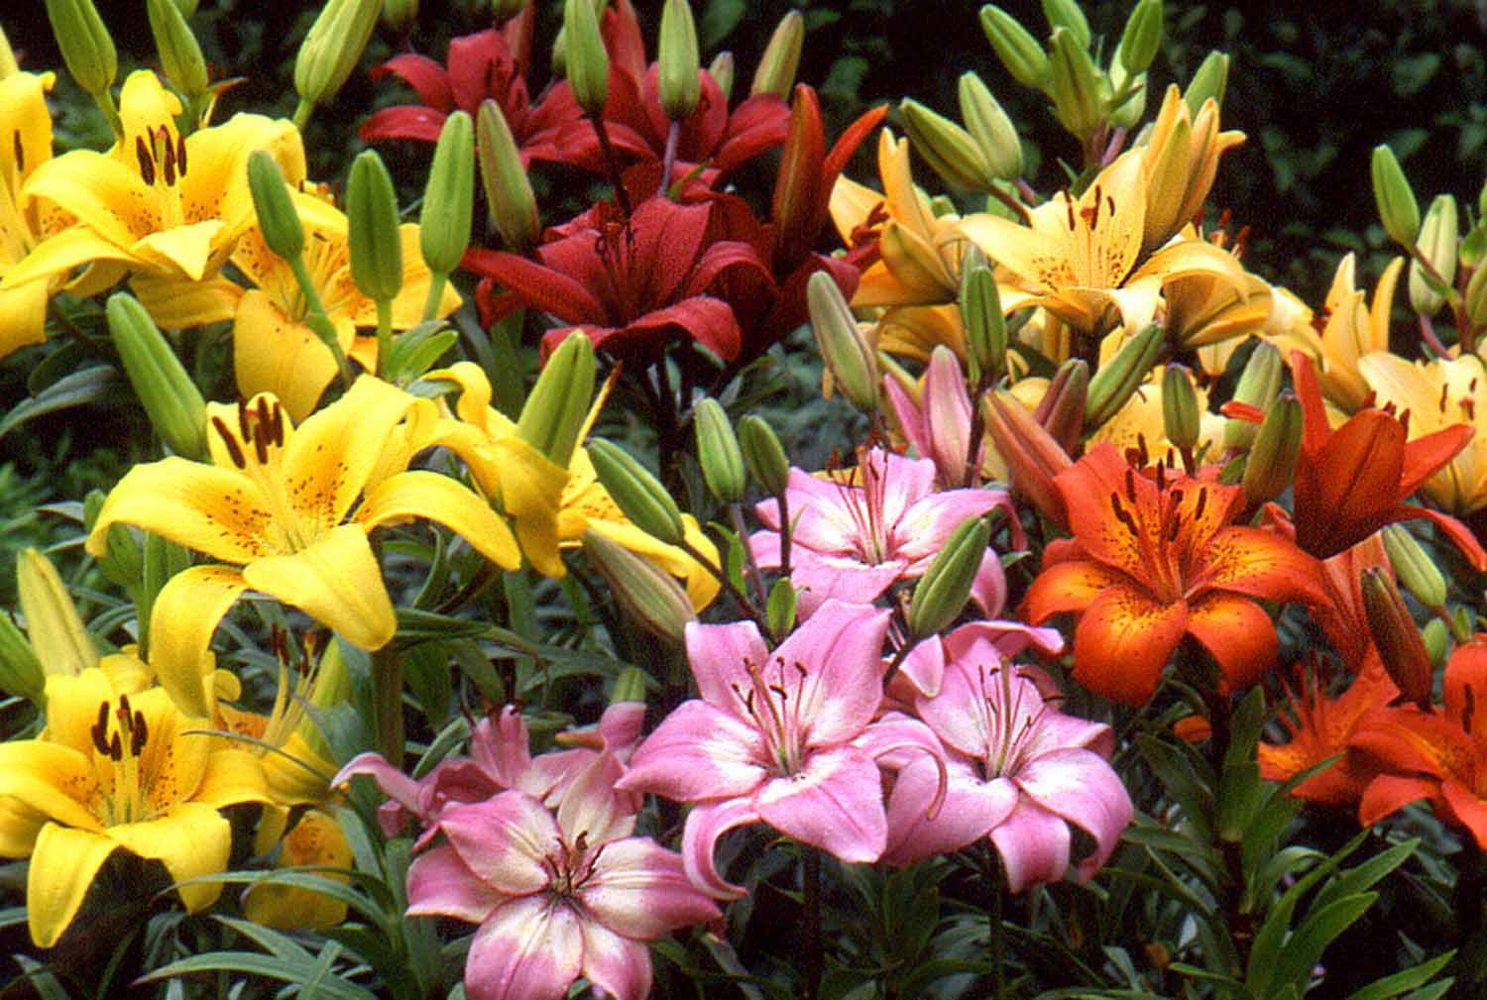
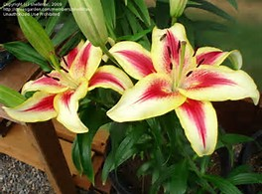
Asiatic Lily
Blooms come in many different colors
Flowers face upward (not drooping or outward-facing like other lilies)
No fragrance — unlike Oriental and Easter lilies
Lance-shaped leaves arranged alternately up the stem (no whorls)
The “stem” that attaches each flower to the plant is longer than on an Easter lily

Slide 10
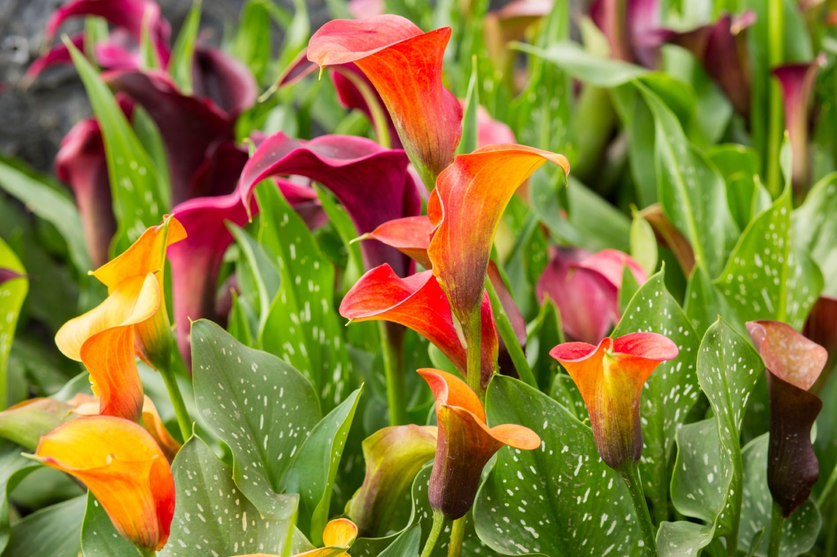
Calla Lily
Flowers and leaves rise directly from rhizomes.
Typically grow in clumps to 24-36” tall
Feature large arrowhead-shaped (sagittate) leaves - often with white spots or translucent flecks
Unique funnel/trumpet-shaped spathe (the "petal" wrap) surrounding a yellow finger-like spadix

Slide 11
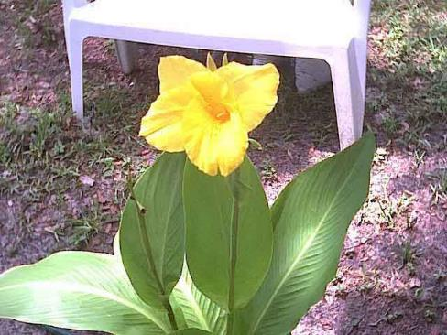
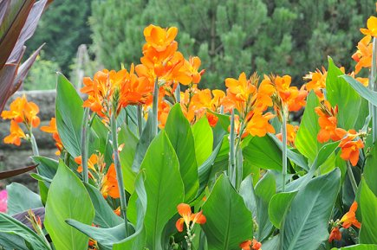
Canna Lily
Leaves come in variety of colors from variegated to green or red
broad paddle-shaped leaves — the biggest leaves of any plant on this list
Can be 4-6’ tall
Large flowers resemble those of an iris
Flowers in hot colors (orange, red, yellow) — no cool colors like blue or purple

Slide 12
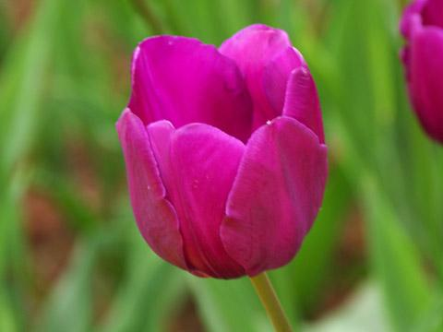
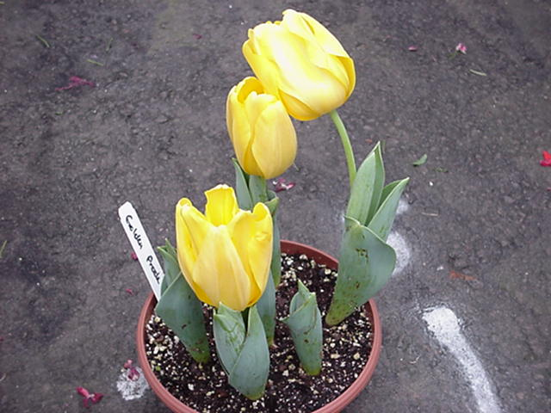
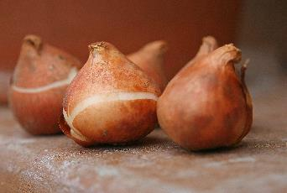
Tulip
Leaves have gray coating that rubs off
At end of life, flower opens all the way up
Leaf wraps around the stem
Small, round bulb with a papery “skin” called a tunic
Cup-shaped flower with exactly 6 petals, one bloom per stem

Slide 13
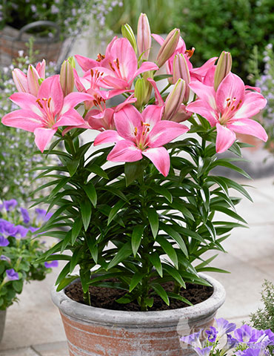
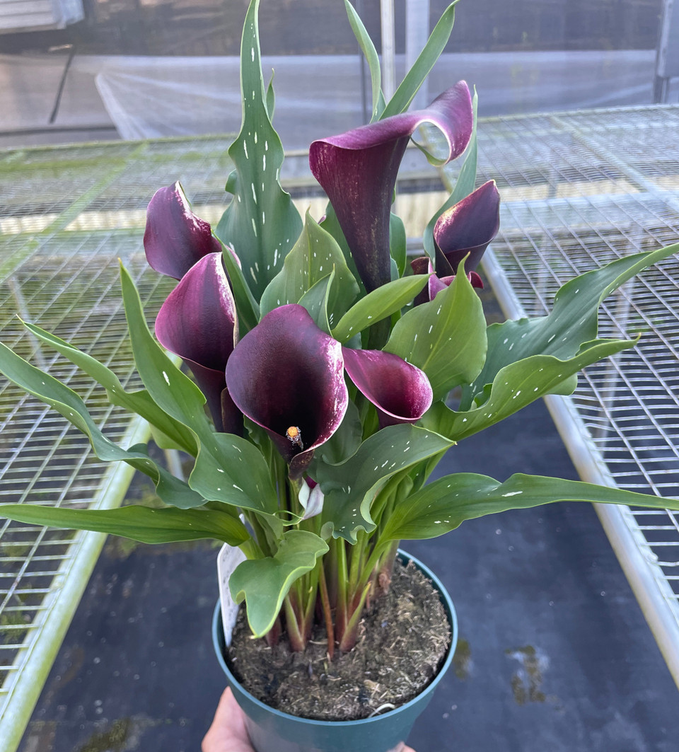
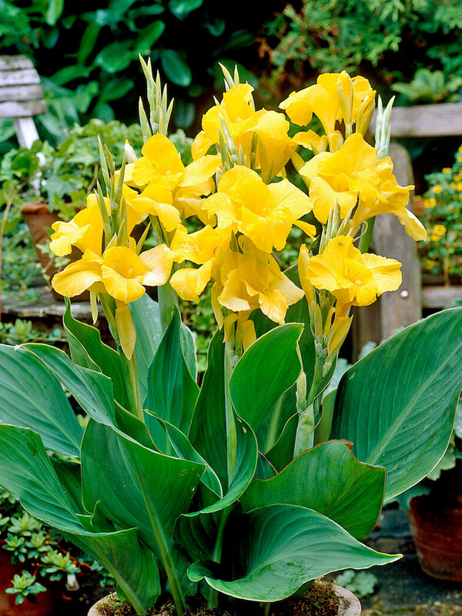
Now let's Compare
Asiatic Lily
Upward facing star flowers
Narrow leaves up the stem
No smell
Calla Lilly
Funnel-shaped wrap petals around yellow center
Pointed leaves
No true stem
Speckled leaves
Canna Lilly
Tallest of all three
Large paddle-shaped leaves
Iris-like, bold colored flowers
Leaves can be green or reddish/purple

Slide 14
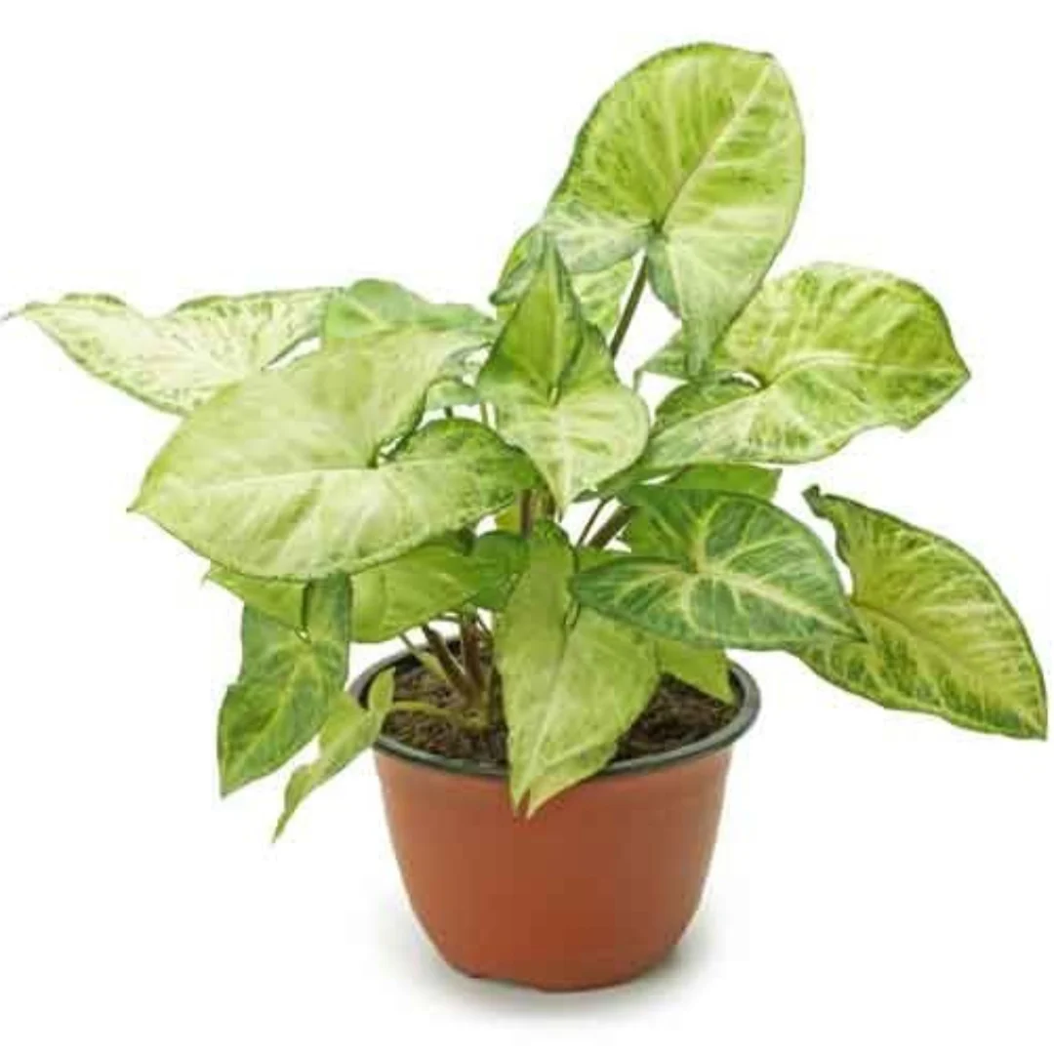
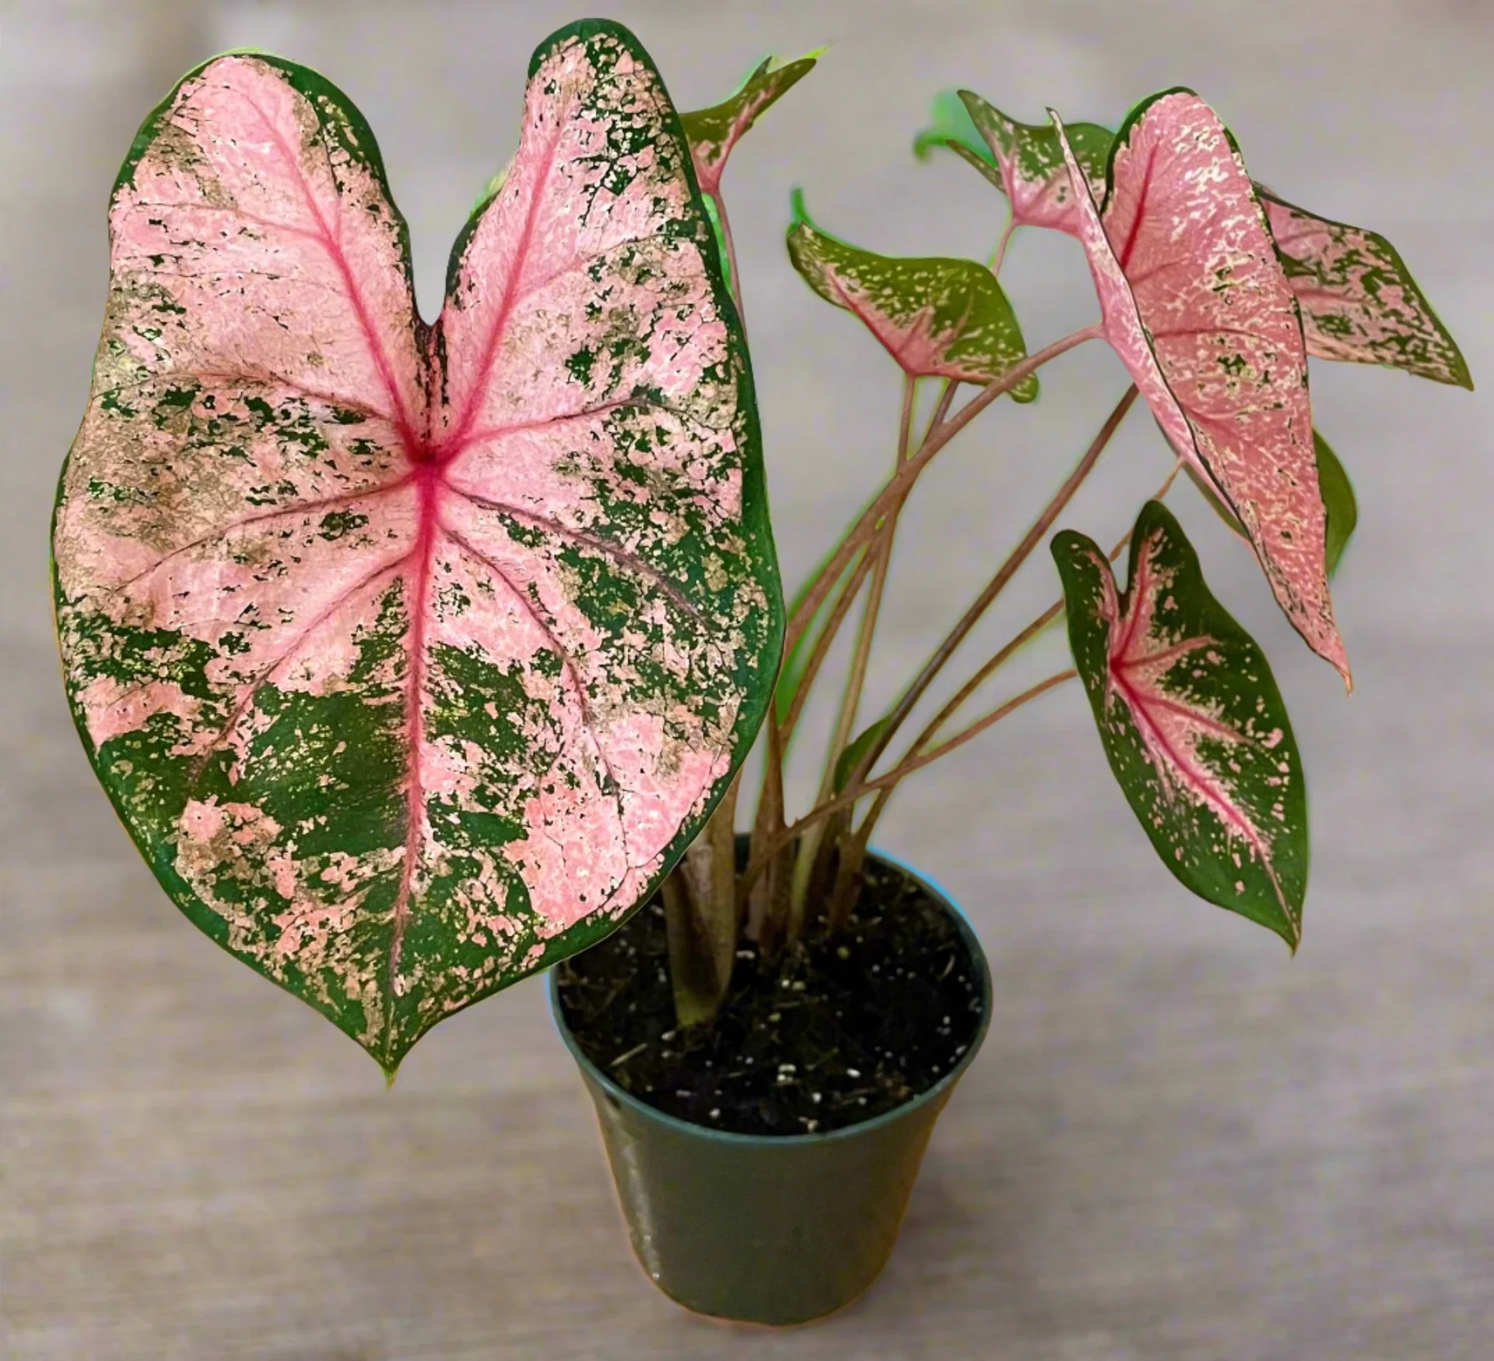
Now lets compare
Nephthytis
Stem attaches at the “V” of the leaf
Arrowhead leaves that get MORE lobed and finger-like as the plant matures
greener, waxier, vining tendency
Caladium
Stem attaches UNDER the leaf
Stays arrowhead-shaped
Bold green, pink, red, white blotches with colorful veins
Thin, almost papery leaves

