Slide 1


Georgia FFA
Floriculture
Plant Identification Tips and Tricks
This is a free resource provided by Georgia Agricultural Education
Original creator: Melissa Riley, Central Region Horticulture Teacher

Slide 2
This PowerPoint was created to provide key characteristics of plants on the Plant Identification list of the Georgia Floriculture Career Development Event

Slide 3
Flowering Potted Plants

Slide 4
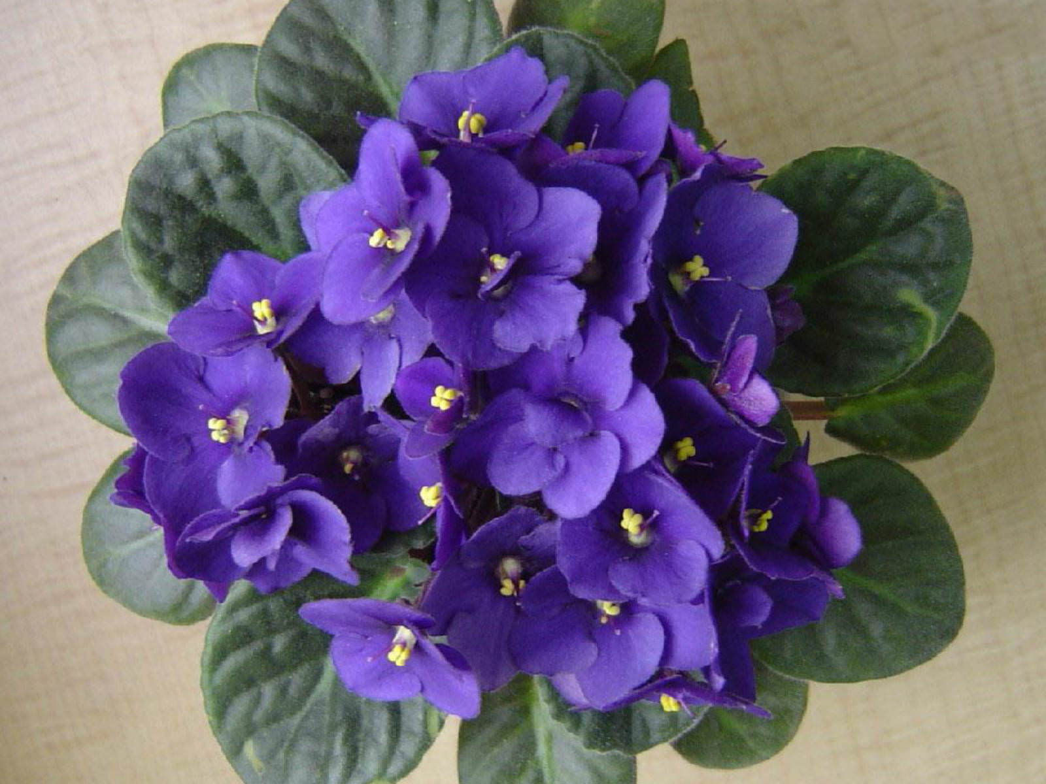
African Violet
Simple 5 petal flowers, one per ‘stem’ in large cluster
Leaves arranged in a flat rosette from the center crown
Small indentations on the leaves
Fuzzy leaf & petiole

Slide 5
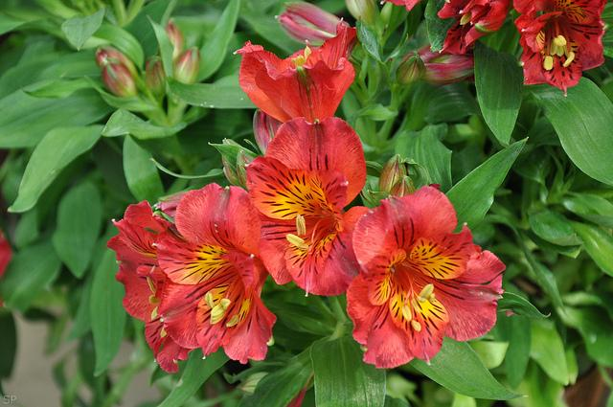
Alstroemeria
Top slender, upright stems in bushy clumps 2-3' tall
Flowers have distinct streaking/spotting inside the petals
Terminal flower clusters at the top of upright stems
Leaves are twisted 180° at the base so the underside faces up

Slide 6
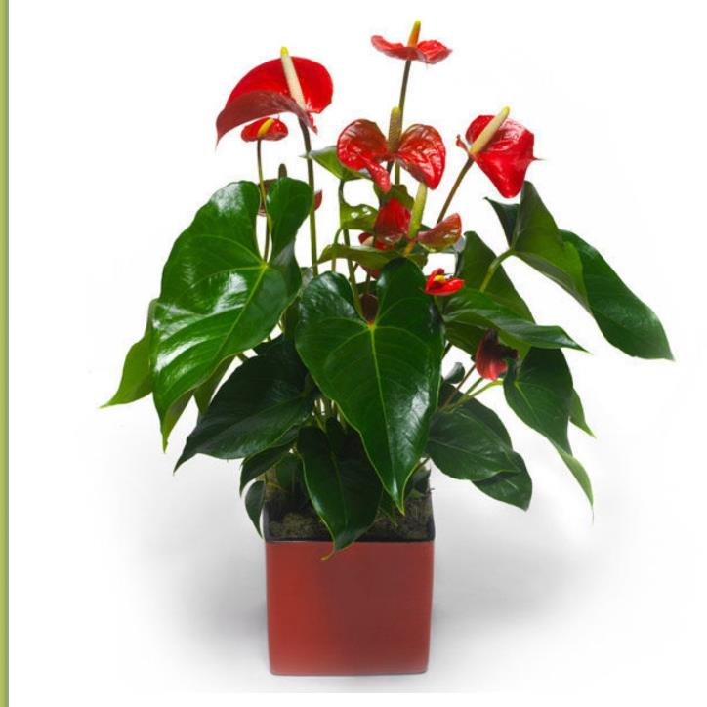
Anthurium
Waxy, palette-shaped spathe (the "flower") looks almost fake/plastic
Yellow finger-like spadix emerges from the spathe
Drooping, heart-shaped, dark green leaves arise on long stems from plant crown
Flowers may appear throughout the year in optimum growing conditions

Slide 7
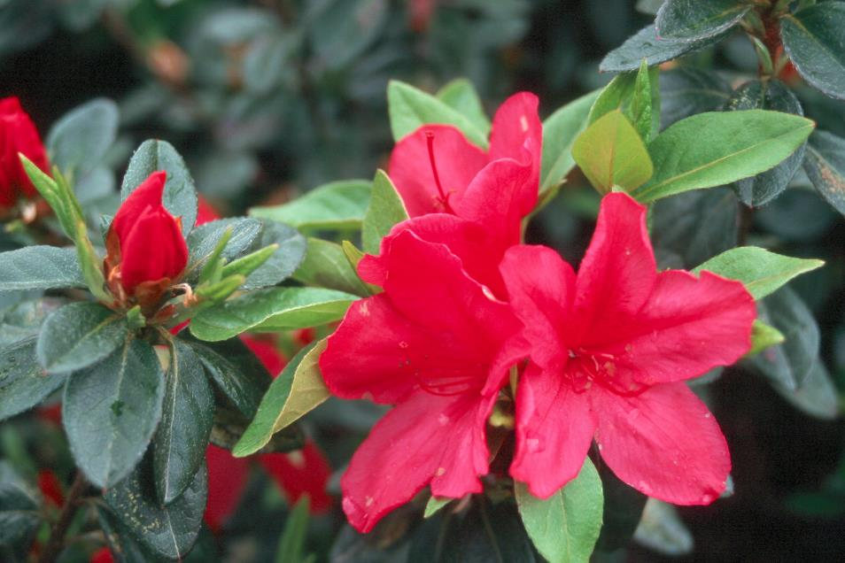
Azalea
Funnel-shaped flowers in clusters at branch tips — showy and abundant
Medium to large evergreen shrub
Leaves oval in shape
Woody stem
Small hairs on both the leaves AND stems

Slide 8
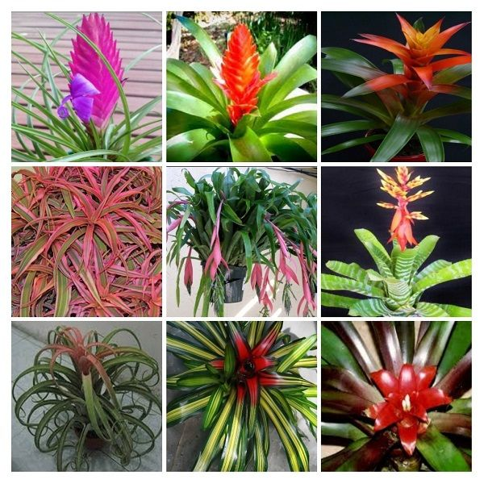
Bromeliad
Strap-shaped, stiff leaves arranged in a rosette — the rosette growth pattern is universal across the family
Leaves form a central "vase" or cup that naturally collects and holds water
Flower spike (inflorescence) emerges from the center of the rosette — always rises from the cup, often dramatically colored

Slide 9
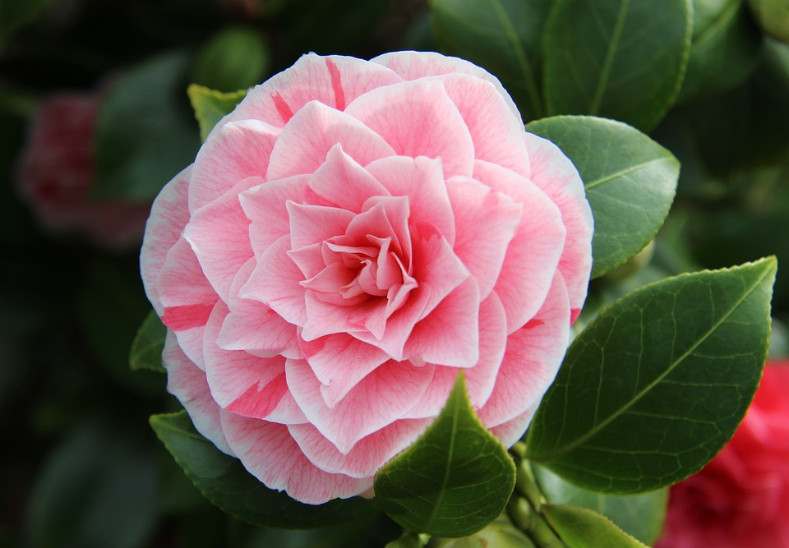
Camellia
evergreen shrub that typically grows to 6-12’ tall
oval, leathery, glossy, dark green leaves (3-4” long)
finely serrated margins
Flowers (3-5” wide) bloom in mid-late winter (December to March)
Large rose-like layered flowers with a ring of yellow stamens in the center

Slide 10
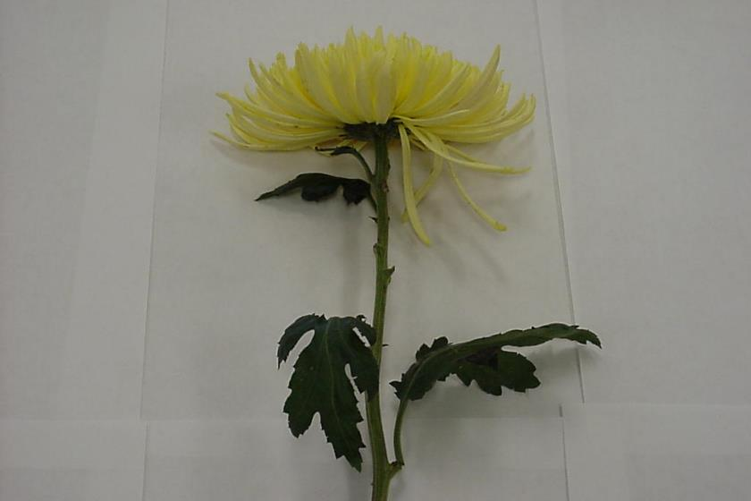
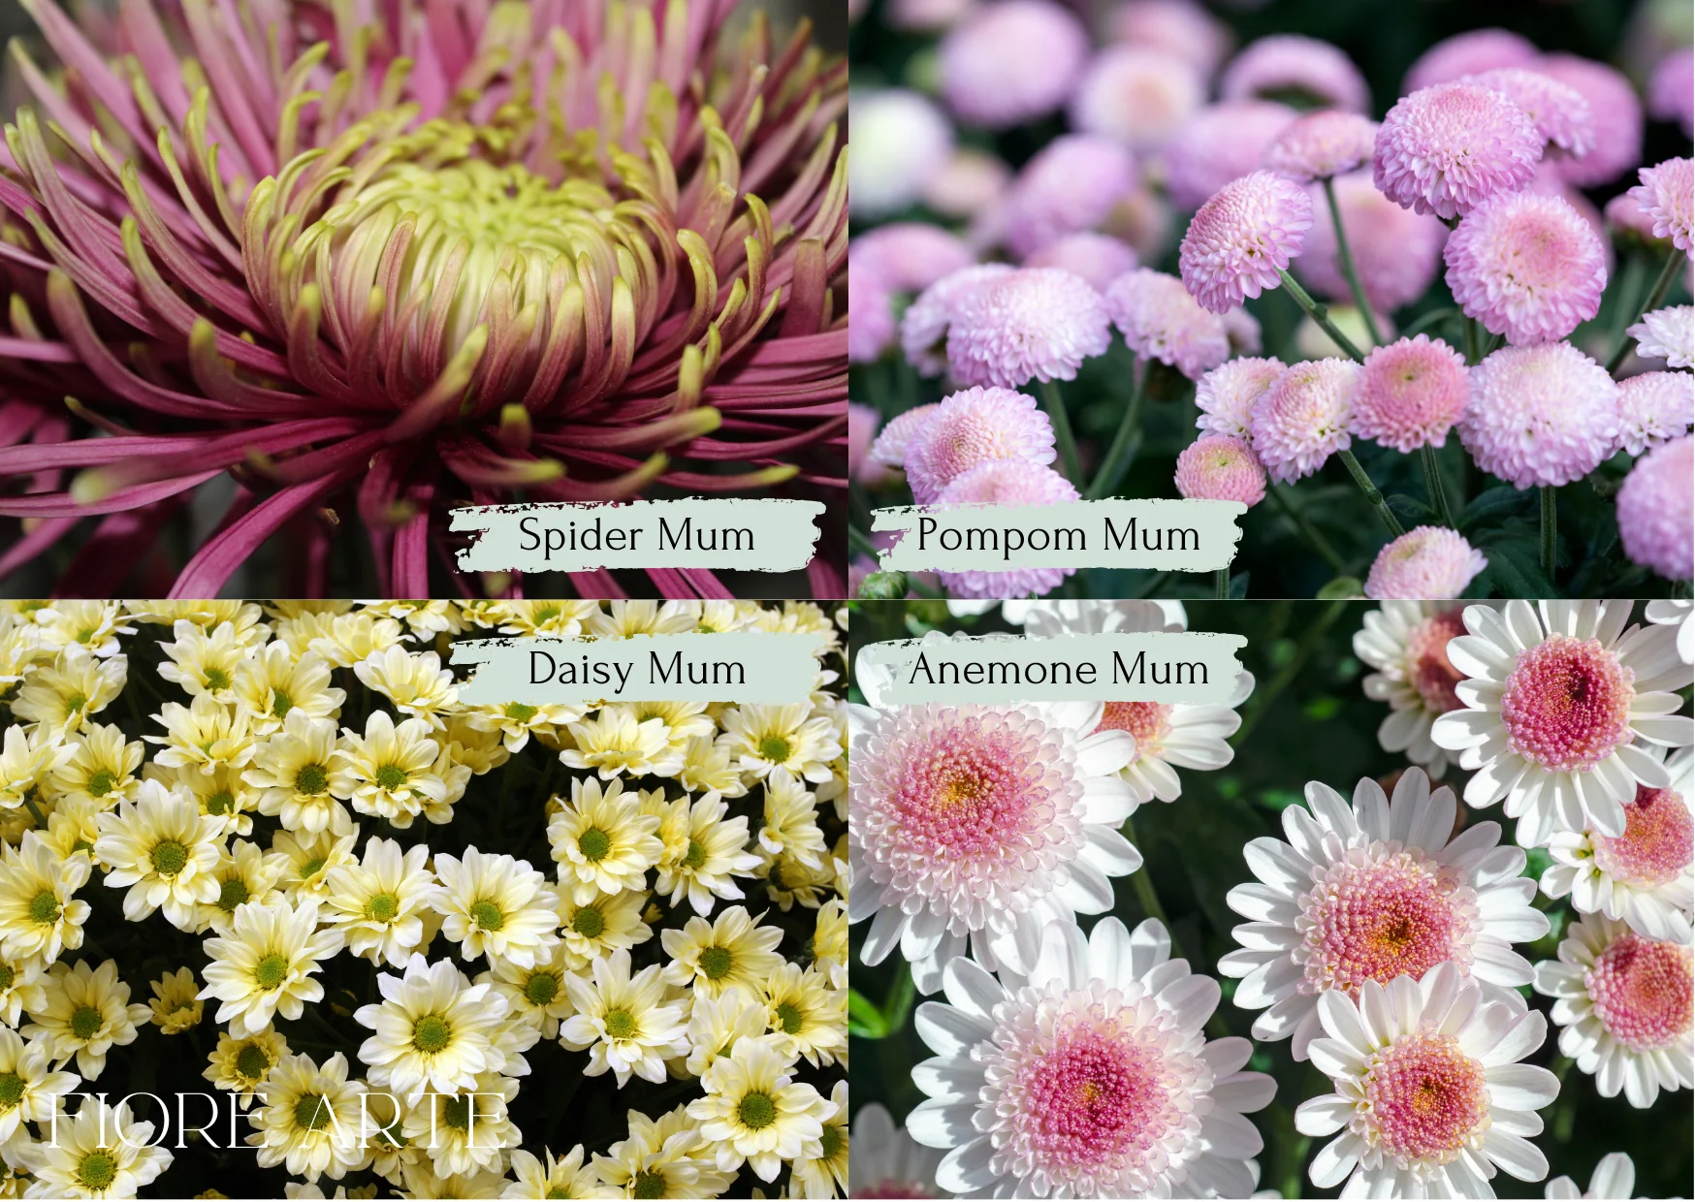
Chrysanthemum
Flower comes in many different styles
Lobed, medium green leaves (to 2” long).
Leaves have 5 main lobes
Hairy stems — noticeably fuzzy to the touch

Slide 11
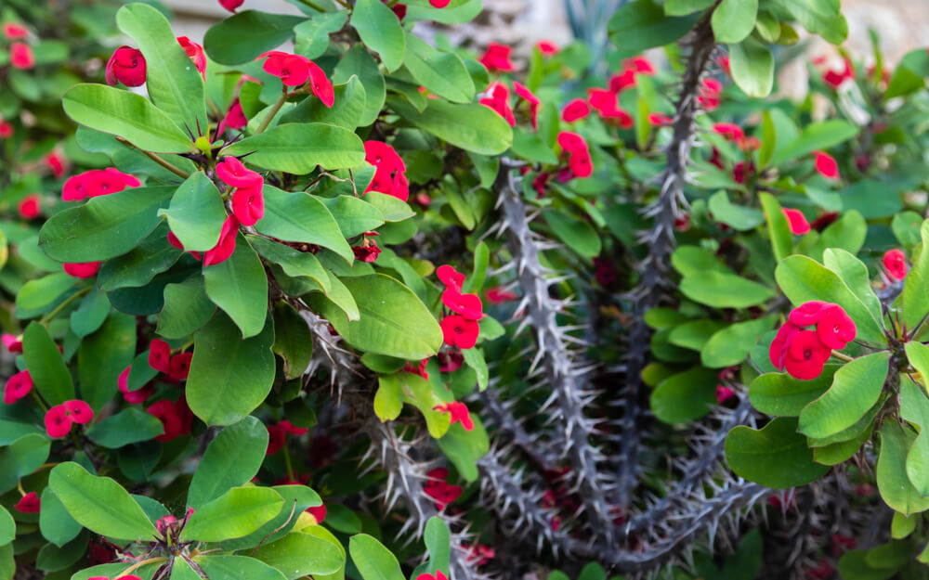
Crown of thorns
Thick, thorns cover the entire stem surface
green foliage forms in a whirled pattern
flowers typically red or pink are actually bracts

Slide 12
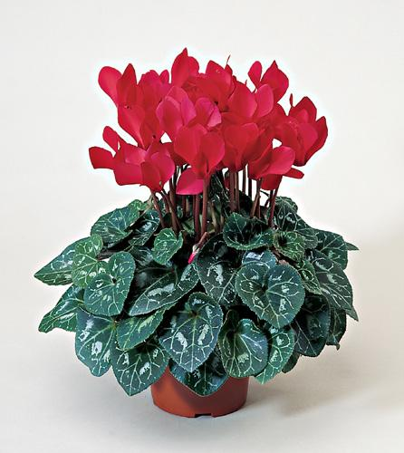
Cyclamen
Leaf margin has very fine teeth
Heart-shaped leaves with a silver marbled pattern and a lighter halo border
Petals sweep dramatically backward/upward (reflexed)
Very coarse leaf

Slide 13
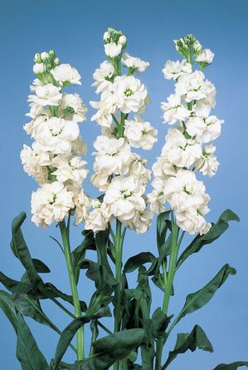
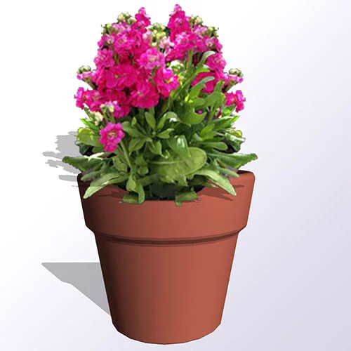
Flowering Stock
Flowers come in different colors
Flowers densely packed along a tall, upright spike
Fuzzy leaf, leaves are very long and slender
Very fragrant

Slide 14
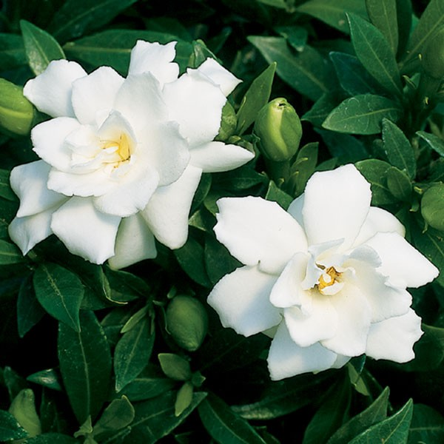
Gardenia
Veins sit down/ indented into the leaf
Leaves turn bright yellow before they fall off
Flower buds have sepals that stick up
Always bloom white, spiraling petals
Waxy leaves
Very fragrant

Slide 15
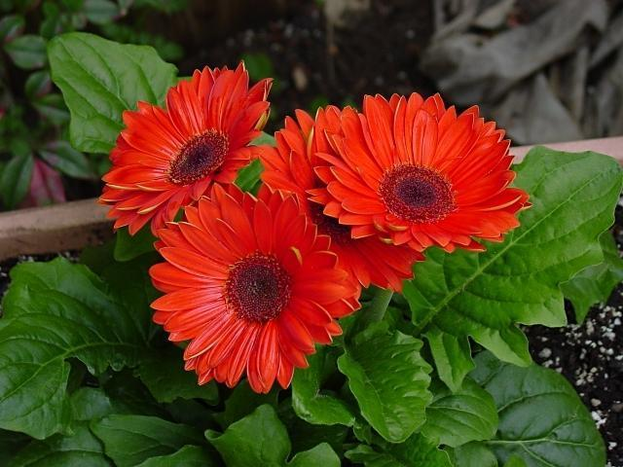
Gerbera Daisy
Large, bold daisy-like flower on a single tall leafless stalk — one flower per stalk
Stays low to the ground
All leaves emerge from the base (basal rosette)
No visible stem except flower “stem”
Leaves are large with a rough, slightly woolly texture and wavy/lobed edges

Slide 16
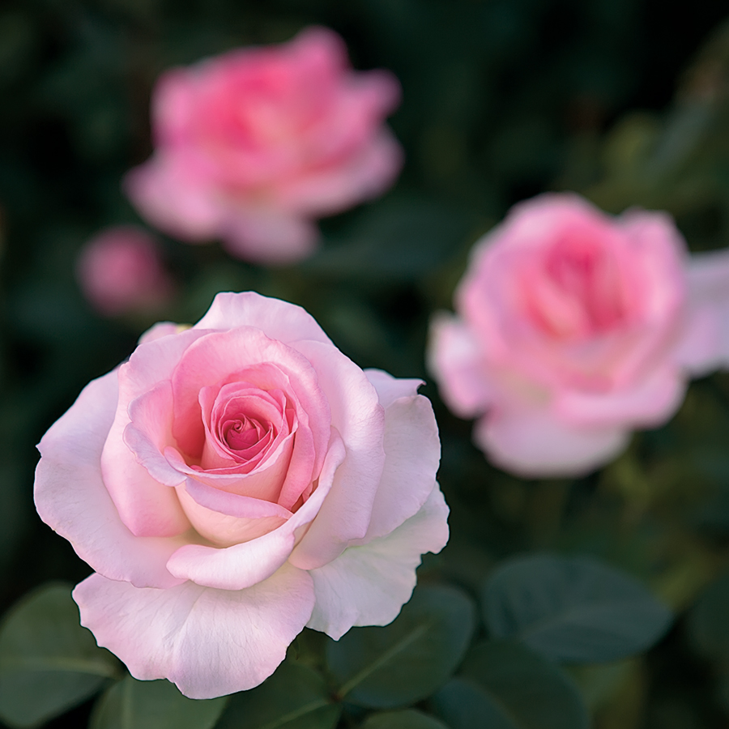
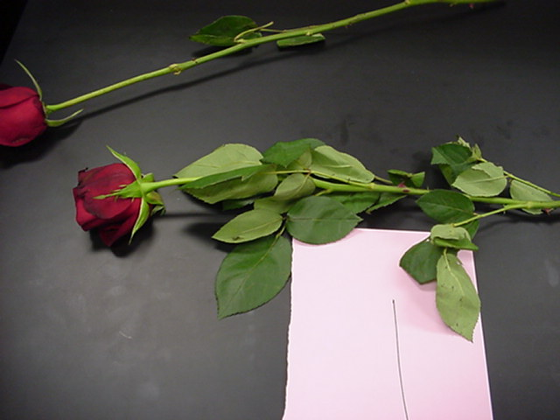
Hybrid Tea Rose
One flower per stem
Compound leaves — leaflets grouped in sets of 3 or 5 along the petiole
Petioles and new growth have a reddish tint
Has thorns

Slide 17
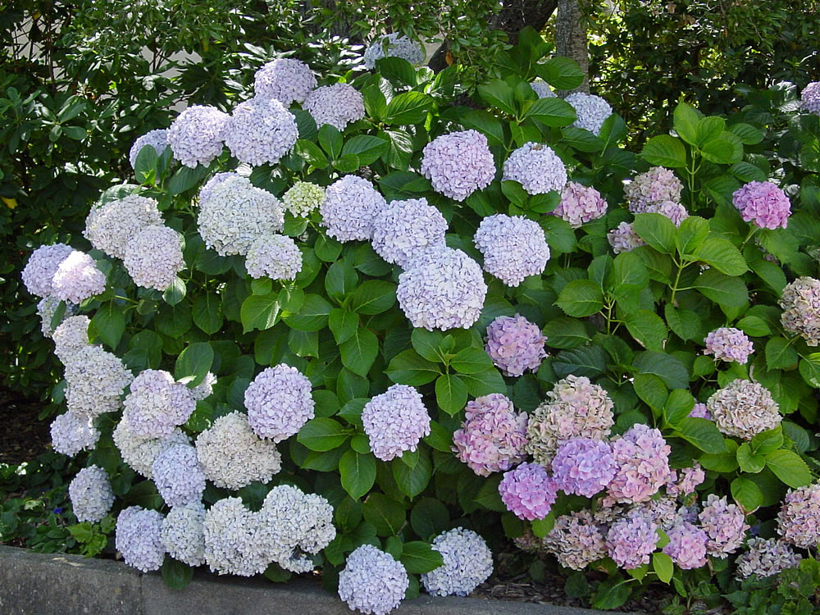
Hydrangea
Massive rounded flower heads made up of many small four-sepaled florets
Serrated edges on the leaf
Leaf veins very noticeable and opposite

Slide 18
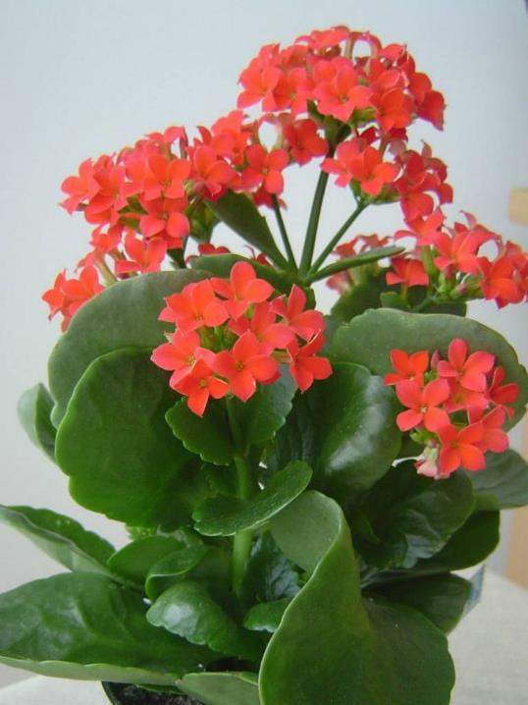
Kalanchoe
Has a spike of flowers that come in a variety of colors
Each tiny flower has exactly 4 petals
Flowers held in flat-topped clusters above the foliage on upright stems
Leaf is waxy, thick succulent-like, and scalloped on the edges

Slide 19
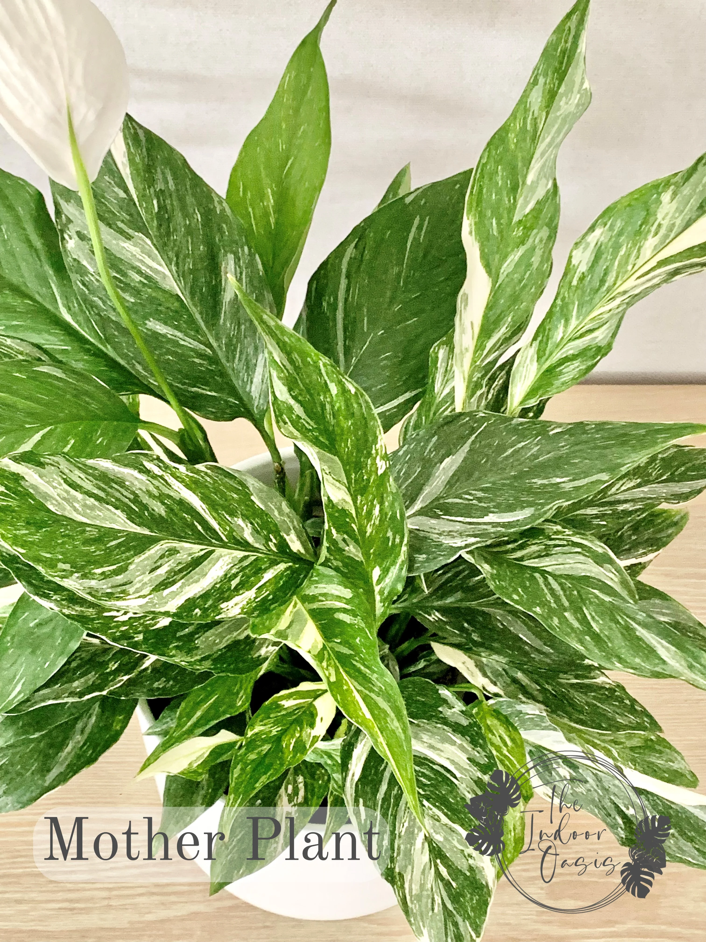
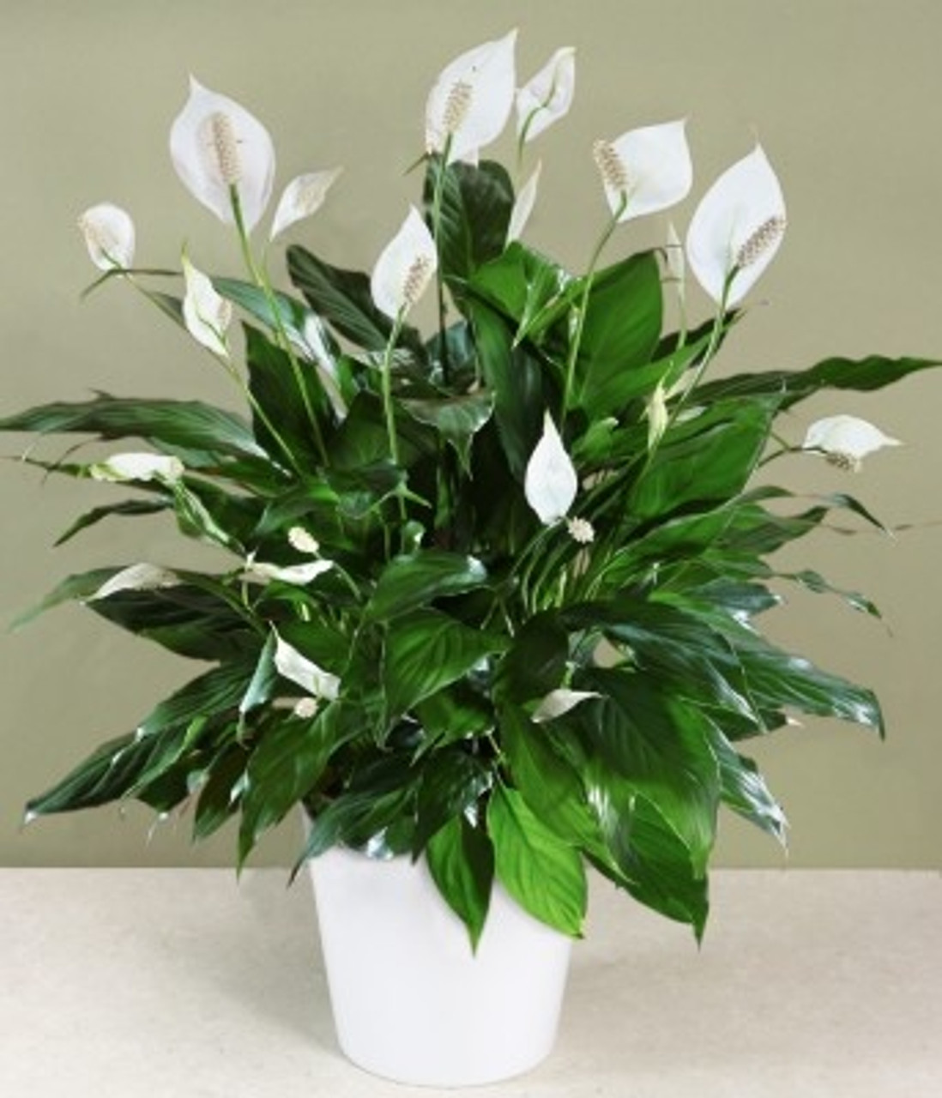
Peace Lily
Leaves can be solid green or variegated
White spathe (hood-shaped bract) wrapped around a cream-colored spadix — always white, no other color
long pointed leaf
Veins are cut into the plant

Slide 20
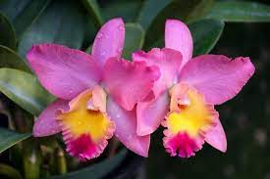
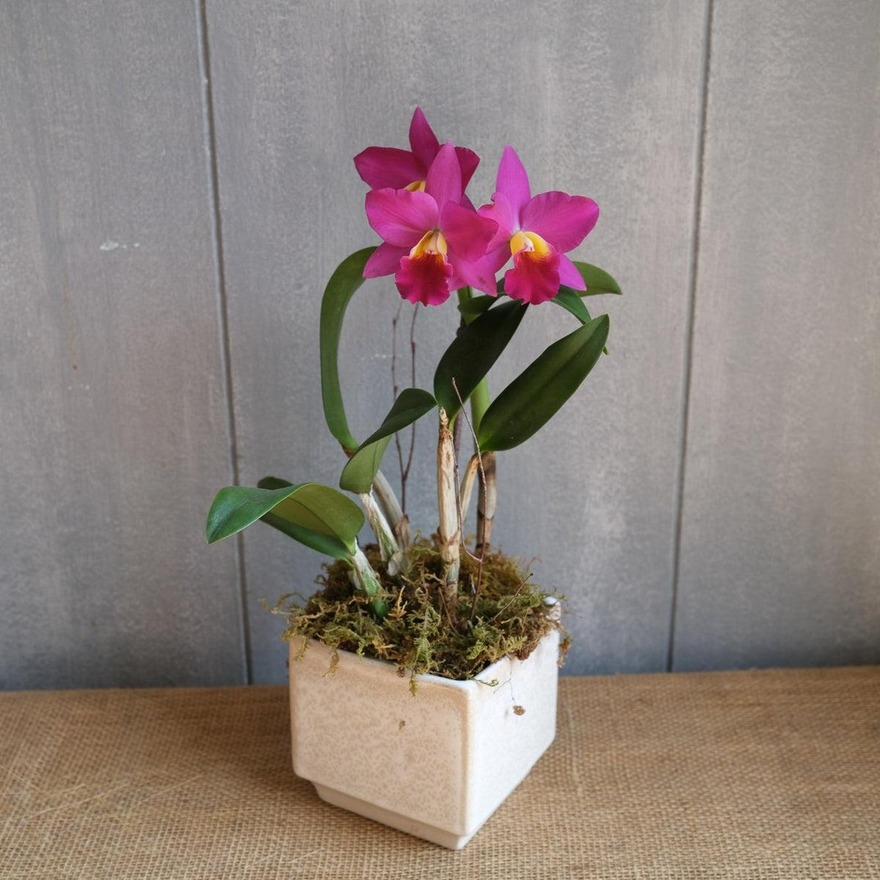
Cattleya Orchid
Cattleyas wrap their roots around branches for stability
Plants grow from pseudobulbs (1-3” thick)
leathery, oblong to broad obovate leaves that are generally dull green

Slide 21
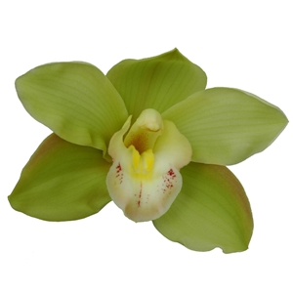
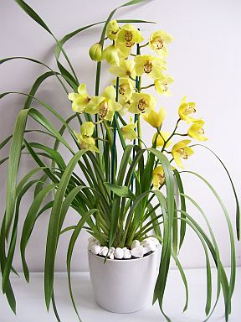
Cymbidium Orchid
Leaves are long and skinny compared to other orchids
5 petals to the flower, long, arching flower spike with 10-20+ blooms — the most flowers per spike of all the orchids on the list
In the throat has a rolled up “tongue” inside of throat
No stem except for flower spike
Backside has a sharp midrib
Has “bulbs” just above the ground

Slide 22
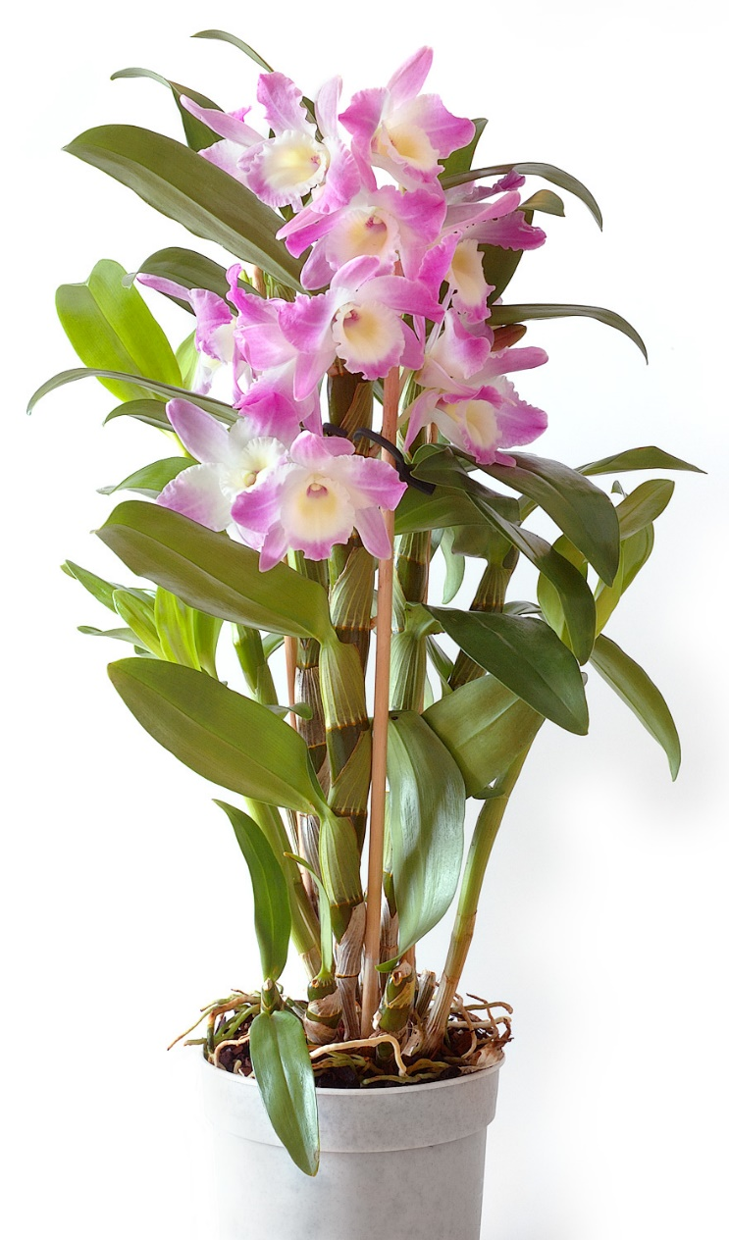
Dendrobium Orchid
Thick, jointed cane-like stems
Smallest flower of all the orchids
Flowers cluster along the cane, not just at the tip
Leaf is rubbery
Aerial roots (Above soil-line)

Slide 23
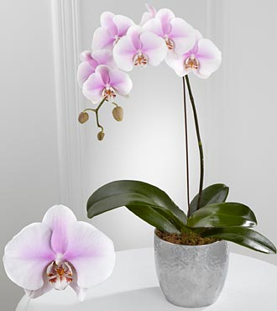
Moth Orchid
Leaves attach to a main stem and stay low the bottom of the stem
Very hard leathery leaf, opposite
Flower – has two distinct “wings”
Thick silvery-green aerial roots often visible

Slide 24
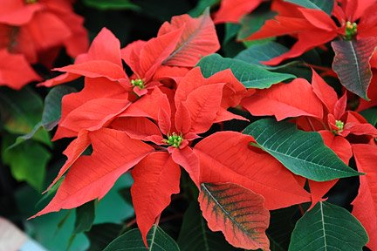
Poinsettia
Flowers are actually modified leaves known as bracts
Midrib on the leaves is usually white
They come in many colors but red is most common

Slide 25
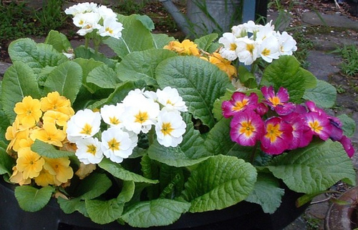
Primrose
Grows low to the ground
Leaves are heavily wrinkled (rugose) with a rough texture and raggedy, wavy edges
Flowers in clusters
5-petal flowers always have a yellow center eye — regardless of petal color
Veins are very distinct

Slide 26
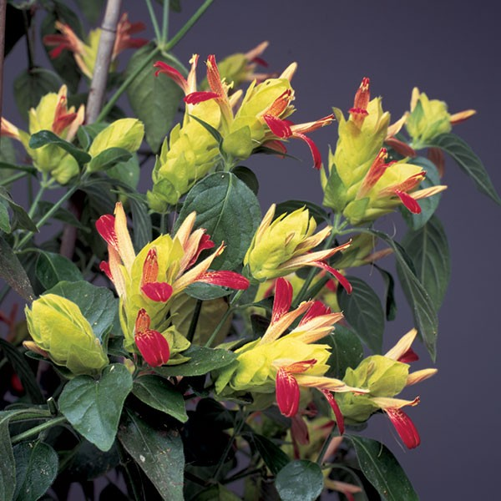
Shrimp Plant
Very long internode between leaves
Flower is pink with yellow markings
Shrub that has an open airy look – not compact
Leaves are opposite

Slide 27
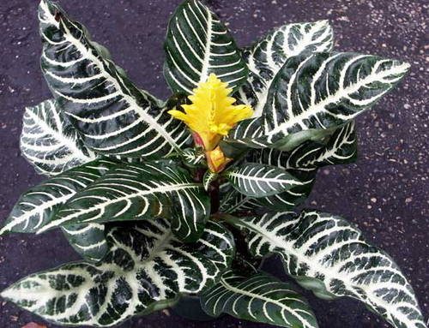
Zebra Plant
Leaves are large, glossy, and deeply veined
Dark green leaves with zebra-like white veins
Spikes of yellow-bracted flowers are long-lasting
Typically 2-18” tall.

Slide 28
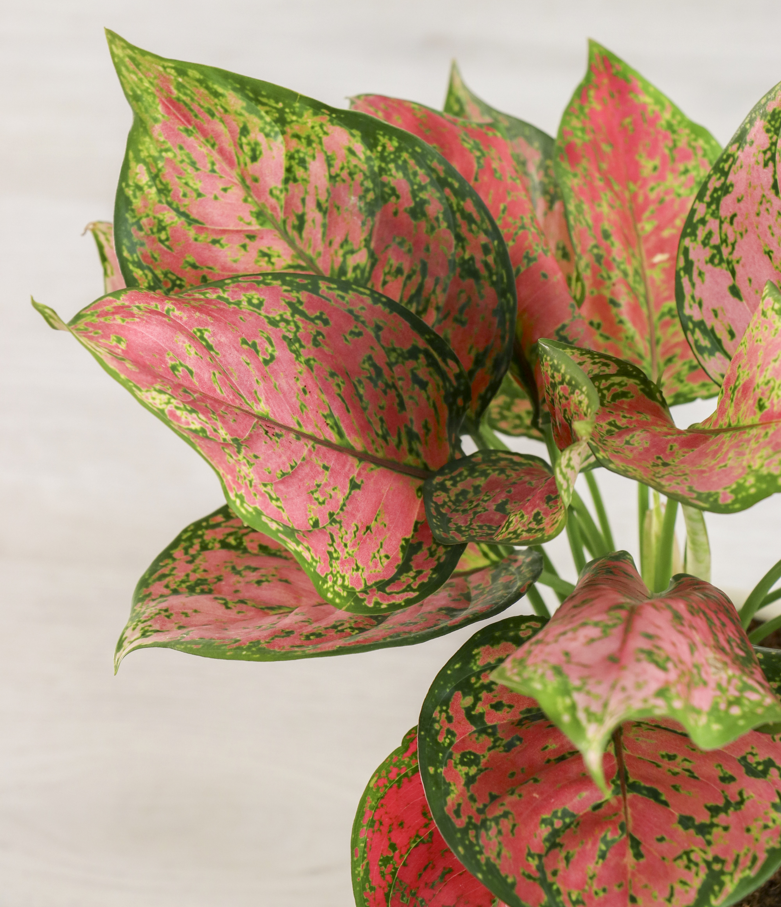
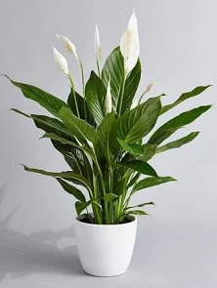
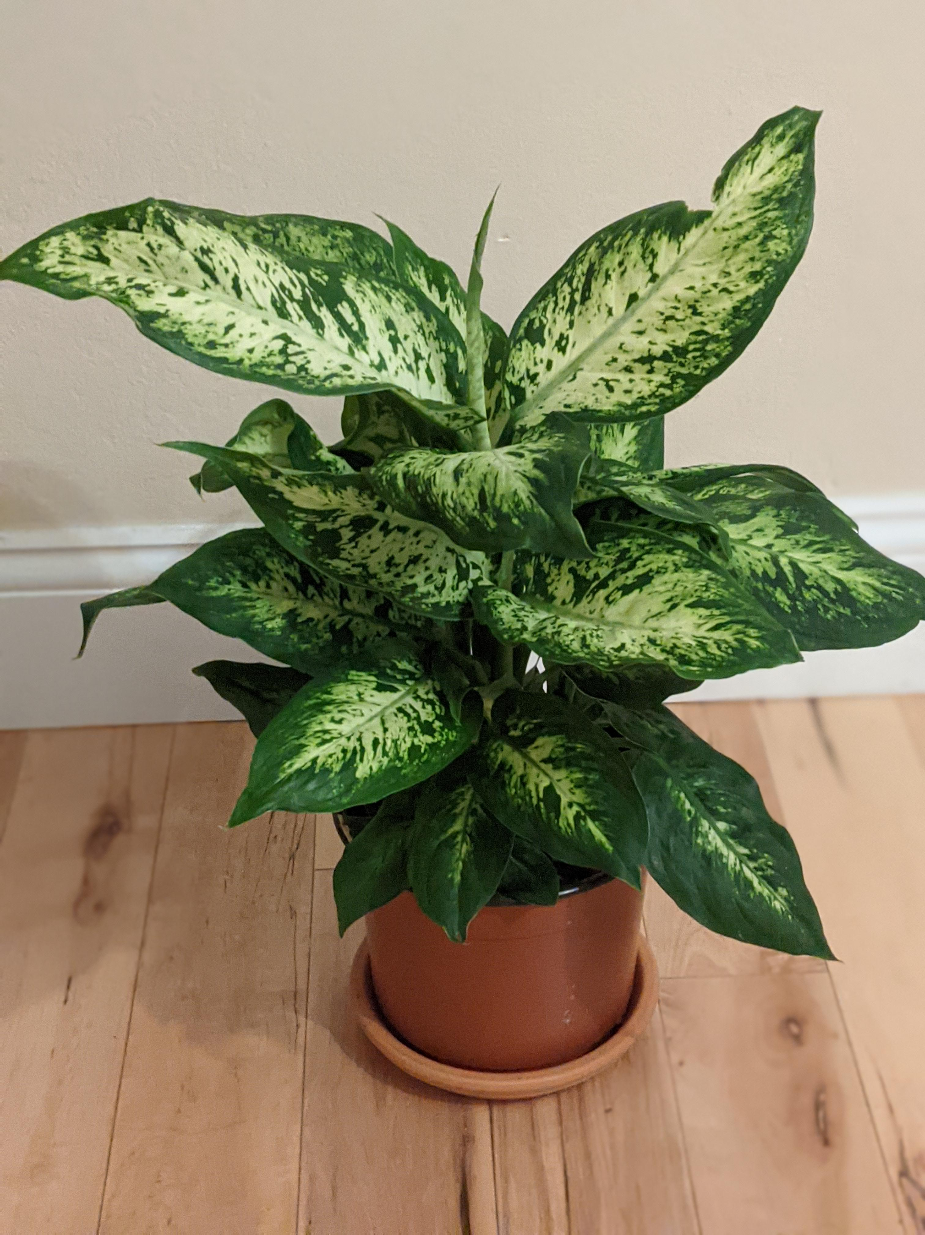
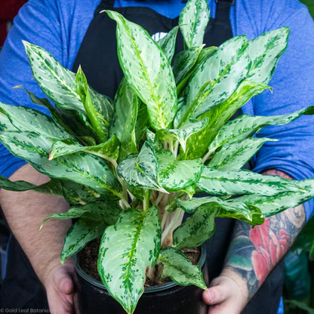
Now let's Compare
Aglaonema
Leaves: Green with silver, grey, or pink markings along veins
Silver or grey markings follow the VEINS outward from midrib
Short, compact stem low to ground
Can also have pink or red tones which the other two never have
Peacy Lily
Leaves: Solid dark green OR variegated
Uniform dark green most common; variegated is all-over
No visible main stem — leaves rise from base
White flower is the giveaway
Dumbcane
Leaves: Green with cream/white blotching in center
Cream blotching heaviest in CENTER of leaf, green edges
Thick, cane-like stem becomes very visible as plant ages

Slide 29
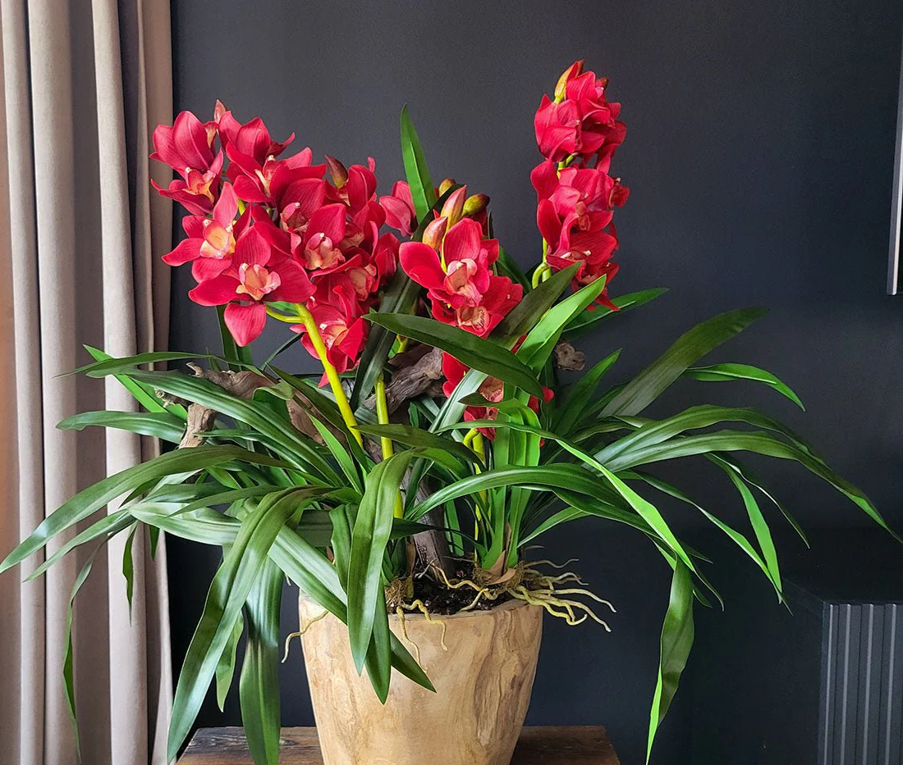
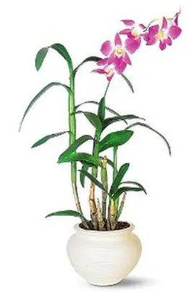
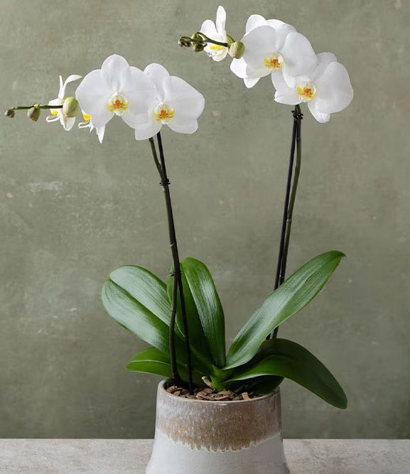
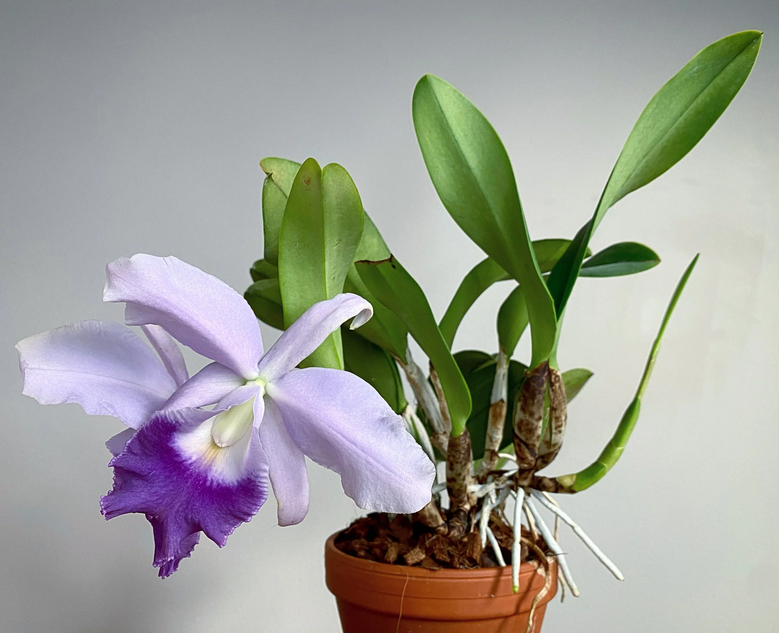
Now let's Compare
Cattleya Orchid
Flower Spike - 1–3 blooms per pseudobulb
Leaf Type - Broad, oblong, dull green
1–2 leaves per pseudobulb
SPREADING
Roots wrap around branches/bark
Dendrobium Orchid
Flower Spike - Clusters along length of cane
Leaf Type - Short, oval, rubbery
Leaves along cane stem
Tallest with a jointed bamboo-like cane
Aerial roots above soil
Moth Orchid
Flower Spike - Long arching spike, evenly spaced blooms
Leaf Type - Large, oval, very thick & leathery
All leaves clustered low at base
Thick silvery-green aerial roots
Cymbidium Orchid
Flower Spike - Long arching spike, 10–20+ blooms
Leaf Type - Long, narrow, grass-like
All leaves from base, no main stem
No visible roots - Hidden in potting mix

Slide 30
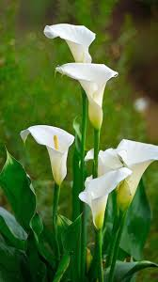
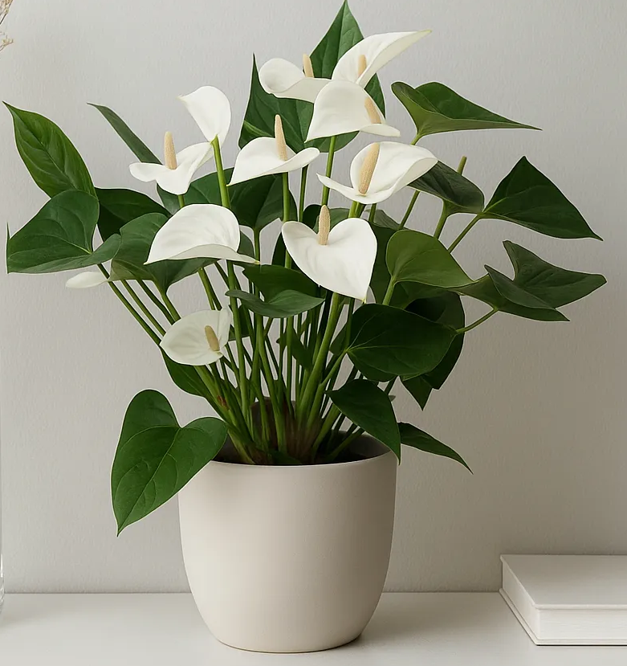
Now let's Compare
Anthurium
Flowers bright red, pink, or white — waxy/glossy
Spathe (flower) flat, palette/heart-shaped - looks almost plastic/lacquered
Leaves heart-shaped, dark green
Leaves smooth, glossy, thick - – long stems from crown
Peacy Lily
Flower always white
Spathe (flower) hood-shaped, curves forward
Leaves long, narrow, pointed
Leaves smooth, veins deeply impressed
Calla Lily
Flowers white, yellow, pink, purple, orange
Spathe (flower) rolled/funnel-shaped trumpet
Leaves large arrowhead (sagittate)
Leaves smooth, often white-speckled

Slide 31
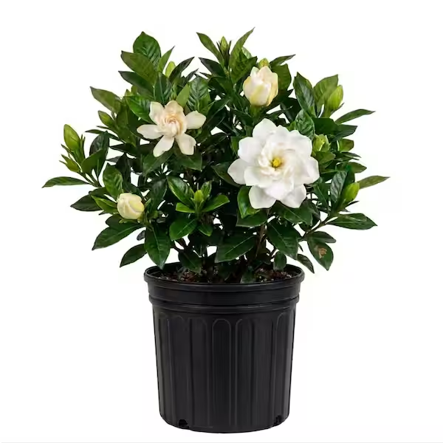
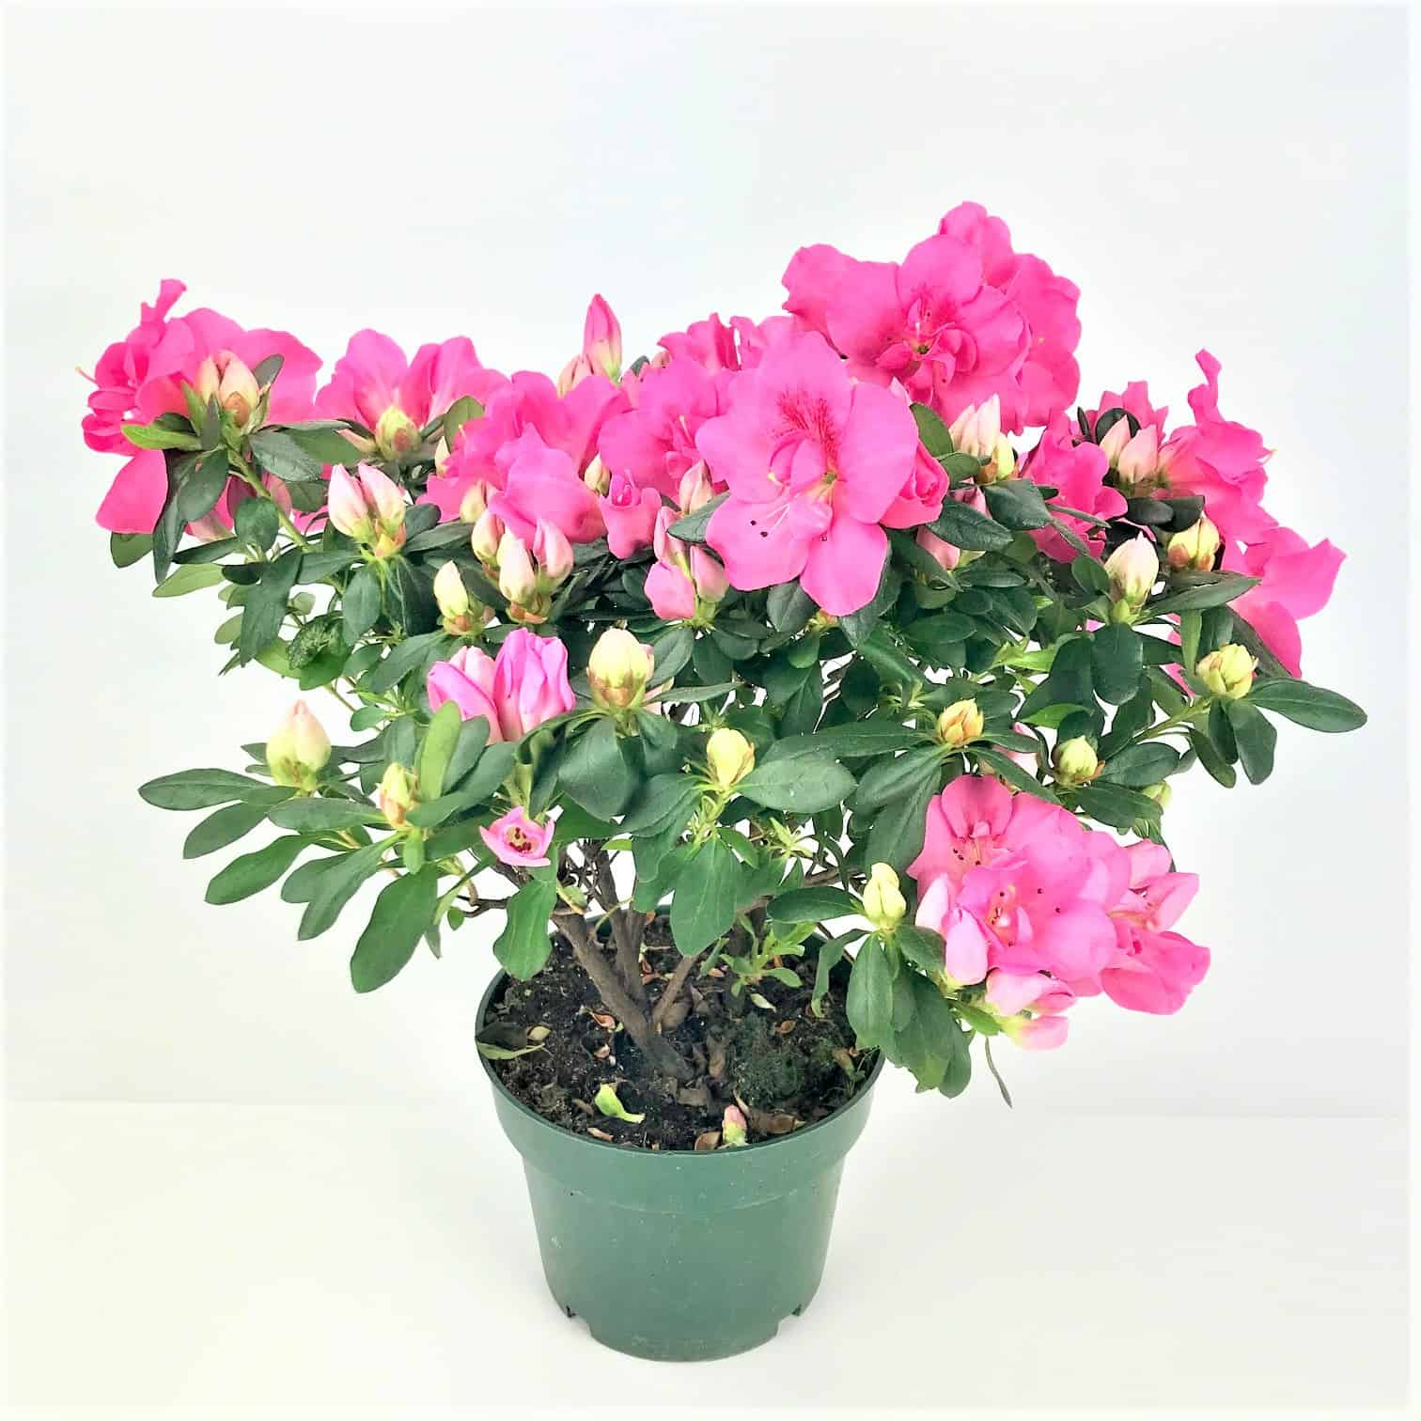
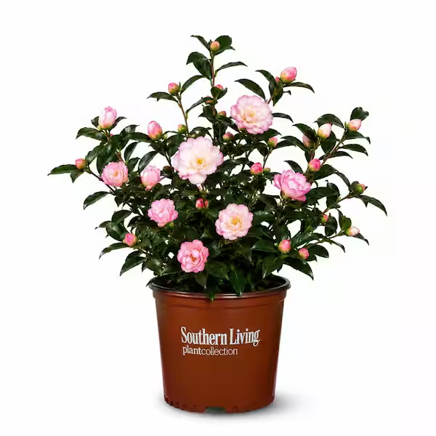
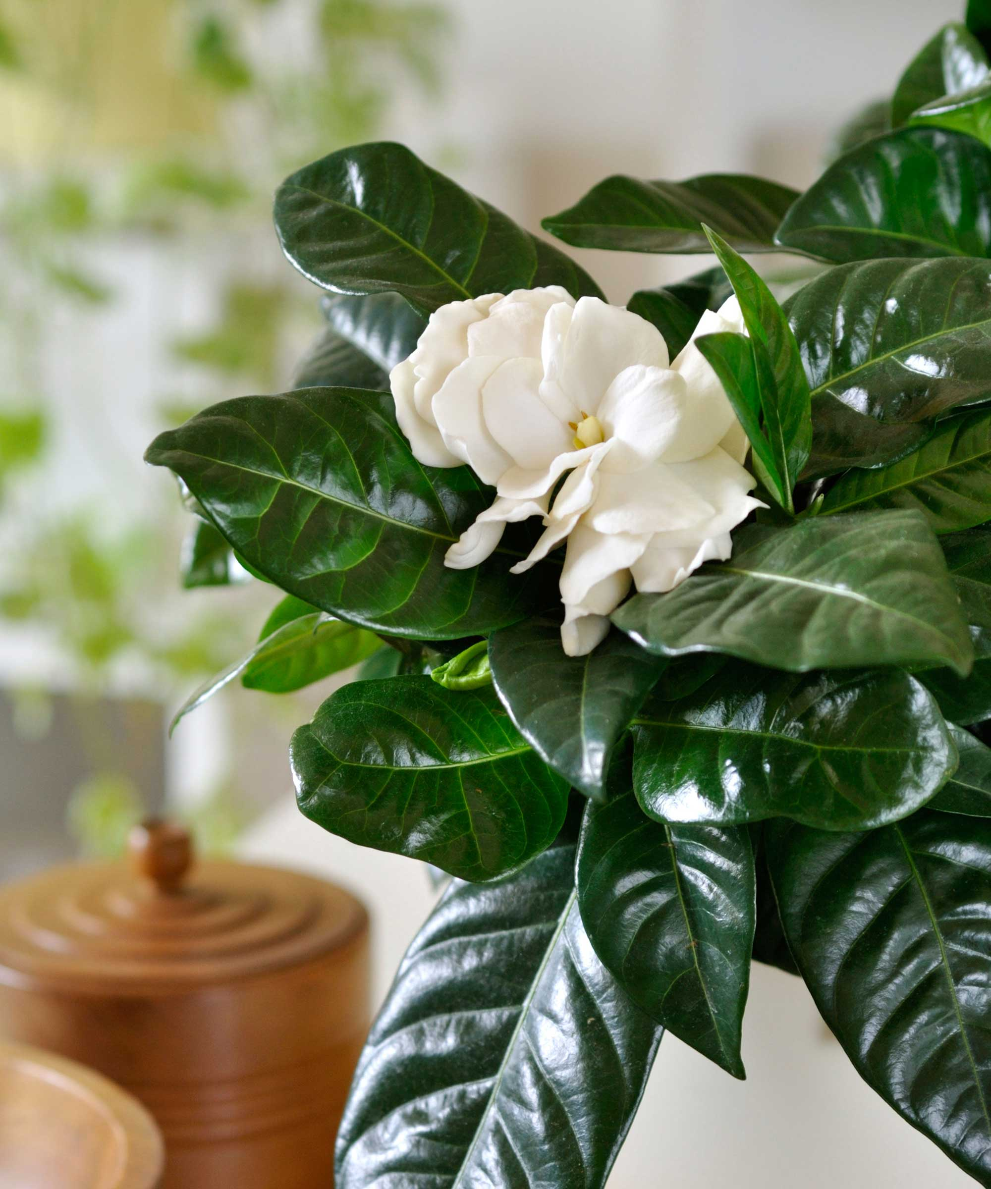
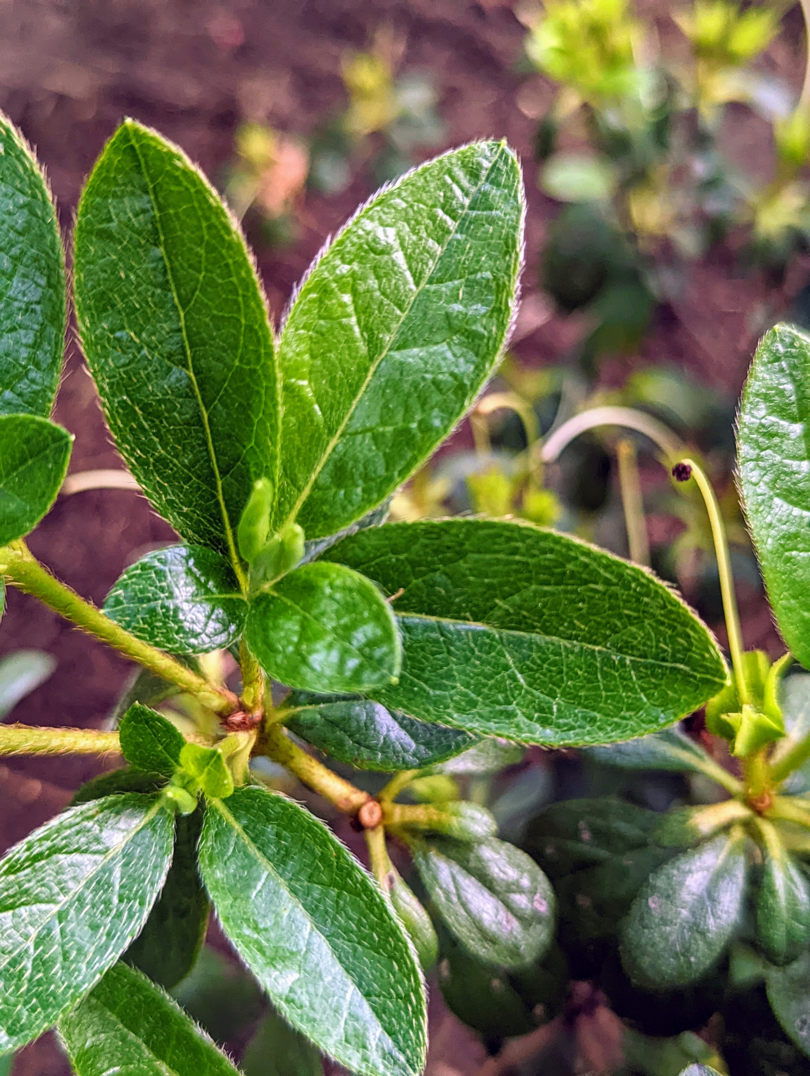
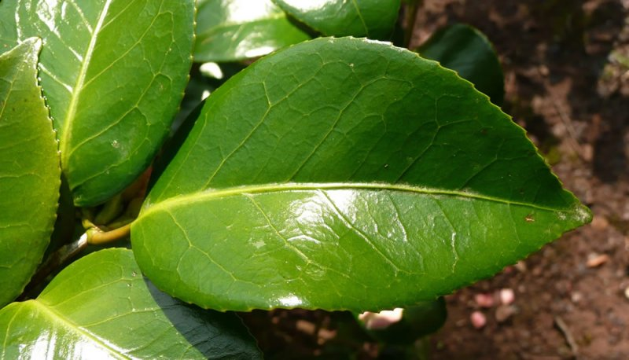
Now let's Compare
Azalea
Flower Shape - Funnel-shaped, 5 petals, prominent stamens
Leaves - Dull, matte — small hairs on surface
Leaves medium green with smooth edges
ALTERNATE leaves
Gardenia
Flower Shape - Creamy white, spiraling petals, very full
Leaves - Waxy, semi-glossy — veins pressed inward
Leaves dark green SMOOTH edges
look for the sepals sticking up around the bud before it opens
OPPOSITE Leaves
Camellia
Flower Shape - Rose-like, many layered petals, ring of yellow stamens
Leaves - Glossy, leathery — shiniest of the three
Leaves dark green SERRATED edges
ALTERNATE leaves

Slide 32
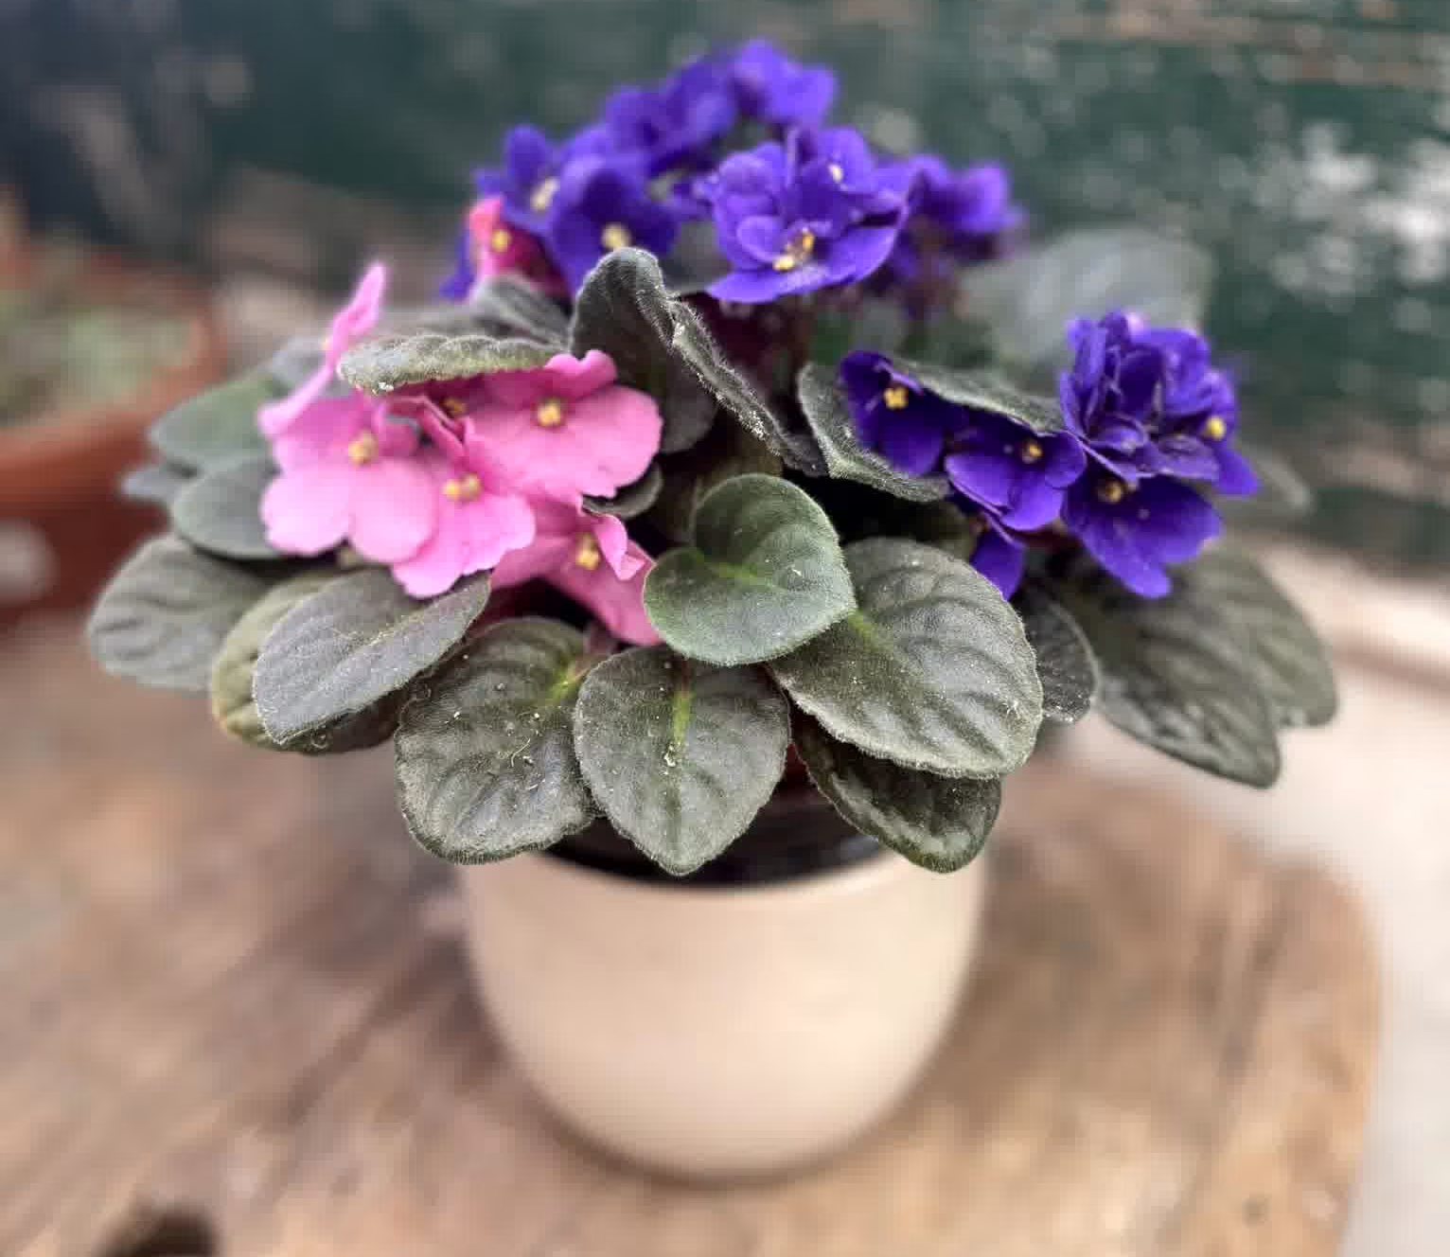
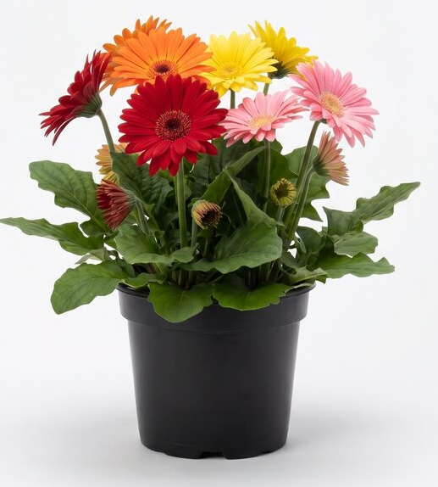
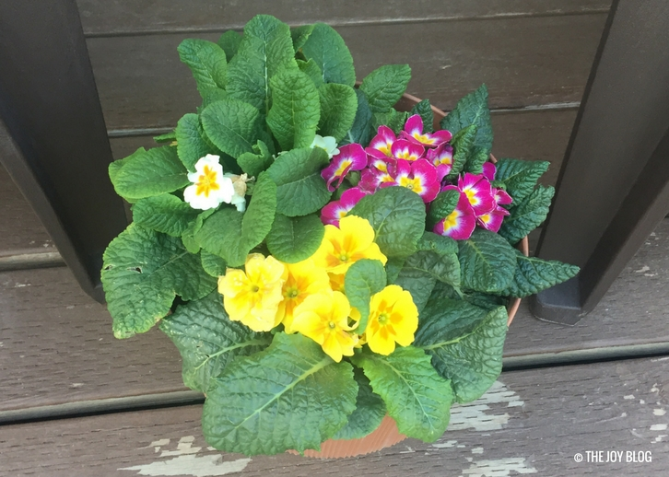
Now let's Compare
African Violet
Flowers - Small 5-petal clusters, one per stem in large group
Yellow stamens, very small
Leaves - Round to oval, slightly scalloped
Fuzzy/velvety — soft to touch
Gerbera Daisy
Flowers - Single large daisy-like, one per stalk
Dark or black center ring
Leaves - Large, slightly lobed, wavy edges
Large, rough, woolly underside
All leaves at the base
Primrose
Flowers - Small 5-petal pinwheel, clustered
Always yellow center eye
Leaves - Oval, heavily wrinkled, wavy/raggedy edge - roughest texture of the three

