Slide 1


Georgia FFA
Floriculture
Plant Identification Tips and Tricks
This is a free resource provided by Georgia Agricultural Education
Original creator: Melissa Riley, Central Region Horticulture Teacher

Slide 2
This PowerPoint was created to provide key characteristics of plants on the Plant Identification list of the Georgia Floriculture Career Development Event

Slide 3
Foliage / House Plants

Slide 4
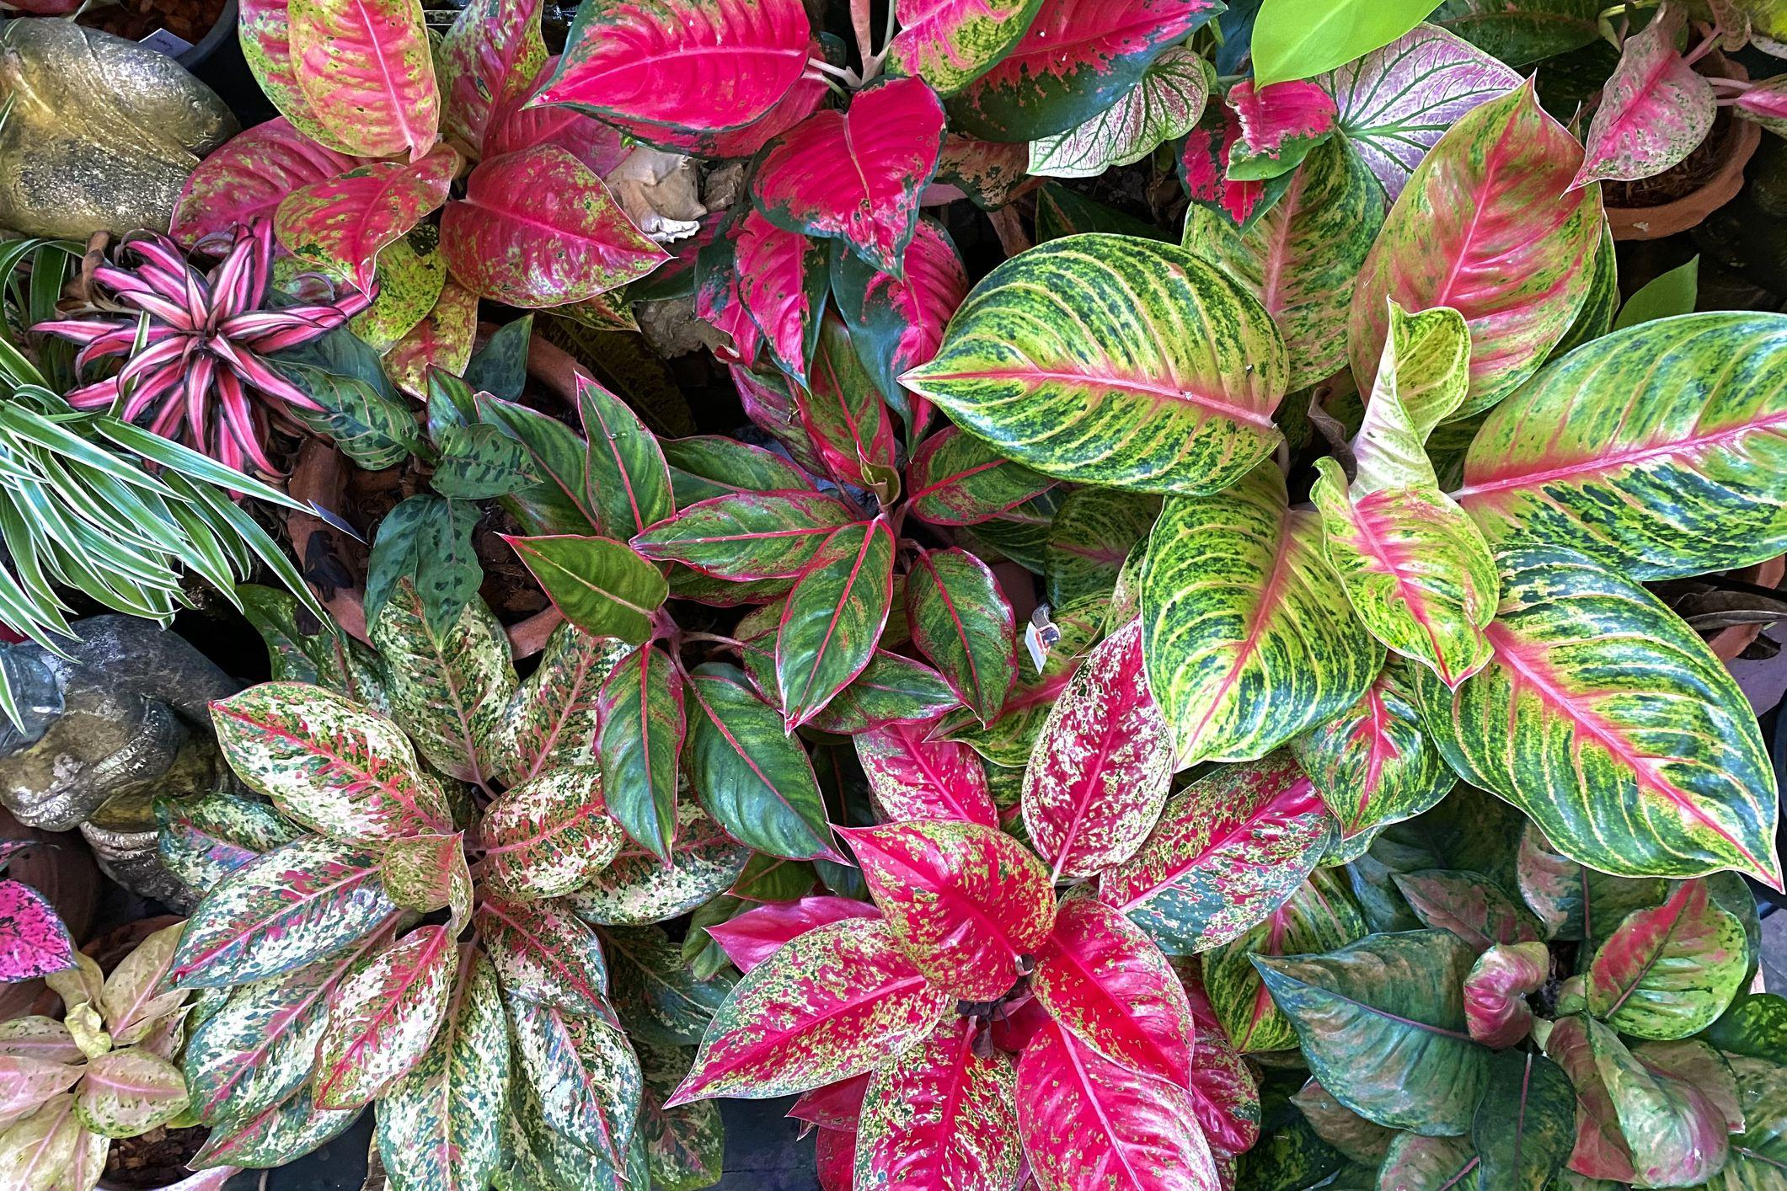
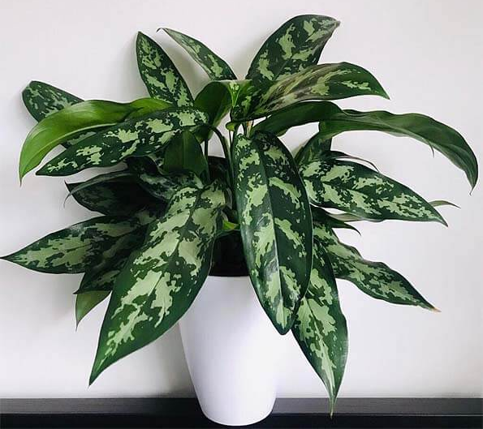
Aglaonema
Variegation follows the veins outward from the midrib — silver, grey, or pink brushstroke pattern
Stays low and compact — short stem, leaves radiate from a low central point
typically grows to 20” tall
rarely flowers

Slide 5
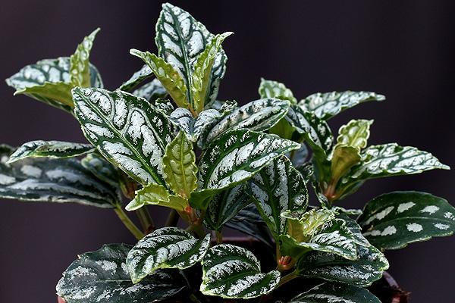
Aluminum Plant
Leaves arranged opposite one another
Typically grows in a shrubby clump to 12” tall.
Elliptic to obovate, toothed, dark green leaves (to 3” long)/
Two broad silver stripes between the veins look almost metallic/foil-like
Reddish-tinged stems

Slide 6
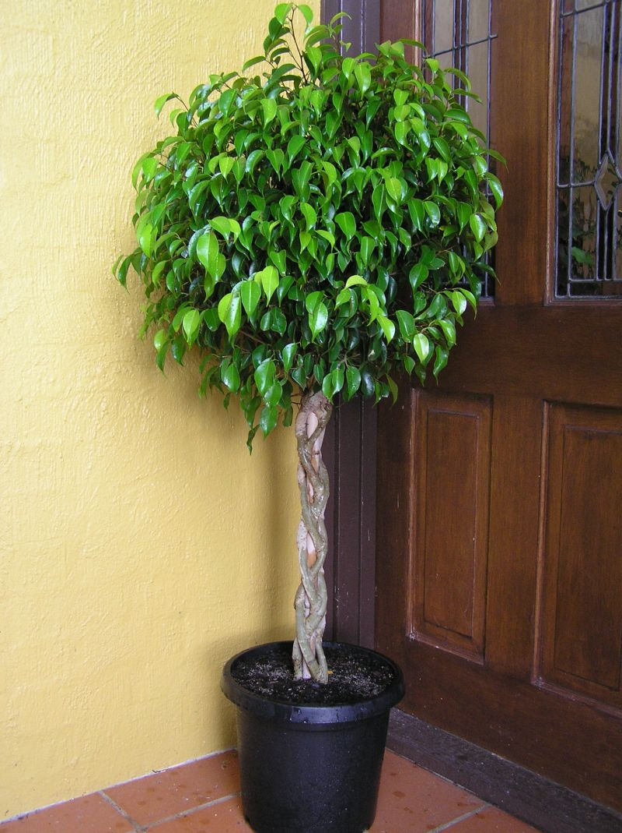
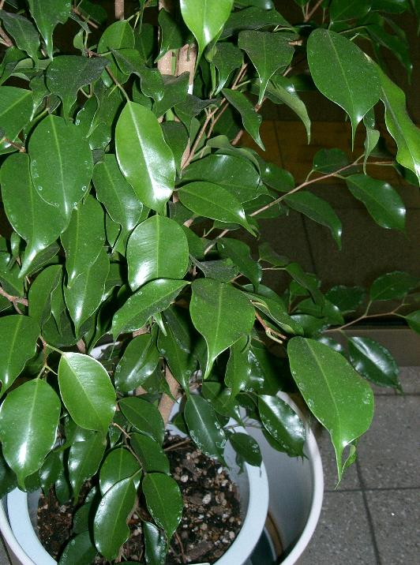
Benjamin Fig
Leaves can be solid green or variegated
This is a tree – can be 1 foot to 20 feet tall
Leaves taper to a distinct elongated "drip tip" or tail at the end
Produces white milky sap
Tree form with a woody, often braided/twisted trunk

Slide 7
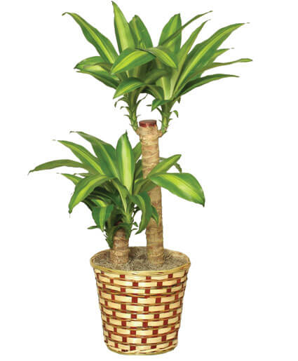
Corn Plant
4-6’ tall range as a container plant
Broad sword-shaped leaves with a bright yellow/cream stripe down the center
Leaves grow in a rosette tuft at the top of a bare cane (palm-like silhouette)
Over time, plants lose their lower leaves revealing bare stems
ringed pattern on the stem

Slide 8
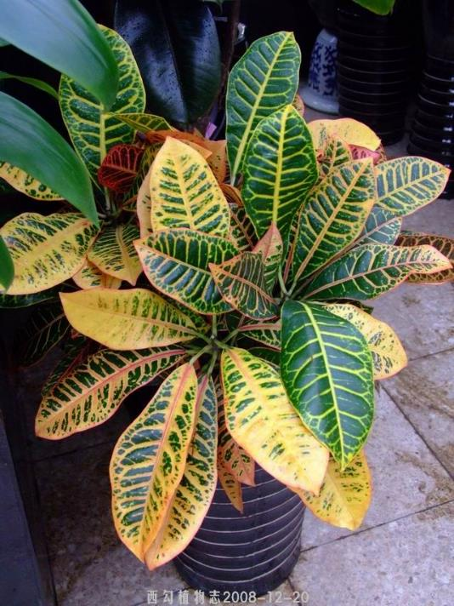
Croton
Foliage is almost always multi-colored
Woody plant that is grown for its foliage
Leathery leaves with contrasting colored veins — often yellow or red veins against dark green
Comes in dramatically different leaf forms — broad/oak-shaped, narrow/strap-like, or twisted corkscrew

Slide 9
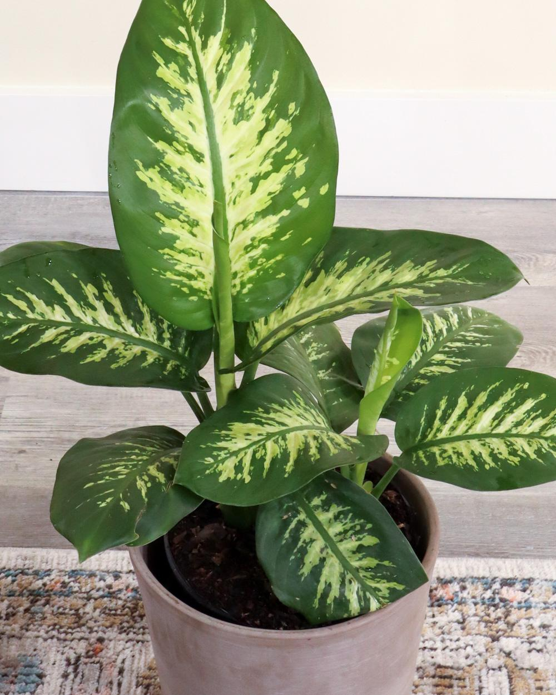
Dumbcane
Green leaves with white centers
large broad oval leaf shape
Leaves appear almost see through
Forms on a cane, that becomes visible as old leaves fall off

Slide 10
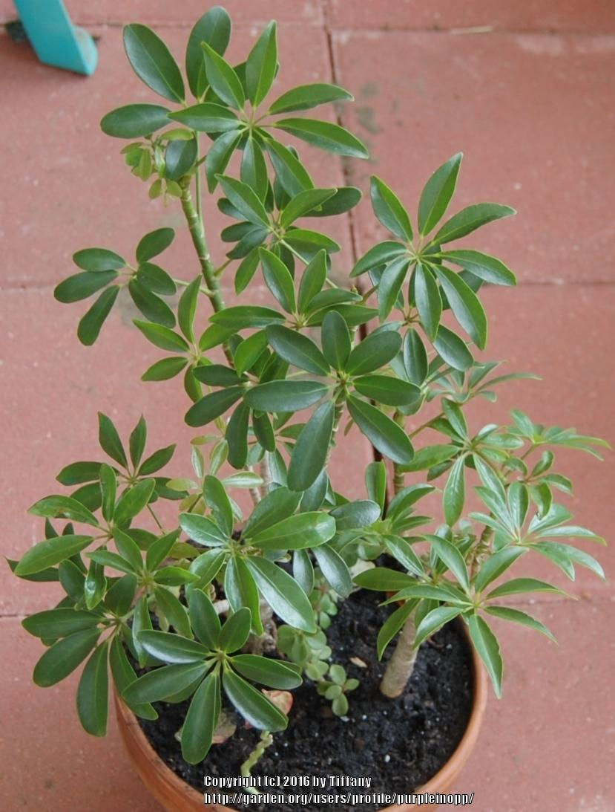
Dwarf Schefflera
Leaves can be variegated or solid green
Leaflets are oval, slightly glossy, and arranged in a perfect whorl
Palmately compound leaf - 5–9 oval leaflets radiate from one central point like the spokes of an umbrella
Green, thick stem

Slide 11
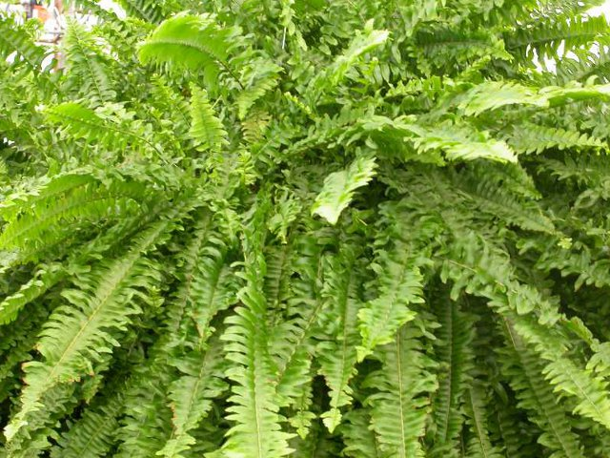
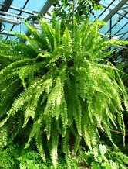
Boston Fern
Long arching fronds lined with many small, paired, rounded leaflets
Fern leaves are known as fronds
Solid bright green, no variegation, no markings
Fronds droop over to cover the pot

Slide 12
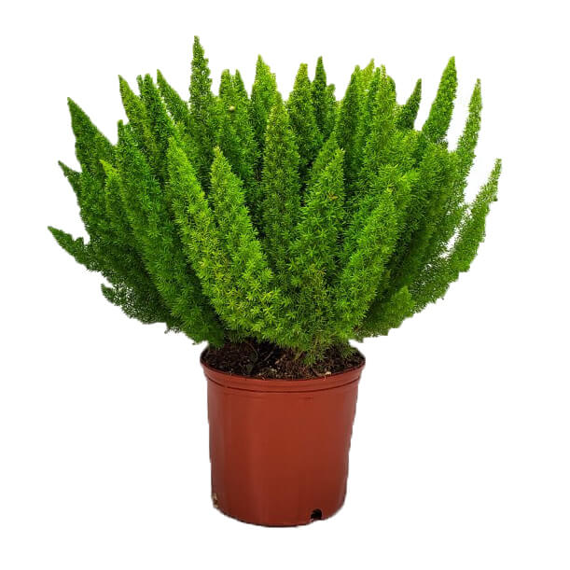
Foxtail Fern
Feathery, upright, bright green needle like stems
Plume (fluffy)-like (resemble fox tails)
Dense growth habit
Can get 2-3 feet tall
Not a true fern

Slide 13
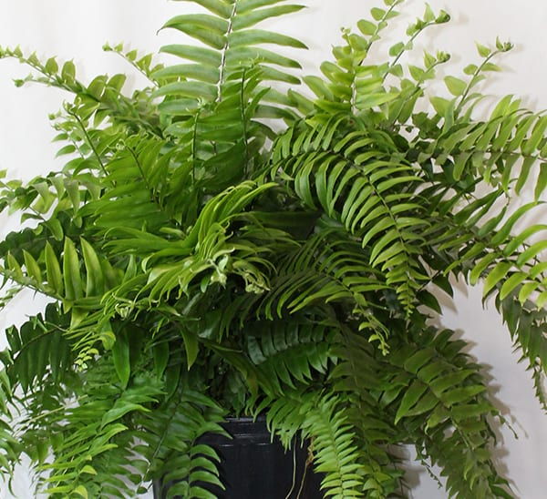
Macho Fern
Grown typically in large containers
largest of all the fronds / glossy appearance
solid green in color
Large spacing between nodes compared to other ferns

Slide 14
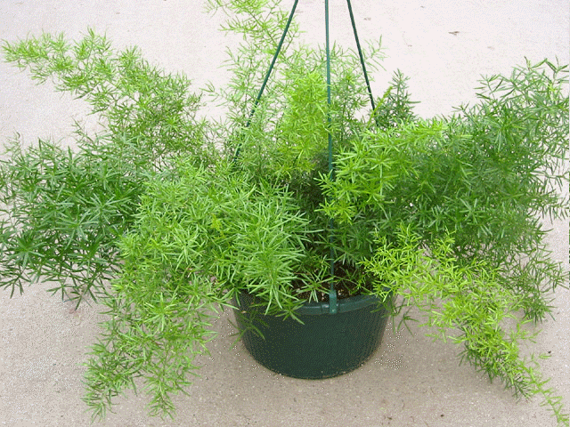
Sprengeri Fern
Fine, needle-like, bright green leaflets on arching stems that spread outward
Leaflets create bushy tail
Plant has small thorns

Slide 15
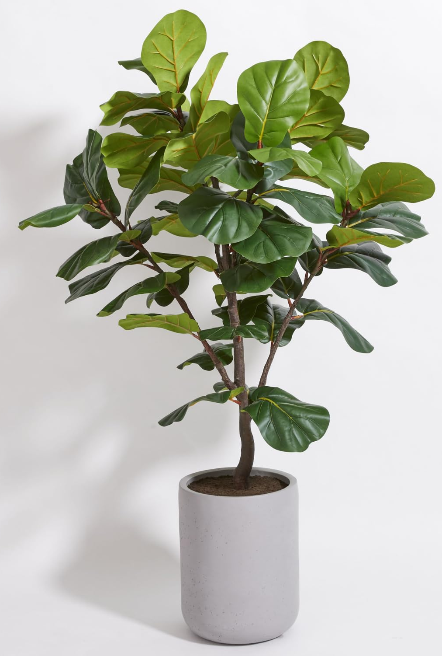
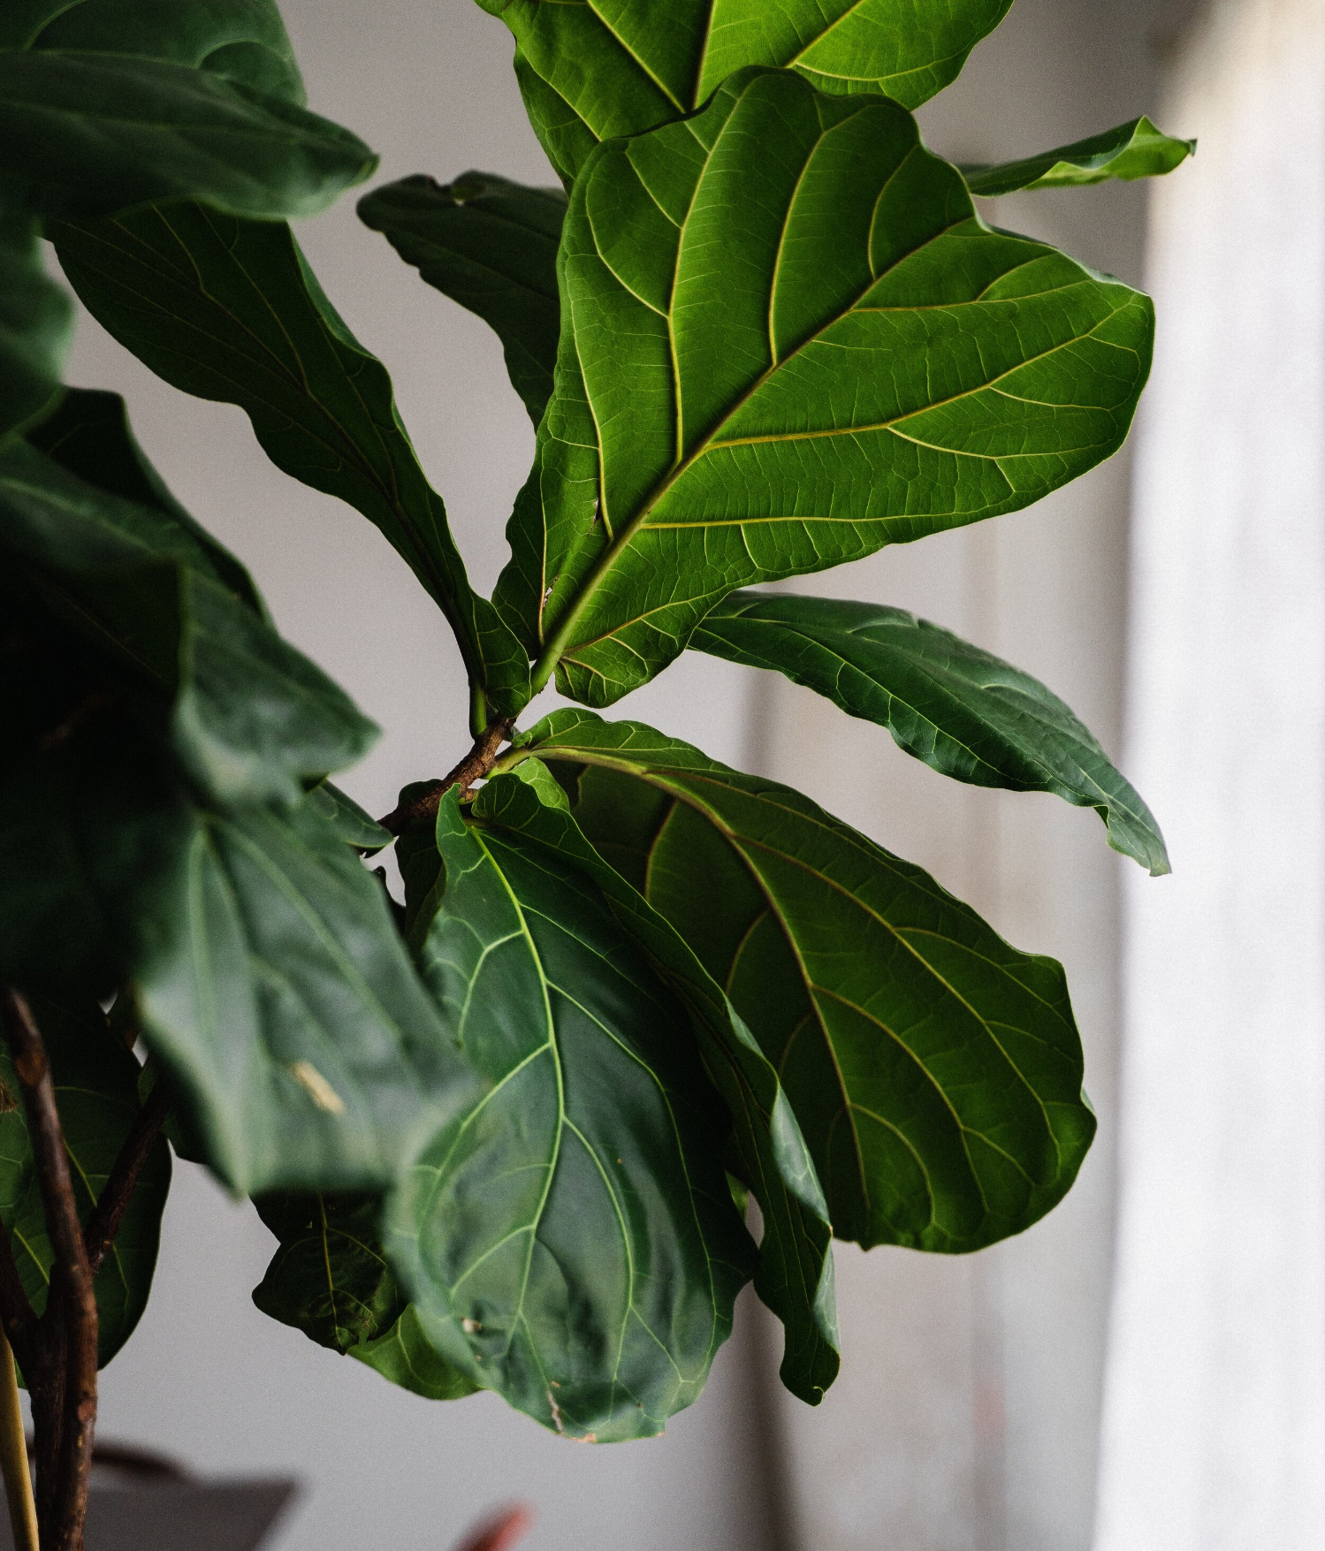
Fiddle Leaf Fig
Leaves are widest near the top and narrow toward the base — the violin/fiddle shape
Large, broad leaves with leathery texture with prominent veins
They produce a milky sap.
Upright, tree shaped

Slide 16
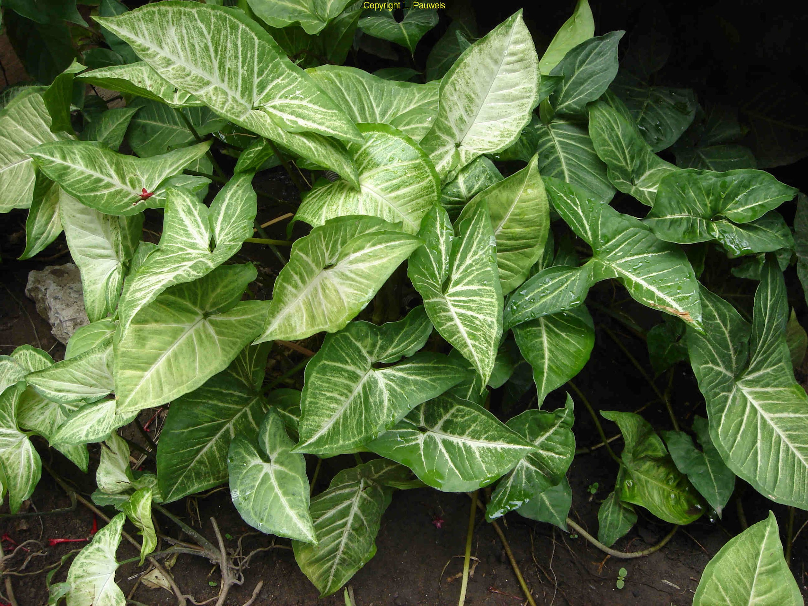
Nephthytis
White veins stand out clearly against the green leaf surface
Arrowhead-shaped leaf that becomes increasingly lobed and finger-like as the plant matures
leaf shape changes dramatically as the plant matures (from simple arrowhead to deeply lobed)
Vining/trailing habit

Slide 17
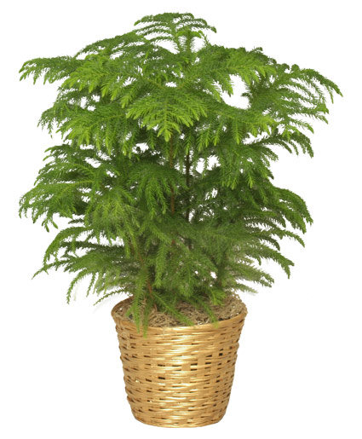
Norfolk Island Pine
Branches grow in perfect horizontal whorls/tiers at each node
Has needles on stems as well as branches
Soft, bright green needle-like modified leaves
Perfect Christmas tree shape - can get very tall (50-70 feet)

Slide 18
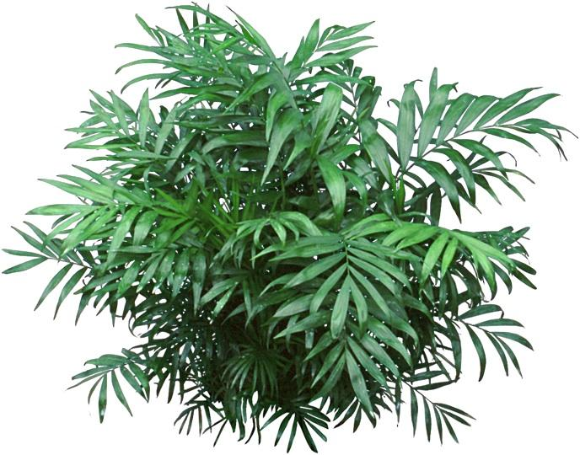
Parlor Palm
Small, compact, usually single-trunked palm
Usually grows to 4' tall
Pinnate (feather-like) arching fronds with 12+ pairs of narrow, slightly drooping leaflets.

Slide 19
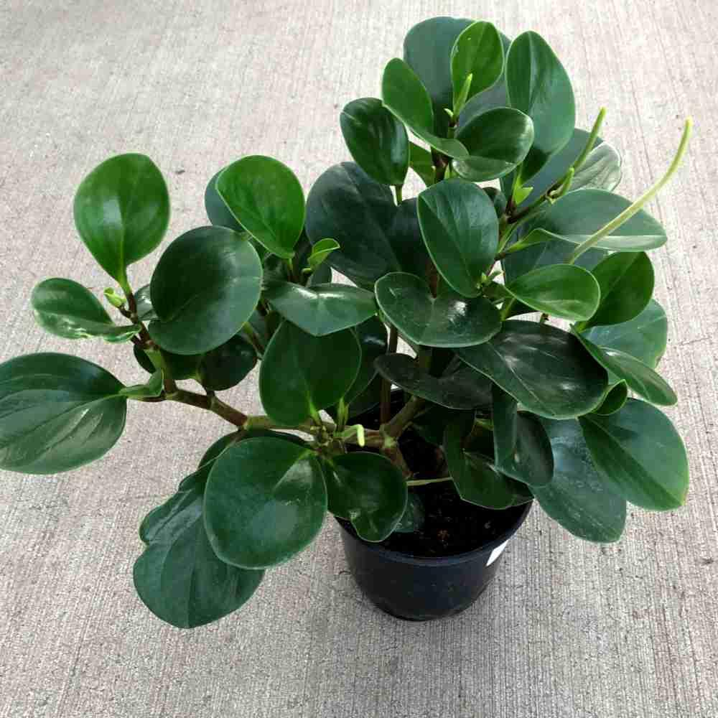
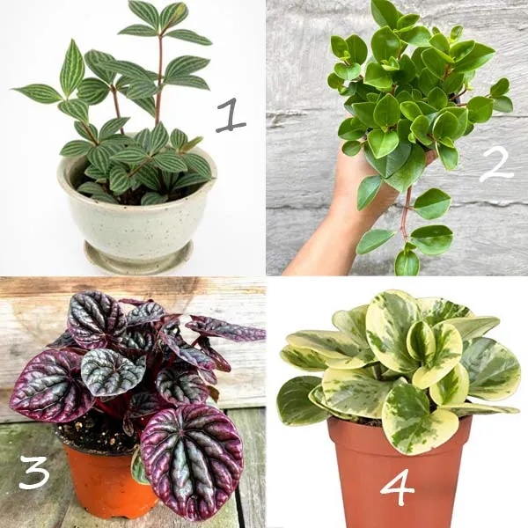
Peperomia
Waxy, elliptic, thick dark green leaves (to 6” long)
succulent-like leaf texture — thick and water-storing
Compact, low, mounded growth — stays small, rarely exceeds 12" in any direction
Small greenish-white flower spikes are distinctive — thin, upright, rat-tail-like spikes with no visible petals

Slide 20
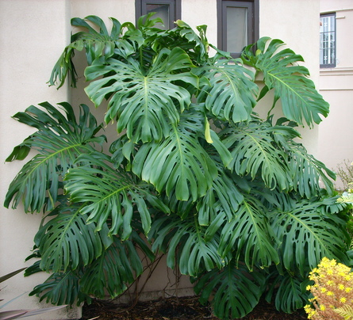
CutLeaf Philodendron
Leaves are solid green or variegated
Deep cuts running from near the midrib all the way to the leaf edge
Mature leaves also develop natural holes (fenestrations) within the leaf
Massive leaf size (up to 3' across) on a climbing vine with thick aerial roots

Slide 21
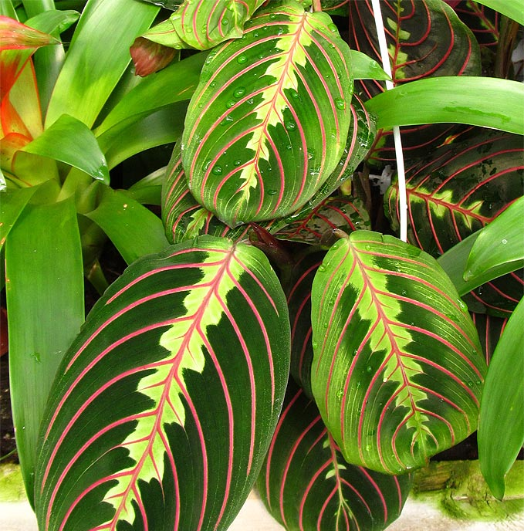
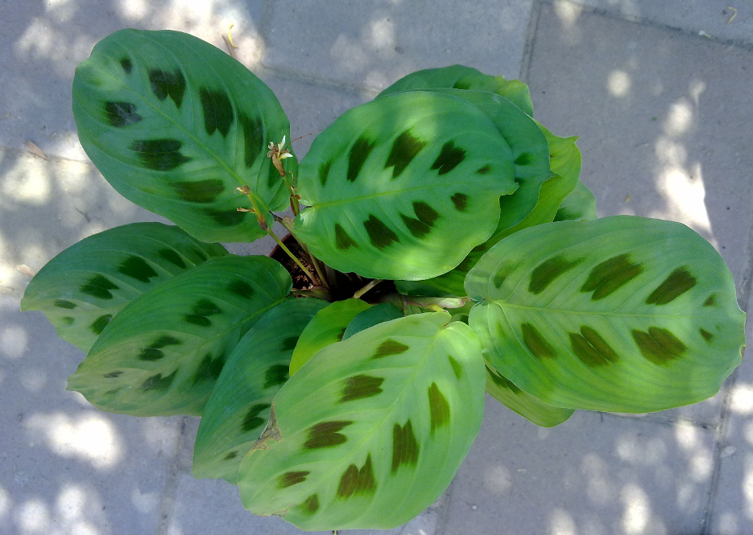
Prayer Plant
Coloring in between the veins of leaves is always a reddish tint
Leaf underside is often deep purple-red
New leaf is rolled as it starts to emerge
Shape of the leaf is very wide and leaf turns up at the margins
Leaves fold upward at night like praying hands and reopen in the morning

Slide 22
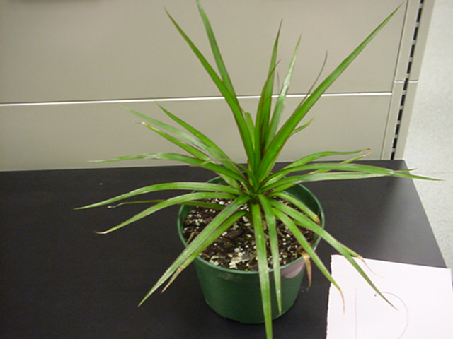
Red Edge Dracaena
Is a large upright plant
Very narrow, strap-like leaves with a distinct red/pink margin running the full length
Leaves radiate in a starburst from the top of a slender cane
Lower leaves drop to reveal a bare, slender cane with ring scars

Slide 23
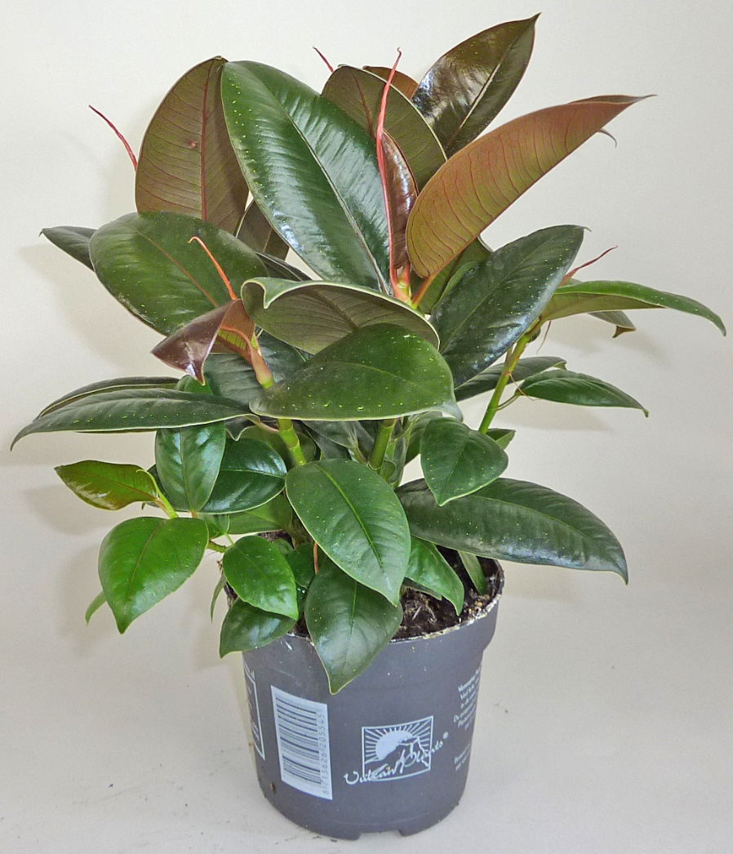
Rubber Plant
Large, thick, extremely glossy dark green leaves with a red midrib
leaves feel almost rubbery (hence the name)
Leaf bud is very distinct
New leaf emerges from a bright red/pink sheath that then falls off

Slide 24
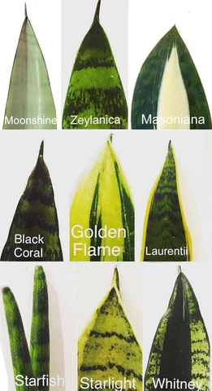
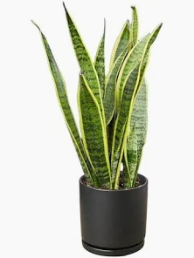
Snake Plant
Plants will have a pattern on leaf similar to snake skin
Stiff, upright, sword-like leaves grow straight up from the soil — the most vertical growth habit of any plant on this list
Leaves are thick and semi-succulent — extremely firm and rigid to the touch

Slide 25
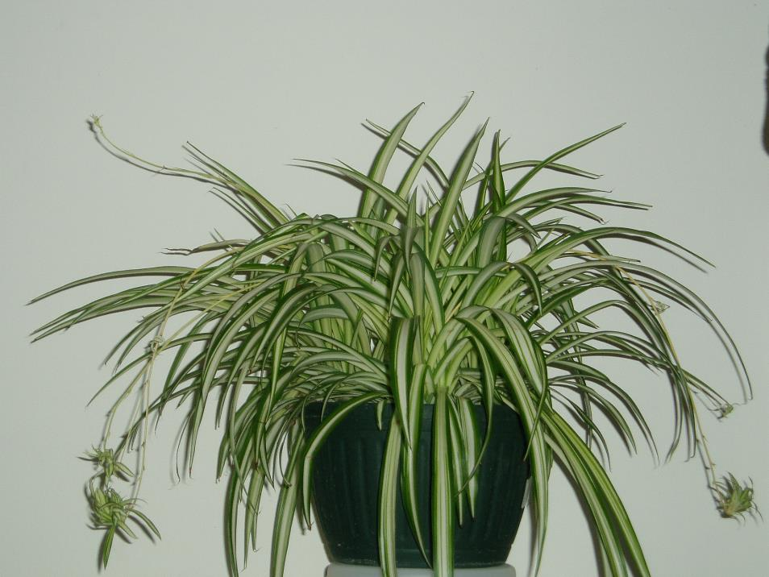
Spider Plant
Long, narrow, arching leaves - are green or striped white.
Flowering stems bear loose panicles of small, white, starry flowers.
Baby plantlets (spiderettes) dangle on long arching runners
When plants are full, they have an interesting, graceful, cascading habit.

Slide 26
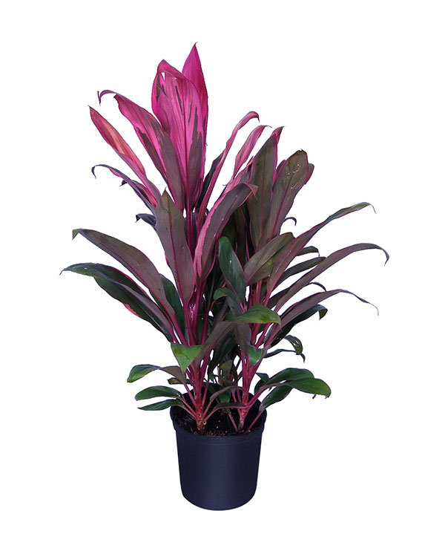
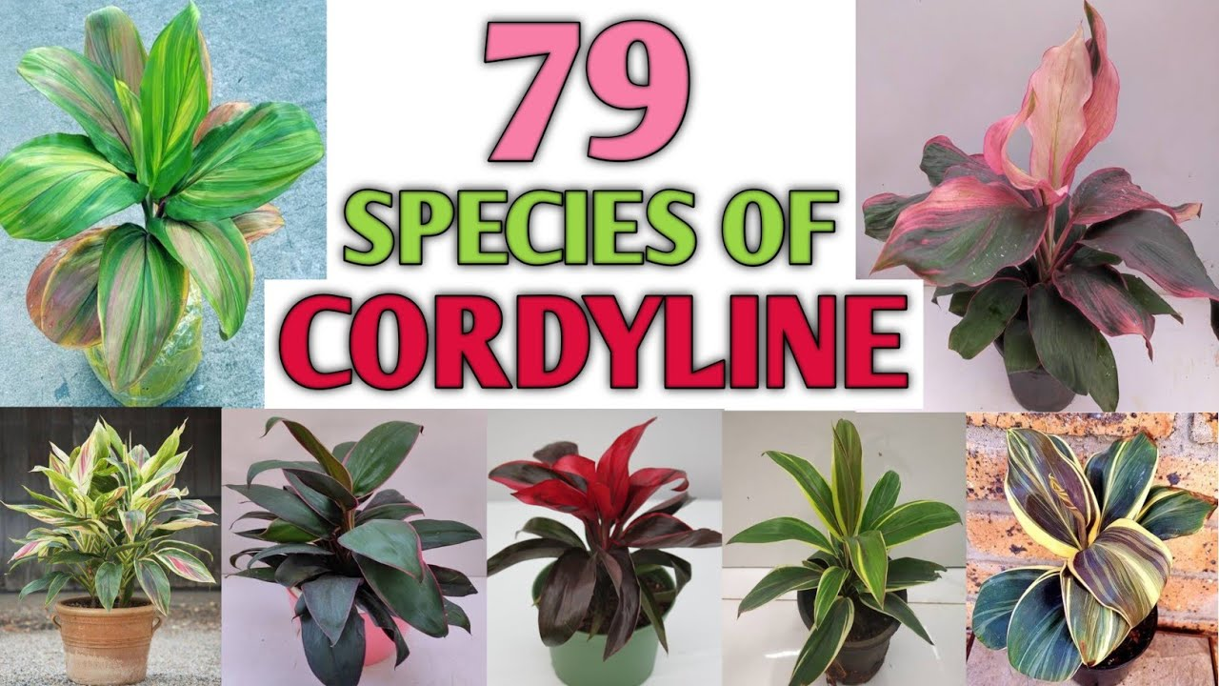
Ti Plant
Also called Cordyline
Smooth, flexible leaves that can be many colors, including light greens, pinks, and dark reds
evergreen shrubs that can grow up to 10 feet tall
Leaves grow in a rosette from the stem tip — smooth, flexible, and slightly floppy
Slender stem with leaves only at the top

Slide 27
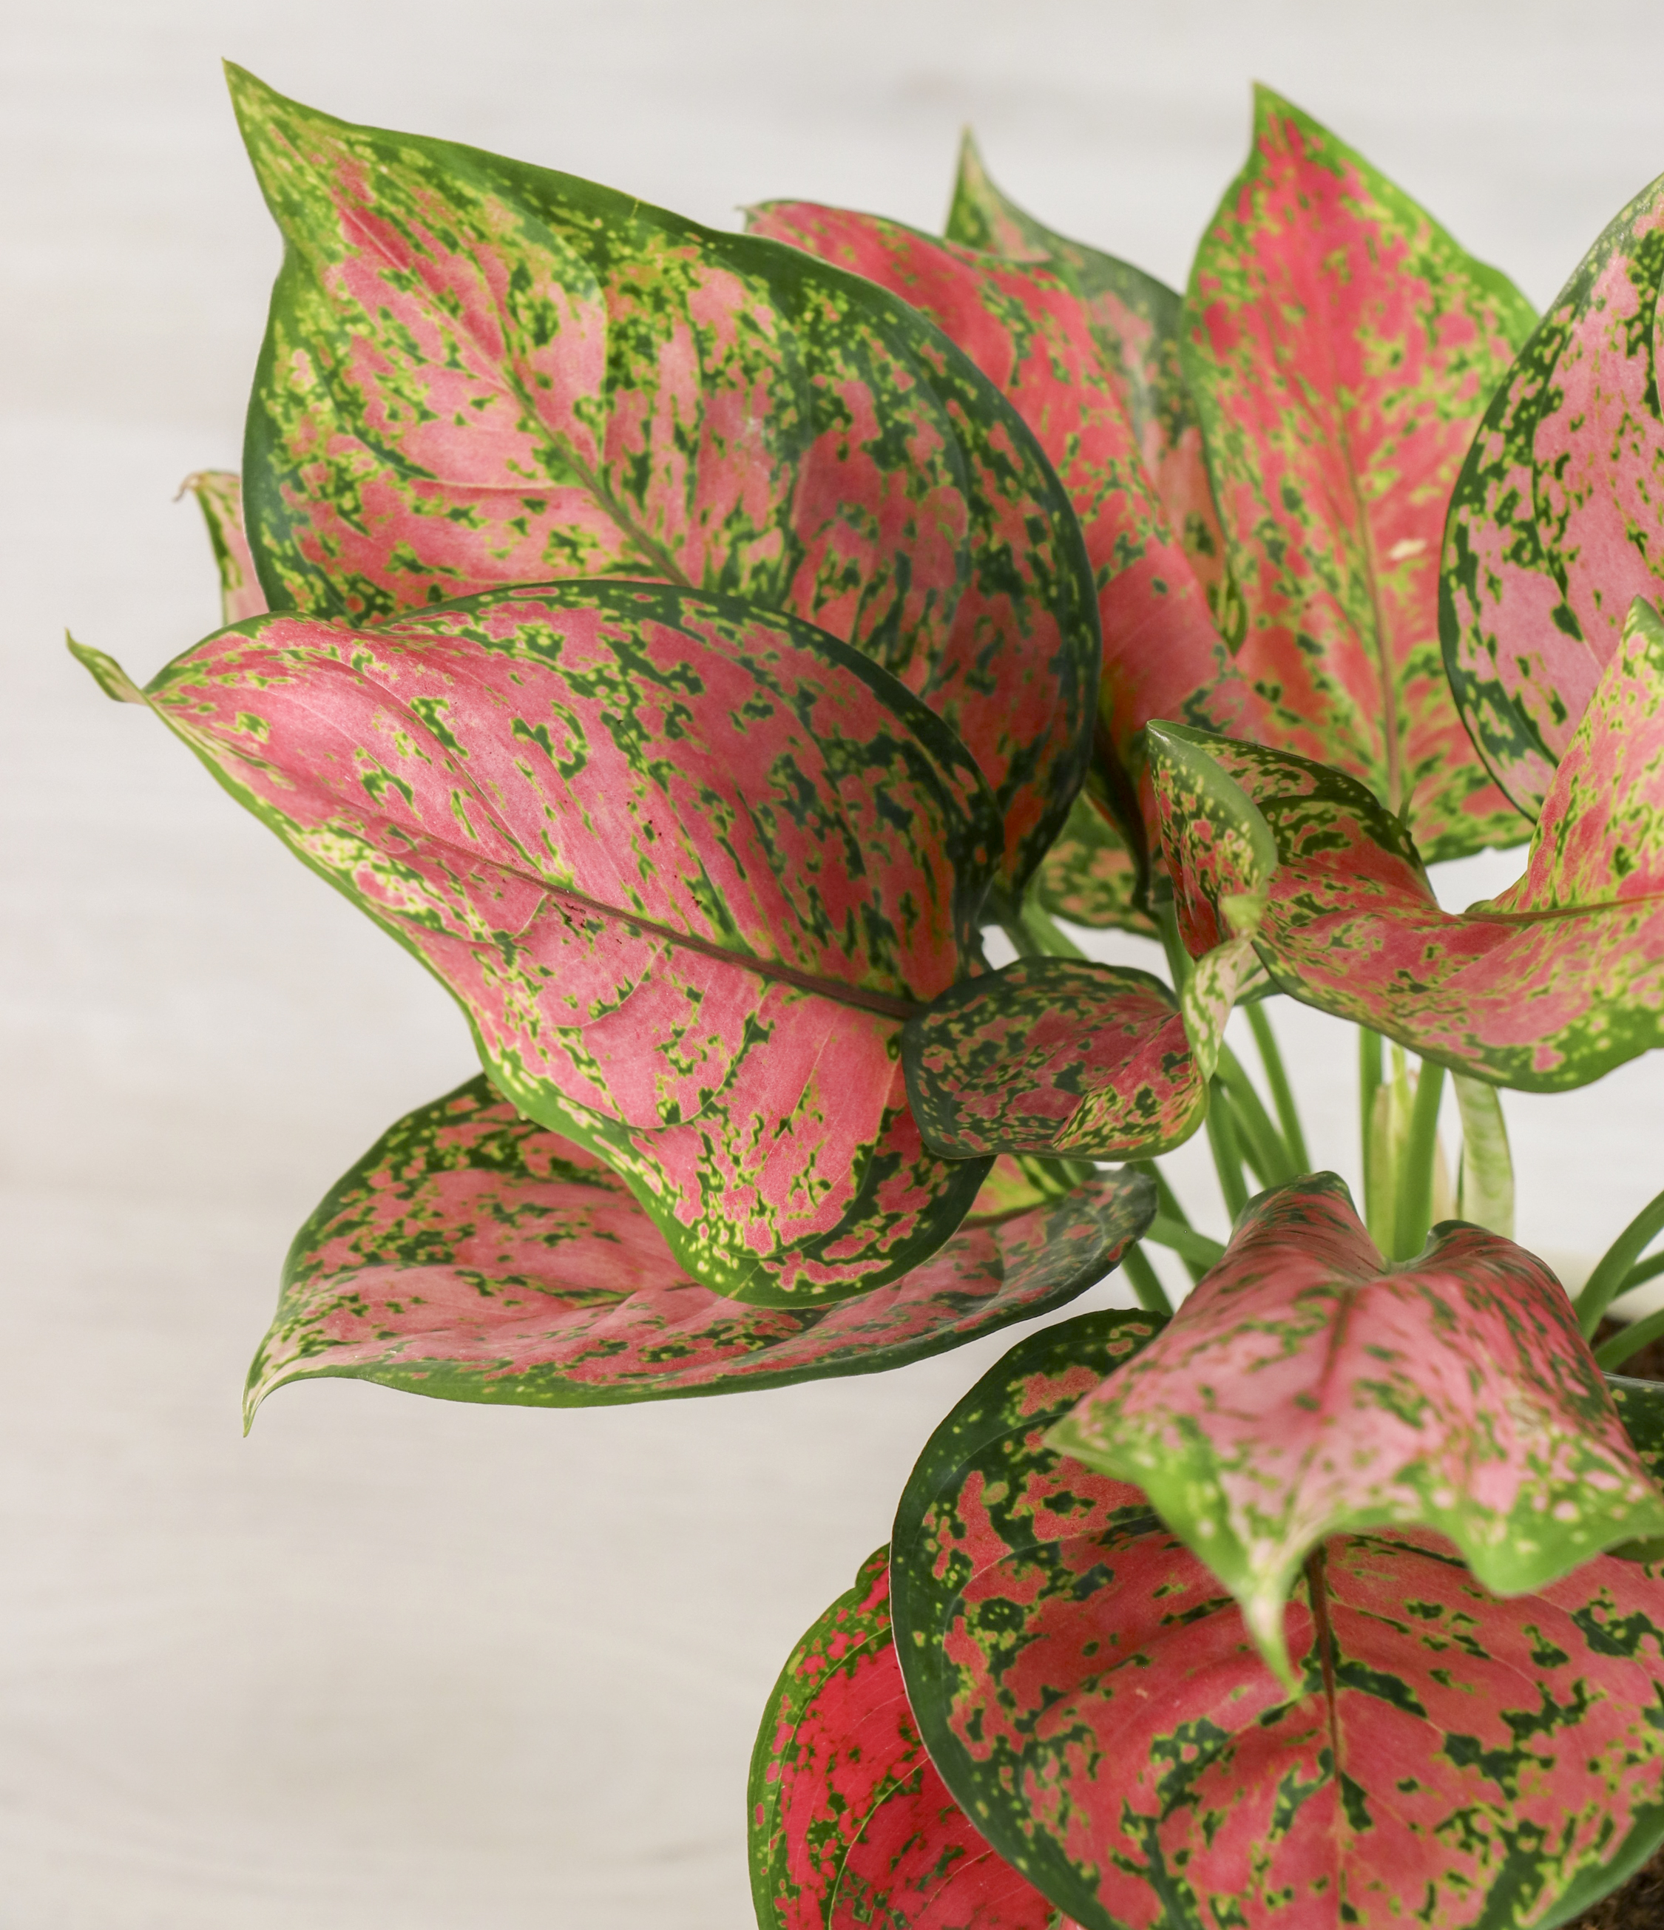
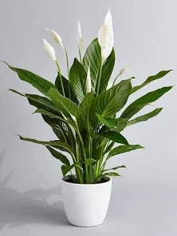
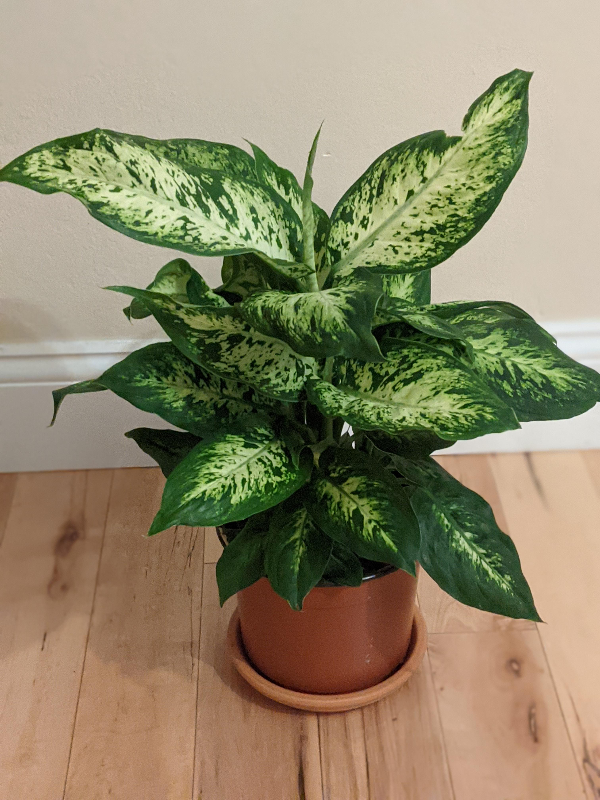
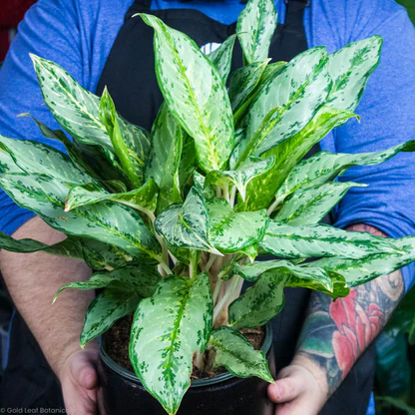
Now let's Compare
Aglaonema
Leaves: Green with silver, grey, or pink markings along veins
Silver or grey markings follow the VEINS outward from midrib
Short, compact stem low to ground
Can also have pink or red tones which the other two never have
Peacy Lily
Leaves: Solid dark green OR variegated
Uniform dark green most common; variegated is all-over
No visible main stem — leaves rise from base
White flower is the giveaway
Dumbcane
Leaves: Green with cream/white blotching in center
Cream blotching heaviest in CENTER of leaf, green edges
Thick, cane-like stem becomes very visible as plant ages

Slide 28
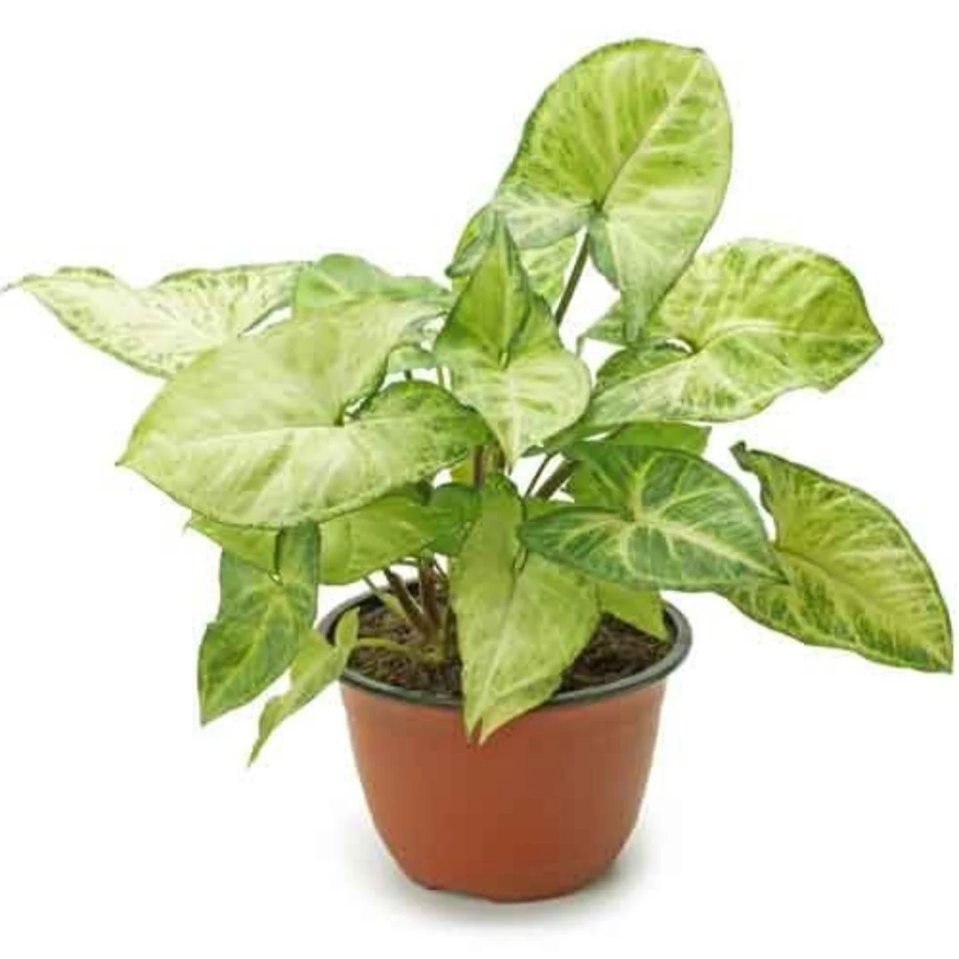
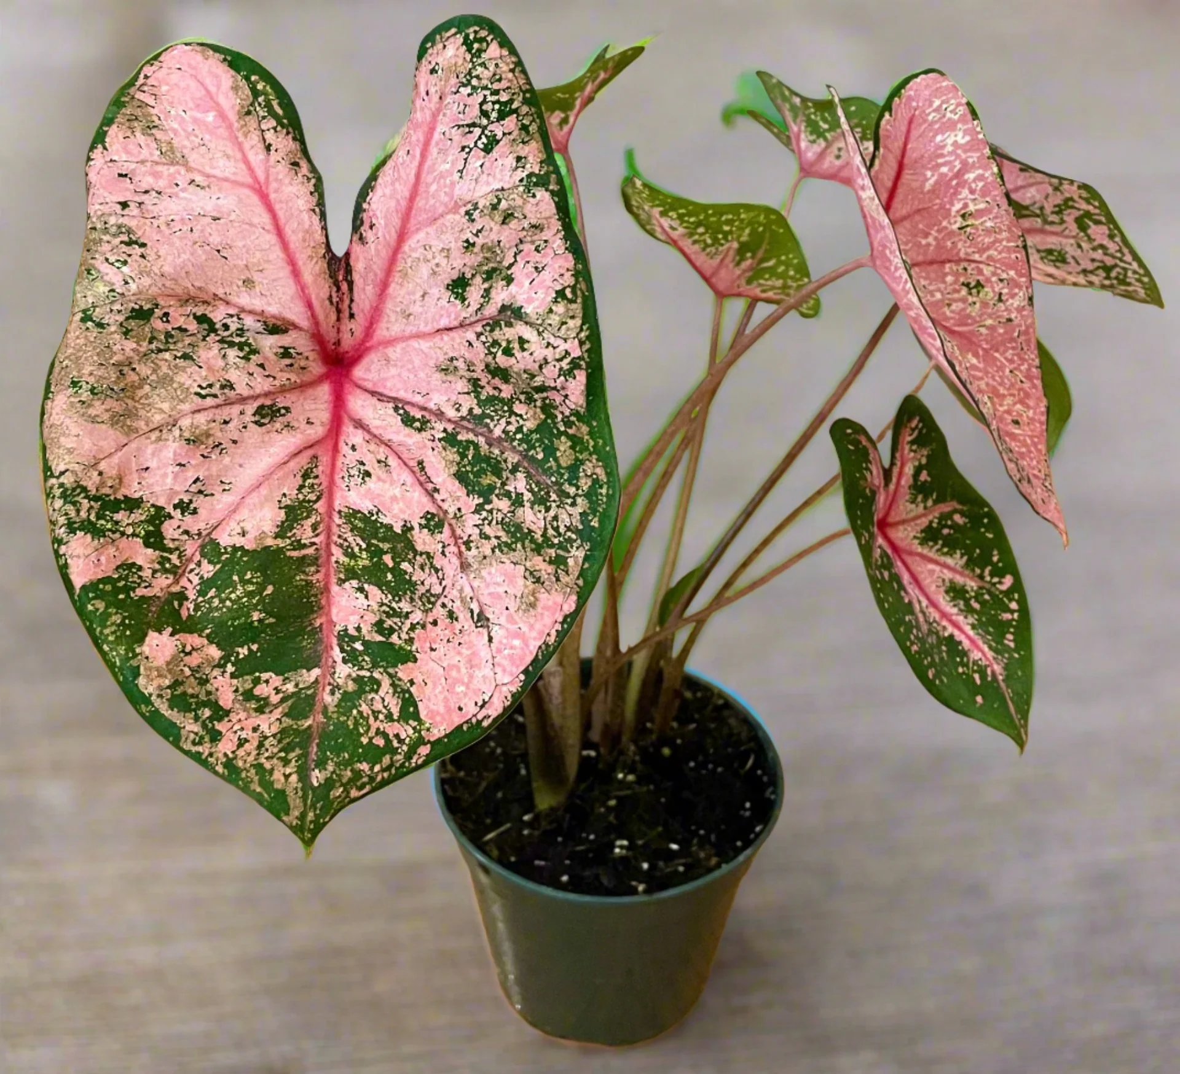
Now lets compare
Nephthytis
Stem attaches at the “V” of the leaf
Arrowhead leaves that get MORE lobed and finger-like as the plant matures
greener, waxier, vining tendency
Caladium
Stem attaches UNDER the leaf
Stays arrowhead-shaped
Bold green, pink, red, white blotches with colorful veins
Thin, almost papery leaves

Slide 29
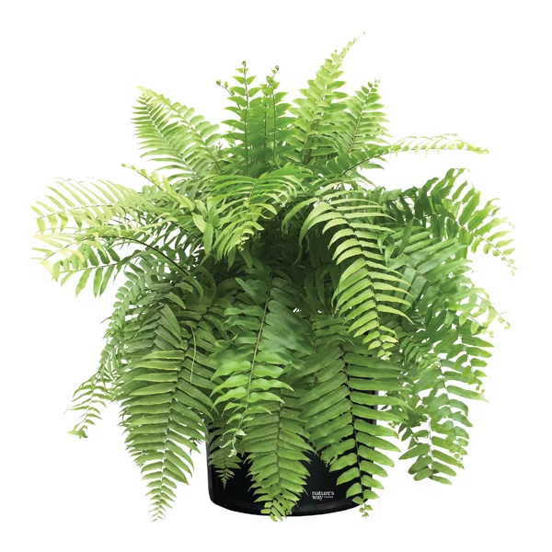
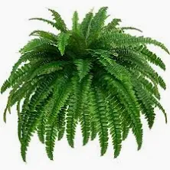
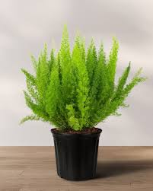
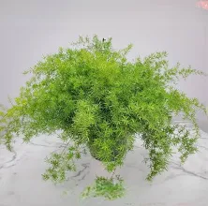
Now let's Compare
Macho Fern
Pinnate fronds — larger, wider leaflets
Fronds long, arching, broader than Boston
noticeably larger leaflets with wider spacing and a shinier surface
Boston Fern
Pinnate fronds — small paired rounded leaflets
Fronds long, arching, drooping at tips
Classic hanging basket fern
Foxtail Fern
Needle-like cladodes (modified stems)
Fronds upright, cylindrical plumes
looks nothing like a true fern
Sprengeri Fern
Needle-like leaflets, finer than Foxtail
Fronds arching, spreading mound
the only one with thorns on the stems

Slide 30
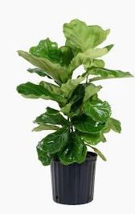
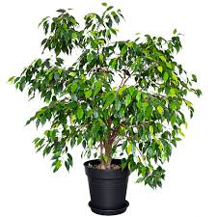
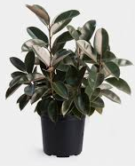
Now let's Compare
Benjamin Fig
Leaves: Small oval with elongated drip tip
The only one with SMALL leaves — hundreds of tiny oval leaves
Woody, often braided/twisted trunk
Fiddle Leaf Fig
Leaves: Broad, widest near TOP, narrowing at base — fiddle/violin shaped
leaves are bold, stiff, and leathery with prominent raised veins
Woody, upright single trunk
Rubber Plant
Leaves: Large oval, slightly elongated - Very thick, extremely glossy, almost rubbery
Woody, upright single trunk
look for the bright red/pink sheath covering each new leaf bud before it opens
new growth always has a reddish tint

Slide 31
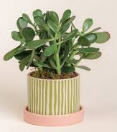
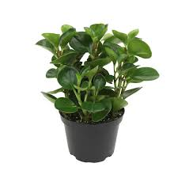
Now lets compare
Jade Plant
The only one that develops a true woody trunk and branches — looks like a miniature tree
Leaves always in opposite pairs on woody brown branches
Very glossy, uniform dark green leaves
Stems are grey to brown/woody when mature
Pepperomia
Low, mounded/bushy — no trunk, many stems
Leaves can vary dramatically in shape and variegation across cultivars
The rat-tail flower spike is unique and unmistakable
Stems are green, red, or purplish

