Slide 1


Georgia FFA
Floriculture
Plant Identification Tips and Tricks
This is a free resource provided by Georgia Agricultural Education
Original creator: Melissa Riley, Central Region Horticulture Teacher

Slide 2
This PowerPoint was created to provide key characteristics of plants on the Plant Identification list of the Georgia Floriculture Career Development Event

Slide 3
Succulents and Cacti

Slide 4
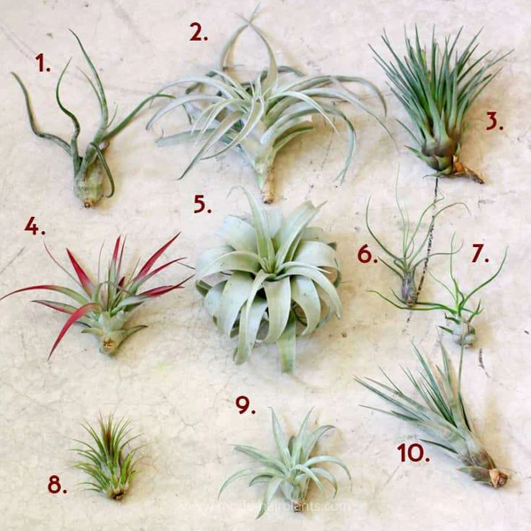
Air Plant
Succulent in appearance
Leaves are coated in silvery-gray trichomes (tiny hair-like scales)
Narrow, strap-like leaves radiating from a central base in a rosette — come in many sizes but always this same fundamental form
Relatively small (less than 6 inches)
Very little root structure / don’t take in much water / absorb nutrients from the air - No soil needed

Slide 5
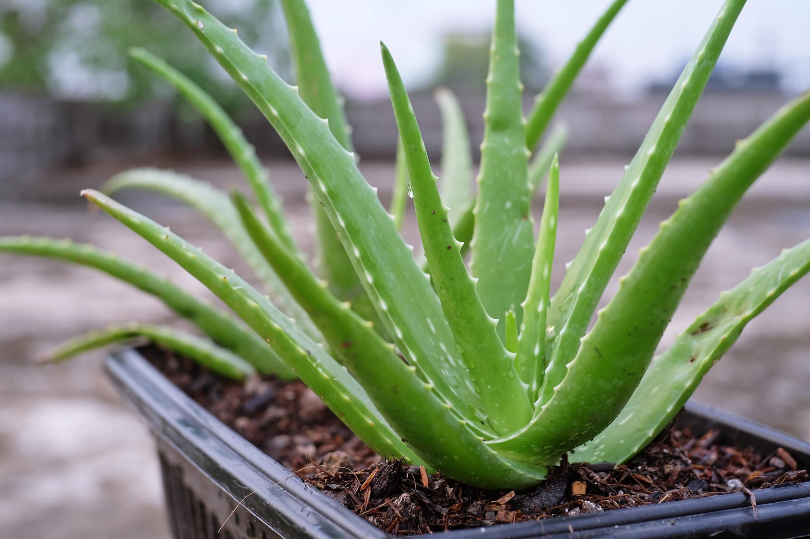
Aloe Plant
Thick, fleshy leaves contain a clear gel
Leaves are light to dark green
Leaves are stiff and upright with sharp marginal teeth and a pointed terminal spine at the tip
Leaves grow in a stemless rosette from the base

Slide 6
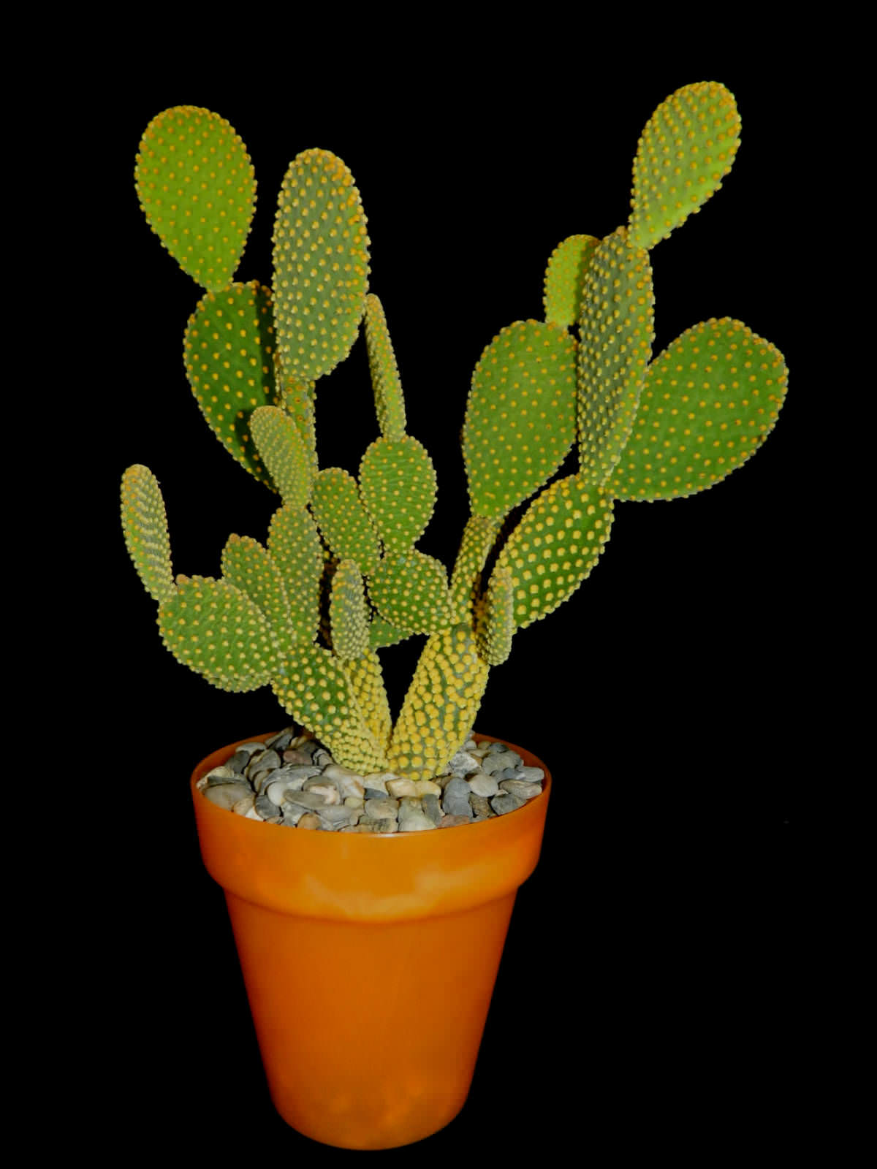
Cactus
Flat, oval pads are modified stems
Spines emerge from distinct areole dots visible all over the pad surface — clusters of tiny dots each producing spines or bristles (glochids)
Pads connect end-to-end building upward

Slide 7
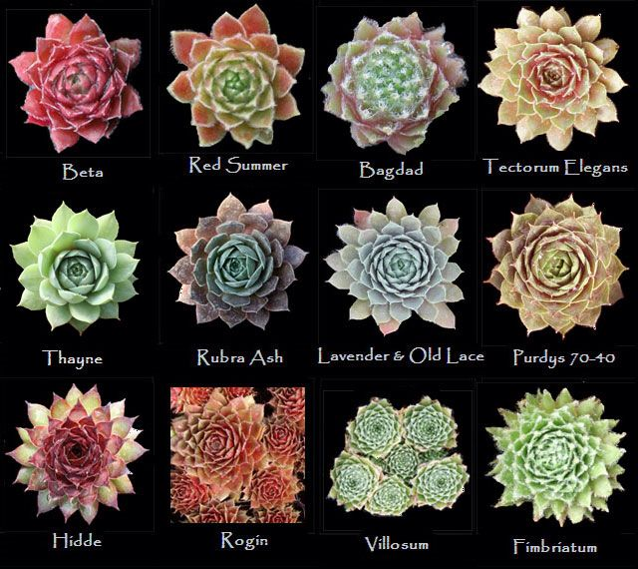
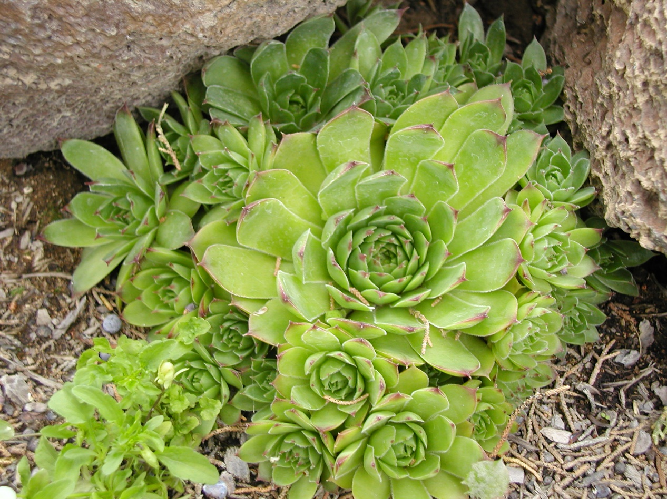
Hens and Chicks
Baby offsets (chicks) spread outward on short stolons from beneath the mother plant
Leaves form an extremely tight, symmetrical rosette
Thick stem, waxy leaves
Soft point at end of each leaf
Leaf color can shift from green to purple, red, or bronze

Slide 8
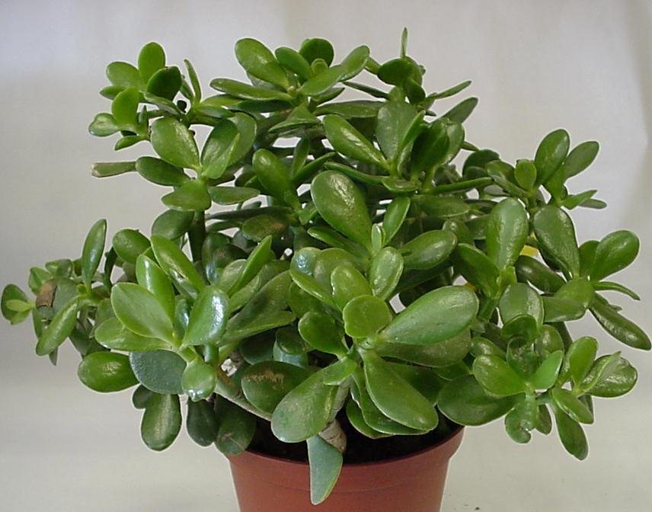
Jade Plant
Oblong, fleshy, shiny, evergreen leaves (to 2” long).
Arranged in opposite pairs along woody branches
Leaves may acquire red tints when grown in direct sun.
Develops a thick, woody, tree-like trunk and branches with age

Slide 9
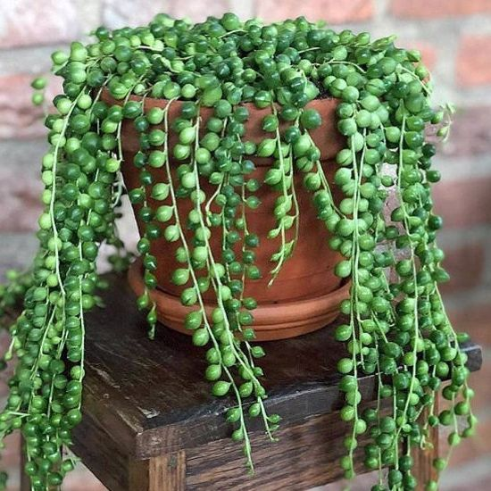
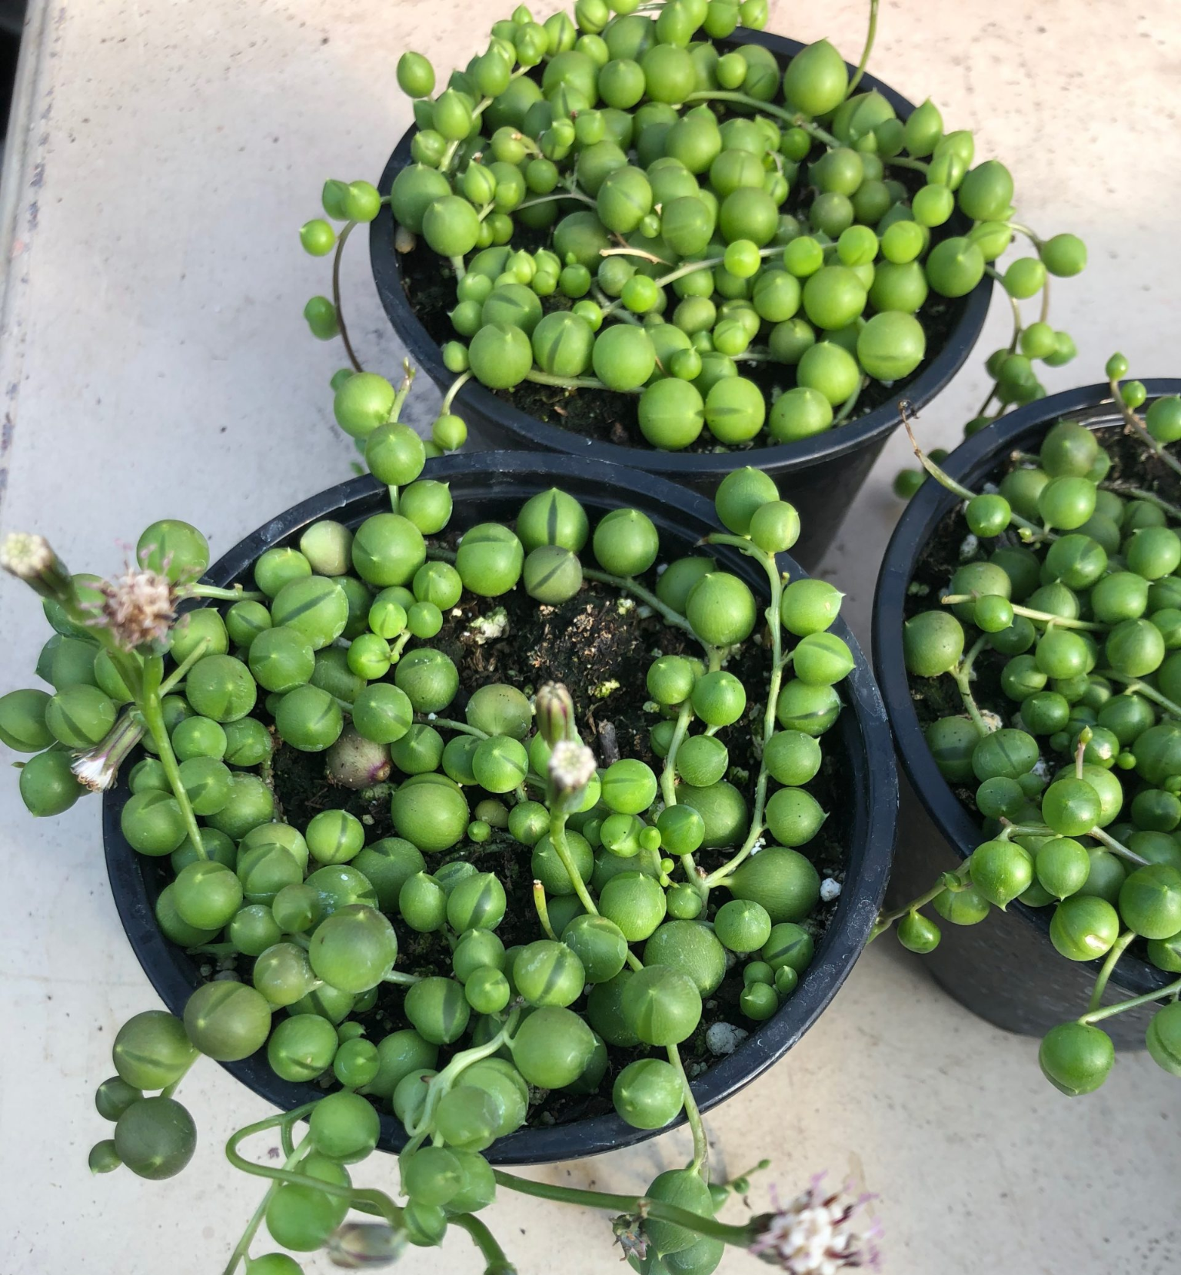
String of Pearls
Round, pea-like leaves on long trailing stems
Trailing stems that can grow up to 3 feet long
Each round leaf has a dark epidermal window (translucent stripe/band) that lets light into the leaf interior for photosynthesis

Slide 10
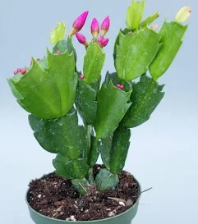
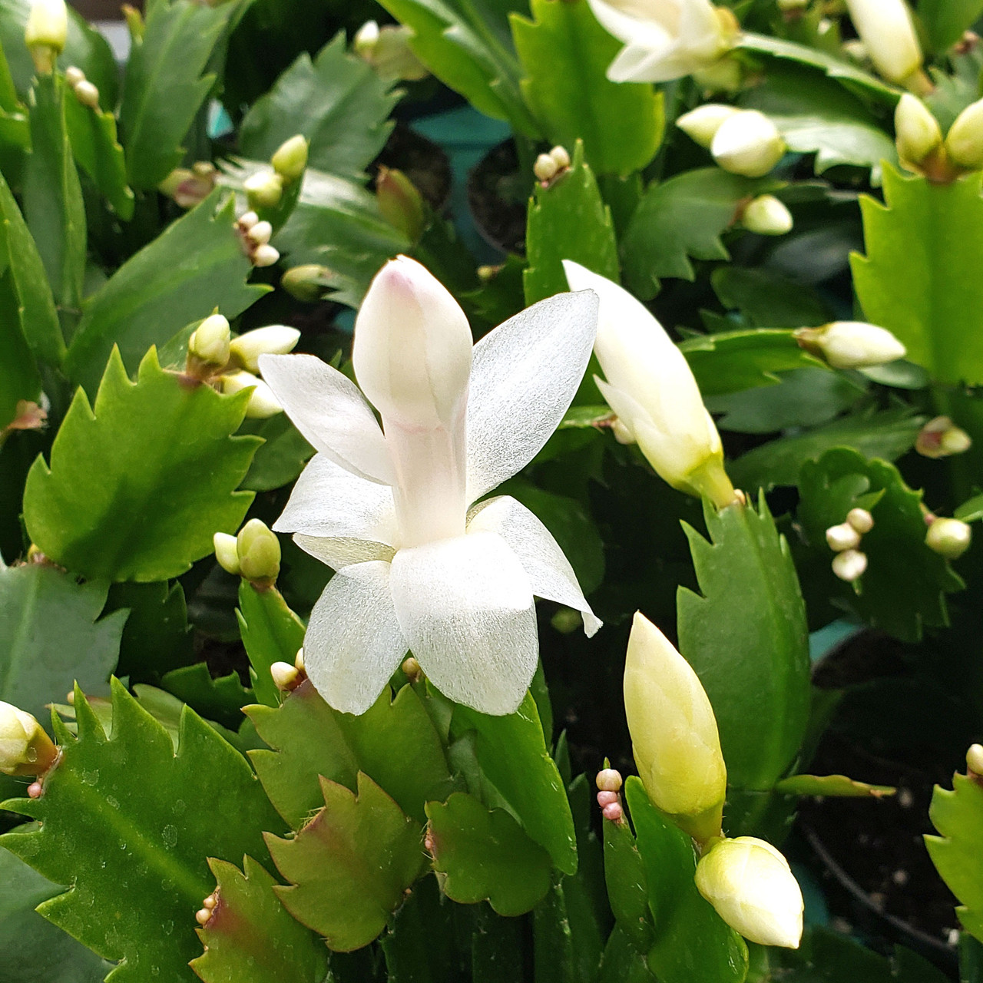
Thanksgiving Cactus
Stem segments have pointed, tooth-like projections on the edges
“Leaves” are actually a modified, flattened stem
Leaves attach one on top of the other

Slide 11
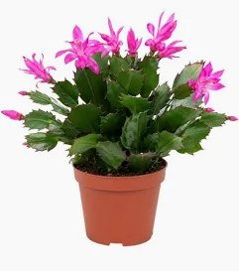
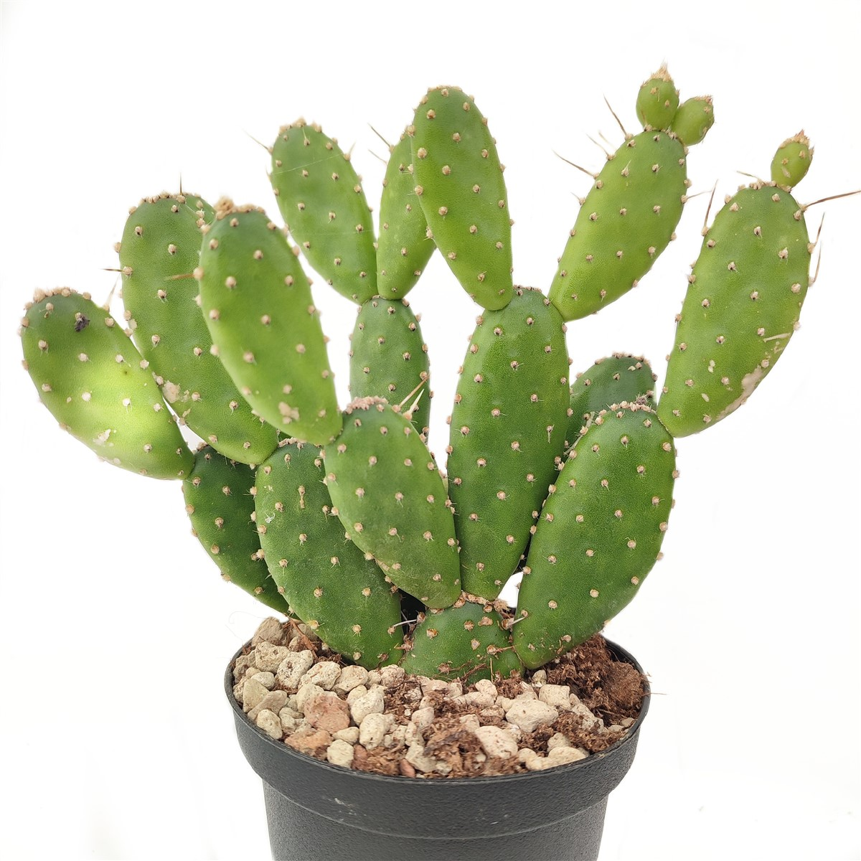
Now lets compare
Thanksgiving Cactus
Flat green segments with pointed tooth-like notches on the edges
Trails or arches downward
Blooms in fall with showy tubular flowers
Absolutely NO spines — safe to handle
Cactus
Oval flat pads stacking upward connected end-to-end
Covered in dot-like areoles with sharp spines AND tiny barbed glochids that are worse than the spines — handle with care
very much a desert plant

Slide 12
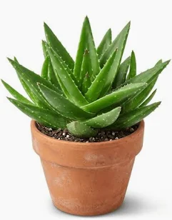
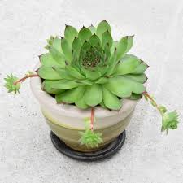
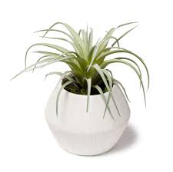
Now let's Compare
Aloe
Long, upright, thick, fleshy, firm leaves
Gel-filled - Snap a leaf and clear gel oozes out
The only one with sharp spiny leaf edges
Green leaves sometimes with white spots
Hens and Chicks
Leaves overlap so perfectly it looks almost artificial
Thick, waxy, firm leaves
Always surrounded by baby offsets on short runners
Can be purple or bronze
Air Plant
NO soil
Silvery-gray fuzzy appearance
Can be displayed in a pot, without a pot, mounted, or in a glass globe
Smallest and most varied in shape of the three

Slide 13
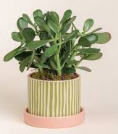
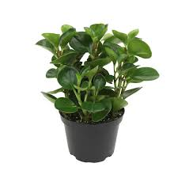
Now lets compare
Jade Plant
The only one that develops a true woody trunk and branches — looks like a miniature tree
Leaves always in opposite pairs on woody brown branches
Very glossy, uniform dark green leaves
Stems are grey to brown/woody when mature
Pepperomia
Low, mounded/bushy — no trunk, many stems
Leaves can vary dramatically in shape and variegation across cultivars
The rat-tail flower spike is unique and unmistakable
Stems are green, red, or purplish

