Slide 1


Georgia FFA
Floriculture
Plant Identification Tips and Tricks
This is a free resource provided by Georgia Agricultural Education
Original creator: Melissa Riley, Central Region Horticulture Teacher

Slide 2
This PowerPoint was created to provide key characteristics of plants on the Plant Identification list of the Georgia Floriculture Career Development Event

Slide 3
Vines and Trailing Plants

Slide 4
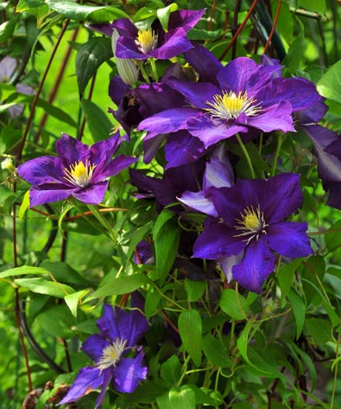
Clematis
Large, showy flowers with 4–6 broad overlapping petals
Leaves are compound, leaves attach to trellis to help hold the plant upright – veins palmate
When petals fall off, usually leave pistil behind
Usually on a trellis or stake
Very thin stem
fluffy, feathery seed head
Leaves in groups of 3

Slide 5
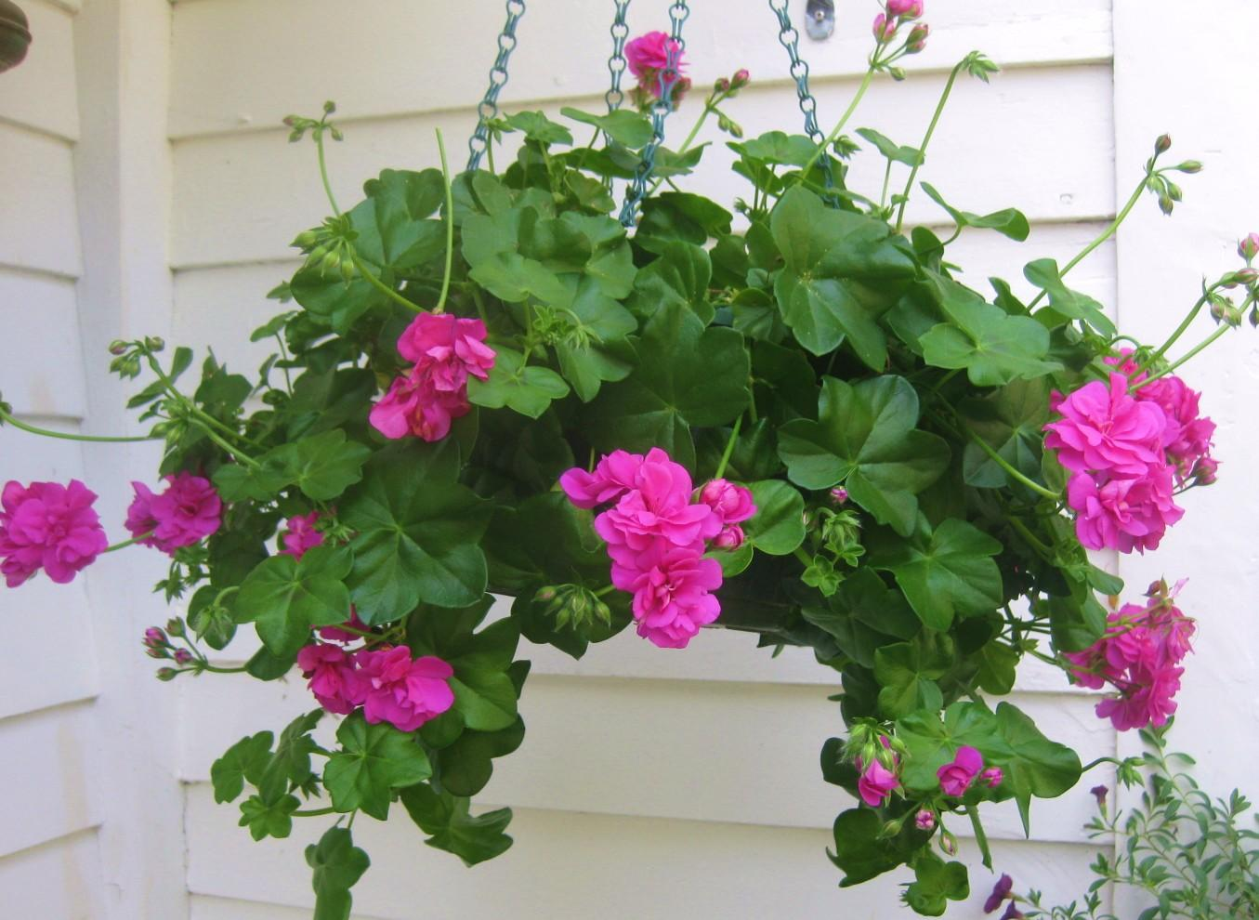
Ivy Geranium
Trailing/cascading habit
Flowers cluster in rounded heads just like regular geranium
Leaves are waxy and glossy, not as hairy as regular geranium
Leaf has ivy-like shape with 5 pointed lobes

Slide 6
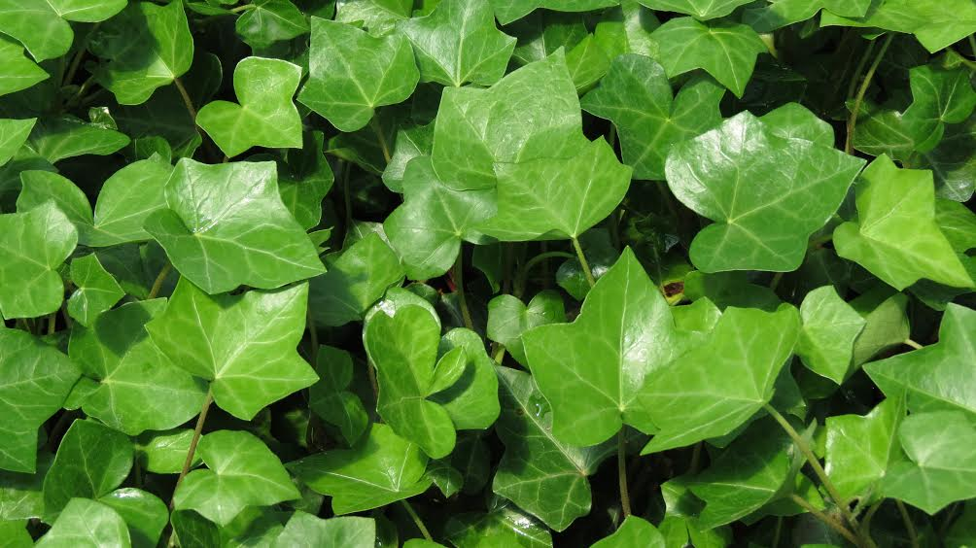
English Ivy
Aerial rootlets along the stem
Classic 3–5 lobed leaf shape with pointed tips and distinctly pale/cream-colored veins against dark green
Waxy, leathery leaf texture
Comes in solid green and different variegated patterns

Slide 7
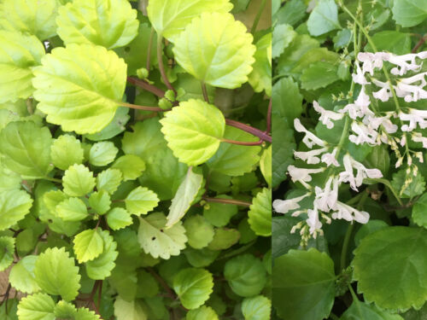
Swedish Ivy
Square stem
Round, scalloped-edge leaves with deep veins
Tiny white flowers bloom in spikes on and off throughout the year
Trailing plant typically grown in hanging baskets

Slide 8
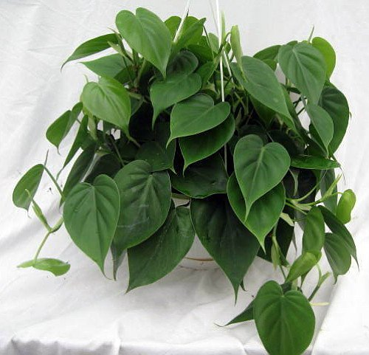
Heartleaf Philodendron
Leaves are thin, soft, and matte, Leaves heart shaped
Can be variegated or solid green leaves
Stem is very smooth, very round
Stipule is a small piece of tissue that is NOT fused to the stem, unlike pothos
New leaves emerge from a pink/bronze papery sheath (cataphyll) that dries and falls off

Slide 9
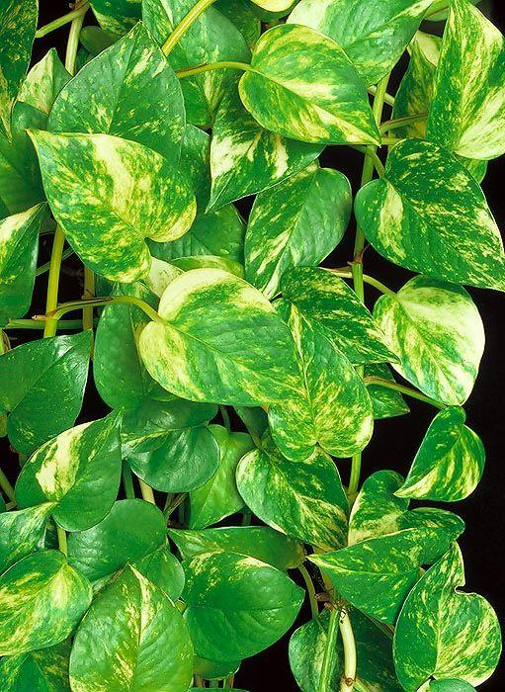
Pothos
Leaves are always marbled either green & white or green & yellow
Leaves are slightly waxy and thick
Trailing growth pattern
Ribbed, grooved node where the stipule is fused to the stem

Slide 10
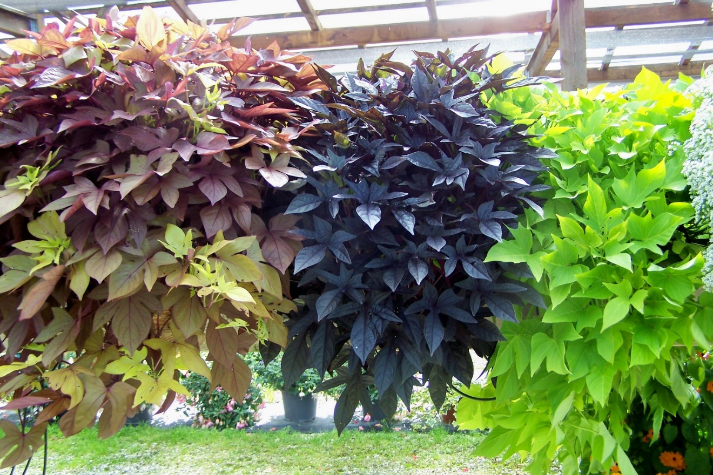
Sweet Potato Vine
Tender perennial
Popular root vegetable
purple, chartreuse and variegated-leaved cultivars
A popular ornamental foliage plant.
Stems typically mound to 9” tall but spread by trailing stems to 8-10’ wide
Leaves of the ornamental varieties are heart-shaped to palmately lobed (to 6” long)
Ornamental varieties usually do not flower.

Slide 11
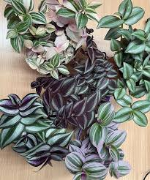
Wandering Jew (Inch Plant)
Leaf surface is shiny and slightly succulent-feeling
almost iridescent in good light
The underside of the leaf is usually solid color
Terminal leaf points straight out
Trailing/cascading habit with jointed, fleshy stems that root easily

Slide 12
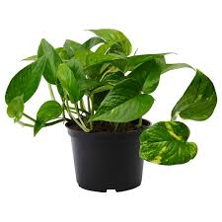
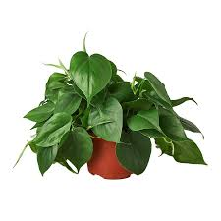
Now lets compare
Pothos
grooved/ribbed node you can FEEL with your finger
Thicker, waxier leaves with marbled yellow or white variegation
slightly bumpy leaf surface
asymmetrical leaf base
Heartleaf Philodendron
look for the bronze/pink papery sheath at the growing tip
Thinner, softer, matte leaves almost always solid dark green
perfectly smooth node
deeper more symmetrical heart notch at leaf base

Slide 13
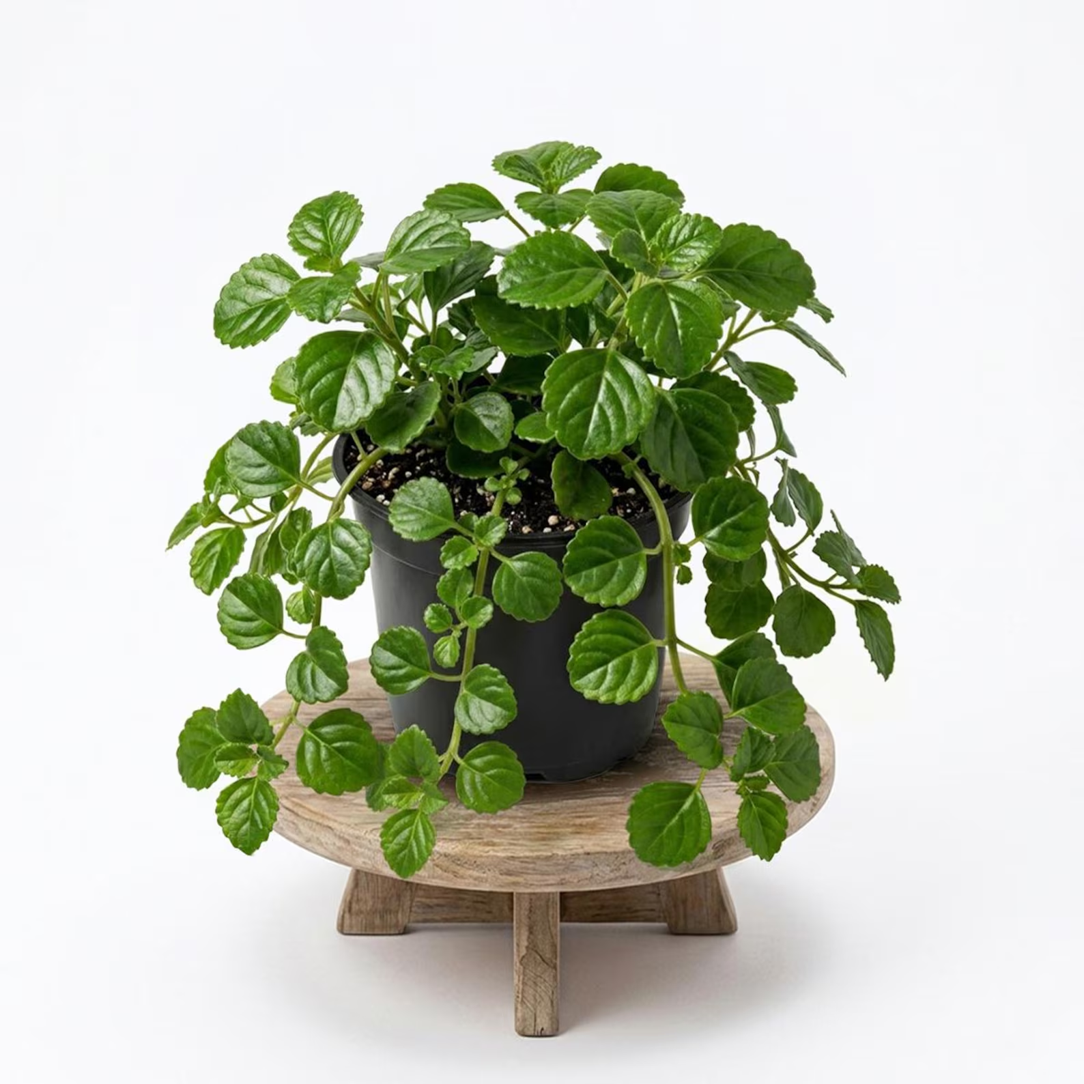
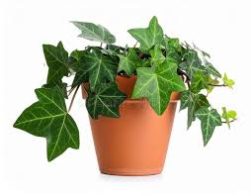
Now lets compare
English Ivy
Classic pointed 3–5 lobed leaf shape everyone recognizes as ‘ivy’
dark green with pale veins
stiff waxy leaf
aerial rootlets let it cling directly to walls without support
many variegated varieties
Swedish Ivy
Round, scalloped-edge leaves with NO points or lobes
square stem
bright light green
produces tiny white flower spikes year-round

Slide 14
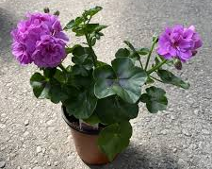
Now lets compare
English Ivy
Classic pointed 3–5 lobed leaf shape everyone recognizes as ‘ivy’
dark green with pale veins
stiff waxy leaf
aerial rootlets let it cling directly to walls without support
many variegated varieties
Ivy Geranium
has showy flower clusters
Named 'ivy' because its 5-lobed leaf LOOKS like ivy — but it's a geranium
waxy, thick, semi-succulent leaves
trails from a hanging basket but cannot climb walls

Slide 15
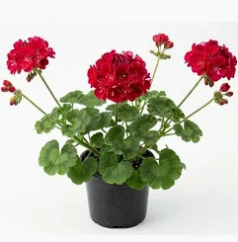
Now lets compare
Geranium
Upright bushy plant
round, hairy leaves with a distinct dark horseshoe/zone marking on the leaf surface
Strong, distinctive smell
Ivy Geranium
has showy flower clusters
Named 'ivy' because its 5-lobed leaf LOOKS like ivy — but it's a geranium
waxy, thick, semi-succulent leaves
trails from a hanging basket but cannot climb walls

