Slide 1
Georgia FFA
Floriculture
Plant Identification Tips and Tricks
This is a free resource provided by Georgia Agricultural Education
Original creator: Melissa Riley, Central Region Horticulture Teacher

Slide 2
This PowerPoint was created to provide key characteristics of plants on the Plant Identification list of the Georgia Floriculture Career Development Event

Slide 3
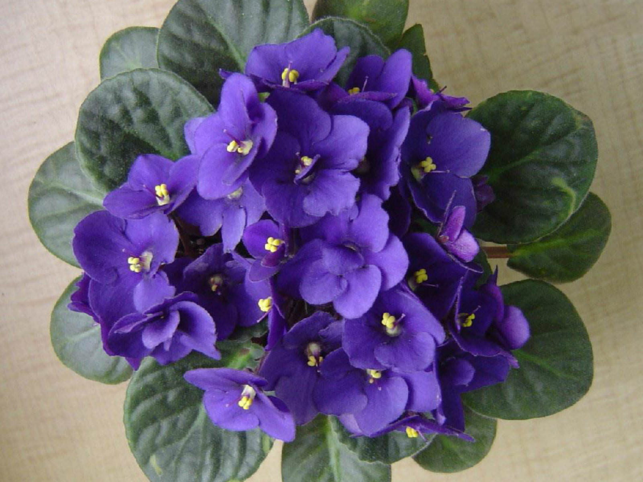
African Violet
Simple 5 petal flowers, one per ‘stem’ in large cluster
Small indentations on the leaves
Fuzzy leaf & petiole

Slide 4
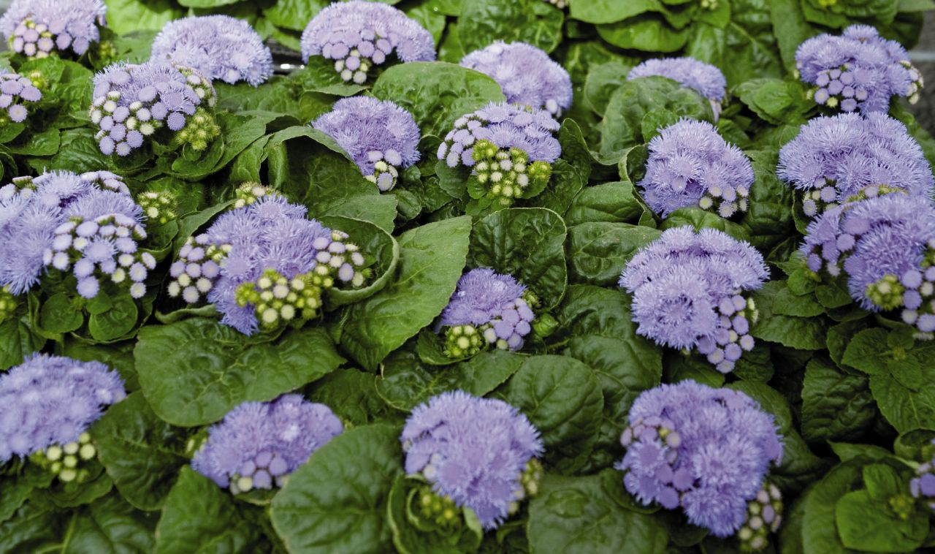
Ageratum
Bedding plant
Fluffy flowers in flattened to slightly rounded clusters atop compact, mounded plants
4” to 18” tall
Leaves typically rounded, cordate-at-the-base, hairy, slightly quilted, soft green

Slide 5
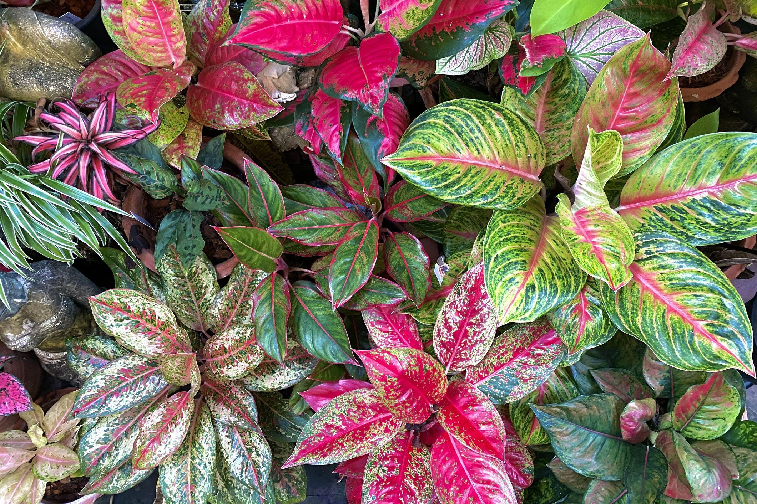
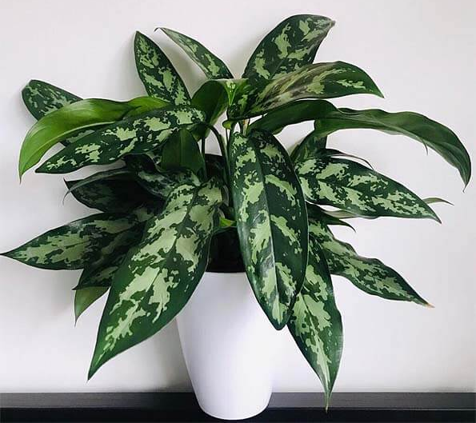
Aglaonema
green camouflage patterns on the upper sides of the leaves
typically grows to 20” tall
rarely flowers

Slide 6
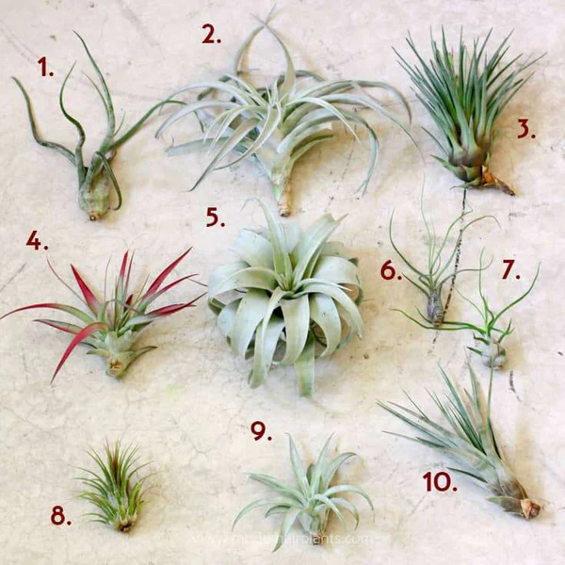
Air Plant
Succulent in appearance
Come in many shapes and sizes but usually relatively small (less than 6 inches)
Very little root structure / don’t take in much water / absorb nutrients from the air

Slide 7
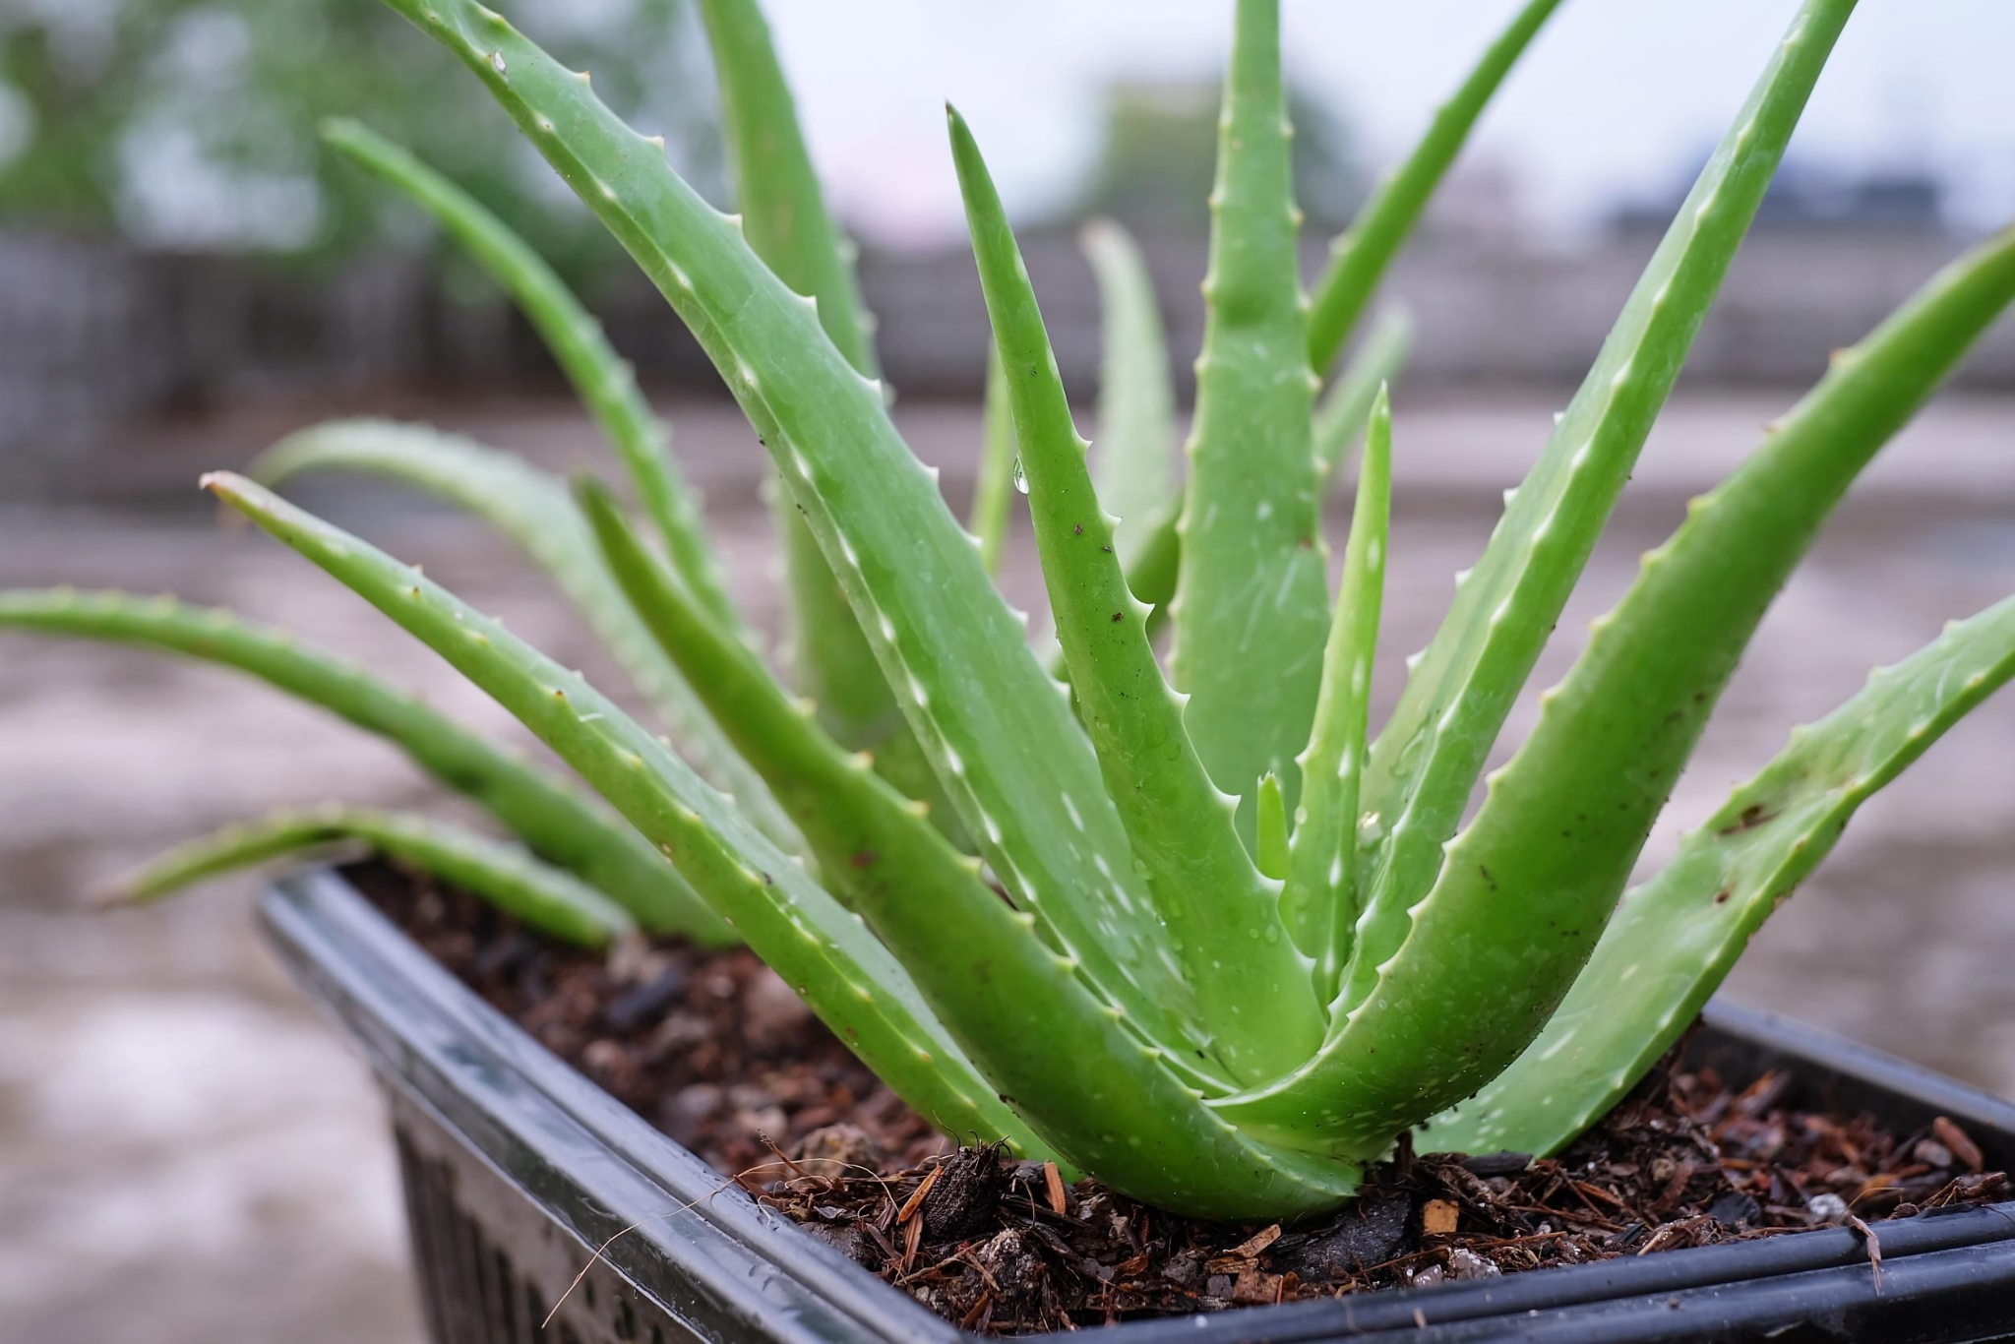
Aloe Plant
Thick, fleshy leaves
Leaves are light to dark green
Slightly serrated edges
Leaves arranged in a rosette pattern

Slide 8
Alstroemeria
Top slender, upright stems in bushy clumps 2-3' tall
Flowers yellow or orange often with spotting and streaking in terminal clusters of small, lily-like flowers
Narrow, twisted, lance-shaped leaves ~4" long, veins run parallel to margins

Slide 9
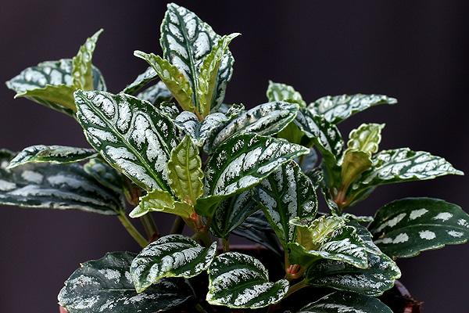
Aluminum Plant
Leaves arranged opposite one another
This is an upright, herbaceous perennial that is noted for its textured green and silver foliage.
Typically grows in a shrubby clump to 12” tall.
Elliptic to obovate, toothed, dark green leaves (to 3” long)/
Two silver stripes on leaves

Slide 10
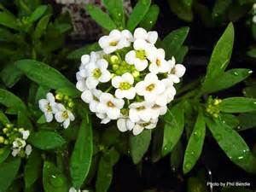
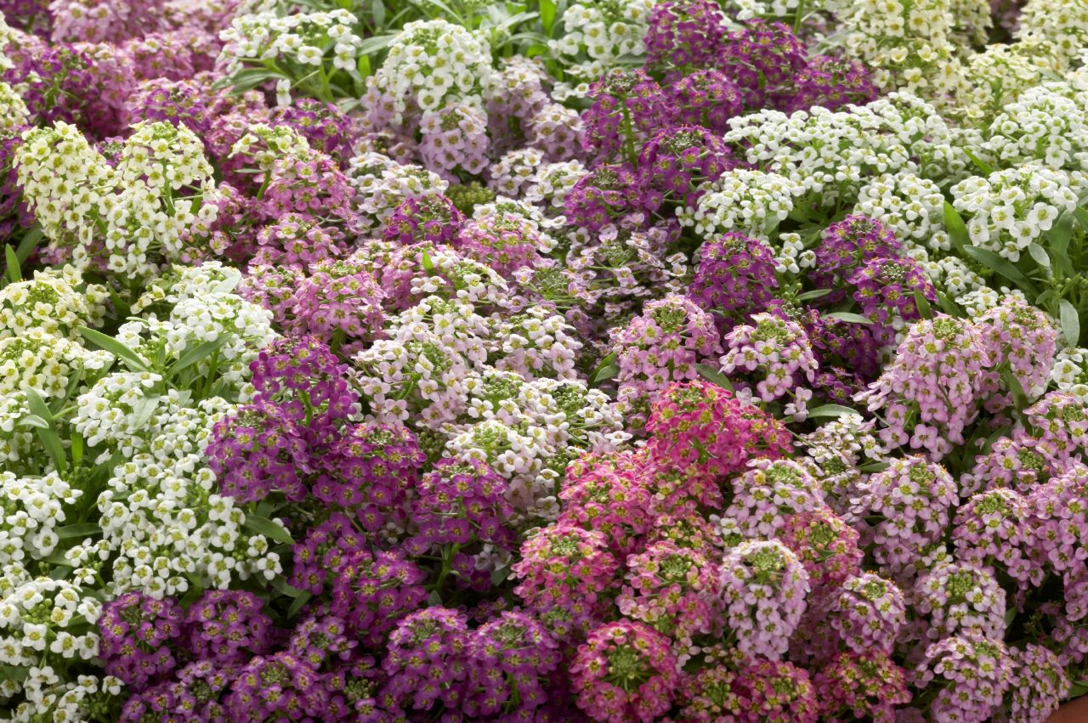
Alyssum
Very small delicate flowers – flowers can be shades of white, pink, or purple
Grows in a mounded shape
Leaves are roughly 1 inch long and only ¼ inch wide
Smells very sweet

Slide 11
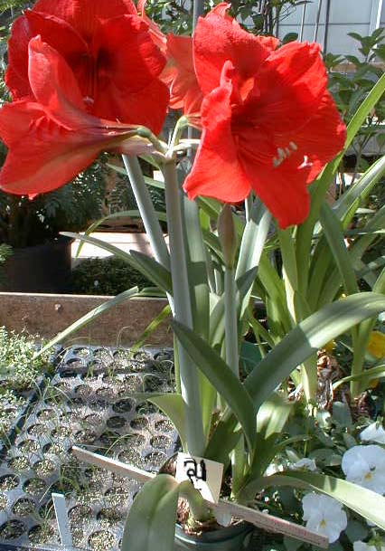
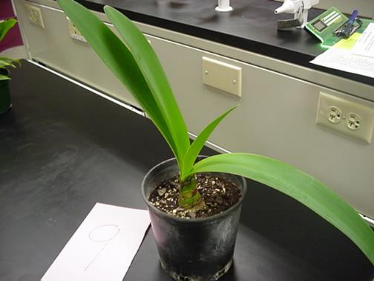
Amaryllis
Bulb, if planted correctly the bulb should show
Leaves opposite, USUALLY same # on each side
Does not have a pronounced mid-rib more of a swollen area on the back of the stem
Large flowers, multiple flowers come out of same point

Slide 12
Anthurium
About 16” tall
Long-lasting, waxy, palette-shaped, bright-red spathes (flowers) with a yellow spadix
Drooping, heart-shaped, dark green leaves arise on long stems from plant crown
Flowers may appear throughout the year in optimum growing conditions

Slide 13
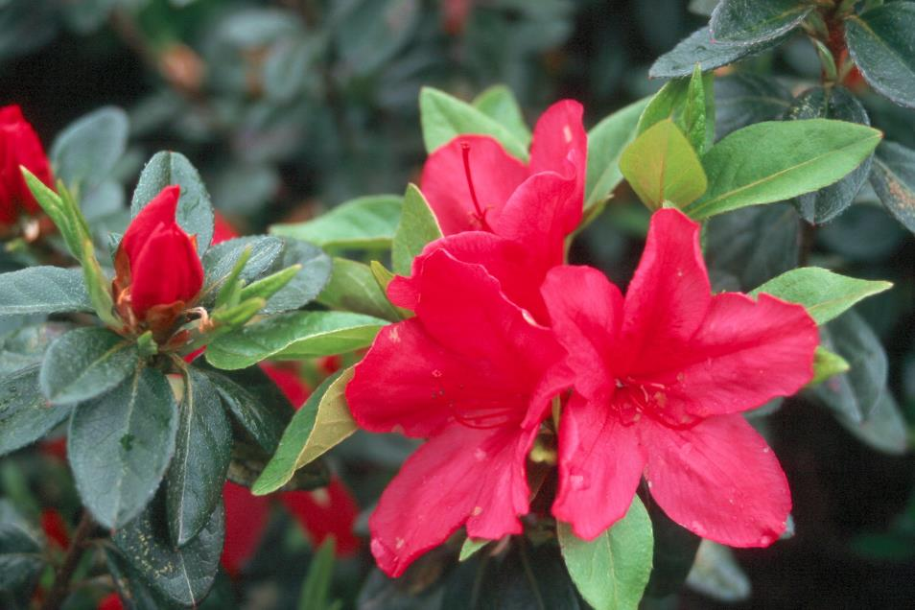
Azalea
Medium to large evergreen shrub
Leaves oval in shape and have small hairs on the top
Woody stem

Slide 14
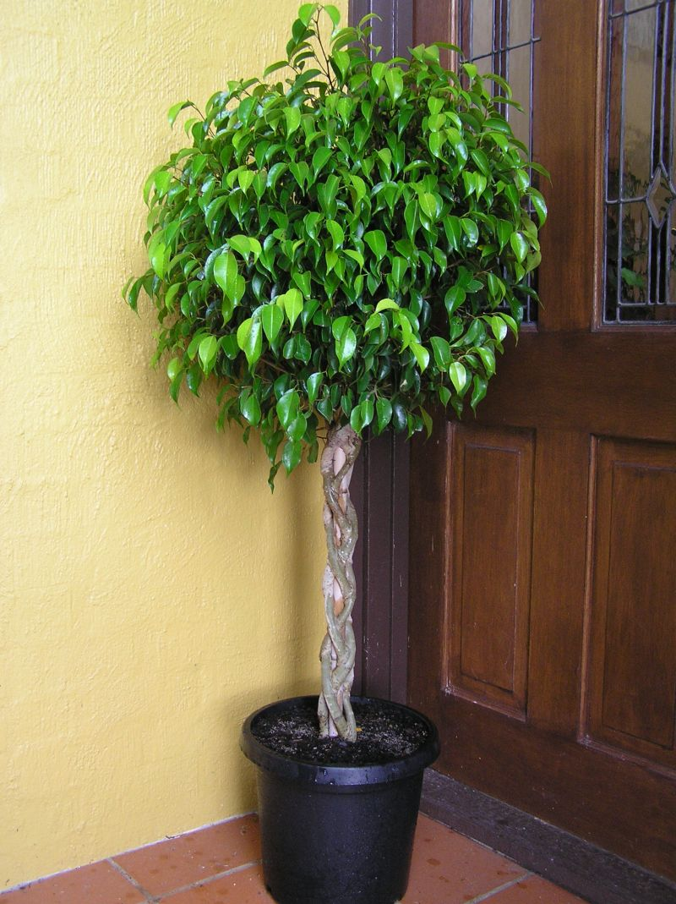
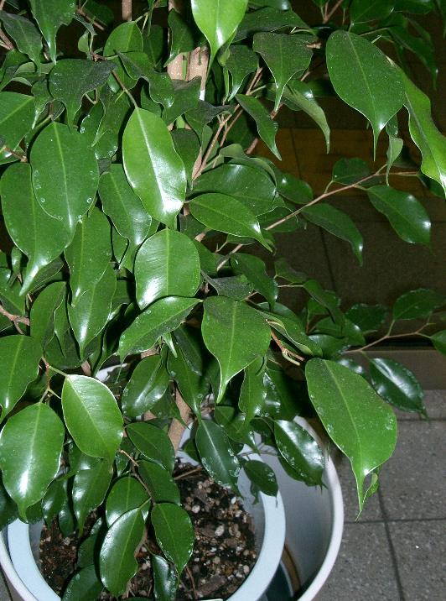
Benjamin Fig
Leaves can be solid green or variegated
This is a tree – can be 1 foot to 20 feet tall
Leaves have a “tail” on the end
Produces white milky sap
Woody Stem

Slide 15
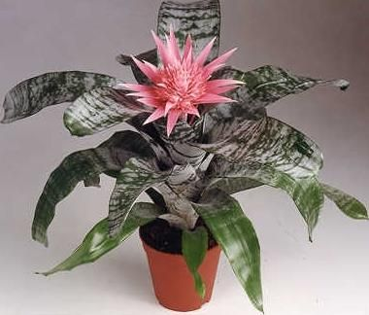
Silver Vase Bromeliad
Stemless plant
Stiff, arching, broad, strap-shaped, silvery-green leaves
Plant 1-2’ tall
Leaf margins have black spines
White scales on leaves can be rubbed off

Slide 16
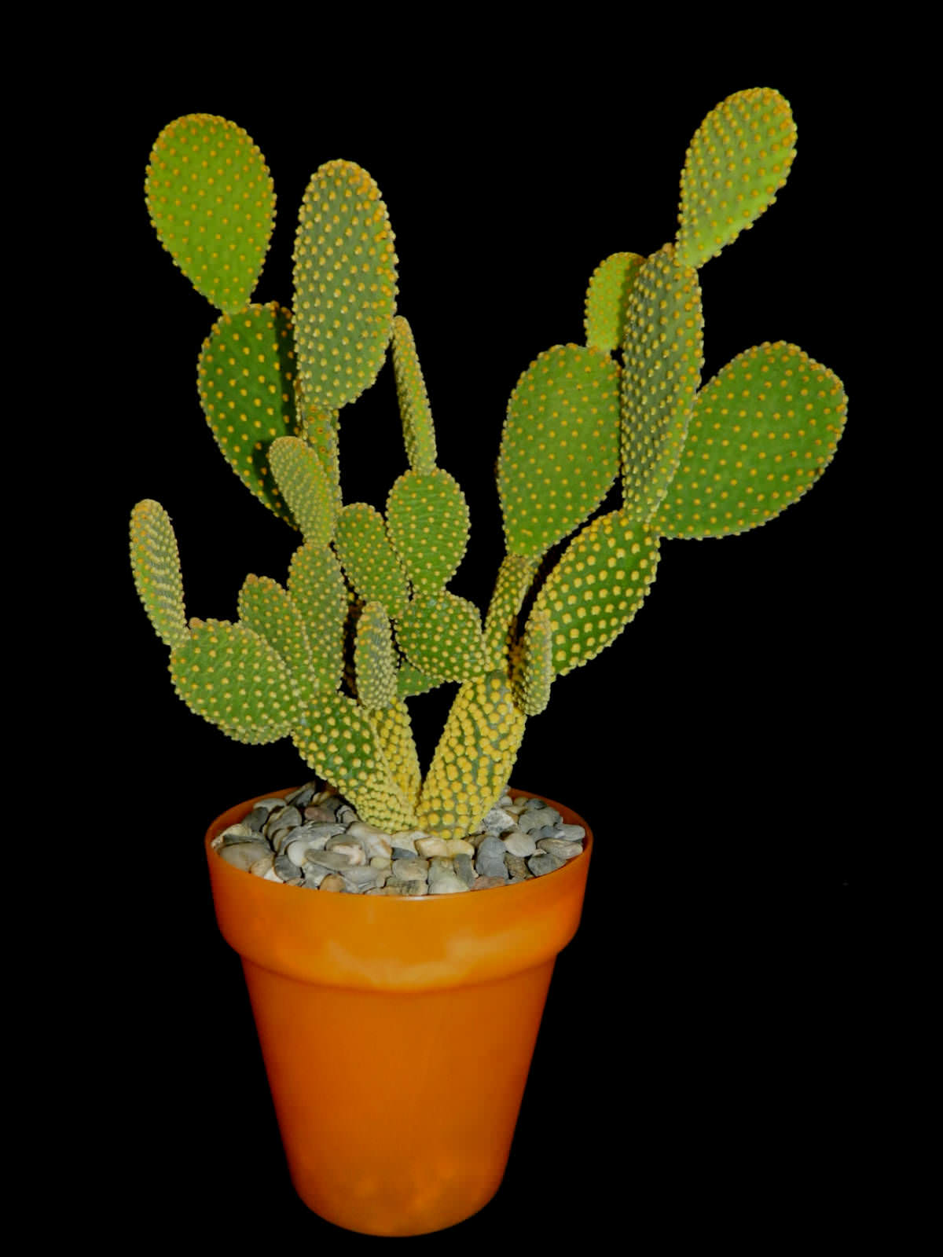
Cactus
Flat/ pad surface
Has thorns
The pads connect directly on top of each other

Slide 17
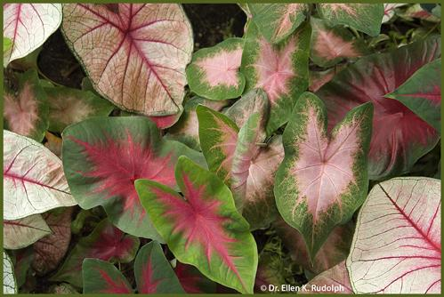
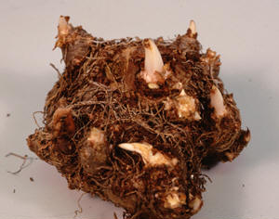
Caladium
Grows from a tuber
Plants grow in clumps 1-2.5' tall
One leaf per stem
Arrowhead-shaped leaves (~1.5' long) various shades of green mottled and blotched with pink, red, white or combinations thereof; distinctively colored veins
Calla-type flowers, if present, are usually hidden

Slide 18
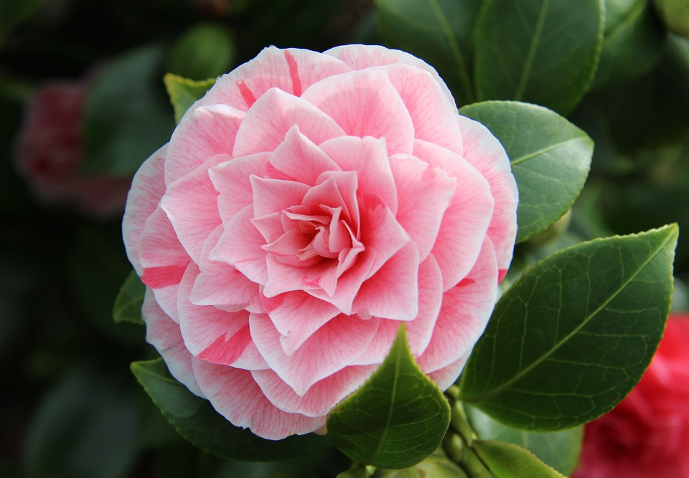
Camellia
evergreen shrub that typically grows to 6-12’ tall
oval, leathery, glossy, dark green leaves (3-4” long)
finely serrated margins
Flowers (3-5” wide) bloom in mid-late winter (December to March)

Slide 19
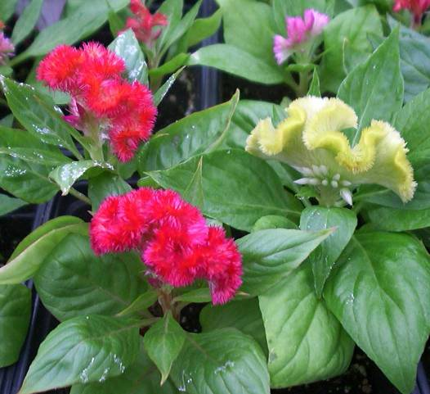
Celosia
Midrib gets progressively lighter in color towards end of leaf
Fasciated, large crested flower heads (3-12” across), with each flower head somewhat resembling the comb of a rooster.
Flower colors include bright shades of orange, red, purple, yellow and pink.
Flowers bloom throughout summer into fall (sometimes to frost) on stems clad with spear-shaped green to red purple leaves.

Slide 20
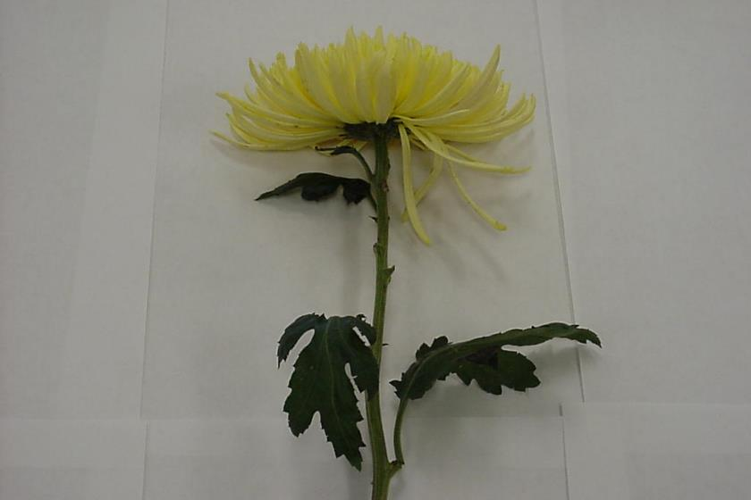
Chrysanthemum
Flower comes in many different styles
Lobed, medium green leaves (to 2” long).
Leaves have 5 main lobes

Slide 21
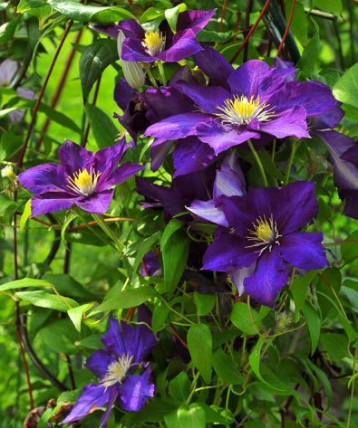
Clematis
Leaves are compound, leaves attach to trellis to help hold the plant upright – veins palmate
When petals fall off, usually leave pistil behind
Grows as a vine so usually on a trellis or stake
Very thin stem

Slide 22
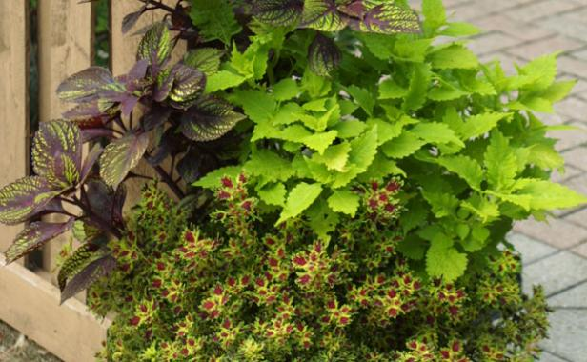
Coleus
Leaves come in multiple sizes, shapes, and colors
Square stem
Leaves are opposite

Slide 23
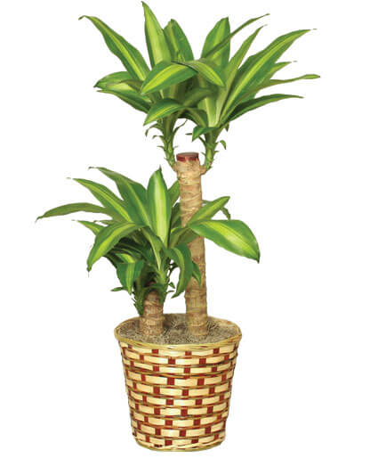
Corn Plant
4-6’ tall range as a container plant
Rosettes of evergreen, parallel-veined, sword-shaped, bright green leaves typically grow to 2’ long and 3” wide
Over time, plants lose their lower leaves revealing bare stems

Slide 24
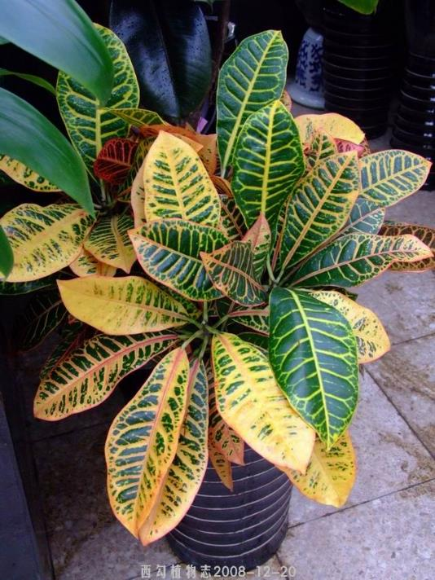
Croton
Foliage is almost always multi-colored
Woody plant that is grown for its foliage
Can be cork screw or slender leaf, grown as a potted plant

Slide 25
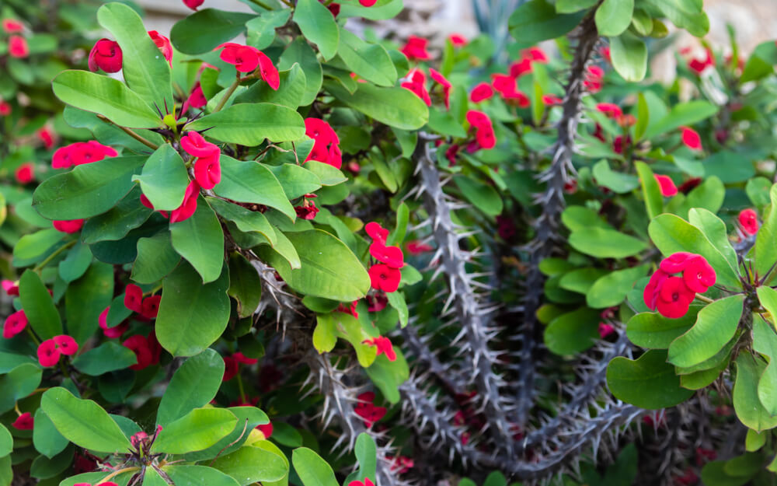
Crown of thorns
Thick, thorns cover the entire stem surface
green foliage forms in a whirled pattern
flowers typically red or pink are actually bracts

Slide 26
Cyclamen
Margin has very fine teeth and a halo of light color
Flowers can be a variety of colors, flowers fold up
Very coarse leaf

Slide 27
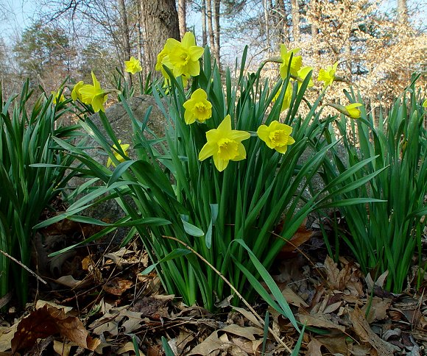
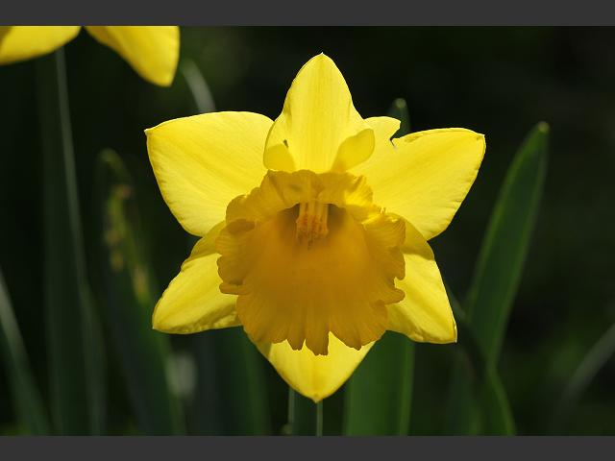
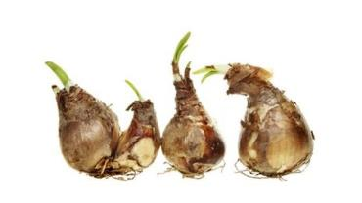
Daffodil
Flower resembles “tea cup & saucer”
Are usually yellow, white, or a mixer of the 2 colors
Leaf is flat with a very round end
Bulb is tear dropped shape

Slide 28
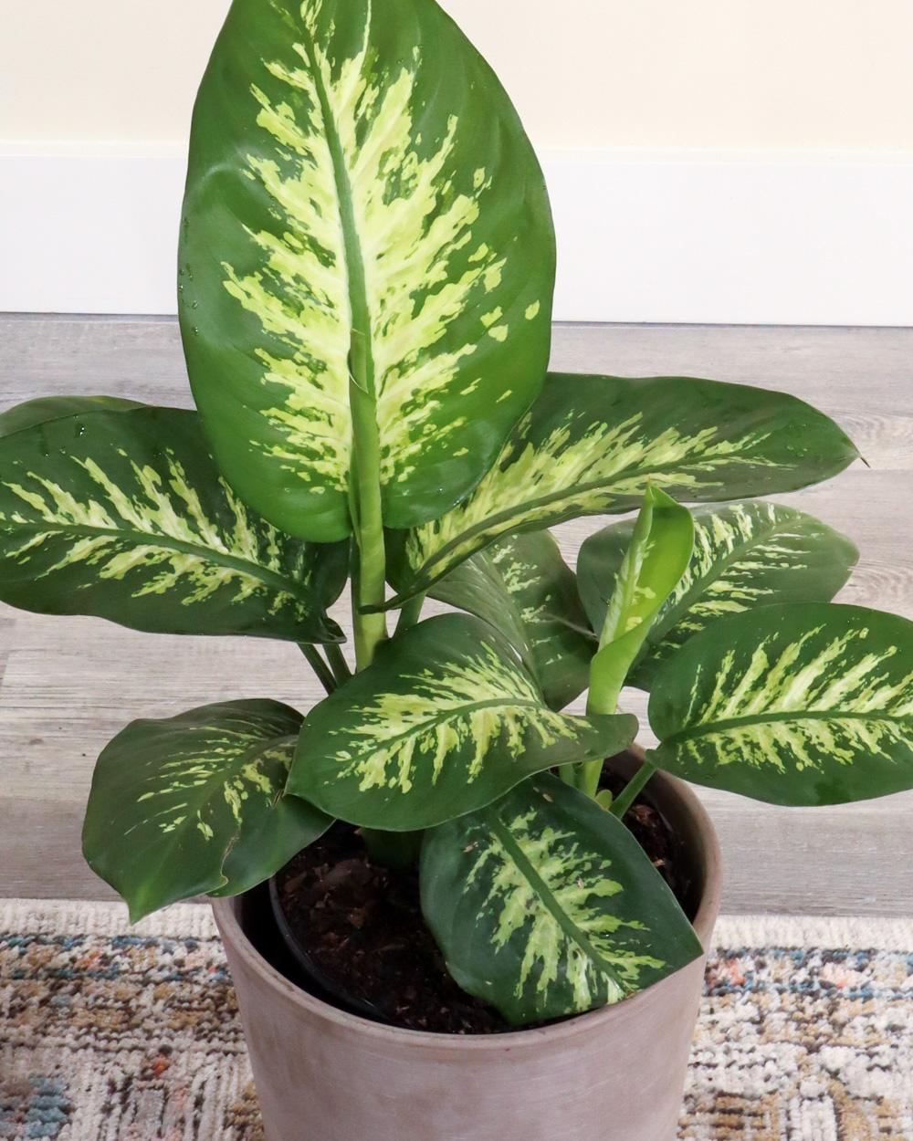
Dumbcane
green leaves with white centers
leaves appear almost see through
forms on a cane, that becomes visible as old leaves fall off

Slide 29
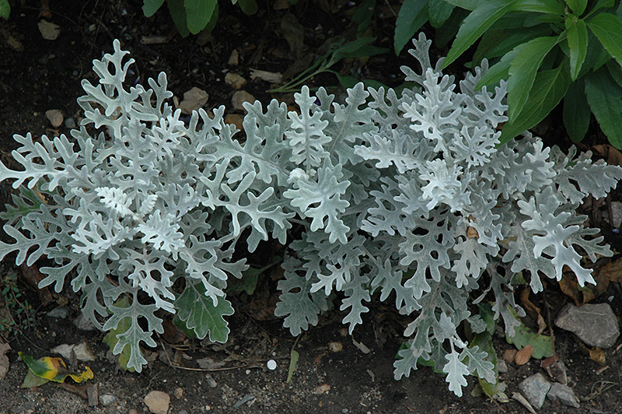
Dusty Miller
Leaves silver or gray in color
Lobed Leaf
Leaves are fuzzy and soft to the touch

Slide 30
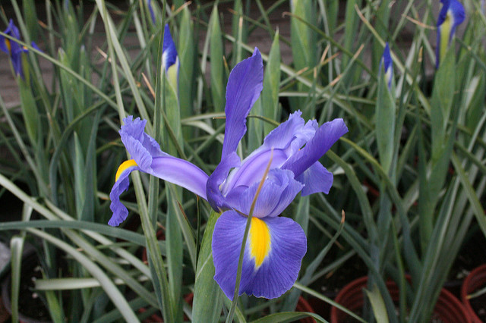
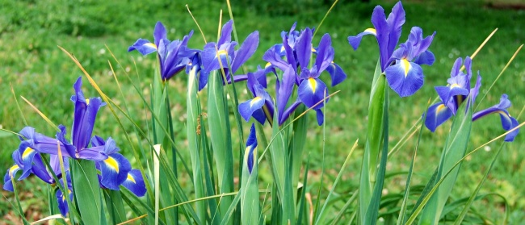
Dutch Iris
Smaller flowers compared to regular irises
Bearded can be purple/ blue or yellow and white
Leaves are very slim and silvery on the inside

Slide 31
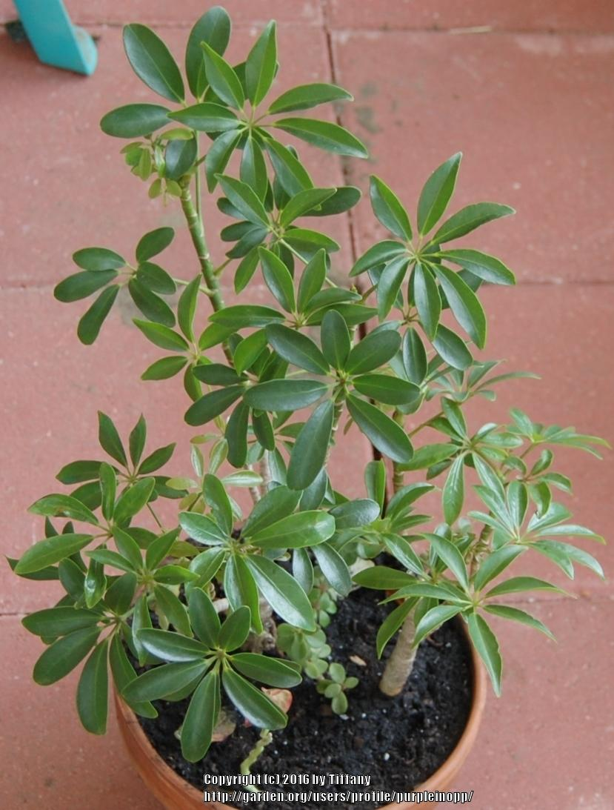
Dwarf Schefflera
Leaves can be variegated or solid green
palmately compound leaf
Green, thick stem

Slide 32
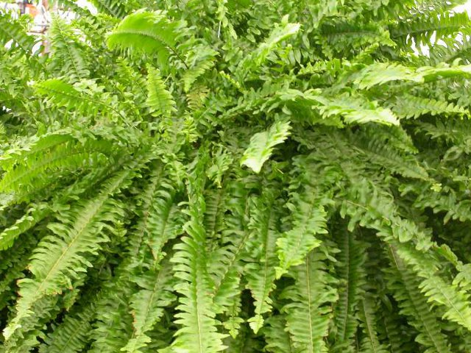
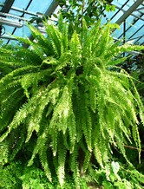
Boston Fern
Typically in a hanging basket
Fern leaves are known as fronds
The fronds are solid green in color
Fronds droop over to cover the pot

Slide 33
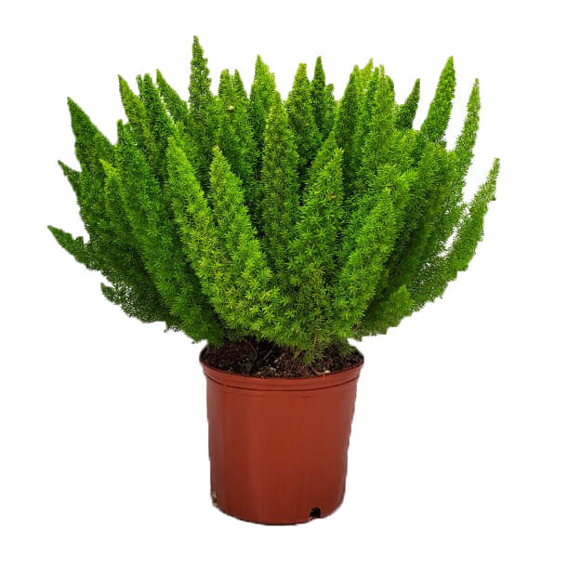
Foxtail Fern
Feathery, upright, bright green needle like stems
Plume (fluffy)-like (resemble fox tails)
Dense growth habit
Can get 2-3 feet tall
Not a true fern

Slide 34
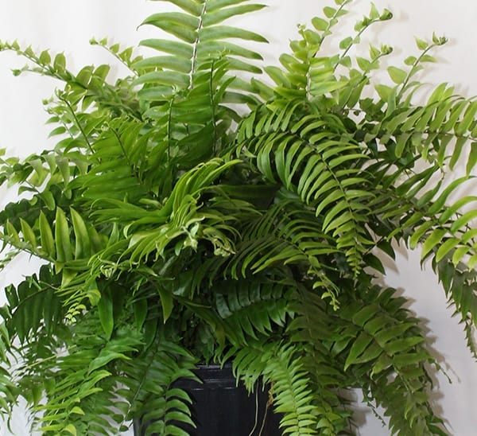
Macho Fern
Grown typically in large containers
largest of all the fronds / glossy appearance
solid green in color
Large spacing between nodes compared to other ferns

Slide 35
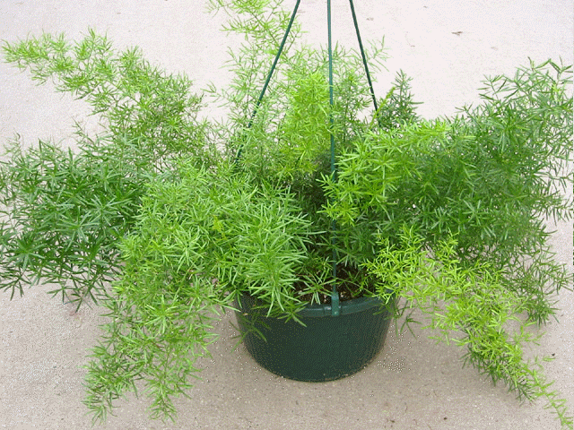
Sprengeri Fern
Dense foliage forms arching mound that matures 1-3’ tall and spreads 3-4’ wide
Leaflets create bushy tail
Plant has small thorns

Slide 36
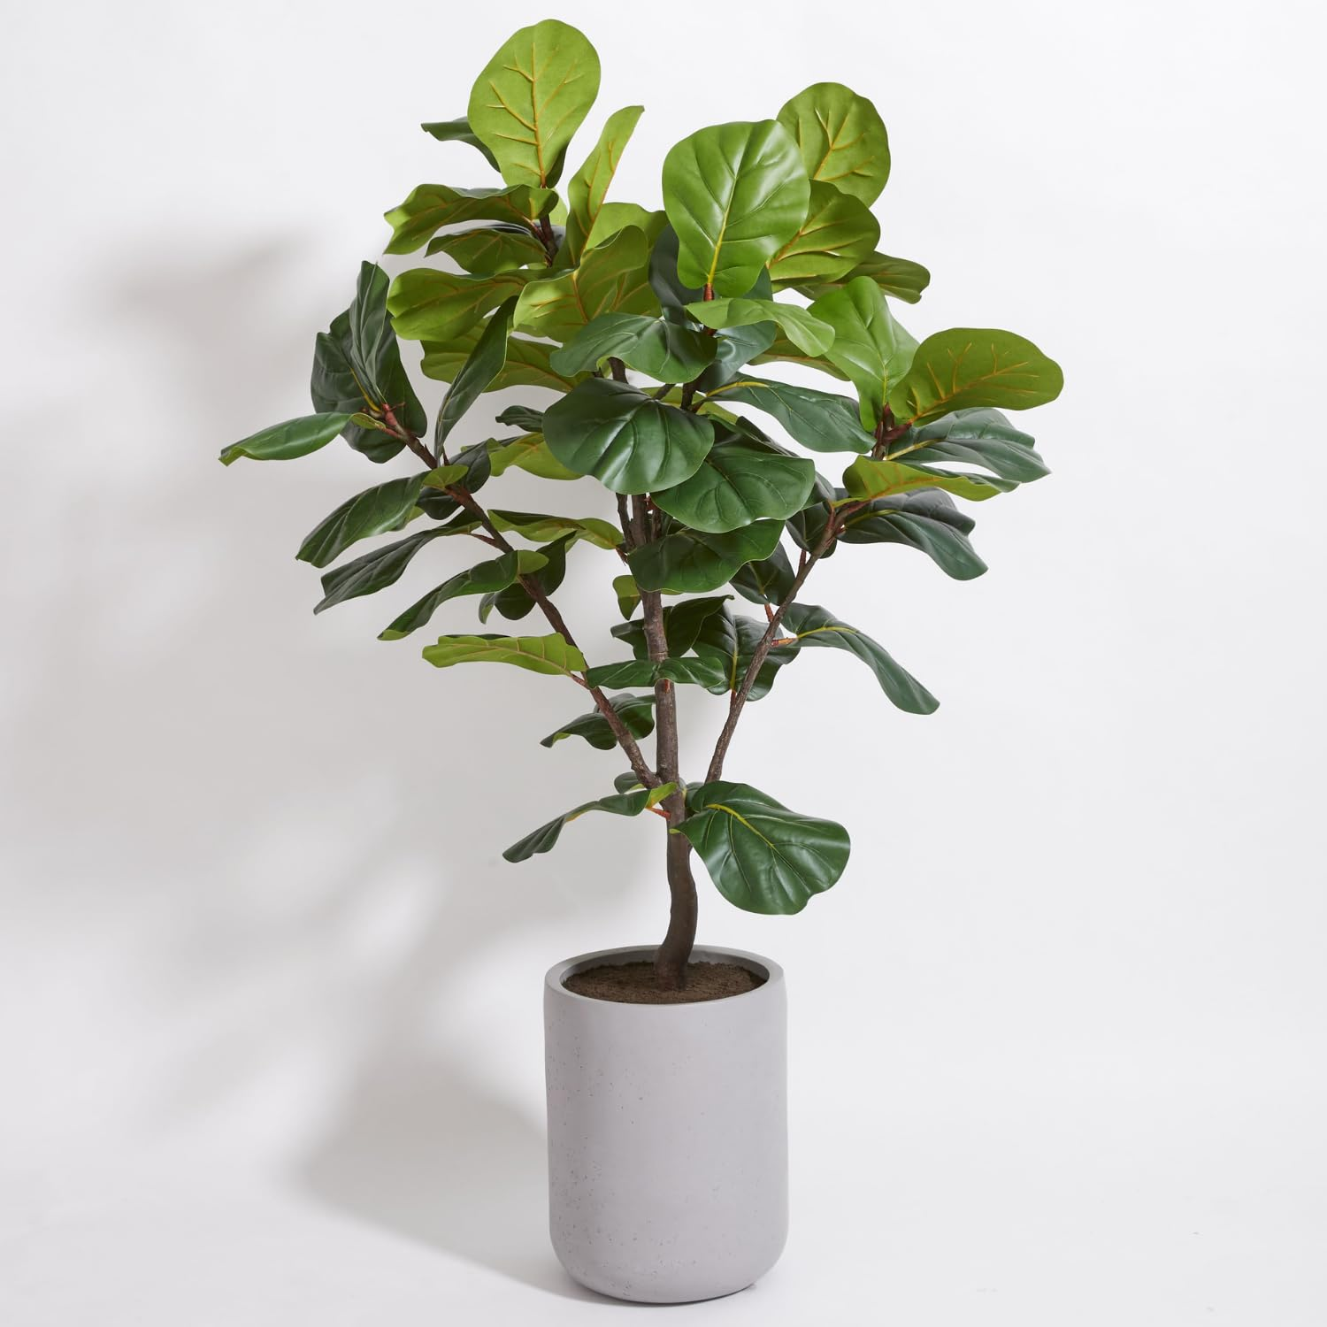
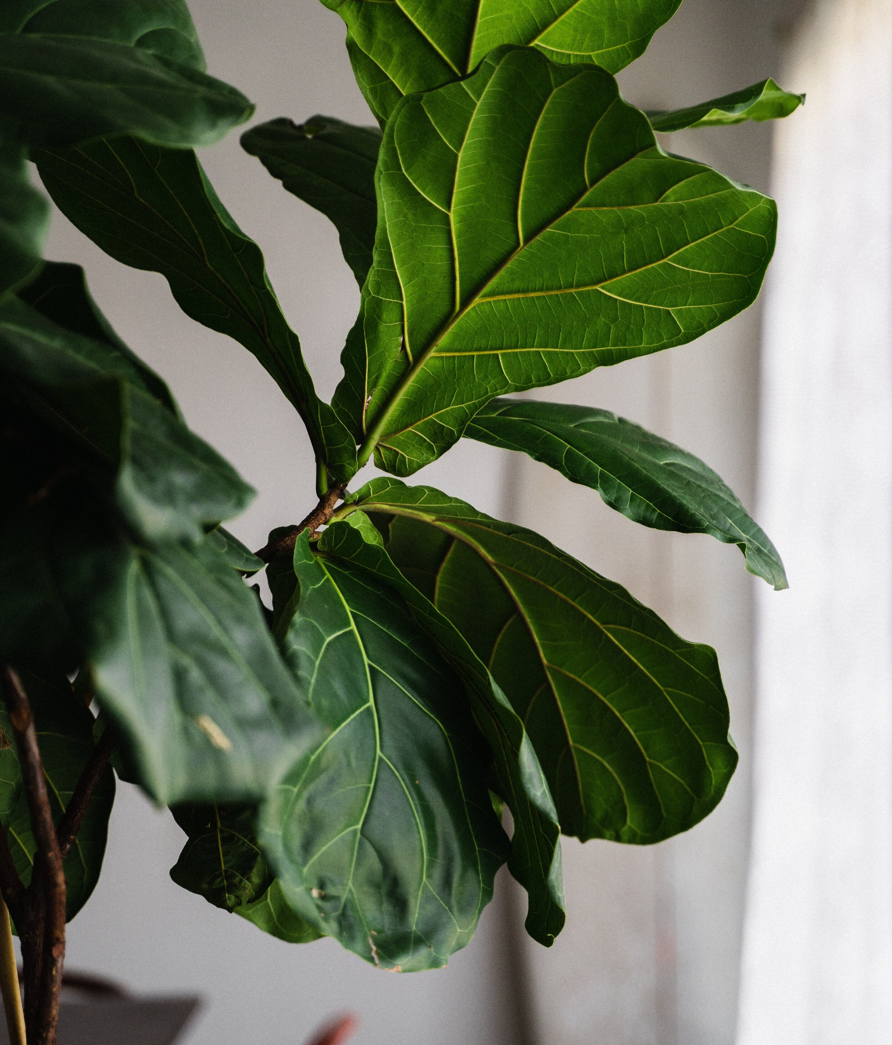
Fiddle Leaf Fig
Large, broad leaves with leathery texture
They have prominent veins and can grow up to 18 inches long.
They produce a milky sap.
Upright, tree shaped
Dark green
leaves

Slide 37
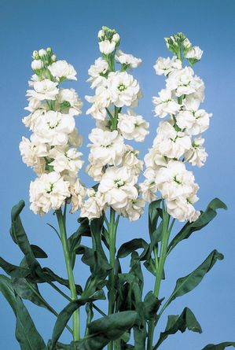
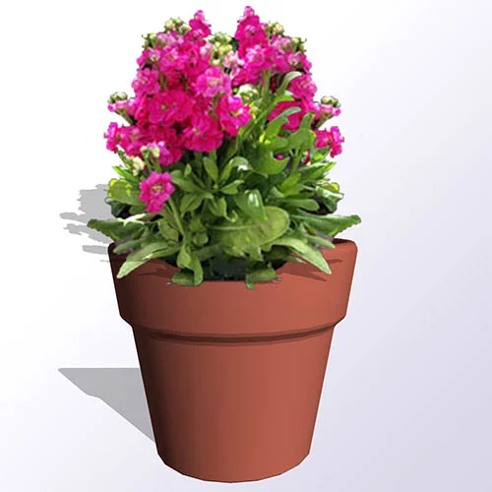
Flowering Stock
Flowers come in different colors, blooms in clusters
Fuzzy leaf, leaves are very long and slender
Very fragrant

Slide 38
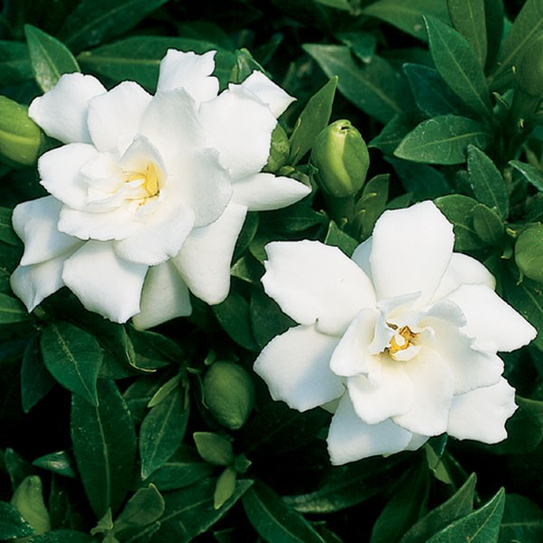
Gardenia
Veins sit down/ indented into the leaf
Leaves turn bright yellow before they fall off
Flower buds have sepals that stick up
Waxy leaves
Very fragrant

Slide 39
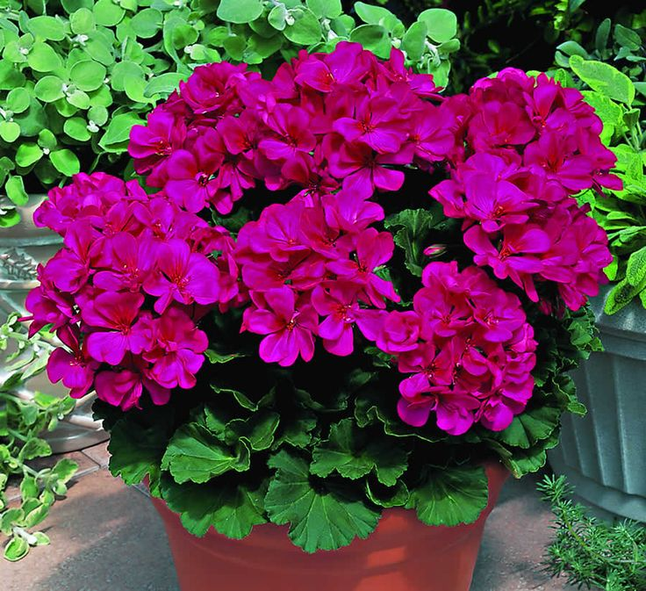
Geranium
Un-opened flower buds face down
Flower “stem” is very long and raises above foliage
Fragrant flowers bloom in clusters
Leaves are round-oval with ruffled edges

Slide 40
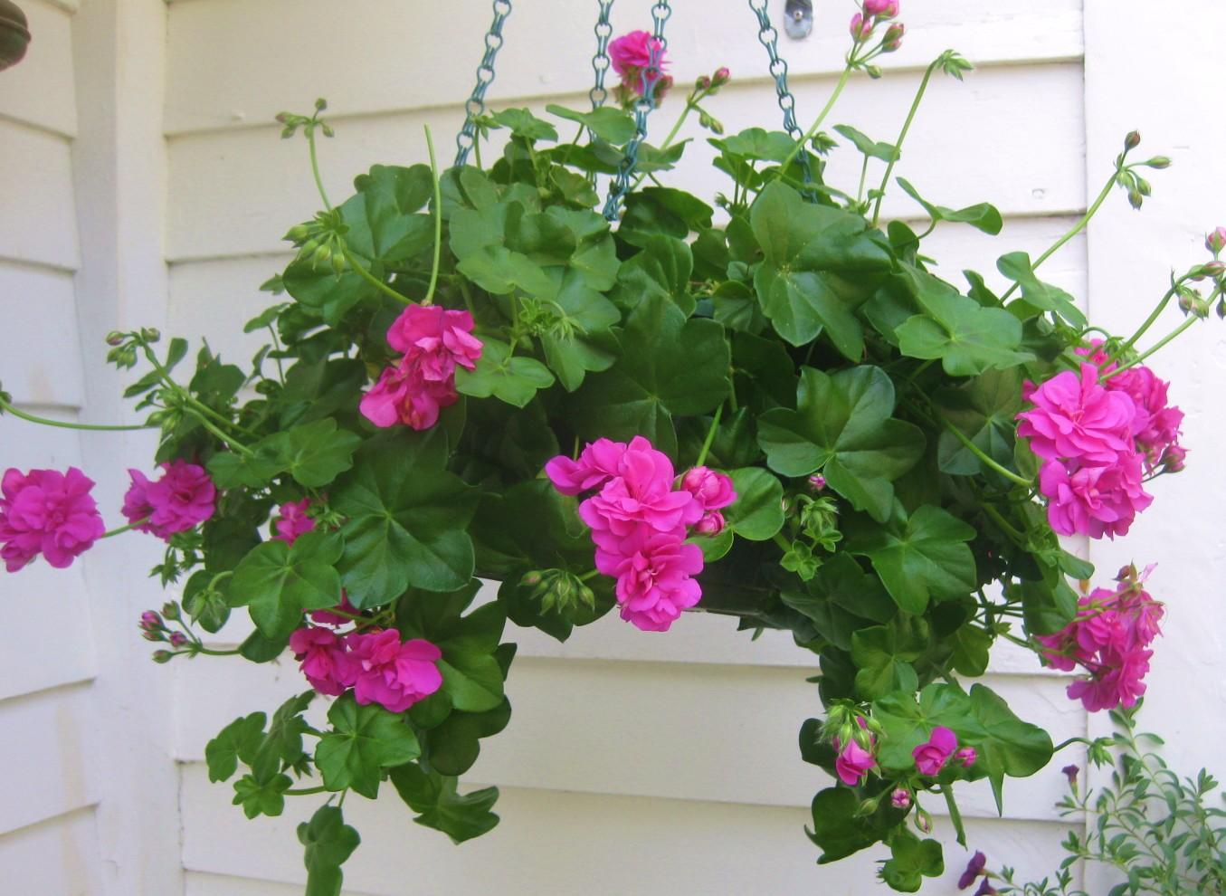
Ivy Geranium
Very stout, wavy lobes on the leaf
Not as hairy as regular geranium

Slide 41
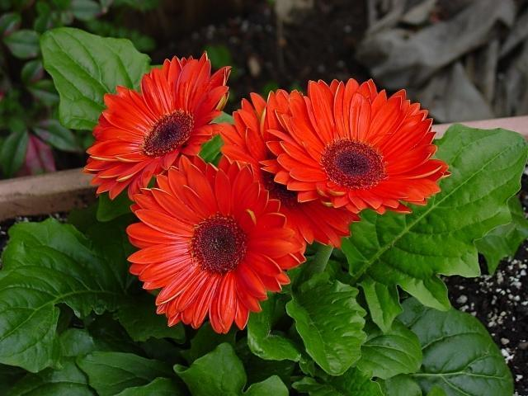
Gerbera Daisy
Flowers come in a variety of colors
Stays low to the ground
No visible stem except flower “stem”

Slide 42
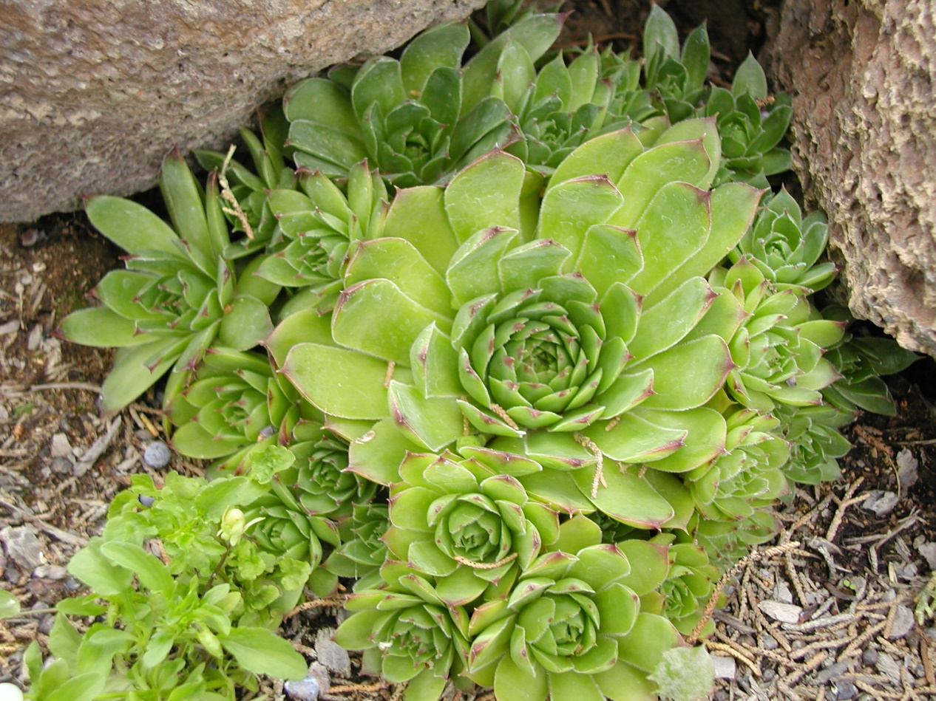
Hens and Chicks
Called hens and chicks because “babies” come out under mother plant
Thick stem, waxy leaves
Soft point at end of each leaf
in the succulent family

Slide 43
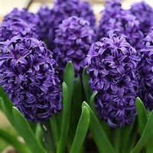
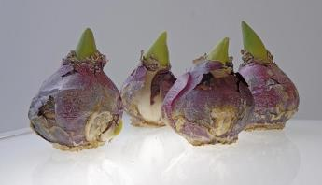
Hyacinth
Flowers come in a variety of colors
Leaf folds up into a boat shape
Bloom very early in the spring,
Very fragrant flowers
Bulb has purplish tint with very flat bottom

Slide 44
Hybrid Tea Rose
One flower per stem
Petioles have a reddish tint
Has thorns

Slide 45
Hydrangea
Large clusters of sepals makes large flower heads
Serrated edges on the leaf
Leaf veins very noticeable and opposite

Slide 46
Impatiens
At the end of every vein is a small soft thorn
Stem is translucent – can see through the stem
It looks like the flower has two stems, but only one attaches to the plant. The other is a nectary gland, and pests like thrips can be found inside of it, lapping up nectar

Slide 47
New Guinea Impatiens
Larger leaves than traditional impatiens
Similar flower but can tolerate more sun
Large, long, narrow leaves that can be variegated
Leaves are usually in whorls of 3-7 leaflets
The flowers have five slightly overlapping petals around a small, button-like center.

Slide 48
English Ivy
Ground cover
Vining, Trailing Growth Pattern
Leaves have 3 main lobes
Comes in solid green and different variegated patterns

Slide 49
Swedish Ivy
undulate, deep-veined, light green leaves
Tiny white flowers bloom in spikes on and off throughout the year
Trailing plant typically grown in hanging baskets

Slide 50
Jade Plant
Oblong, fleshy, shiny, evergreen leaves (to 2” long).
Leaves may acquire red tints when grown in direct sun.

Slide 51
Kalanchoe
Has a spike of flowers that come in a variety of colors
Leaf is waxy, scalloped on the edges

Slide 52
Asiatic Lily
Blooms come in many different colors
The “stem” that attaches each flower to the plant is longer than on an Easter lily

Slide 53
Calla Lily
Bulb
Flowers and leaves rise directly from rhizomes.
Typically grow in clumps to 24-36” tall
Feature large arrowhead-shaped (sagittate) leaves
Extremely showy flowers Commercially grown as a very popular cut flower.

Slide 54
Canna Lily
Leaves come in variety of colors from variegated to green or red
Can be 4-6’ tall
Large flowers resemble that of an iris
Flowers are orange, yellow or red

Slide 55
Peace Lily
Leaves can be solid green or variegated
Flower is always white
long pointed leaf
Veins are cut into the plant

Slide 56
Marigold
Has a very distinct odor to ward off pests
Leaves are compound
Flowers grow in a pom/pom shape
Flower colors are typically shades of red, yellow, and orange

Slide 57
Million Bells
Flowers look like small petunias
Compact, mounded plants grow 3-9” tall on mostly trailing stems.
Prolific bloomers produce hundreds of 1” wide flowers from spring to frost
Flower colors include shades of violet, blue, pink, red, magenta, yellow, bronze, and white

Slide 58
Nephthytis
Veins are different coloration from leaf – usually white
Arowhead shaped leaf

Slide 59
Norfolk Island Pine
Has needles on stems as well as branches
Needles are modified leaves
Tree form
Can get very tall (50-70 feet)

Slide 60
Cattleya Orchid
Cattleyas wrap their roots around branches for stability
Plants grow from pseudobulbs (1-3” thick)
leathery, oblong to broad obovate leaves that are generally dull green

Slide 61
Cymbidium Orchid
Leaves are long and skinny compared to other orchids
5 petals to the flower
In the throat has a rolled up “tongue” inside of throat
No stem except for flower spike
Backside has a sharp midrib
Has “bulbs” just above the ground

Slide 62
Dendrobium Orchid
Thick, very apparent stem
Smallest flower of all the orchids
Leaf is rubbery
Aerial roots (Above soil-line)

Slide 63
Moth Orchid
Leaves attach to a main stem and stay low the bottom of the stem
Very hard leathery leaf
Flower – has two distinct “wings”

Slide 64
Ornamental Pepper Plant
Shrubby mounds 1-4’ tall
Lance-shaped to oval medium green leaves
Star to bell-shaped white or yellow flowers give way to edible peppers ranging from extremely hot chili peppers to sweet bell peppers
Many cultivars developed for ornamental use featuring attractive peppers in bright shades of red, yellow, purple, orange and brown.

Slide 65
Pansy
Flowers have two layers of petals
Leaves have scalloped edges

Slide 66
Parlor Palm
Small, compact, usually single-trunked palm
Usually grows to 4' tall
Dense, attractive foliage, compact shape and easy maintenance.
Handsome, arching, green pinnate leaves, with 12 or more pairs of narrow leaflets per leaf, lend a tropical flair to indoor locations.

Slide 67
Pentas
A tropical woody-based perennial that grows to 1-2’ tall in beds or containers.
A many-branched, somewhat sprawling plant
Features 4” wide rounded clusters of star-shaped flowers.
Elliptic to lanceolate dark green leaves (to 6” long).
Flowers are pink, magenta, lilac or less commonly white.

Slide 68
Peperomia
Waxy, elliptic, thick dark green leaves (to 6” long)
Many variegated cultivars with foliage that is mottled with cream, gray or gold
Small greenish-white flowers on spikes (to 5” long)

Slide 69
Petunia
Trumpet/ tube shaped flower – lots of colors
All the petals are attached together
Leaf is pointed and fuzzy, stem is fuzzy
Plant typically grows in a downward pattern

Slide 70
CutLeaf Philodendron
Leaves are solid green
Deep “cuts” start almost at the midrib and move to edge of the leaf
Actually grows out as a vine

Slide 71
Heartleaf Philodendron
Leaves heart shaped
Can be variegated or solid green leaves
Stem is very smooth, very round
Stipule is a small piece of tissue that is NOT fused to the stem, unlike pothos

Slide 72
Poinsettia
Flowers are actually modified leaves known as bracts
Midrib on the leaves is usually white
They come in many colors but red is most common

Slide 73
Polka-Dot Plant
brightly variegated or spotted leaves that look like polka dots
Leaves are oval shaped
The plant has a small bushy growth habit and tends to branch out as it grows.

Slide 74
Portulaca
Features 2” diameter flowers in orange, yellow, red, pink, white and bicolors.
Plants typically grow 4-8” tall and spread to 15” wide.
Flowers bloom summer to frost.
Spatulate to ovate, flat, fleshy leaves (to 1.25” long).

Slide 75
Pothos
Leaves are always marbled either green & white or green & yellow
Trailing growth pattern
Stipule is a small piece of tissue that is fused to the stem, unlike philodendron, creates the appearance of a ribbed node

Slide 76
Prayer Plant
Coloring in between the veins of leaves is always a reddish tint
New leaf is rolled as it starts to emerge
Shape of the leaf is very wide and leaf turns up at the margins

Slide 77
Primrose
Grows low to the ground
Raggedy edge on the leaf
Flowers in clusters
Center of the flower is always yellow
Veins are very distinct

Slide 78
Red Edge Dracaena
Grows on a stalk
Bottom of the stalk sometimes drops its lower leaves – leaving a bare cane appearance
Is a large upright plant
Edges of the plant are indeed red

Slide 79
Rubber Plant
New growth has reddish color
Midrib has reddish color
Leaf bud is very distinct
The bud also has a sheath that will fall off

Slide 80
Salvia
Comes in a variety of colors, flowers is upright on a stalk with lots of blooms on one stem
Has a square stem
Leaf is triangle in shape

Slide 81
Shrimp Plant
Very long internode between leaves
Flower is pink with yellow markings
Shrub that has an open airy look – not compact
Leaves are opposite

Slide 82
Snake Plant
Plants will have a pattern on leaf similar to snake skin
Upright spiked leaf form

Slide 83
Snapdragon
Upright form
Flower well from spring to fall
Dragon-shaped, tubular, two-lipped, closed flowers
Flowers come in both pastel and bright colors such as shades of white, yellow, red, pink, orange, peach and purple (some bicolors)
Lance shaped, glossy dark green leaves (to 3” long)

Slide 84
Spider Plant
It has linear leaves that are green or striped white.
Flowering stems bear loose panicles of small, white, starry flowers.
Plantlets are formed at the flowering nodes.
When plants are full, they have an interesting, graceful, cascading habit.

Slide 85
String of Pearls
1/4 inch round leaves that look like small peas
trailing stems that can grow up to 3 feet long
has a dark ban of tissue on each leaf
this is an “epidermal window” which allows light to enter the interior of the leaf, effectively increasing the area available for photosynthesis.

Slide 86
Sweet Potato Vine
Tender perennial
Popular root vegetable
purple, chartreuse and variegated-leaved cultivars
A popular ornamental foliage plant.
Stems typically mound to 9” tall but spread by trailing stems to 8-10’ wide
Leaves of the ornamental varieties are heart-shaped to palmately lobed (to 6” long)
Ornamental varieties usually do not flower.

Slide 87
Thanksgiving Cactus
“Leaves” are actually a modified, flattened stem
Leaves attach one on top of the other

Slide 88
Ti Plant
Also called Cordyline
Smooth, flexible leaves that can be many colors, including light greens, pinks, and dark reds
evergreen shrubs that can grow up to 10 feet tall
slender, single or branched stems

Slide 89
Tulip
Leaves have gray coating that rubs off
At end of life, flower opens all the way up
Leaf wraps around the stem
Small, round bulb with a papery “skin” called a tunic

Slide 90
Vinca
Flower bud has pinwheel shape
Mounding 6-18” (less frequently to 24”) tall and as wide
Flowers have five flattened petal-like lobes and appear in upper leaf axils
Colors include pale pink, rose, hot pink, red, lilac, and white, often with contrasting darker throats/eyes
Oblong to ovate glossy, green leaves (2” long) with white midrib

Slide 91
Verbena
Stems and leaves are slightly hairy
Flowers in small clusters and in a variety of colors
Leaves are triangle shape

Slide 92
Wandering Jew (Inch Plant)
Always purple in color, comes in darker shades of purple and purple/green combo
End leaf points straight out

Slide 93
Wax Begonia
Waxy leaves gives glossy look
Leaf margins look like torn paper, rough, ragged edges
Leaves can be green or bronze

Slide 94
Zebra Plant
Leaves are ovate to elliptic in shape
Dark green leaves with zebra-like white veins
Spikes of yellow-bracted flowers are long-lasting
Typically pruned to 12-18” tall.

Slide 95
Zinnia
Annual
Composite, brightly colored flowers
No petiole – leaves go right up to stem
Growth pattern is upright
3 midribs to each leaf

